Slide 1


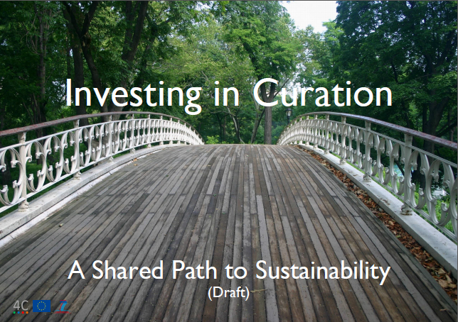
Collaboration to Clarify the Costs of Curation
Neil Grindley – Jisc, UK
Luis Faria – Keep Solutions, Portugal
Katarina Haage – German National Library
Ulla Bøgvad Kejser – Royal Danish Library

Slide 2
Collaboration to Clarify the Costs of Curation
How can organisations working in a variety of different domains more cost-effectively look after and account for the digital assets in their care?
Notes:
The 4C roadmap tries to address that question by outlining the steps that should be taken over the next five years in order to maximise the efficiency of digital curation and to ensure sustainability.

Slide 3
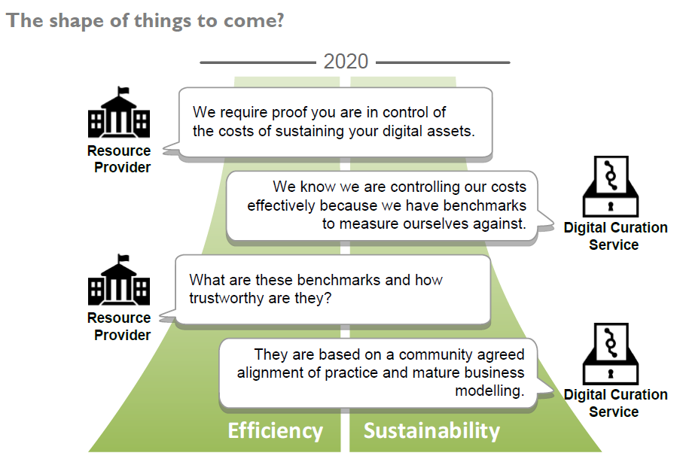
Collaboration to Clarify the Costs of Curation
Notes:
What is driving our need to better understand our curation costs?
Efficiency is the prime motivation for organisations (or funders, or policy makers) what we are calling ‘resource providers’.
There is a relationship between the resource provider and the curation service but they have different goals. When all is functioning well, these goals are mutually compatible. When money is tight and the relationship is put under pressure, the onus will be on the curation service to prove it understands the need for efficiency (and can prove that it is indeed functioning efficiently). And in turn it will ask the resource provider to understand that the need to think sustainably.
This depiction leaves out the requirement to prove value and benefit. Which is a related but different (and very lengthy) discussion in its own right!

Slide 4
Collaboration to Clarify the Costs of Curation
Challenges hindering our attempts to cost curation.
Lack of data to better understand where we are spending in relation to curation.
Curation not often included in financial accounting approaches.
No common agreement on describing data holdings.
No easy way to compare curation related spending with peers.
Understanding the value of investing.
Notes:
The random numbers problem - how do we meaningfully compare the numbers that we end up with?
Activity based costing versus financial accounting methods.
Describing the amount and type of data that is being looked after.
Complexity - the detail builds up very quickly across different organisations and it doesn’t map together easily. Also, sensitivity around data – many (most?) organisations are not comfortable broadcasting what it costs them to manage their data. How do we effectively anonymise costs data?
Being able to judge whether an investment represents good value. Is there potential Return on Investment? Does the investment mitigate risks or realise specific benefits?

Slide 5

Collaboration to Clarify the Costs of Curation
Notes:
There are quite a few assumptions built into this.
The term ‘Curation’ (as the wider and more embracing activity – let’s try and avoid a discussion about what is digital curation!)

Slide 6
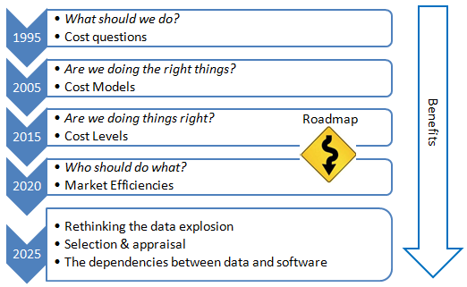
Collaboration to Clarify the Costs of Curation
Situating the Roadmap in time
Notes:
We chose to focus on the next 5 years.
It corresponds with H2020 but that’s not the principle reason.
It’s worth acknowledging that although cost (and benefit and value and clarifying the business reasons for doing digital curation) are an issue right now, a hard challenge, we will move on from it and there are bigger (potentially more difficult) challenges ahead.
It may be that by solving this one, we make life easier for ourselves when we tackle the next ones.

Slide 7
Collaboration to Clarify the Costs of Curation
Stakeholder groups
Curation Practitioners
Curation Researchers
Data Users (and Re-users)
Managers (and Financial Officers)
Member Organisations
Policy Makers (Resource Providers / Data Owners)

Slide 8
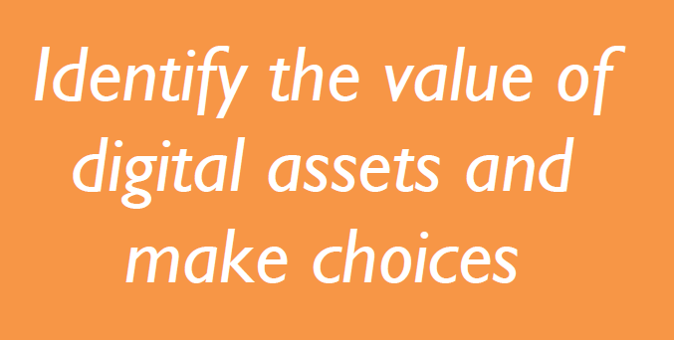
Collaboration to Clarify the Costs of Curation
Message 1
Notes:
2 difficult and related problems are referenced here:
How do we go about quantifying or realising the value of our digital assets?
How do we go about assigning value to each data object (or dataset, data stream, series, collection) when confronted with massive amounts of data?
It should be part of the ‘business as usual’ function of an organisation to assign time and resource to understanding the value of their assets.
What does this mean in practice? What exactly are we suggesting organisations do to achieve this goal?
A periodic data inventory or audit, the goal of which is to ensure that every item of data (or dataset, data stream, series, collection) is aligned with the organisation’s business objectives.
There are many things that can be said for each message. Maybe try and pick out three key points for each of them. Things that might spark a discussion or provoke different perspectives from different people.

Slide 9
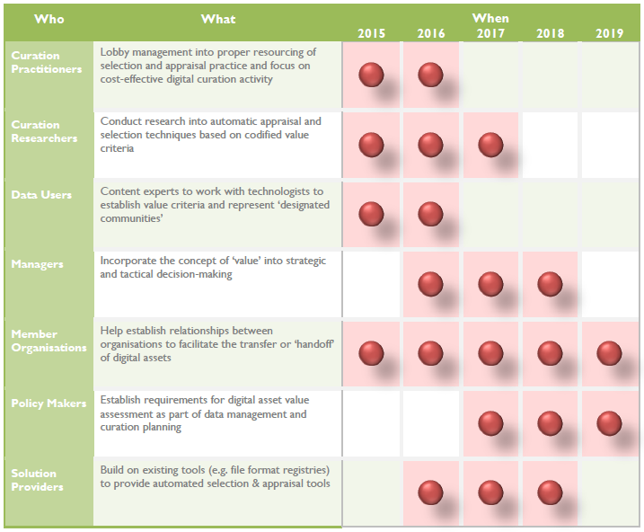
Collaboration to Clarify the Costs of Curation
Notes:
If we try and preserve everything, we will end up with assets that are hard to find, difficult to understand and complicated to re-use
If we are resolved and are willing to devote resources to it, it should be possible to design effective semi-automated selection and appraisal methods that will help us cope with large volumes of digital content
The managers (and policy makers) perhaps have the most difficult job here. To understand that an investment needs to be made to understand the investment they have already made!

Slide 10
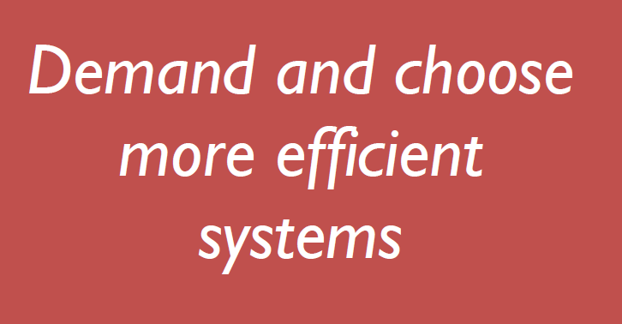
Collaboration to Clarify the Costs of Curation
Message 2

Slide 11
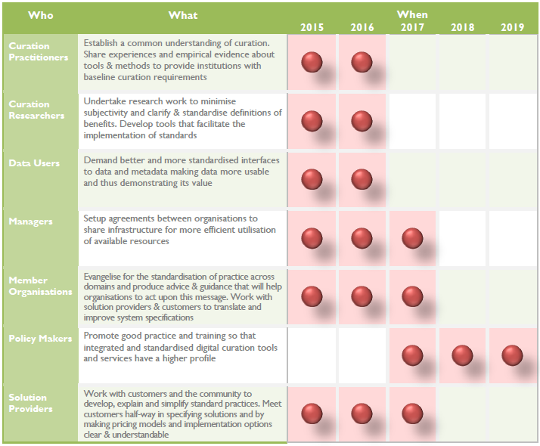
Collaboration to Clarify the Costs of Curation

Slide 12

Collaboration to Clarify the Costs of Curation
Message 3
Notes:
Choosing the most efficient and effective curation infrastructure must be based on shared knowledge and expertise.
The assumption is that organisations should aspire towards mature curation services and that this will often result in shared infrastructures and require working in partnership with other organisations and service providers
Effective collaboration requires investment. It takes time and effort and managerial understanding to collaborate effectively and the motivations to do so must be understood by all parties.

Slide 13
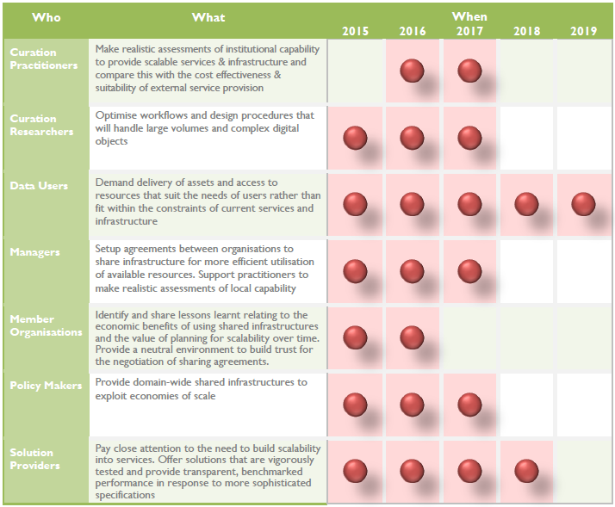
Collaboration to Clarify the Costs of Curation

Slide 14
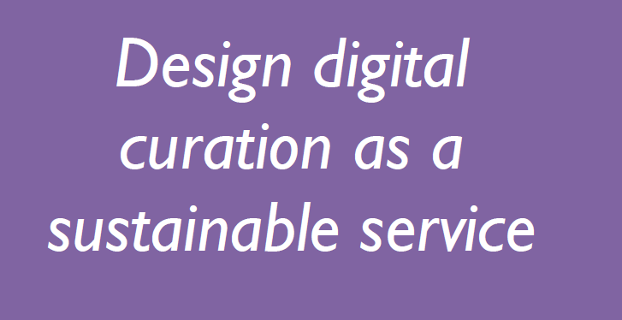
Collaboration to Clarify the Costs of Curation
Message 4
Notes:
All organisations should be seeking to mature their digital curation activities. It should be designated as a service that delivers a business function
As a service, there will be a supply-side and a demand-side and it is important (even if both are internal to an organisation) that the participants in this ‘transaction’ are clear about their roles and responsibilities
When it is clear who is curating what for whom, it will be easier to declare the business case for curation and to support the arguments for continued investment

Slide 15
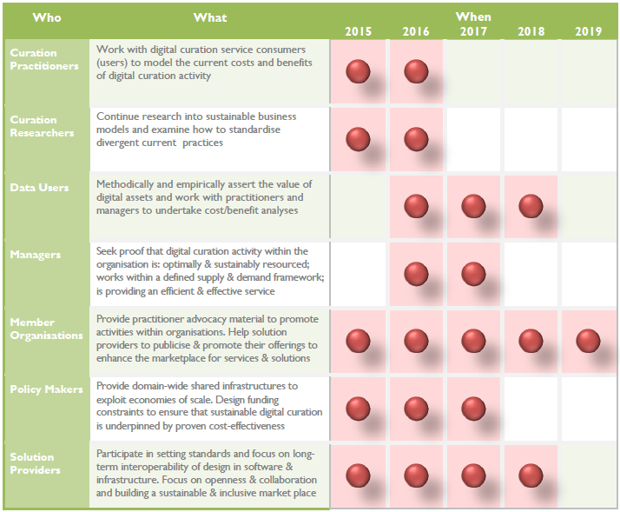
Collaboration to Clarify the Costs of Curation

Slide 16
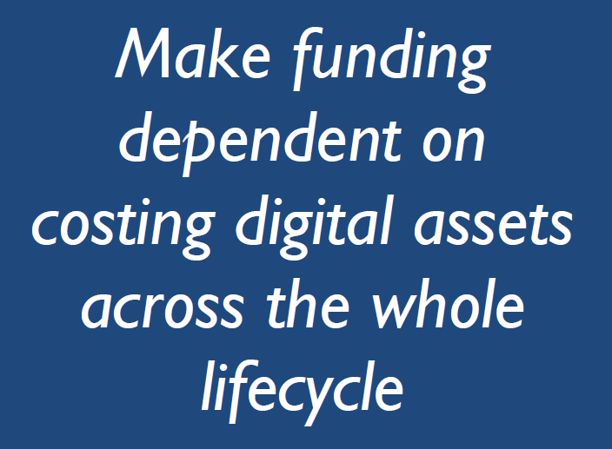
Collaboration to Clarify the Costs of Curation
Message 5
Notes:
If we make funding contingent on being able to declare plausible cost estimates, this effectively means that organisations will have to engage in cost modelling activity at some level
This clearer and more insistent focus on the cost of curation may result in some organisations rethinking their current digital asset stewardship arrangements. It could mean that affording long-term preservation doesn’t actually align with their business objectives.
The question of trust is critical to underpin an effective ownership chain where digital assets can be passed over to organisations that are better placed to curate assets into the future.

Slide 17
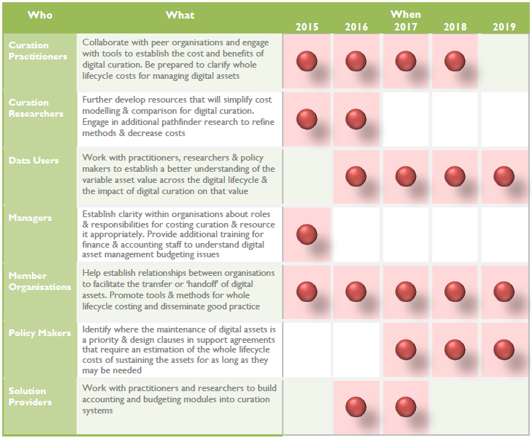
Collaboration to Clarify the Costs of Curation

Slide 18
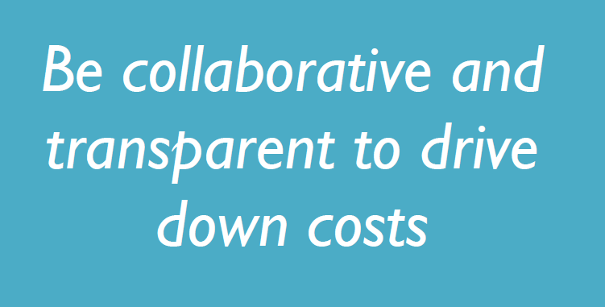
Collaboration to Clarify the Costs of Curation
Message 6
Notes:
Comparing operational costs and effort with peers is essential for identifying where efficiencies and savings can be made. This comparison can only happen if people are prepared to share.
The Curation Costs Exchange provides this mechanism but will need support from the community, not only in the first instance to populate the Exchange with data, but ongoing support to keep it valid as a community resource
If those who provide digital curation services can be contextually descriptive about their products and transparent about their pricing structures, this will enhance possible comparisons, drive competitiveness and lead the market to maturity.

Slide 19
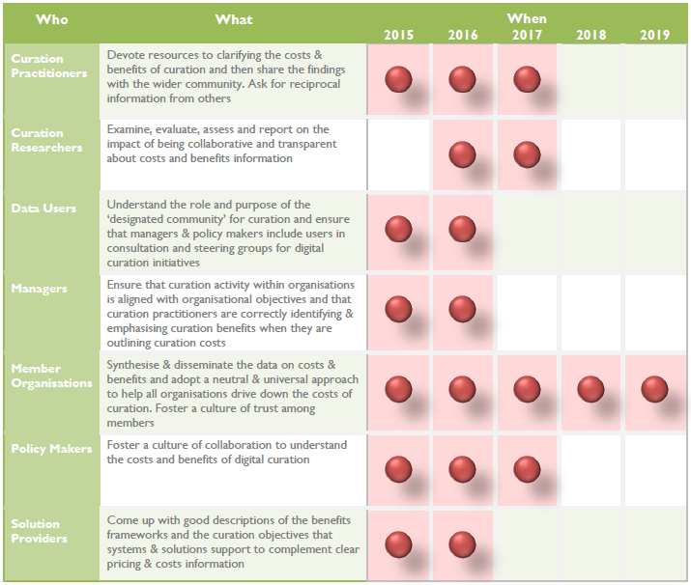
Collaboration to Clarify the Costs of Curation

Slide 20
Collaboration to Clarify the Costs of Curation
To ensure that the roadmap is a convincing, practical and plausible document, we need your views on...
Are the key messages meaningful to you?
Do you agree with the messages?
If the messages apply to you, are you prepared to act on it?
Are these messages aimed at the right audiences? Who else should be targeted?

