Slide 1


Supporting DMPs: lessons from other institutions
Sarah Jones
Digital Curation Centre, Glasgow
sarah.jones@glasgow.ac.uk
Twitter: @sjDCC
Advanced DMPonline workshop, 23 November 2015, Glasgow

Slide 2

Basic guidance and support
Most university policies include a requirement for DMPs so you need to explain what to cover in plans via:
Templates listing themes/questions to cover
Custom guidance by uni or discipline
Example answers or boilerplate text
Links to local contacts and support
A library of successful DMPs to reuse

Slide 3
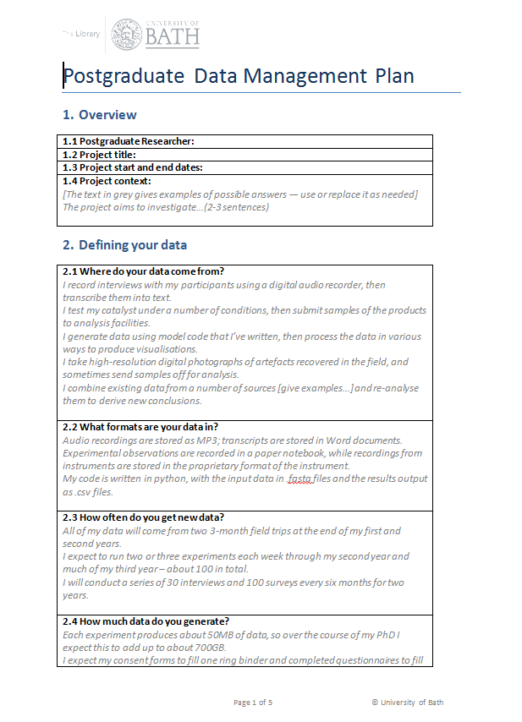
Example DMP templates
DCC Checklist (generic template) www.dcc.ac.uk/sites/default/files/documents/resource/DMP/DMP_Checklist_2013.pdf
Bath postgraduate template http://opus.bath.ac.uk/30772
DataTrain template www.lib.cam.ac.uk/preservation/ datatrain/documents.html
20 questions for RDM https://datamanagementplanning.wordpress.com/2012/03/07/twenty-questions-for-research-data-management
MRC template www.mrc.ac.uk/research/research-policy-ethics/data-sharing/data-management-plans

Slide 4
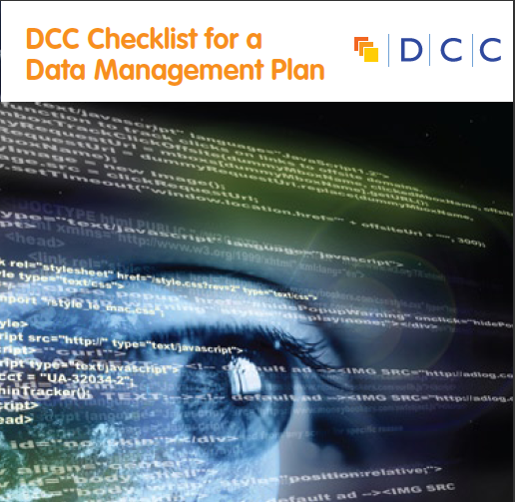
DCC generic template for a DMP
Data Collection
What data will you collect or create?
How will the data be collected or created?
Documentation and Metadata
What documentation and metadata will accompany the data?
Ethics and Legal Compliance
How will you manage any ethical issues?
How will you manage copyright and Intellectual Property Rights (IPR) issues?
Storage and Backup
How will the data be stored and backed up during the research?
How will you manage access and security?
Selection and Preservation
Which data should be retained, shared, and/or preserved?
What is the long-term preservation plan for the dataset?
Data Sharing
How will you share the data?
Are any restrictions on data sharing required?
Responsibilities and Resources
Who will be responsible for data management?
What resources will you require to deliver your plan?

Slide 5
Example templates from DMPonline
University of East London has two templates in DMPonline
Postgraduate DMP
Standard DMP
Shorter – six sections
Less formal wording e.g. ‘looking after your data’
Straightforward guidance
2 phases – lite and full DMP
6-8 sections overall
Questions more formal / factual
Guidance longer and more directive

Slide 6
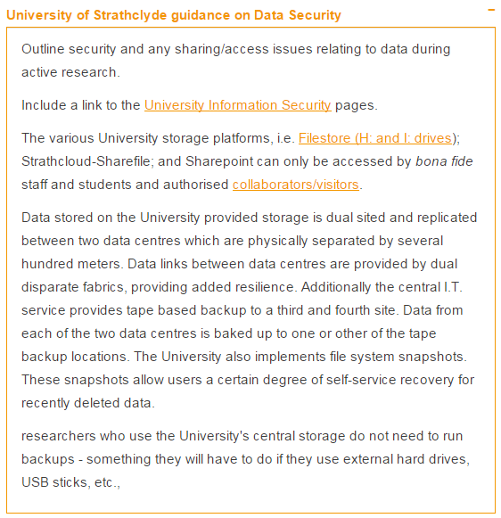
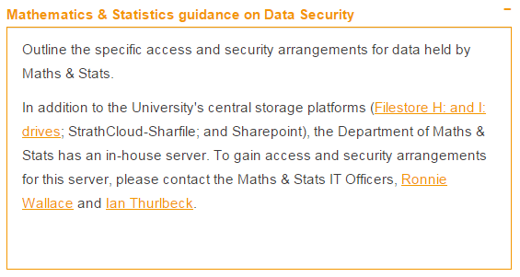
Custom guidance
Strathclyde University has guidelines for the whole institution and 3 departments:
School of Government and Public Policy
Social Work and Social Policy
Maths and Statistics

Slide 7
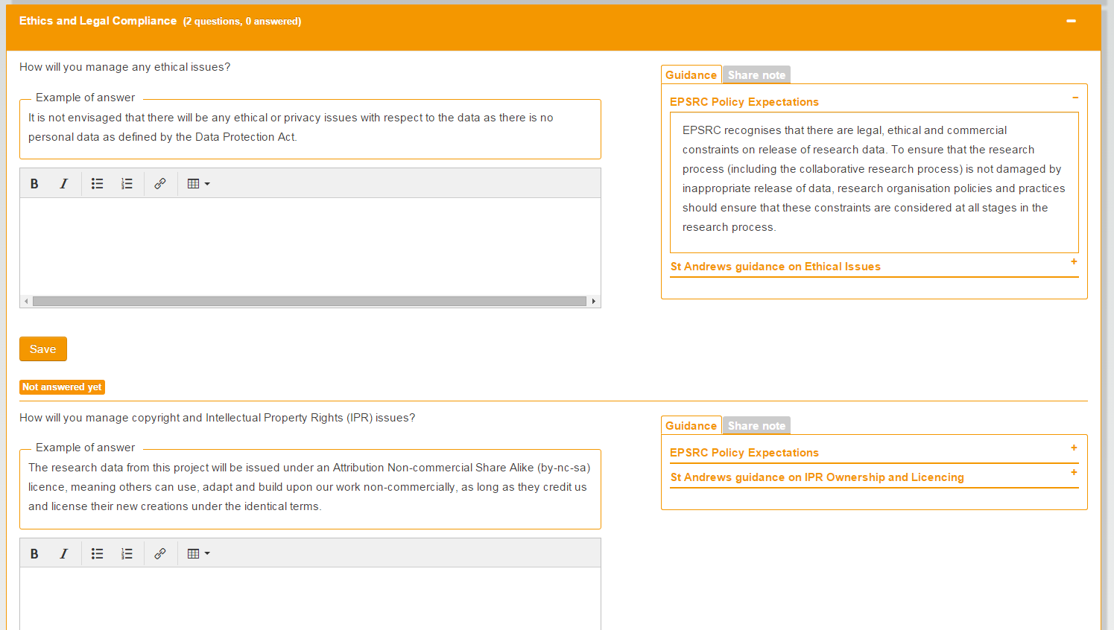
Example answers
St Andrew’s University has added example answers for every question in the EPSRC template

Slide 8
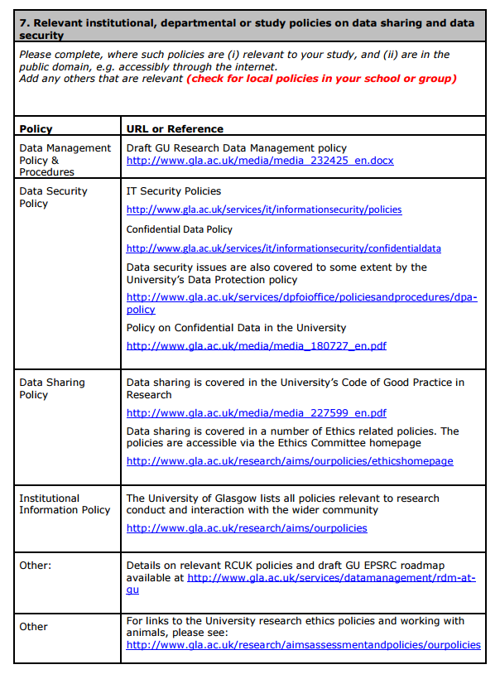
Suggested answers
The University of Glasgow has template answer for the policy question in the MRC template.
The table is prepopulated with links to all the University policies.

Slide 9
Example plans
108 DMPs from the National Endowment for the Humanities (USA)
www.neh.gov/divisions/odh/grant-news/data-management-plans-successful-grant-applications-2011-2014-now-available
20+ scientific DMPs submitted to the NSF (USA) provided by UCSD
http://libraries.ucsd.edu/services/data-curation/data-management/dmp-samples.html
2 Rural Economy & Land Use (RELU) programme examples (UK)
http://relu.data-archive.ac.uk/data-sharing/planning/examples
Further examples:
  www.dcc.ac.uk/resources/data-management-plans/guidance-examples

Slide 10
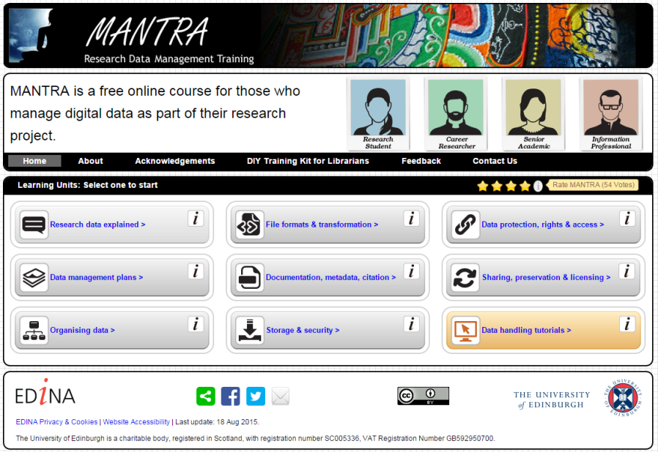

More in-depth support
Training courses
Tailored guides
Reviewing plans
Consultancy services

Slide 11
A range of DMP support services
For example, Stanford University offers:
Information on funding agency requirements
Guidance and best practice on writing a plan
An online tool (DMPTool)
Sample agency-specific plans
An FAQ and workshops
A DMP review service
http://library.stanford.edu/research/data-management-services/data-management-plans

Slide 12
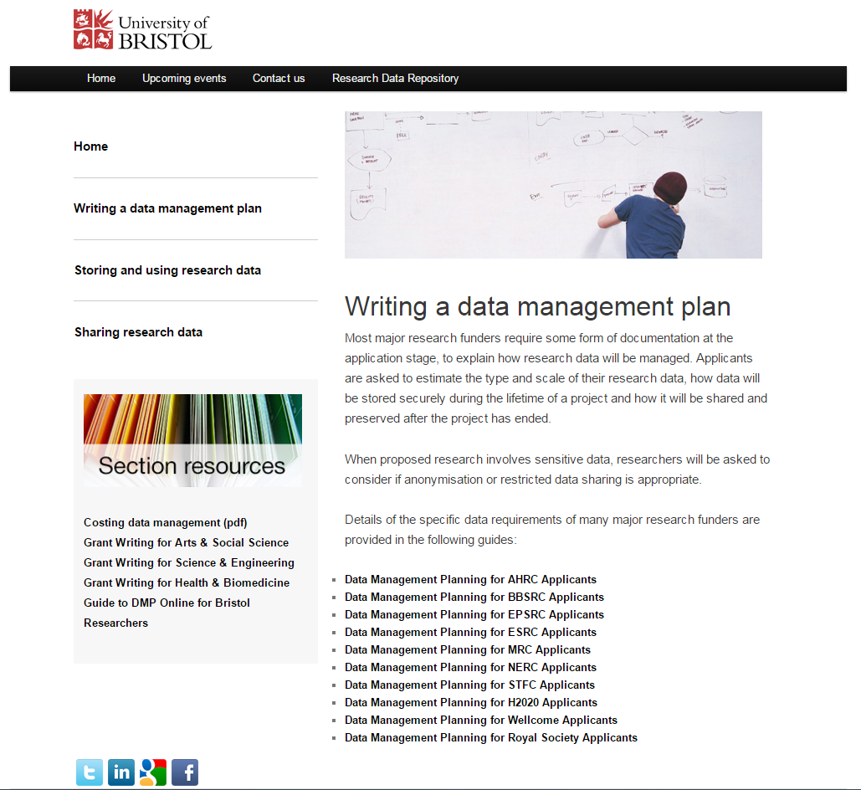
University of Bristol DMP services
https://data.bris.ac.uk/planningdata

Slide 13
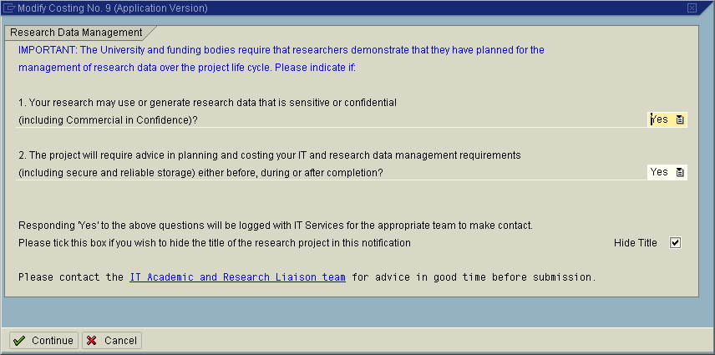
Integrating DMPs into workflows
Example of embedding flags into the grant costings system at the University of Leicester
www2.le.ac.uk/offices/itservices/about/news/old-news/2010/July/lucre-08-07-10

Slide 14

CPUT data management tool
Collaboration with Technical University of Munich
Developing tool that encompasses data management planning (using DMPonline code) and incorporates into institutional RDM workflows
Contact Zanele Mathe for more information
Webinar slides:
www.slideshare.net/joydavidson378/cput-webinar-with-audiocompressed2?ref=http://www.dcc.ac.uk/training/curation-webinars/videos-and-slides

Slide 15
DMPs to define / allocate storage
The University of Manchester requires an outline DMP prior to a grant application
This asks questions about the storage requirements to plan activity / resourcing and allocate space
The outline DMP generates an RDM Plan Reference Number to include in the Research Application form. Researchers can’t proceed without this.
www.library.manchester.ac.uk/services-and-support/staff/research/ services/research-data-management/data-management-planning-tool

Slide 16
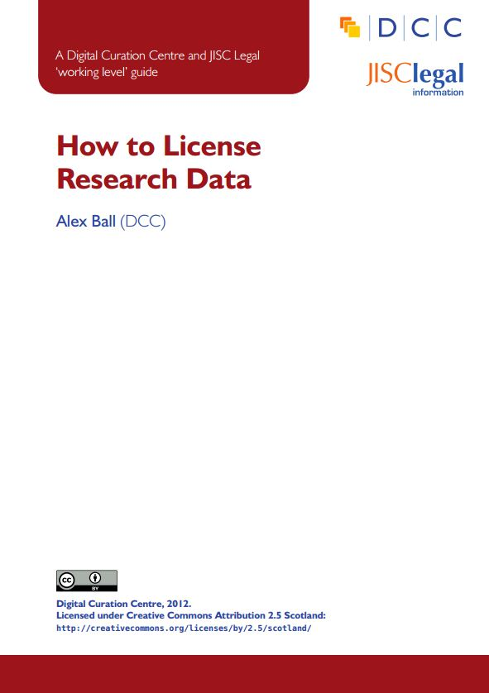
Reviewing DMPs
Useful guidelines
ESRC guidance for peer-reviewers www.esrc.ac.uk/_images/Data-Management-Plan-Guidance-for-peer-reviewers_tcm8-15569.pdf
Medical Research Council guidelines www.mrc.ac.uk/documents/pdf /data-management-plans-guidance-for-reviewers
Johns Hopkins grant reviewers sheet https://dmp.data.jhu.edu/resources/grant-reviewers-guide
How to assess DMPs forthcoming guide

Slide 17
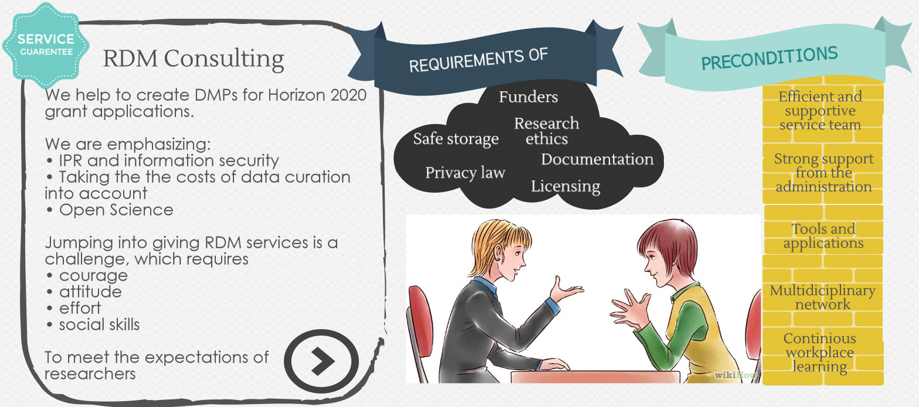
University of Helsinki example
Consulting, supporting and networking with researchers & all other interest groups
Slide content courtesy of Mari Elisa Kuusniemi (MEK), University of Helsinki Library

Slide 18
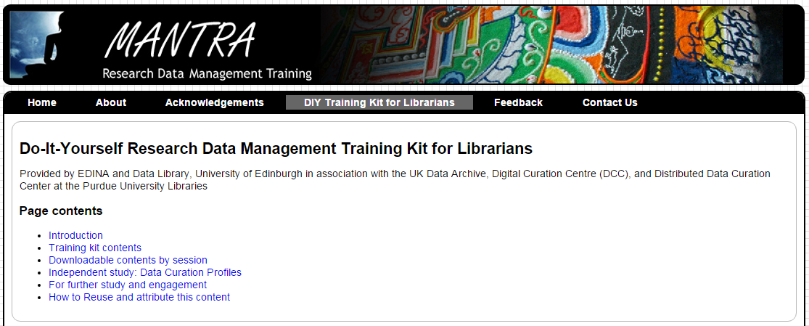
DIY training kit for librarians - MANTRA
Created by the data library at Edinburgh University
Builds on the MANTRA online training for RDM
Equips and empowers librarians to training themselves in groups to address RDM and provide support
http://datalib.edina.ac.uk/mantra/libtraining.html

Slide 19

Thanks for listening
DCC resources on DMPs:
www.dcc.ac.uk/resources/ data-management-plans
Follow us on twitter:
@digitalcuration and #ukdcc

Slide 20
How to support DMPs?
What have you been doing that works well?
What else would you like to try?
Are there other things you would like to see supported in DMPonline?

