Slide 1



Curation Costs Exchange
Collaboration to Clarify the Costs of Curation
Understanding and comparing digital curation costs to support smarter investments
Sarah Middleton sarah@dpconline.org
Digital Preservation Coalition
www.dpconline.org

Slide 2
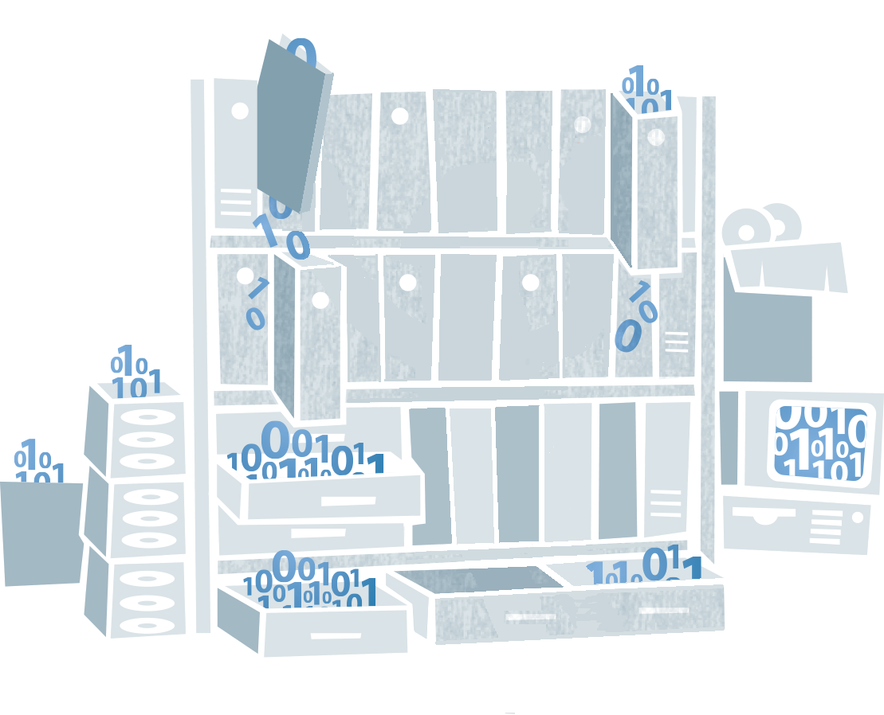

Collaboration to Clarify the Costs of Curation
Project
context
www.digitalbevaring.dk
Notes:
Volumes of data to be curated is increasing rapidly
Budgets are not increasing in line with this growth
Investments in digital curation must be strategically and carefully targeted
Need to get best value for money

Slide 3
Collaboration to Clarify the Costs of Curation
Vision The 4C vision is to create a better understanding of digital curation costs through collaboration.
Mission Our mission is to provide useful, useable resources which support the process of cost management in digital curation.
Notes:
established to help organisations across Europe (and beyond) to more effectively invest in digital curation and preservation.
REF – Vision and Mission
Started in February 2013, for 2 year – finishing January 31st 2015
13 partners across Europe, representing curation cost experts
Already been a lot of work in the area of curation costs (much of it by the partners themselves) and the project aimed to build on this (rather than reinventing the wheel), to:
Articulate the benefits of informed investments in digital curation
Make the already available resources more accessible and user friendly
Create greater transparency around curation costs
Project is ‘open and social’ – depends entirely on the input, guidance and feedback from stakeholder groups
This has been great, we have built up a network of over 350 individuals from organisations ranging from:
SMEs and vendors, large archives and libraries, the BBC, the aerospace industry,
and banks… thanks to Lloyds who have provided their input.

Slide 4


Collaboration to Clarify the Costs of Curation
How have we achieved these aims?
Feb 2013
Project Kickoff
Preparation
Who we are & what we do
Cost
model
Eva-
luation
Summer 2013
Study of stake-
holders
Contact Stakeholders
Participation, debate, emerging findings
Summer 2014
Draft
Roadmap, CCEx
Beta,
Cost
Concepts
Emerging
Resources
Dissemination, legacy, recommendations
Jan 2015
Oct 2014
4C Conference
Project Close
Full
version
CCEx
Final
Roadmap
Notes:
Highlighted some of the key outputs (not all) on this journey here - EXPLAIN
Underpinning much of the work in the second half of the project was the cost model analysis
Found that while each was perfectly suitable for the organisations which developed them, they were not easily transferrable or support the process of ‘understanding digital curation costs’
Led to:
Roadmap for sustaining transparent investment in digital curation, work on cost concepts, and a weird and wonderful thing called the Curation Costs Exchange

Slide 5
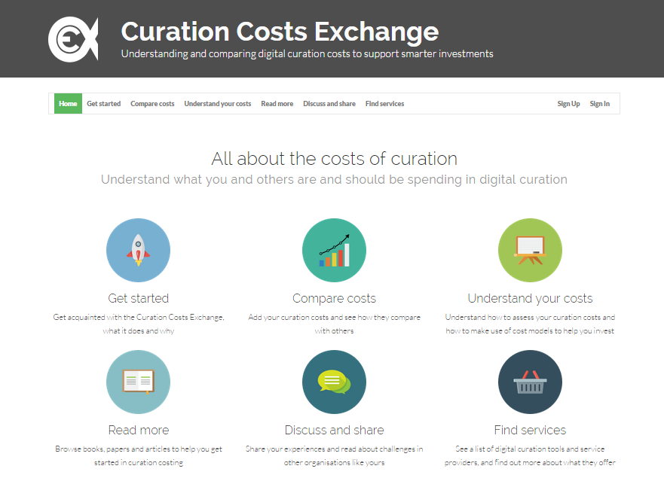
www.curationexchange.org
Collaboration to Clarify the Costs of Curation
Notes:
What is it?
Framework of useful information designed to help anyone who creates or curates digital content, or funds the process, to make smarter investments in digital curation – arranged in this online platform.
Features which are designed appeal to a range of users:
Those who are already investing in digital curation, and want to see how their costs compare to other similar organisation e.g…curators who want to make efficiencies, funders who want to be sure their investment is well placed, SMEs or vendors who want to be sure their services remain competitive
Those who want to know about more about investing in digital curation before they take the plunge…
What does it do?
Cost Comparison Tool or ‘Compare Costs’ sits at the heart of the CCEx - if you HAVE cost data already
enables exchange and comparison of cost data
provides the opportunity to identify greater efficiencies, better practices and valuable exchanges of information between organisation.
data is anonymised and amalgamated into user averages for the benefit of comparison.
identity is only shared if organisation consents
‘Understand your Costs’ toolkit of resources drawn from the 4C
provide that grounding through the lifecycle of digital curation costs.
If planning to build a business case for investments in digital curation, carry out a cost appraisal or analysis, or want to know about cost modelling,

Slide 6

Get started
Benefits of sharing
Description of features
Audience
Privacy policy
Collaboration to Clarify the Costs of Curation
Notes:
Get started is our ‘about’ page, with information about what’s what, what’s where and what the CCEx can do to help you.

Slide 7
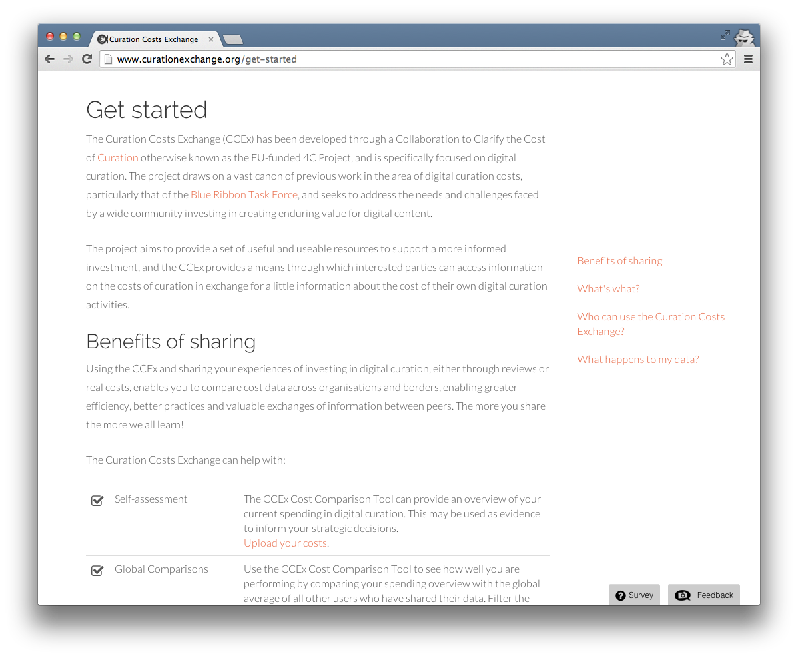
Get started

Slide 8

Compare costs
See what others spend in digital curation
Add your own cost data sets
Compare with other groups and peers
Similar organisations based on your profile
Collaboration to Clarify the Costs of Curation
Notes:
brains of the CCEx – here are some of the things you can do with the tool
Encourages users to be bold and share their cost data, in return for cost information about their peers.
the more we share the more we learn.
Once you can see what other organisations are spending in certain areas, and you make that comparison with your own costs, its easy to see where greater efficiencies, and better practices might be introduced.

Slide 9
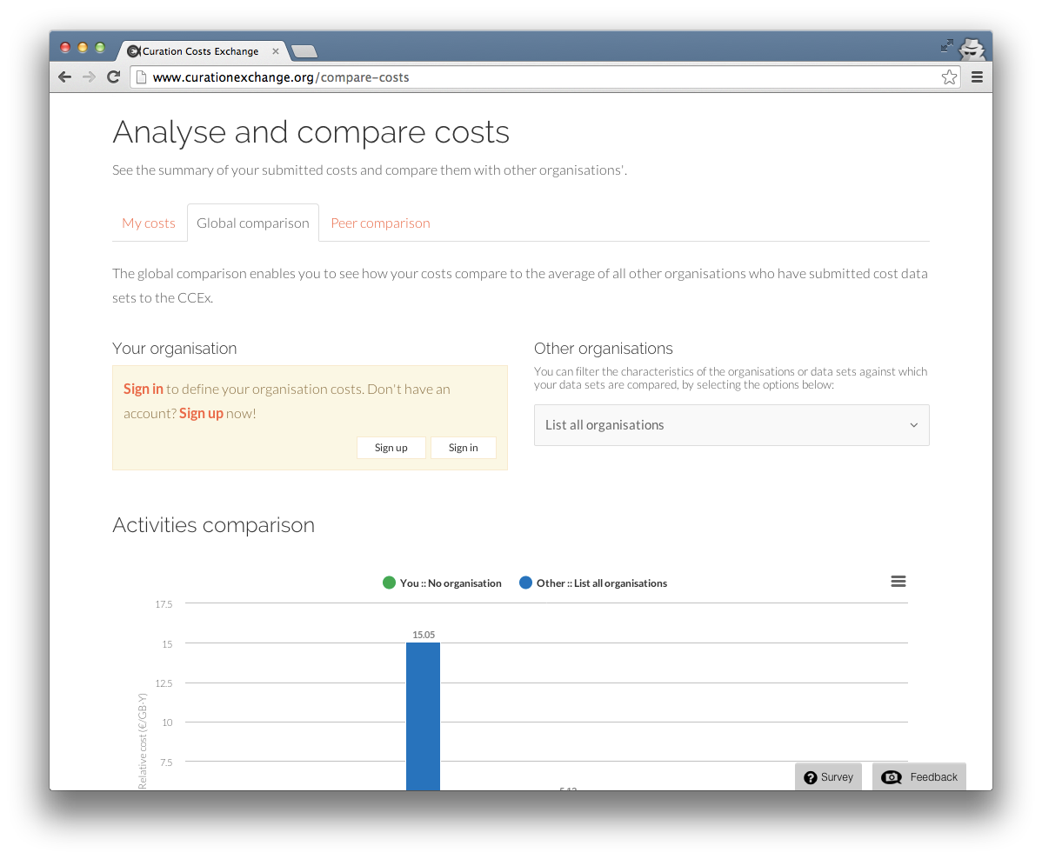
Compare costs
Notes:
first page you come to
Immediately presented with an amalgamation of costs submitted to the CCEx, and the option to filter this…
And if you want to work through and see how your costs compare, you are invited to sign up and create your own account

Slide 10
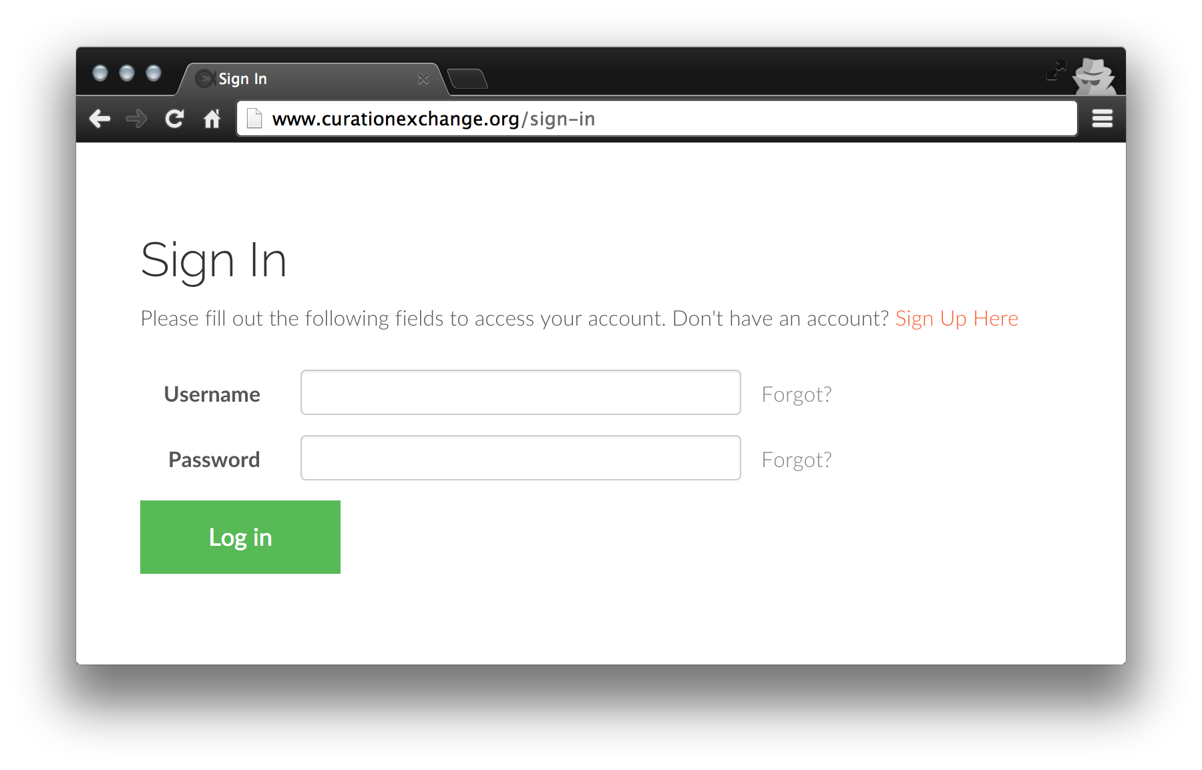
Compare costs
1
Collaboration to Clarify the Costs of Curation
Notes:
Like so…

Slide 11
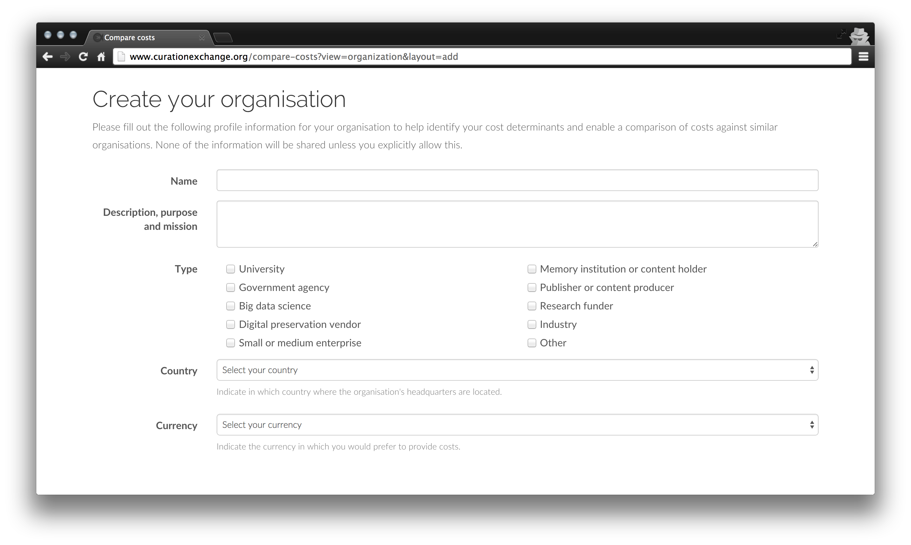
Compare costs
2
Collaboration to Clarify the Costs of Curation
Notes:
So that the CCEx can match your cost information with others similar to yours we ask you to fill in a profile section.

Slide 12
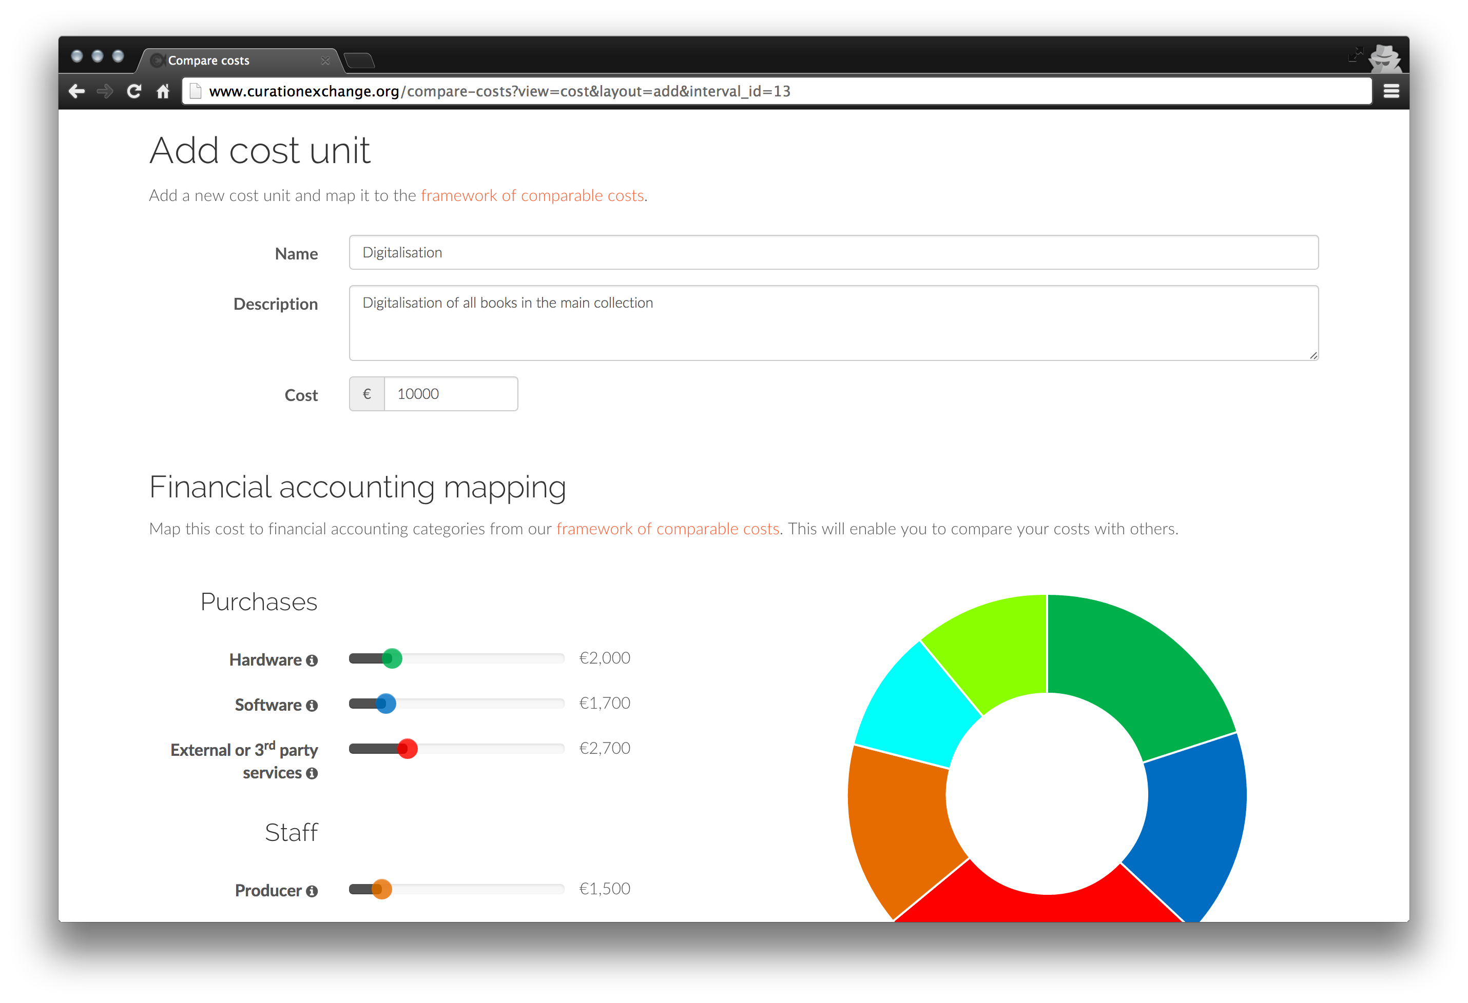
Compare costs
3
Notes:
add information about your ‘cost units’ – i.e. the things you spend your money on, whether that is on technology, a process or on human or other resources
You describe what it is and how much it cost, over a specified time frame.

Slide 13
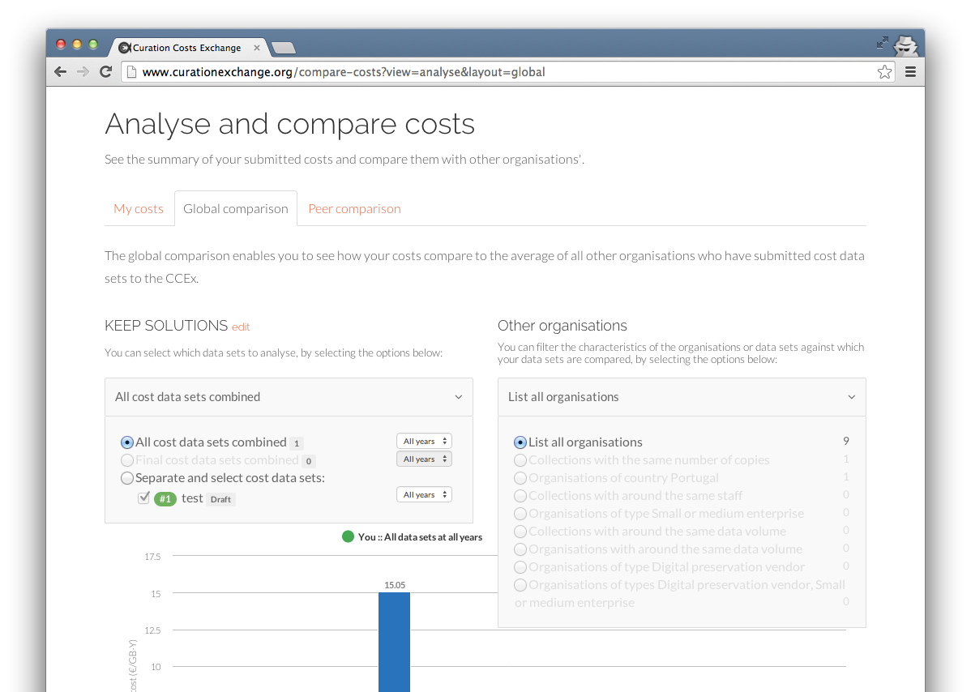
Compare costs
4
Notes:
Comparison
Two options for comparison – global and peer-to-peer
The Global Comparison shows how your costs compare with an average of all costs submitted by other CCEx users.
filter the results, by selecting which organisations to display, and which to hide
The graphs show an overview of your costs, broken down by ‘Financial Accounting’ and ‘Activities,’ – displayed alongside the average of all costs submitted by other CCEx users, or the organisations you have chosen to filter by.
Helps identify how your costs compare with the global average, and whether you spend more or less in some areas than others do.
Where you identify that you spend less, it may be that you have adopted a practice which is particularly cost effective that you can share with others.
And likewise, where you spend more in a particular area than others, it may be that there is a different approach you could adopt, which would help you drive down your costs – helping your budget go further.
Different organisations will have different emphases depending on their purpose and mission, so if you seem to be spending a lot on software development and you develop and maintain your archive system in-house for example, – this is most likely to be ok.

Slide 14
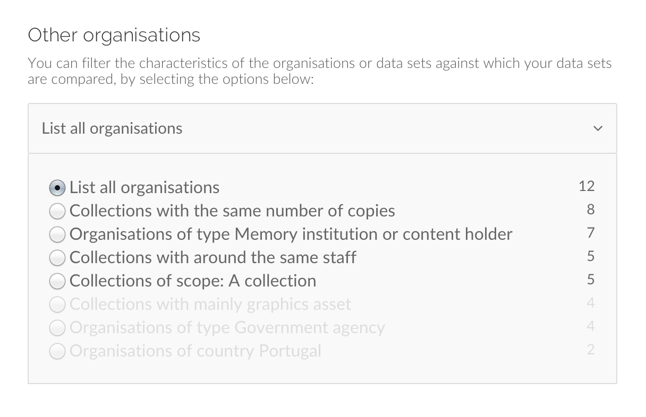
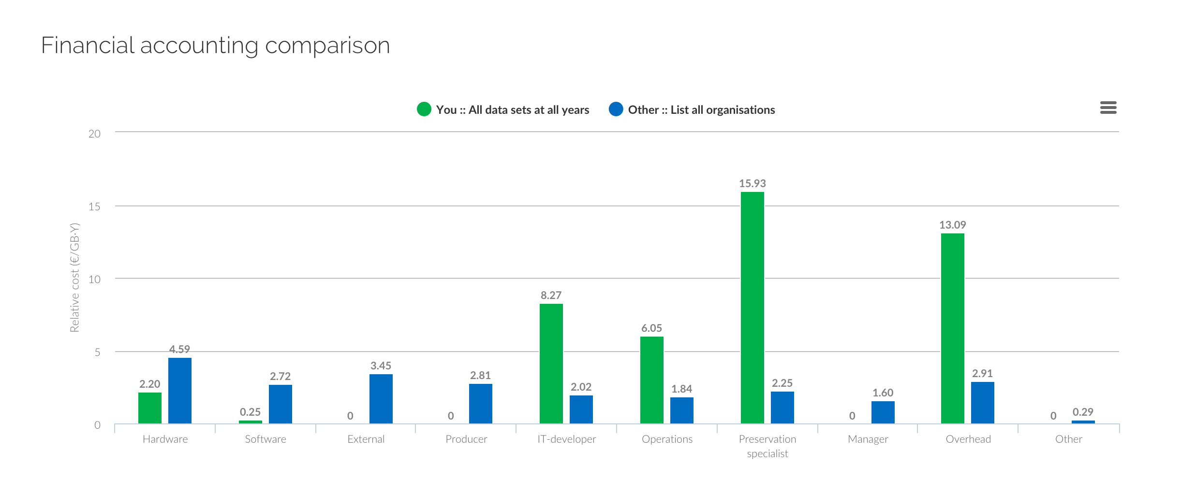
Compare costs
Global comparison
Filter by organisation type, asset types, data volume, staff size, and others.
Notes:
costs compared with the global average within the CCEx

Slide 15
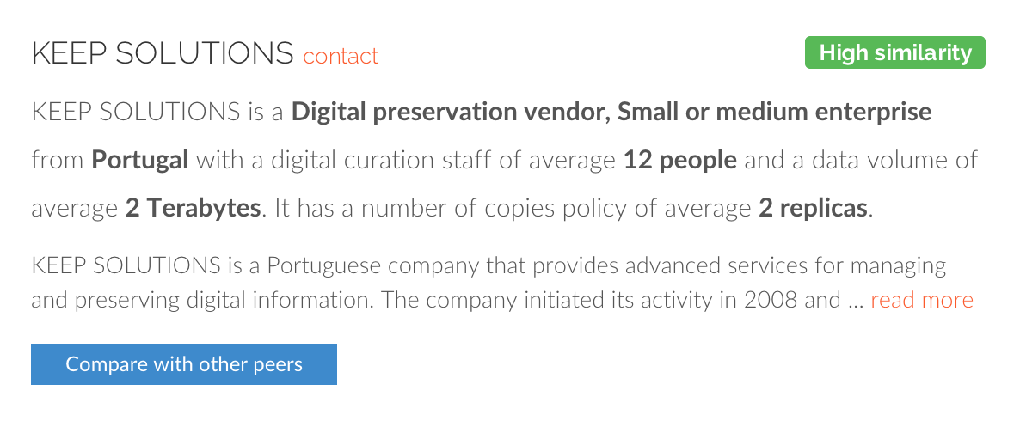
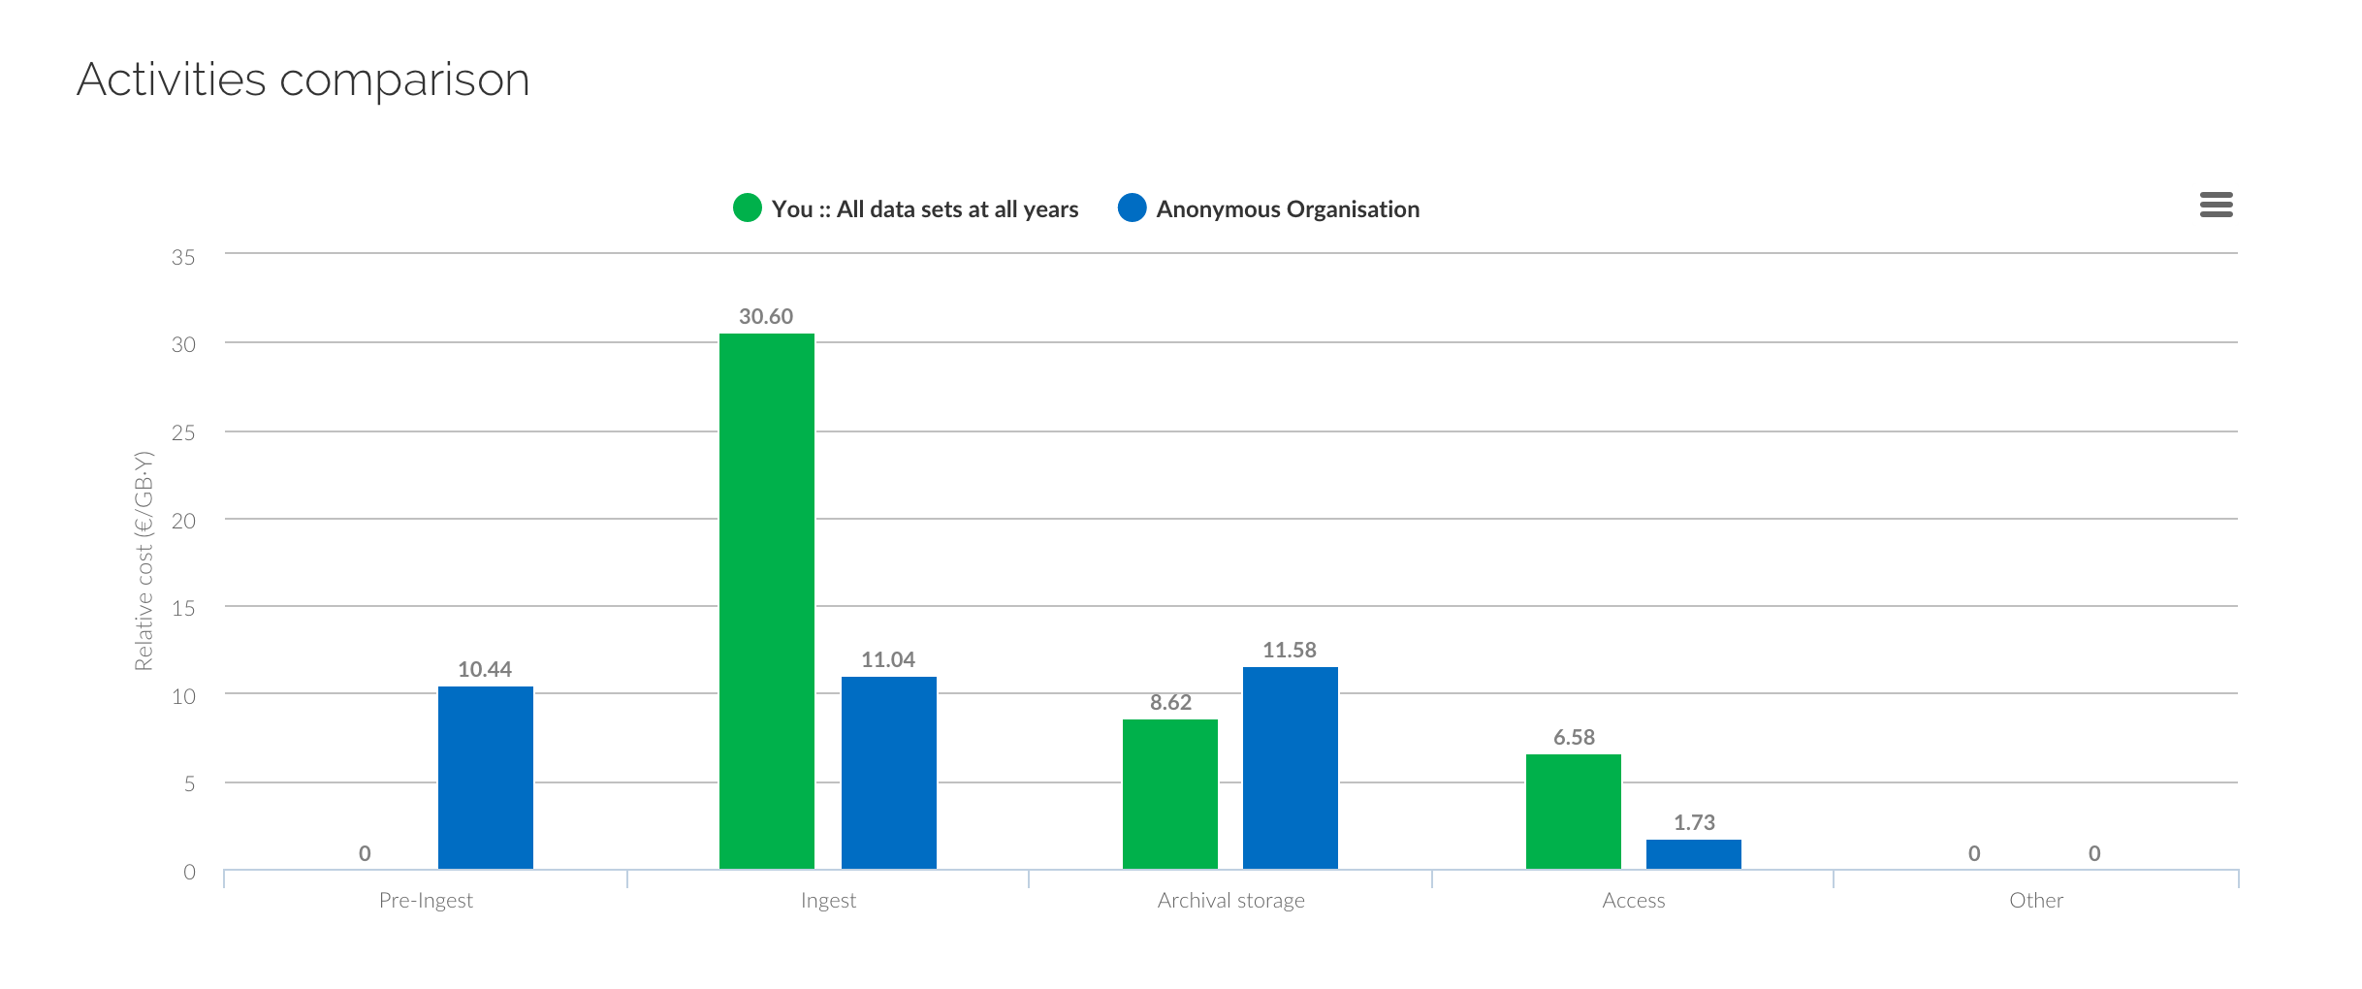
Compare costs
Peer comparison
Select to compare with organisations alike yours, sorted by similarity to your own profile.
Notes:
compare your costs with similar organisations or ‘peers’
Based on the profile info you submitted – the CCEx will match you with the closest similar organisation so you can see how an organisation in your own country, sector, size operates and whether there is anything you can learn from them.
Option to request contact with this organisation in a LinkedIn style…
If anonymised will say Organisation A in Portugal for example…

Slide 16













Understand your costs
Core cost concepts
Economic sustainability reference model
Indirect cost drivers
Quality and trustworthiness
Model requirements specification
Summary of cost models
Notes:
if you don’t have curation costs to compare…
Still plenty of resources to help provide understanding of digital curation costs, before you invest or while you are investing…
These are the resources drawn from the 4C project which aim to provide that understanding:
CCM - demonstrates the key concepts in the costs and benefits of digital curation; helpful when putting together a business case for spending of any kind in this area whether that is on staffing, activities or hardware and software.
ESRM - highlights key digital curation concepts, relationships, and decision points in a complex problem space, helping users to benchmark and compare their own local models and invest strategically to preserve data for the long term.
Indirect Cost Drivers - pin points a set of values significant in the practice of digital curation today. These values may incur cost but these costs will either realise a specific benefit or mitigate a particular risk. Applied at organisational management level the drivers and related risks and benefits can help to inform decision making about curation investment and help to shape business cases, sustainability strategies and derive best value from digital assets.
Quality and Trustworthiness - examines the costs and benefits of investing in a Trusted Digital Repository, for those considering certification.
Model requirements spec - provides concepts and a generic specification for create your own models.
Summary of cost models - Drawing from the ‘Evaluation of Cost Models and Needs & Gaps Analysis’ deliverable, provides an overview of selected cost and benefit models and helps users identify which model may best suit their needs.

Slide 17



Read more
Browse books, papers and articles to help you get started in curation costing.
Discuss and share
Share your experiences and read about challenges in other organisations like yours.
Find services
See a list of digital curation tools and service providers, and find out more about what they offer.

Slide 18
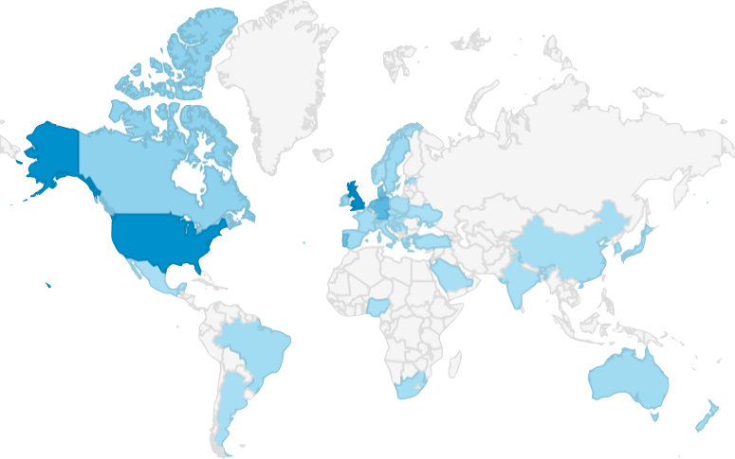




Usage
Notes:
great response to the CCEx so far since we released the beta version in August…

Slide 19
Usage
3
0
Organisations
Have shared their curation costs
Collaboration to Clarify the Costs of Curation

Slide 20

The Curation Costs Exchange needs you!
Collaboration to Clarify the Costs of Curation
Notes:
The digital curation community recognises the potential of the CCEx, esp CCT to help understand digital curation costs and articulate the benefits of investment in this area
success will be measured in the readiness of organisations to share sensitive cost data and by the Cost Comparison Tool’s adequacy and pertinence:
Does it work properly? Is it intuitive? Are the results interesting?
We think we’ve covered adequacy and pertinence in high level of user involvement in developing the tool, in fact the CCEx is a product of the user requirements that we have identified through deliverables, consultations and workshops, webinars, focus groups, beta-testing, and usability tests.
two key challenges remain: to gather cost data, and to translate these into figures that organisations of all kinds find meaningful and engaging.
meaningfulness depends on how many cost data sets the CCEx is able to attract in order to generate statistically reliable and useable figures.
meaningfulness of the results is the compelling argument for the submission of new cost data sets.
CCEx needs community support, to use it, add to it, take care of it – and above all share their data with it to make it work.

Slide 21
www.curationexchange.org
Collaboration to Clarify the Costs of Curation
Notes:
The Curation Costs Exchange may be found at …
full release will coincide with the 4C/DPC ‘Investing in Opportunity: Policy, Practice and Planning for a Sustainable Digital Future’ Conference at the Wellcome Trust in London, UK on 17th and 18th November 2014.

Slide 22
What happens next?
Collaboration to Clarify the Costs of Curation
Take some time to explore CCEx
Focus group discussion on CCEx
Notes:
The Curation Costs Exchange may be found at …
full release will coincide with the 4C/DPC ‘Investing in Opportunity: Policy, Practice and Planning for a Sustainable Digital Future’ Conference at the Wellcome Trust in London, UK on 17th and 18th November 2014.

