Slide 1


Overview of DCC activities –
Data Management Planning
Joy Davidson
Digital Curation Centre
University of Glasgow
joy.davidson@glasgow.ac.uk
Funded by:
This work is licensed under the Creative Commons Attribution-NonCommercial-ShareAlike 2.5 UK: Scotland License. To view a copy of this license, (a) visit http://creativecommons.org/licenses/by-nc-sa/2.5/scotland/ ; or, (b) send a letter to Creative Commons, 543 Howard Street, 5th Floor, San Francisco, California, 94105, USA.

Slide 2
Agenda
Time Activity
11:00 Overview of DCC activities - Data Management Planning (JD)
11:30 Funders' requirements for Data Management and Sharing Plans (SJ)
11:45 Coffee
12:00 Demo of DMP Online (SJ)
12:15 Group exercise (All)
12:45 Wrap up and close (JD)

Slide 3
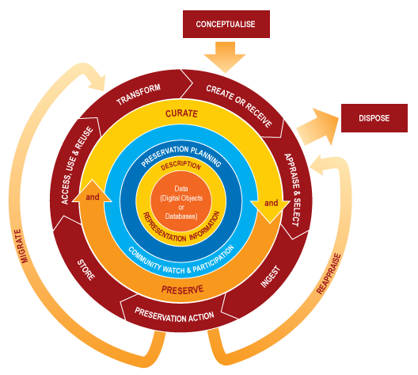

What is data curation?
“the active management and appraisal of data over the lifecycle of scholarly and scientific interest”
Curation is part of
good research practice
Manage
Share
Notes:
3

Slide 4
What is data management?
Data management involves looking after data to ensure it
remains securely accessible and usable by the researchers
who created it and by those they need to share it with for as
long as the data needs to be kept.

Slide 5
What kind of information are we talking about?
Correspondence (blog posts, emails, tweets)
Web pages/sites (text, images, links, e.g., Facebook)
Databases
Publications
Raw data (captured from instruments)
3D models and visualisations

Slide 6
What does this mean for researchers?
Learn effective procedures for creating and organising their data (naming, formats, structure, storage, back-up)
Be able to assess the value of their data for long-term retention
Understand the range of legal restrictions that may apply to the access and reuse of their data and others
Be able to identify their requirements and communicate these to other stakeholders to jointly assess risk and plan for the management of their data
Understand how early decisions can affect longer-term use

Slide 7
The key challenge for researchers
Adhering to institutional requirements and meeting RC and funding bodies’ mandates
Lack of data centres for deposit and support
Maintaining their professional reputation
But – most don’t know who can help them manage their data or where they can acquire the right skills

Slide 8
Potential benefits for researchers
Retain access to their data in the short and longer-term to validate their research
Ability to add value to their data and make links between other sources of information to provide greater pool of knowledge
Increased income opportunities via funded research

Slide 9
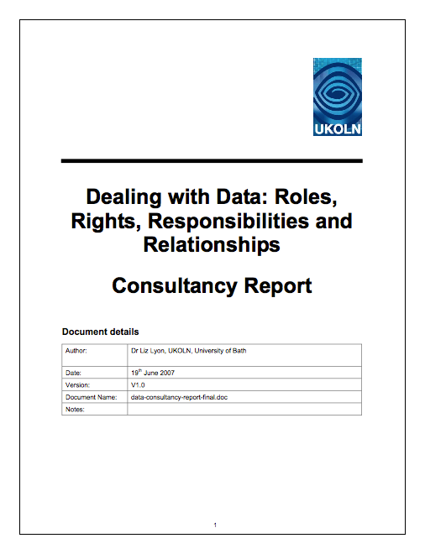
Background to DMP work
Liz Lyon (DCC Bath) ‘Dealing With Data’ (2007) consultancy report...
REC 9. Each funded research project should submit a structured Data Management Plan for peer-review as an integral part of the application for funding. (1, 2)
http://www.ukoln.ac.uk/ukoln/staff/e.j.lyon/publications.html#2007-06-19

Slide 10

Why plan?
Why plan data management? The 5 Ps...
Perfect Planning Prevents Poor Performance
Data management is a journey with multiple drivers /stakeholders, from researchers to funders to support staff to curators to long-term data centres: each has to follow the same map in order to mitigate the risk of not getting there.

Slide 11
The limits of planning
The plan is really just the starting point – not the
end of the road.
Implementation of the plan is where the real work
starts.
Remember that the plan is a living document – will
likely change several times over the life of the
project.

Slide 12
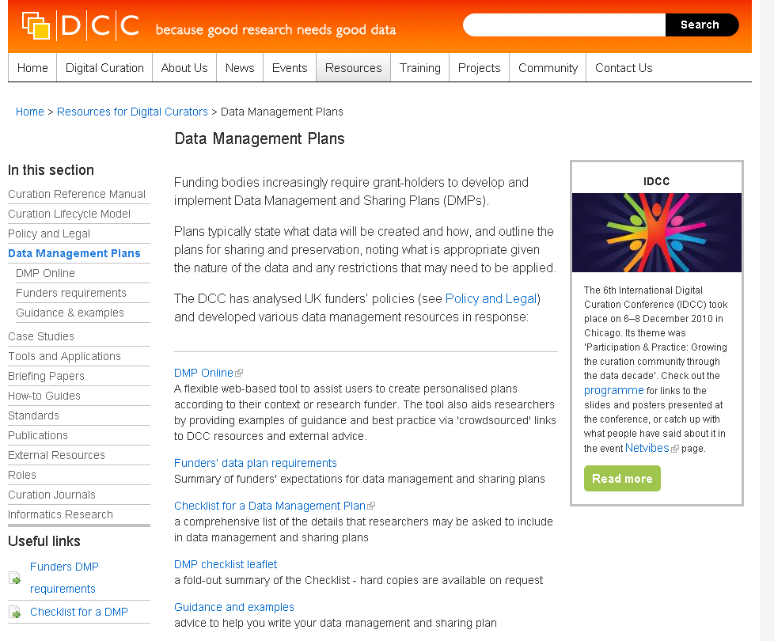
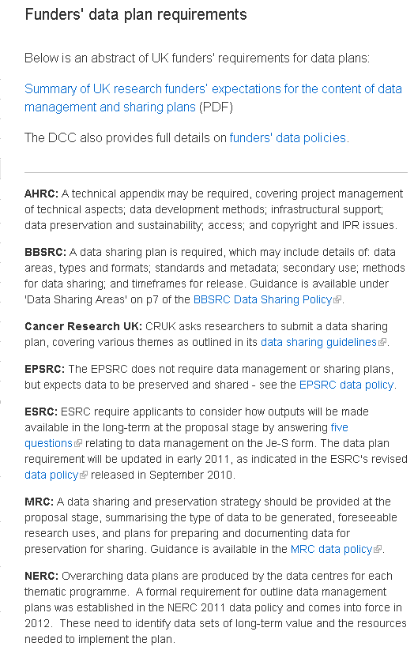
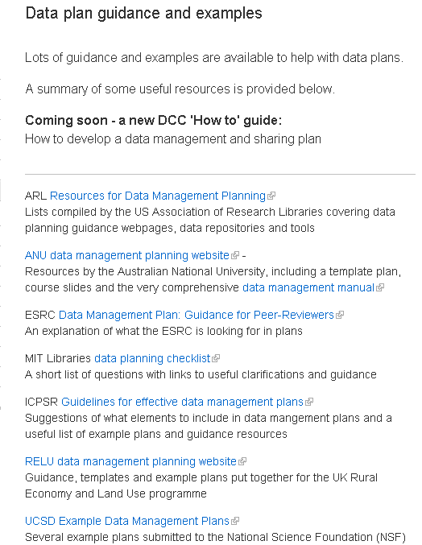
Data planning resources on the Web
our resources
www.dcc.ac.uk/resources/ data-management-plans

Slide 13
Analysis of data-related policies
We conducted an analysis of the major UK research funders’ data-related policies (Jones, 2009)...
Major findings:
Not all funders have data policies
Some have different policies for different programs
Requirements are expressed in different ways
In a word, they’re diverse...
http://www.dcc.ac.uk/resources/policy-and-legal/overview-funders-data-policies
(N.B. Sarah will cover this in more detail in the next session...)
Notes:
Requirements expressed in different ways, i.e. as easy to answer bullet-points, within paragraphs of text in the policy itself, in the Joint Electronic Submission (Je-S) form...

Slide 14
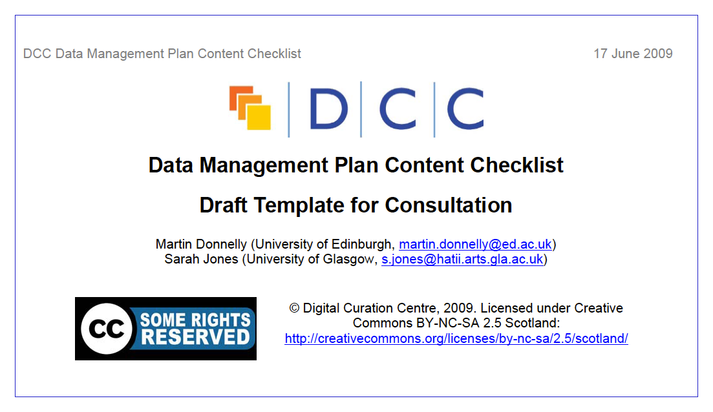
Checklist for a Data Management Plan
We pulled together a list of all the UK funders’ requirements, gathered them into thematic groups, and supplemented this list with our own expertise... (Donnelly & Jones, 2009)
This became the first ‘Data Management Plan Content Checklist’ (Checklist v1.0’) – it had 51 questions/headings. (Post-consultation, v2.0 had 115 questions/headings.)
Notes:
Consultation followed, which informed the wordings and orderings. We then made a populable Word Template out of the Checklist, but it was very long and wasn’t very user-friendly, so we built an online tool...

Slide 15
How the Checklist developed
Changes to the DCC Checklist...
More questions
Atomic questions
Closed questions
More active/direct language
Broadened thematic coverage
We are always interested in feedback on this – it’s a work in permanent beta, reacting to changes in the game...

Slide 16
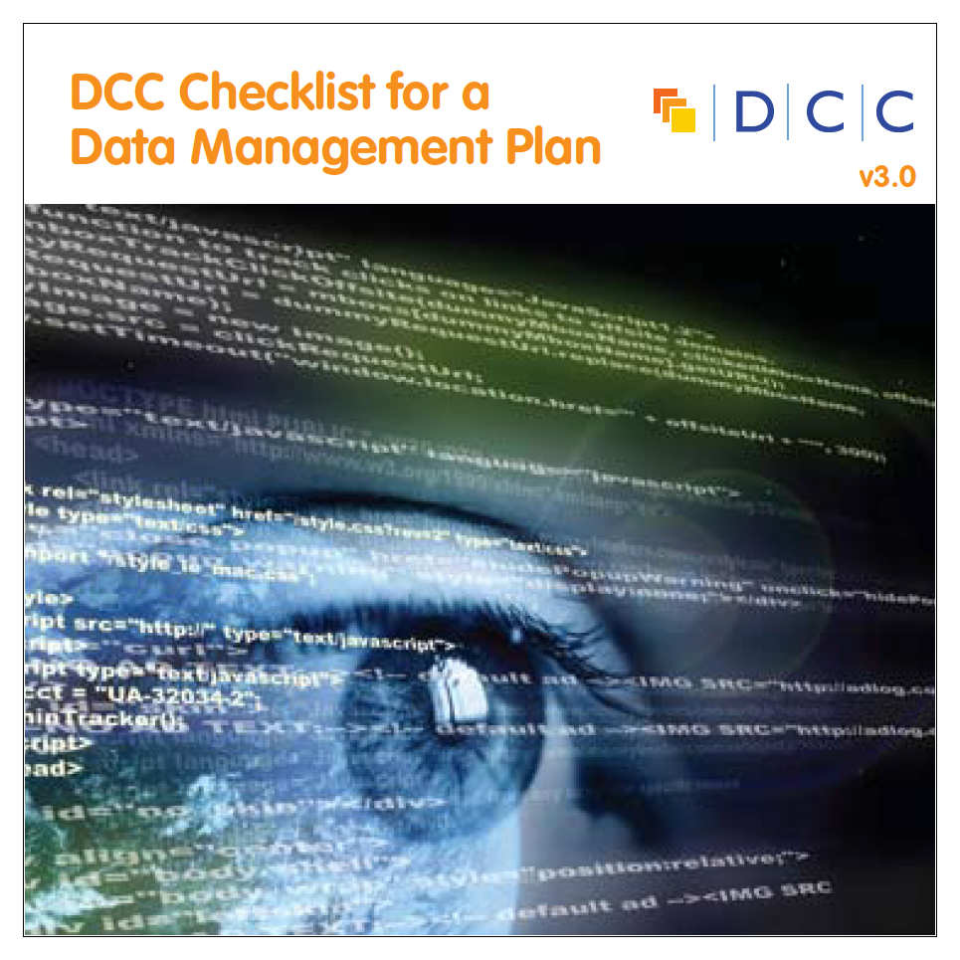
The Checklist
Introduction and Context
Data types, formats, standards and capture methods
Ethics and Intellectual Property
Access, data sharing and re-use
Short-term storage and data management
Deposit and long-term preservation
Resourcing
Adherence and review
Agreement / ratification
Annexes

Slide 17
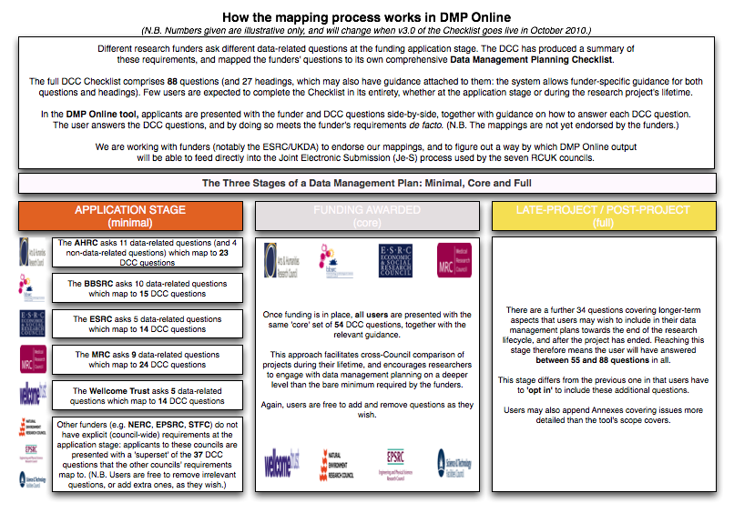
Mapping the general to the specific
We mapped our Checklist questions to each funder’s data-related requirements, and determined three key stages...
Notes:
...and then input it all into the new DMP Online system.

Slide 18
DMP Online: what does it do?
DMP Online has four principal functions. It enables users to...
Create, store and update multiple versions of data
plans at the application and in-project stages
Meet funders’ specific data-related requirements*
Get funder- and institution-specific guidance on best practice and helpful contacts
Customise and export DMPs in a variety of formats
* Disclaimer: mappings are not yet endorsed by funders...
Notes:
Overview of functionality...

Slide 19
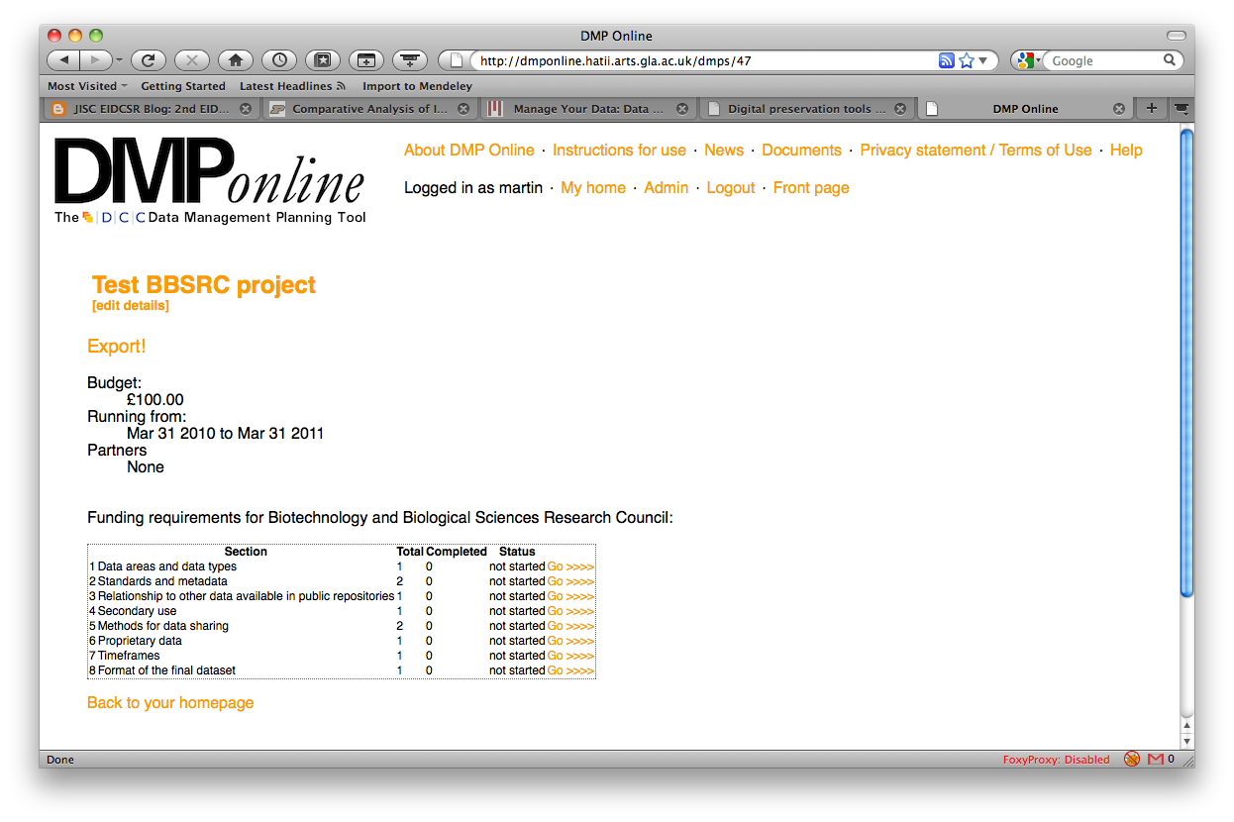
DMP Online v1.0

Slide 20
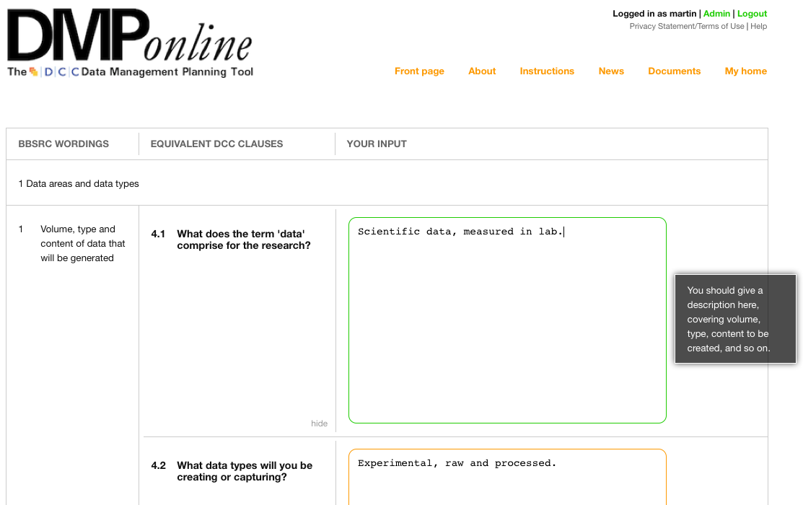
DMP Online v2.0
Key changes:
Cleaner interface
Funder-specific guidance
Versioning feature
CSV output

Slide 21
DMP v3.0 (coming soon...)
Definite
Closer liaison with funders to approve mappings etc
Hybrid templates: institution(s) + discipline(s)…
Integration with research admin systems
Cloud deployment
More granular permissions, inc. sharing of plans
More and better admin-side reports
Improved export options (RDF? Other formats?)
Possible
Licensing / Creative Commons integration
Navigable registry of Data Management Plans
See current JISC MRD call

Slide 22
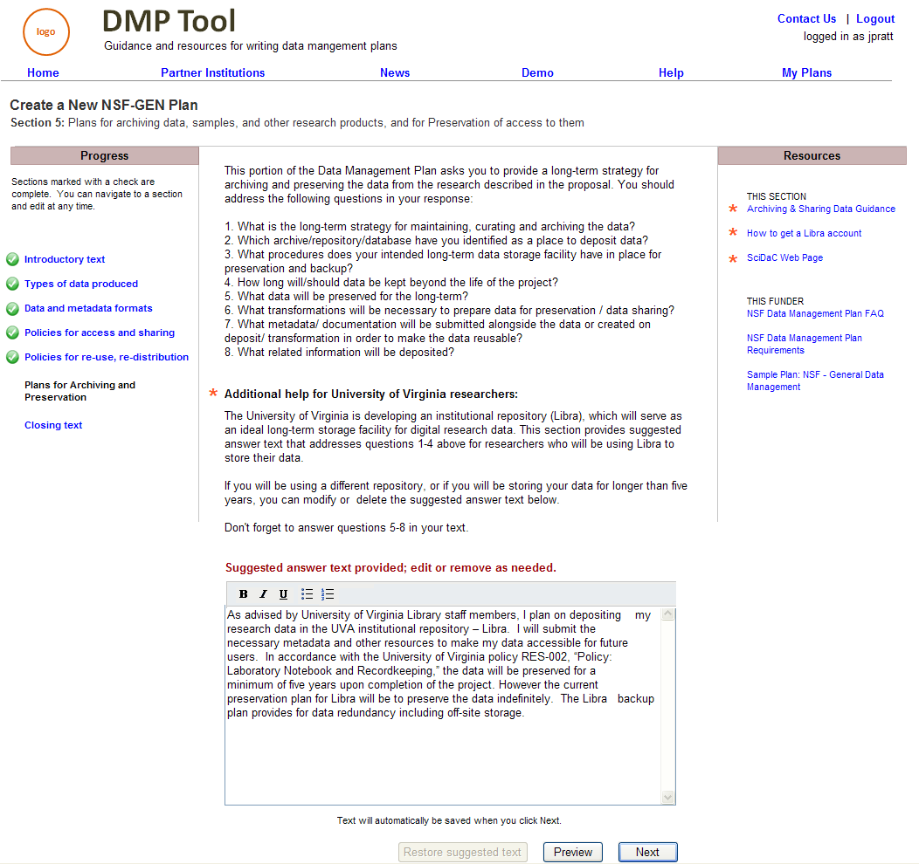
Collaboration with US partners
We’re advising on a DMP Tool being created by a team of US universities
Image courtesy T. Seneca,
California Digital Library
https://bitbucket.org/dmptool/main/wiki/Home

Slide 23
Providing support for JISC MRD
www.dcc.ac.uk/contact-us/help-desk/data-management-infrastructure-helpdesk
Strands A1 & A2 - Institutional RDM Infrastructure
A1 for projects at an early stage of development
A2 to extend/embed existing pilot infrastructure
Strand B - RDM Planning for projects / departments
Strand C - Integrated RDM planning tools for institutions (DMP Online)
www.jisc.ac.uk/fundingopportunities/funding_calls/2011/06/managingresearchdata.aspx

Slide 24
Additional work needed
Training for dmp reviewers (UK Data Archive/ESPRC)
Better idea of what data management costs should be covered by the institution and what should be covered by funders (possible RDMF topic)
More examples of what a good dmp looks like (even better, what a bad one looks like!)
Better integration with current research processes (e.g., raising a Project Approval Form)
Better idea of how dmp’s may be monitored over time (by funders and/or by institutions)

Slide 25
Thanks – any questions?

