Slide 1


DaMSSI-ABC & Jorum
Siobhán Burke
Jorum Educational Technologist
18th April 2013

Slide 2
What is Jorum?
A free and open national repository for OER in the UK
A trusted source of quality OER for UK FE & HE
A robust, safe and sustainable hosting platform for OER
A showcase for UK learning and teaching resources
Notes:
Jorum is a source of freely available, open educational resources. The service is open to all and is aimed at teachers, lecturers, librarians, learning technologists and other support staff who wish to access and/or share learning and teaching resources created by other staff in the post-16 education sector.
Jorum is hosted and maintained by Mimas, who have years of experience of providing technical support and user guidance. Based at the University of Manchester and funded by Jisc, Jorum supports the wider OER community by providing a central place for sharing, hosting and promoting the very best of UK learning and teaching resources for both the UK and beyond.
The deposit or sharing process is controlled by the UK Access Management Federation, which uses either Athens or Shibboleth logins. This control ensures the quality of the resources in Jorum. For an individual or institution who does not belong to the Federation, we also have a Trusted Depositor login facility in order to avoid any possible barriers to sharing your resources with us, as I’m aware that this may be the only login option for some of you.
The resources in Jorum can be re-used for your own teaching purposes depending on what the author allows. This is determined by the Creative Commons licence attributed to each resource in Jorum. These licences govern how a resource may be reused or re-purposed.

Slide 3
What are the benefits of using Jorum?
Provides security – a national repository service
Can reduce costs for the individual and institution
Improves discoverability of your OERs
Can provide data about your OER usage
Highlight your resources to a wide audience
Notes:
Jorum is a national service funded by Jisc for the benefit of the OER community. Jorum offers a secure, central repository for hosting your resources. As it is funded and supported by Jisc since 2002, Jorum offers a stable platform for hosting an individual’s or institution’s OERs.
Jorum can help to reduce costs for an institution in several ways. Jorum provides a hosted repository for your OERs AS WELL AS an expert team to maintain and develop that repository, so these costs are not replicated in your own institutions. Jorum offers the individual a user-friendly search interface making it easier to find resources that fit your needs and build on them rather than starting from scratch every time.
Jorum offers usage reports to provide insight to the success of sharing your resource.
At Jorum we support communications and marketing of resources and individual OER depositors or sharers through our Featured Resources and User Stories sections. Our User Stories section is used to display mini-case studies kindly provided by our users on their experiences of using Jorum to search and/or share their resources with Jorum and we welcome any one willing to tell us about their experiences.

Slide 4
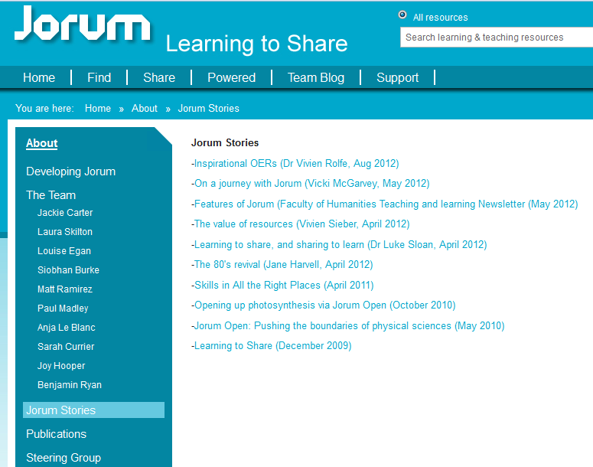
User Stories
Notes:
Here’s a list of our current user stories. They’re are honest accounts of how these individuals have found using Jorum, either to find and re-use resources in some way or share their resources with Jorum.
It would be really good if any of you were willing to contribute to one of these as we do show these to people as these can have a greater impact on potential OER users and creators than we can.
If I can just quickly show you Featured resources.

Slide 5
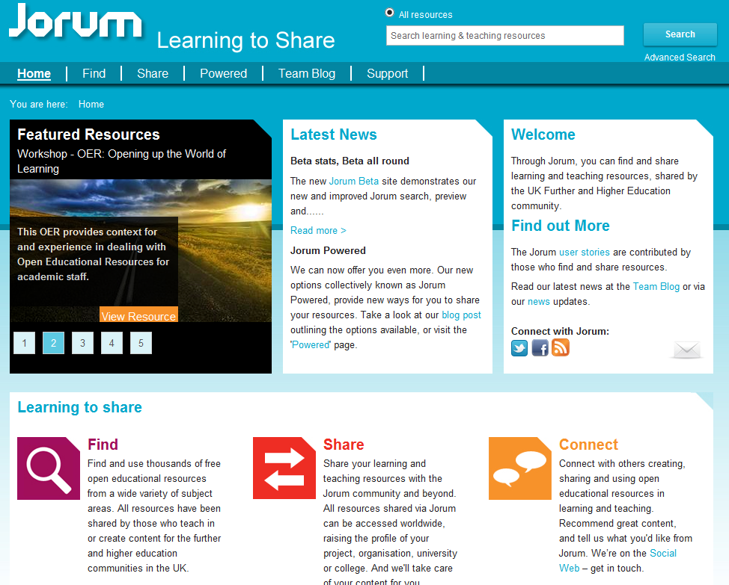
Featured Resources
Notes:
This is an image of the current Jorum home page and you can see that our Featured Resources section is prominently displayed here. We choose 5 different resources every month according to a common theme and present them as a little slideshow. We aim to contact the authors to let them know we’ve done this and also announce the resources through the Jorum twitter and Facebook accounts.
User Stories and the Featured Resources section are a way that Jorum can enhance an individual’s or an institution’s reputation. And certainly usage of a resource noticeably increases as a result of being included in the Featured Resources section. And I certainly want to use the 4 DaMSSI-ABC projects and perhaps one from the original DaMSSI project in this way.

Slide 6
Recent developments: DSpace upgrade
Migration to DSpace version 1.8 will enable:
A more robust system for the future
New and improved metadata fields
New resource ingest methods
New collections
Notes:
This migration to DSpace 1.8 from version 1.5 happened just a few weeks ago. It may not sound like a massive progression but what it will allow Jorum to do, is have a more flexible system which will enable to deliver better functionality from now on and into the future.
New metadata fields such as Publisher and Type of resource and more. This will improve reporting usage at institutional level.
We also are able to index records from other repositories, making Jorum nearer to the one-stop shop for OER resources in the UK. Likewise this same technology will allow us to push our records out to Discovery services used by many libraries. And we are already in discussion with the system vendors including ExLibris’s Primo, Serial Solutions’ Summon and Ebsco’s Discover.
And finally we can now include different collections within Jorum beyond just the previous FE and HE options. Here is an example of Resource, which is a collection available within Jorum of resources created by Scotlands Colleges.

Slide 7
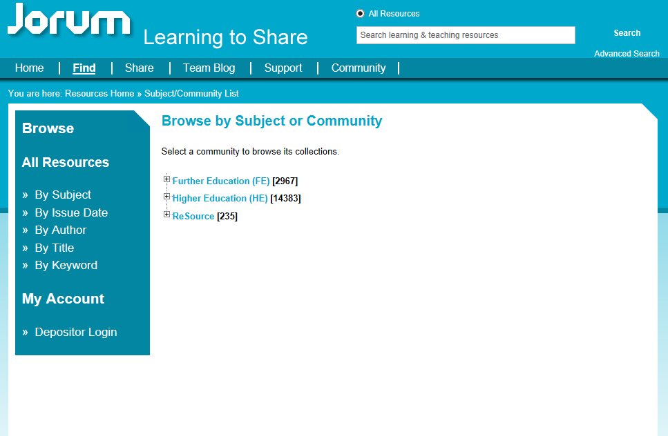
Featured Resources

Slide 8
Jorum Powered: What & Why?
Requirements beyond ‘core’ Jorum
Customised ‘showcase’
Cost effective offers
Notes:
Finally, I’d like to introduce you to our newest initiative and that is the idea of ‘Jorum Powered’.
So this goes beyond what Jorum will be able to offer within the scope of the DaMSSI-ABC project but hopefully we might get there.
‘Jorum Powered’ has come about as a result of working with our community and realising that there are requirements that ‘core’ Jorum alone does not meet. What I mean by ‘core’ Jorum is all that I’ve mentioned above, that is, the free, open access, central storage repository for OERs produced by the UK Further & Higher Education sector. There is a demand that the OERs being created by that sector are managed, shared and promoted in new ways and Jorum is now in a position to support these needs going forward by offering a cost effective solution.
The options include a fully hosted repository service as we are doing for the College Development Network in Scotland called Re:Source

Slide 9
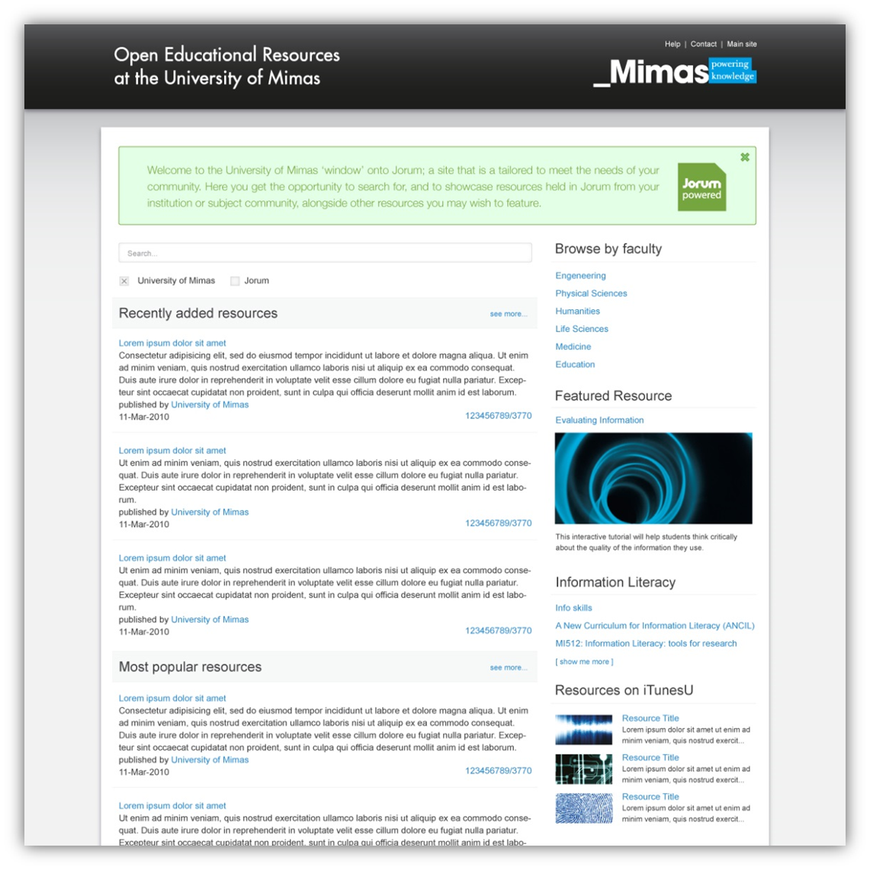
Mock-up window
Notes:
Here we see an example of a ‘Window’ for a fictitious University of Mimas. I’ll just point out some of the key functionality it can offer…
Branding
As you can see, it is has its own branding and with this is a option you would have full control over the page layout and design, customising your interface and helping to raise the profile of your institution.
Search
It has a dedicated search feature, using the new Jorum search functionality; allowing your users to search only your own content, or include any or all of Jorum’s other collections. Your users can also preview resources, before deciding to download them.
Showcase
On the right hand side, you can see you could have your own Featured Resource section showcasing your resources held in Jorum from your institution or a subject community, alongside other resources you may wish to feature.
Links
The ability to link to external information such as blogs, and information from other social media sources such as twitter, RSS feeds etc. is also included as part as of the Jorum Window offering.
Usage data
Finally, your Jorum Window can also include usage data, such as your most popular resources and will also give you and your users access to detailed reports about usage of all of your resources.
_________________________________
So although we’re not in a position to have this yet, we can create the infrastructure to enable this or even an API version for the future. So what we propose is…

Slide 10
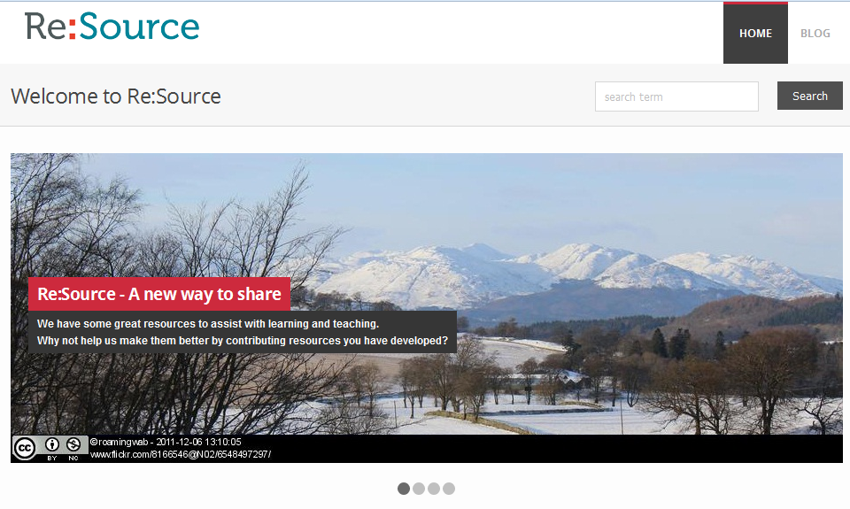
Jorum Powered: Re:Source Sub-site
Notes:
And there will be an API for an institution to develop their own interface using Jorum content and then there’s the middle option which is what has been suggested for DaMSSI-ABC.

Slide 11
New Hierarchy
Notes:
Returning to the DaMSSI-ABC project, this is the current collection hierarchy and this is what Jorum proposes…

Slide 12
New Hierarchy
+ Digital Literacies [423]
+ Further Education [2971]
+ Higher Education [14395]
+ Re: Source [275]
Notes:
A new top level collection called Digital Literacies, with 2 sub categories…

Slide 13
New Hierarchy
+ Digital Literacies [423]
-- Information Literacy [358]
-- Research Data Literacy [65]
+ Further Education [2971]
+ Higher Education [14395]
+ Re: Source [275]
Notes:
… Information Literacy and Research Data Literacy. This will enable browsing of all 3 of these new collections.
But having a collection can also offer customised metadata fields to include new and specific RDM fields such as Audience, Level, etc. and each having if desired, their own controlled vocabulary. Each of these fields would of course be searchable as well.

Slide 14
Current metadata field options
Subject
Title
Description
Type
Language
Keywords
Resource Duration
Date of Creation
Author
Publisher
Controlled vocabulary
Optional
Optional
Controlled vocabulary
Controlled vocabulary
Optional
Controlled vocabulary

Slide 15
New metadata fields for RDM?
Audience
Researcher
Early career professional
Professor
Undergraduate
Librarian/Information professional
Others?
Controlled vocabulary
?
Ability to choose more than one option?
Notes:
Others? Do we want/need a controlled set of keywords?

Slide 16


Any questions?
Contact us:
www.jorum.ac.uk/support
support@jorum.ac.uk
0161 275 6109
@JorumTeam

