Slide 1


Introduction to Data Management Plans
Sarah Jones
Digital Curation Centre, Glasgow
sarah.jones@glasgow.ac.uk
Twitter: @sjDCC
Intro to RDM workshop, 30 November 2016, London

Slide 2
What is a data management plan?
A brief plan written at the start of a project to define:
how the data will be created?
how it will be documented?
who will access it?
where it will be stored?
who will back it up?
whether (and how) it will be shared & preserved?
DMPs are often submitted as part of grant applications, but are useful whenever researchers are creating data.

Slide 3

Why manage data?
Non pecuniae investigationis curatore
sed vitae facimus programmas datorum procurationis
(Not for the research funder, but for life we make data management plans)
Make your research easier
Stop yourself drowning in irrelevant stuff
Save data for later
Avoid accusations of fraud or bad science
Write a data paper
Share your data for re-use
Get credit for it
Notes:
You may know the old saying “We do not learn for school, but for life”. For planning and carrying out data management we’d like to encourage a similar attitude in researchers and other stakeholders.
There are lots of reasons to manage research data. You may be required to explain how you will manage your data by your funder or university. Ultimately though, it’s to make your research easier. If data are properly documented and organised, you can stop yourself drowning in irrelevant stuff and find the data when you need it – for example to validate findings. By managing your data you can also more easily share it with others to get more credit and impact.
Well-managed data opens up opportunities for re-use, integration and new science. And RDM is just part of a researcher’s life…

Slide 4
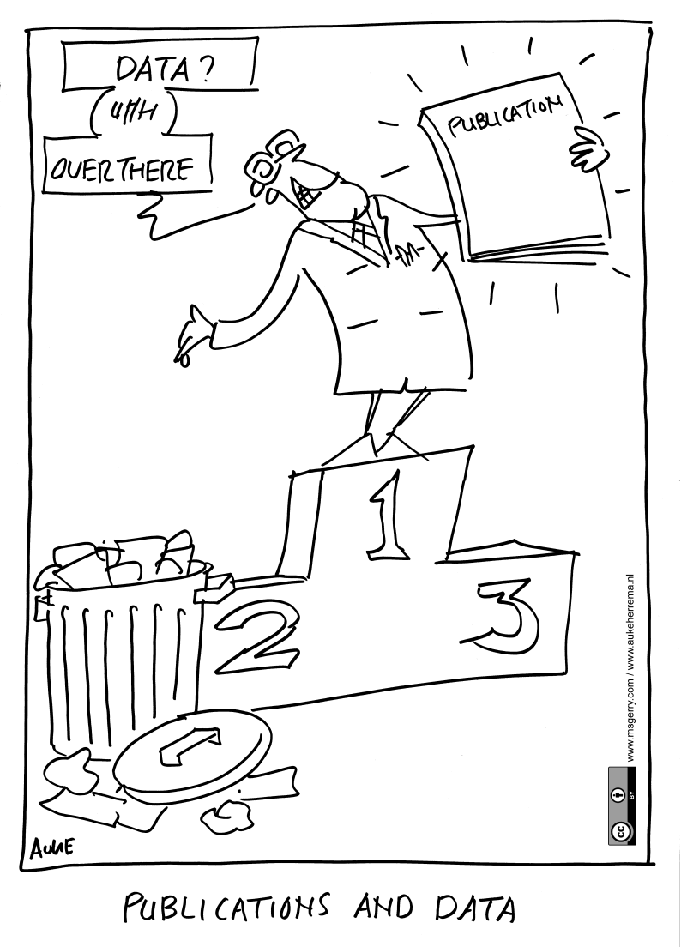
Don’t undervalue research data

Slide 5
Benefits of DMPs for institutions
Opportunity to engage with researchers and improve RDM practice
Raise awareness of support available
Collate information to inform service delivery
Ensure the University is not exposed to risk
Ability to recover costs via grants

Slide 6

What are the risks of not doing it?
Bids with technical ambitions that can’t be delivered on
Legal non-compliance DPA, FOI…etc.
Inability to scrutinise → damage to research integrity, reputation, retractions
Loss of data or (re)usability
Research outputs lack visibility
Public communication diminished
Potential loss of research income
Loss of reputation, research record, value and ££

Slide 7
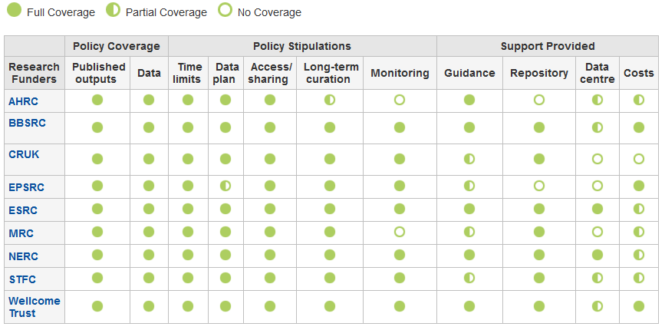
Which UK funders require a DMP?
n.b. Although the EPSRC doesn’t ask for a DMP in grant applications, it still expects one to be in place for every project
www.dcc.ac.uk/resources/policy-and-legal/overview-funders-data-policies

Slide 8










Some other funders that require DMPs or equivalent

Slide 9
What do research funders want?
Usually a brief plan submitted in grant applications, and in the case of NERC, a more detailed plan once funded
The Horizon 2020 pilot is different as DMPs are deliverables to be submitted during the project
1-4 sides of A4 as attachment or a section in application form
Typically a prose statement covering suggested themes
An outline of data management and sharing plans, justifying decisions and any limitations

Slide 10

Different stages of a DMP
Outline DMP
Basic, short plan
Answer a few questions
Written at grant application stage
Full DMP
Detailed plan
Define procedures
Written in conjunction with data centres
www.nerc.ac.uk/research/sites/data/dmp

Slide 11
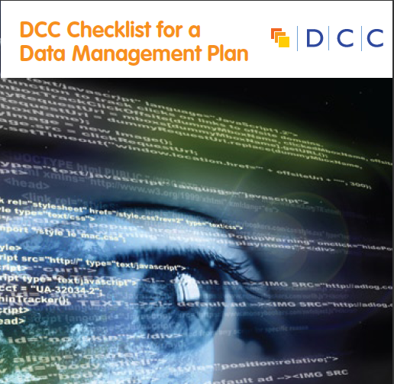
DCC Checklist for a DMP
The DCC assessed existing funder requirements, DMP templates and other best practice to see what should be included in plans. This was synthesised down into common themes and questions.
13 questions on what’s asked across the board
Prompts / pointers to help researchers get started
Guidance on how to answer
www.dcc.ac.uk/sites/default/files/documents/resource/DMP_Checklist_2013.pdf

Slide 12
Common themes in DMPs
  Description of data to be collected / created
  (i.e. content, type, format, volume...)
  Standards / methodologies for data collection & management
  Ethics and Intellectual Property
  (highlight any restrictions on data sharing e.g. embargoes, confidentiality)
  Plans for data sharing and access
  (i.e. how, when, to whom)
  Strategy for long-term preservation

Slide 13
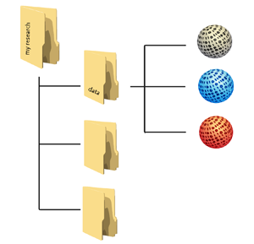

Planning trick 1: think backwards
What data organisation would a re-user like?
CREATING DATA
PROCESSING DATA
ANALYSING DATA
PRESERVING DATA
GIVING ACCESS TO DATA
RE-USING DATA
Notes:
Let’s adopt the perspective of a future data user – maybe yourself: what should your data organisation – folders with data, metadata and documentation – look like at the moment that you start sharing - outside your team - and archiving?
When you are part of a large project which has been going on for some years already, this may be obvious, but for many researchers it isn’t clear from the start.
To answer that broad question, you want to come up, at an early stage, with answers regarding:
Types and formats of data;
New and/or existing;
Expected size;
Metadata;
Documentation;
Software.

Slide 14
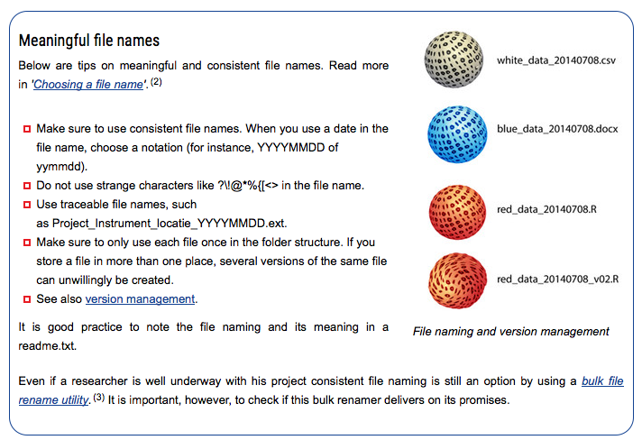
Data organisation
http://datasupport.researchdata.nl/en/start-de-cursus/iii-onderzoeksfase/organising-data

Slide 15
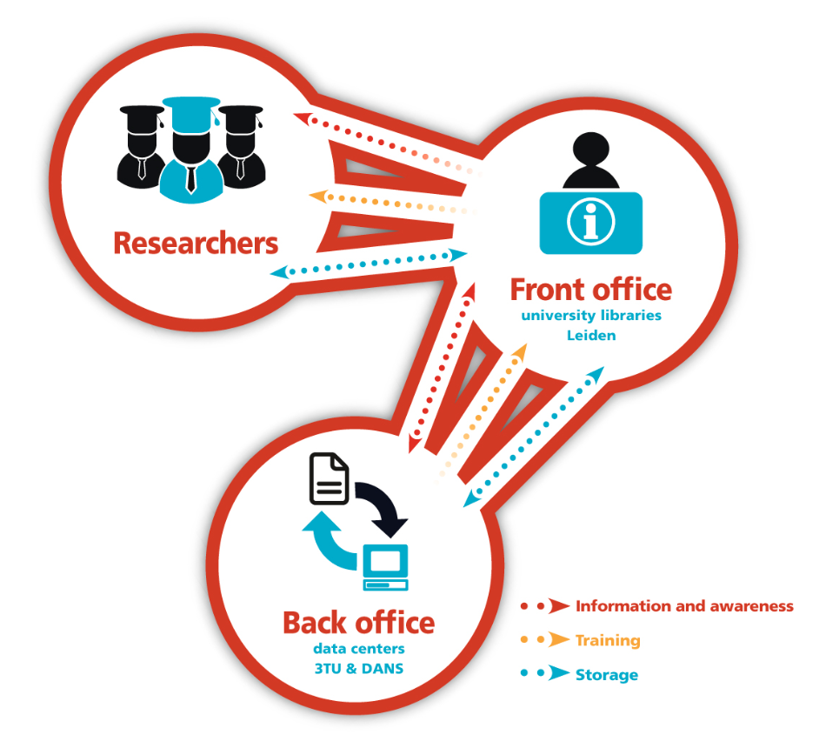



Planning trick 2: include RDM stakeholders
Commercial partners
Institution
RDM policy
Facilities
Publishers
Data Availability policy
€$£
Research funders
www.openaire.eu/briefpaper-rdm-infonoads
Notes:
It’s no fun to do the exercise by yourself, so use this as a communication opportunity.

Slide 16


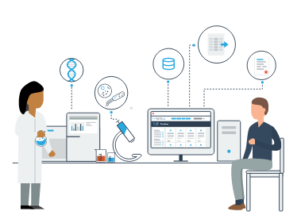

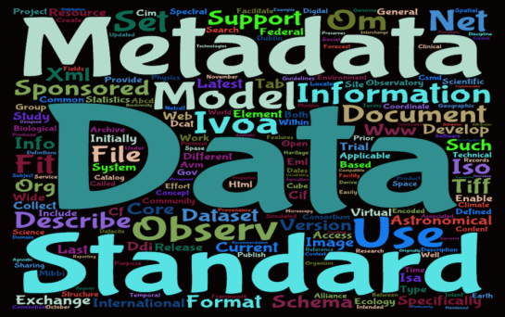
Planning trick 3: ground your plan in reality
Base plans on available skills, support and good practice for the field – show it’s feasible to implement

Slide 17
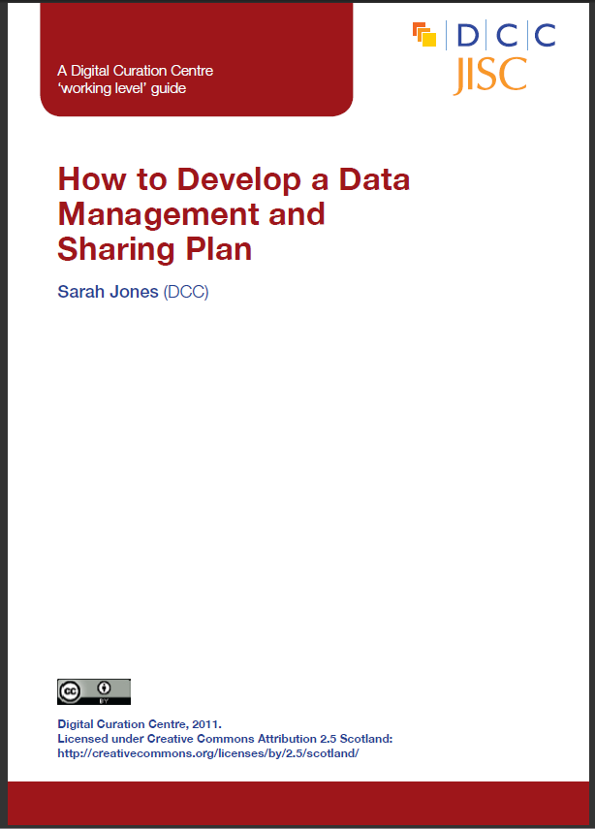

DCC support on DMPs
Webinars and training materials
How-to guides and other advisory documents
Checklist on what to cover in DMPs
Example DMPs
DMPonline
www.dcc.ac.uk/resources/data-management-plans

Slide 18
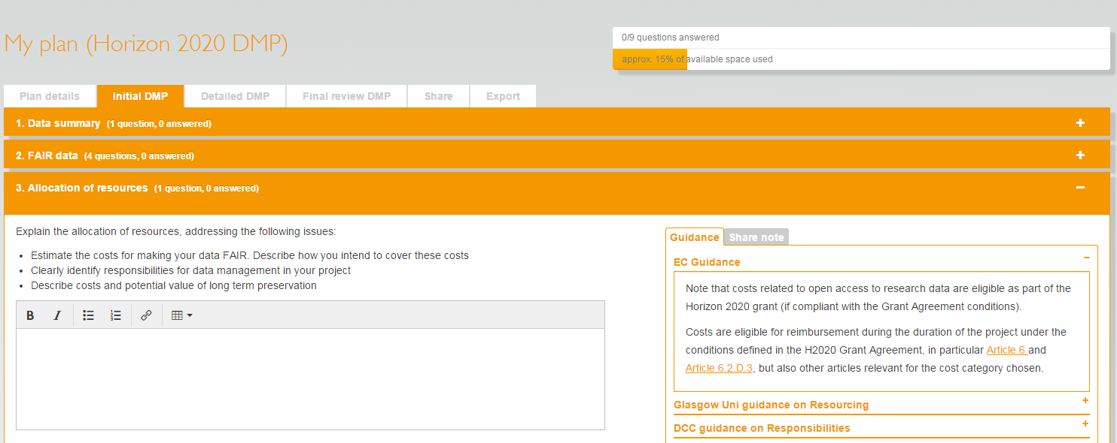
What is DMPonline?
A web-based tool to help researchers write
data management plans
https://dmponline.dcc.ac.uk

Slide 19
Main features in DMPonline
Templates for different requirements (funder or institution)
Tailored guidance (funder, institutional, discipline-specific etc)
Ability to provide examples and suggested answers
Supports multiple phases (e.g. pre- / during / post-project)
Granular read / write / share permissions
Customised exports to a variety of formats
Shibboleth authentication

Slide 20
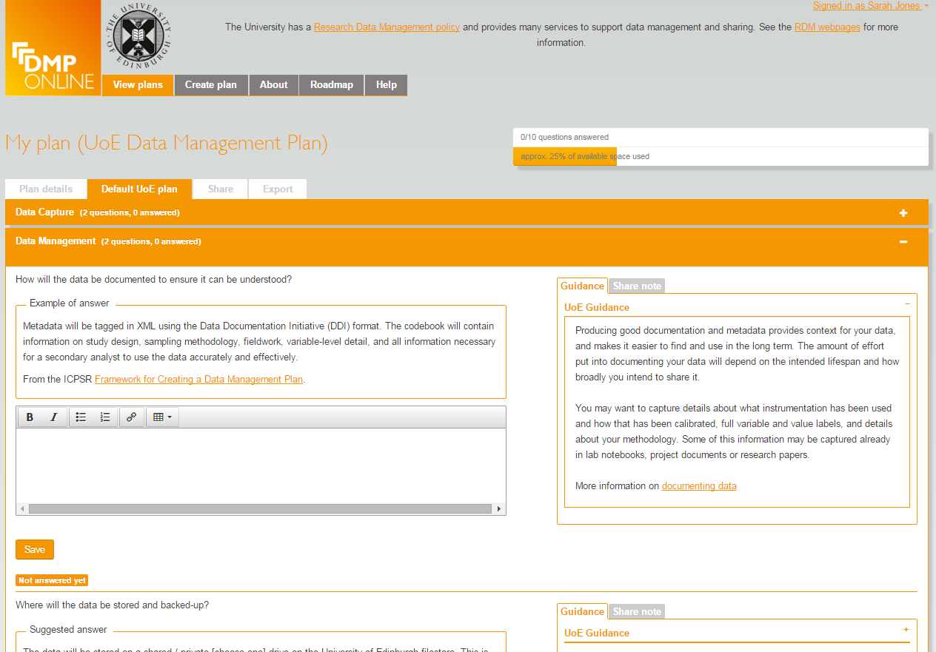
Options for unis to customise DMPonline
Organisations can:
Add their own template(s)
Customise existing funder templates
Provide example and suggested answers
Local guidance with links to support and services
Include their own logo and text in a banner
Review basic statistics
…

Slide 21
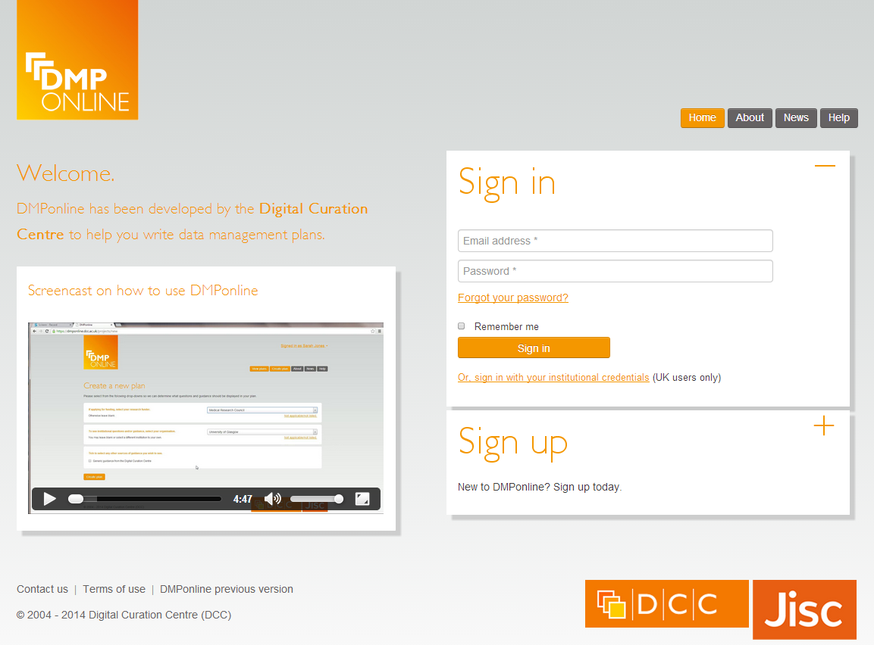
DMPonline demo
https://dmponline.dcc.ac.uk

Slide 22
Key messages
Data management is part of good practice whether you plan to make the data open or not
    it benefits you!
The process of planning is the most important aspect. Think about the desired end result and plan for this.
Approach DMPs in whatever way best fits your project. Don’t just let funder requirements drive things.

Slide 23

Thanks for listening
DCC resources on DMPs:
www.dcc.ac.uk/resources/data-management-plans
Follow us on twitter:
@DMPonline and #ukdcc

