Slide 1


Introduction to developing and implementing research data policies
Joy Davidson
Digital Curation Centre

Slide 2
Data Management Planning
Research Data Management Landscape
Data Management Planning

Slide 3

Funders’ mandates
“Publicly funded research data are a public good, produced in the public interest, which should be made openly available with as few restrictions as possible in a timely and responsible manner that does not harm intellectual property.”
RCUK Common Principles on Data Policy
http://www.rcuk.ac.uk/research/Pages/DataPolicy.aspx

Slide 4
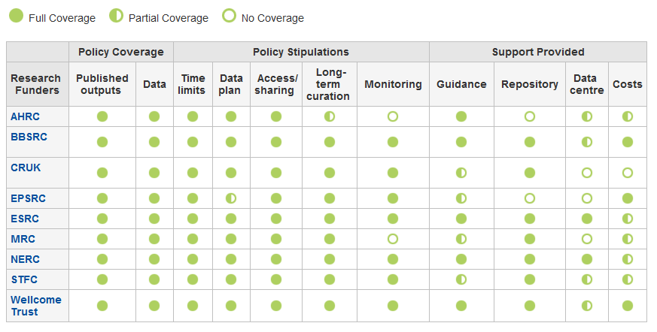
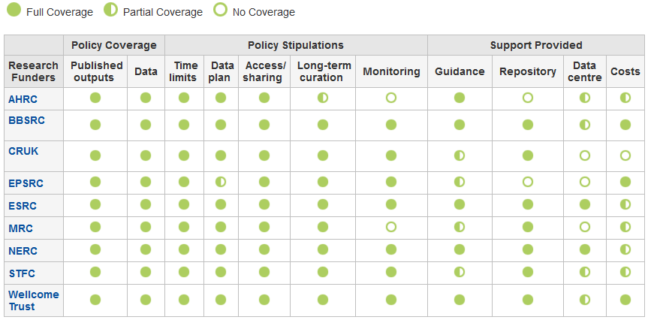
DCC Policy Table
www.dcc.ac.uk/resources/policy-and-legal/ overview-funders-data-policies

Slide 5

Ultimately funders expect:
timely release of data
  once patents are filed or on (acceptance for) publication
open data sharing
  minimal or no restrictions if possible
preservation of data
  typically 5-10+ years if of long-term value
See the RCUK Common Principles on Data Policy:
www.rcuk.ac.uk/research/Pages/DataPolicy.aspx

Slide 6

“Research organisations will ensure that effective data curation is provided throughout the full data lifecycle, with ‘data curation’ and ‘data lifecycle’ being as defined by the Digital Curation Centre. The full range of responsibilities associated with data curation over the data lifecycle will be clearly allocated...”
...institutional responsibility
www.epsrc.ac.uk/about/standards/researchdata/Pages/expectations.aspx

Slide 7

“Data sets are becoming the new instruments of science”
Dan Atkins, University of Michigan
Notes:
But also, data driven research becoming the norm in all disciplines. To be competitive in this new research landscape, researchers need access to good quality data and infrastructure. At the moment, worrying statistics on reproducibility. Good institutional policies can help to promote good research practice but also require support for implementation.

Slide 8

Digital data as the new special collections?
Sayeed Choudhury, Johns Hopkins
Notes:
Some HEIs are looking at research data as a new type of special collection. This illustrates that there is increasing recognition in the value of research data in its own right as part of the institutions legacy and history - not just publications.

Slide 9
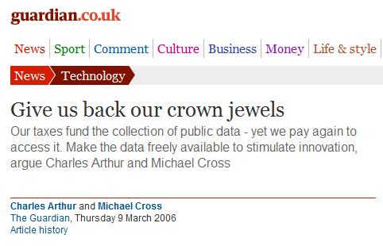

Research data: institutional crown jewels?
http://www.flickr.com/photos/lifes__too_short__to__drink__cheap__wine/4754234186/
Notes:
HEIs are wary of giving up the rights to these assets to publishers as we did with publications. E.g., we don’t want to have to pay twice to access our own research and the benefit from it. Polcies can help to avoid giving over rights to external entities.

Slide 10
Data Management Planning
Develop and Implementing a Research Data Policy
Data Management Planning
Notes:
So, a bit about the landscape, but what do you need to bear in mind when developing a research data policy?

Slide 11
Be clear on what activity is being covered in your policy
“the active management and appraisal of data
over the lifecycle of scholarly and scientific interest”
Data have importance as the evidential base
of scholarly conclusions
Curation is part of good research practice
Notes:
Firstly, any policy should be very clear about what they mean by terms such as research data management and curation.
The DCC definition implies adding value to data selected for retention. Adding value requires a commitment of time and resource.
Universities should be clear that RDM and curation are not just about storage. But also about support services. This must be reflected in any policies that are developed.

Slide 12
Research data can be anything – be clear on what research data means in your policy!
models and visualisations
databases
raw data (captured from instruments)
cleaned data (anonymised)
blogs, tweets
images
audio
Whatever researchers are producing!
Notes:
Institutions need to be prepared to deal with a wide range of data types. Anything that researchers are working with might potentially need to be retained.
Policies should be explicit about what research data are covered by the policy. Just for funded research activity? All research?
What about PhD students and thesis work?
At a minimum, institutions should ensure that research data required to validate published research findings are retained in line with funders’ mandates.
It is a good idea to work with disciplines to determine what level of data would be required – raw data, algorithms, visualisations?

Slide 13
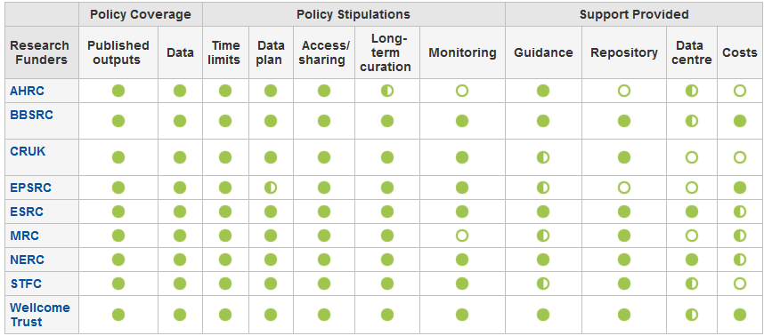
Funders’ data policies
http://www.dcc.ac.uk/resources/policy-and-legal/overview-funders-data-policies
Notes:
Be aware of funders’ policies when developing your own.
Most funders’ require data to be retained for 10+ years. In the case of EPSRC, they expect data to be kept for 10 years after it was last accessed so , institutions may need to retain data in perpetuity!
The DCC’s at-a-glance summary of funders’ data management and sharing policies is a good resource for anyone who needs to understand funders’ RDM and curation requirements.

Slide 14
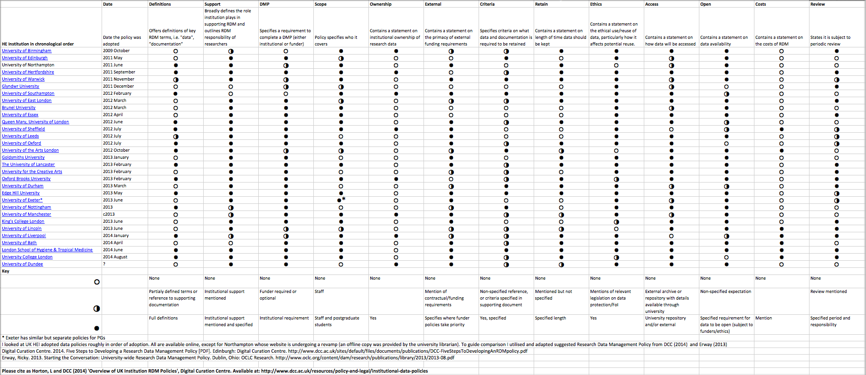
Overview of UK Institutional RDM Policies
http://www.dcc.ac.uk/resources/policy-and-legal/institutional-data-policies

Slide 15
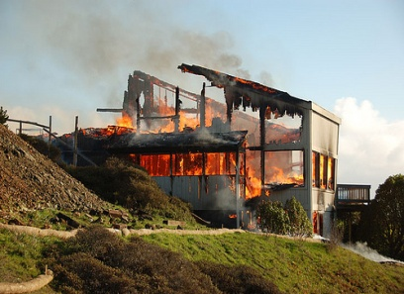

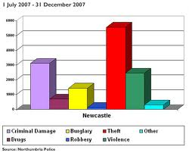
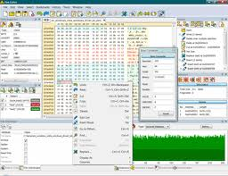
Not just sticks, there are carrots too!
Help prevent data
loss
Enable validation of results
More citations
9-30% increase shown in study
(Piwowar H. and Vision T.J 2013 , https://peerj.com/preprints/1.pdf)
Easier to do research…
Notes:
Policies are useful to help shape services and identify priorities within an institution, but they aren’t always the best way to motivate researchers.
So, in any activities you undertake to promote institutional RDM policy development, be sure to stress the potential benefits to researchers.

Slide 16
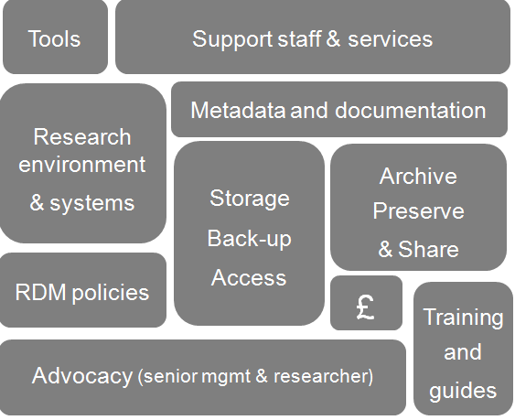
Components of a research data service
Notes:
The policy along is not enough!
Policies are just one part of a successful research data management service.
Various other components need to be addressed as well to ensure that researchers can – and want to – adhere to the policies. Sustaining the service through core funding will crucial.
Ensuring there is adequate support to ensure compliance to the policy is feasible and can be monitored will be vital.
To do this, senior management support – and more importantly funds – are crucial .

Slide 17





Examples of research data policies
“Statement of commitment”
→ Infrastructure → policy
legal compliance style
a section in uni DM policy
useful guide as appendix
“10 commandments”
mutual promises
aspirational
Based on Edin. with a few additions
Baseline of RCUK Code
+ procedures & support
www.dcc.ac.uk/resources/policy-and-legal/institutional-data-policies
Notes:
You don’t need to start from scratch. There are a lot of examples out there that you can reuse. Lots of different styles as well.
Top tip – draw upon institutional policies you already have in place (data protection/FoI, research conduct, etc.)
The University of Edinburgh’s policy is aspirational as they know there’s some way to go to make it a reality.
The University of Hertfordshire has RDM requirements as part of a wider data management policy. The language/style is more legal, however an appendix provides much more practical guidance on data management.
The University of Northampton reiterates the RCUK Code as its guiding principle and usefully provides guidance on procedures and support to explain how the policy should be implemented.
The DCC has been collecting examples of policies and there are links from the DCC website.
You’ll have a chance to consider the right style of policy for RTU later this morning.

Slide 18
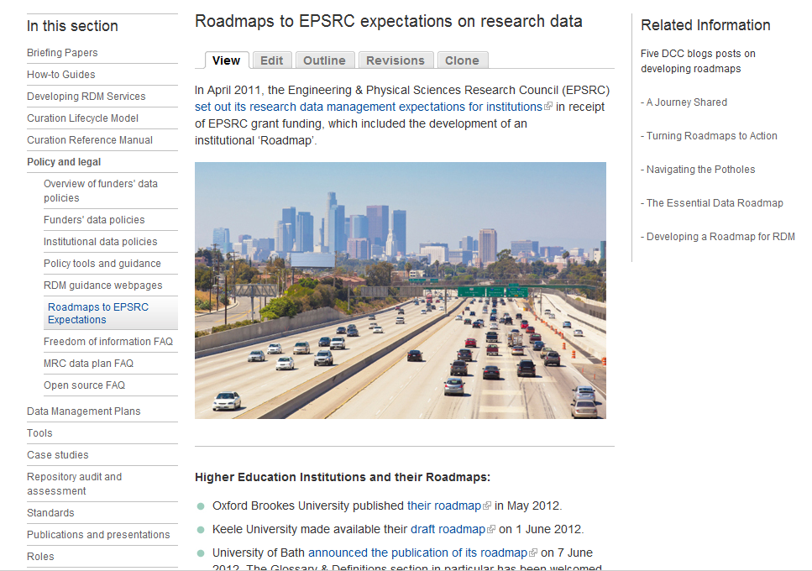
Institutional Roadmaps
http://www.dcc.ac.uk/resources/policy-and-legal/epsrc-institutional-roadmaps

Slide 19
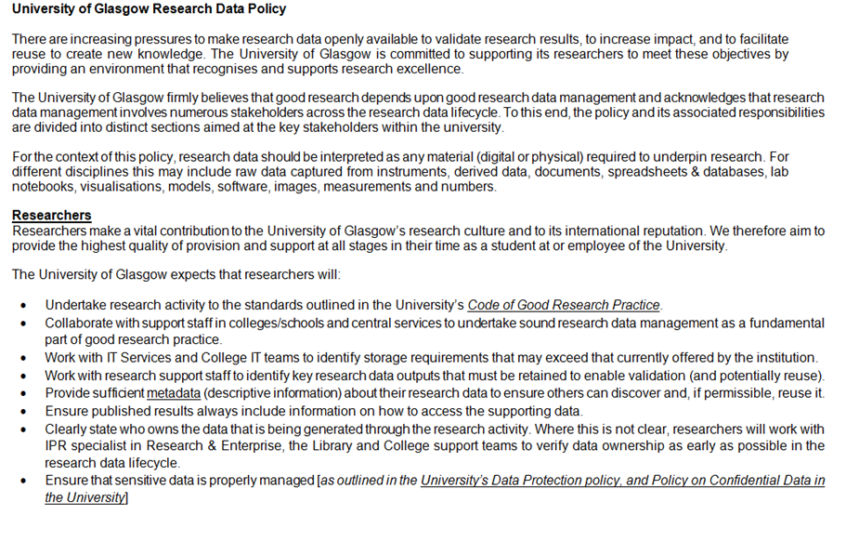
University of Glasgow Research Data Policy
http://www.gla.ac.uk/services/datamanagement/rdm-at-gu
Notes:
An example of what we are trying to do locally at the University of Glasgow.
Our policy breaks up the various expectations across the stakeholders and provides some views on University support commitment.
This shows the expectations for Researchers, College/School and Central support services.

Slide 20
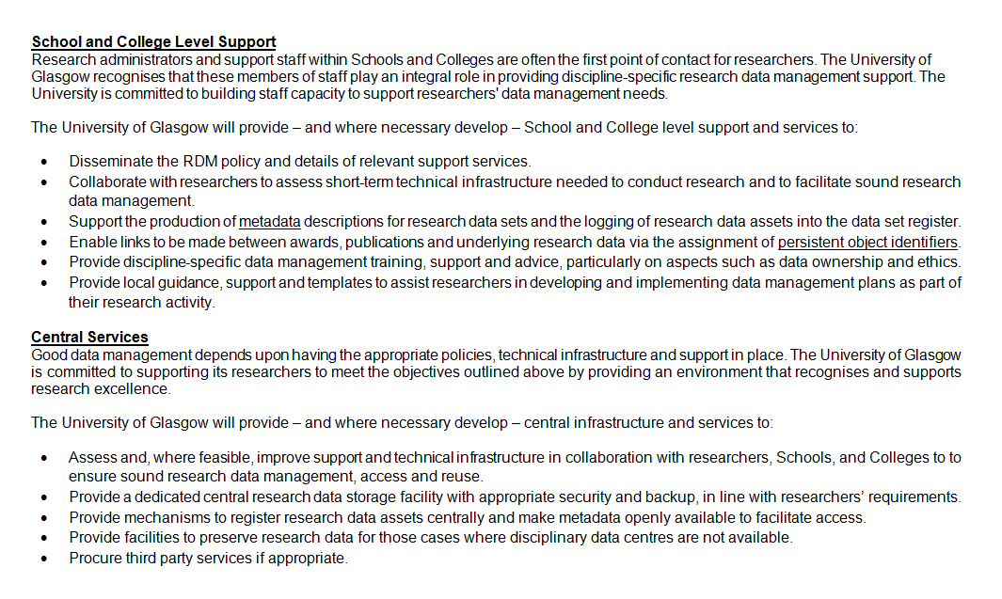
University of Glasgow Research Data Policy
Notes:
Top tip – it is a good idea to develop and refine the policy iteratively with consultation from stakeholders rather than having a very small group develop and ratify the policy and then roll it out.
The GU policy is draft and will be developed iteratively with the stakeholders to ensure we come up with something that most people can live - and hopefully - comply with.

Slide 21
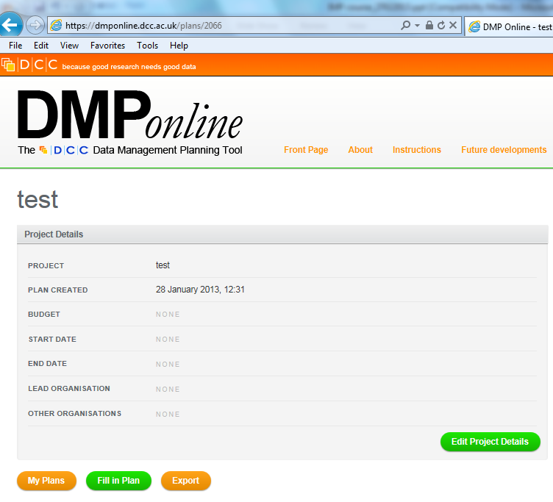
Data management planning
Notes:
How will data management plans fit in with your policy? All research, funded research?
Where will data management plans be kept? Grants team for pre-award, repository for post-award, PI for in-project?
The DCC has developed DMPonline which provides funder-specific templates for researchers completing data management plans at the grant stage.
A number of UK HEIs are developing institutional templates that include local policies and guidance. DCC are happy to work with institutions who wish to develop their own templates.

Slide 22



Active research stage – an ‘academic dropbox’
http://libraryblogs.is.ed.ac.uk/jiscdatavault/
Piloted at Lincoln & Edinburgh
http://tiny.cc/owncloud-pilot
www.dataflow.ox.ac.uk
Notes:
Policies should also consider aspects such as how researchers can work during the active phase of the research project.
Try to make it easy!
DataFlow at Oxford aims to make the transition of data between the university drives to longer-term storage a one click process.
Hertfordshire also provide a standard folder structure to researchers to use in new projects to help organise their data during the active phase.
Most researchers work using collaborative tools such as DropBox and Google Docs. Janet are offering some more secure cloud-based spaces to help researchers.

Slide 23
Selecting what to keep
Key questions:
What data must be kept? (for validation, etc)
What must not be kept? (e.g. personal data)
Is it worth keeping the data? – cost/benefits
Where will the data be kept?
Who pays?
Notes:
23
Key questions:
What data must be kept? (for validation, etc)
What must not be kept? (e.g. personal data)
Is it worth keeping the data? – cost/benefits
Where will the data be kept?
Who pays?

Slide 24
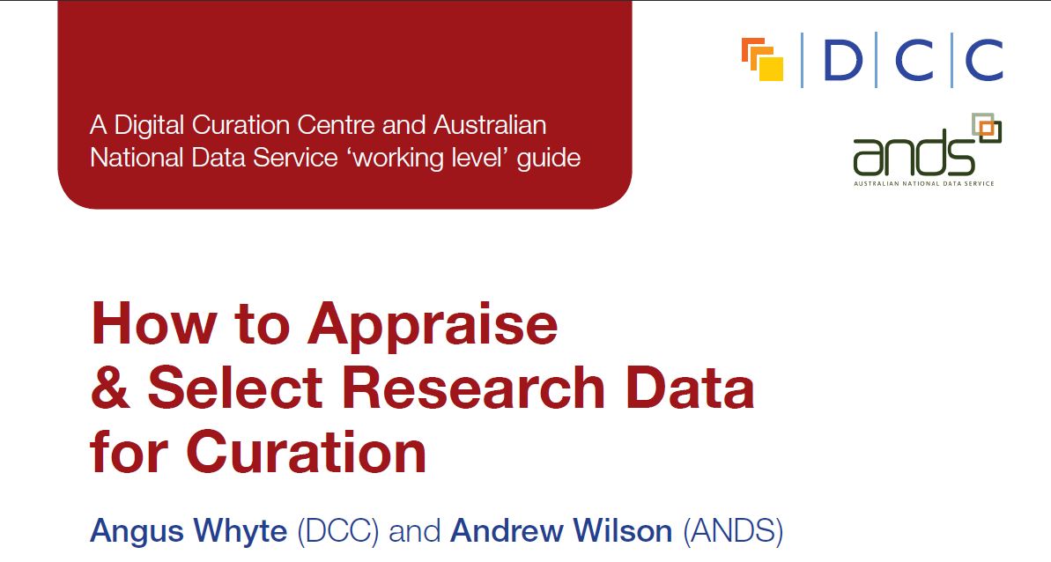
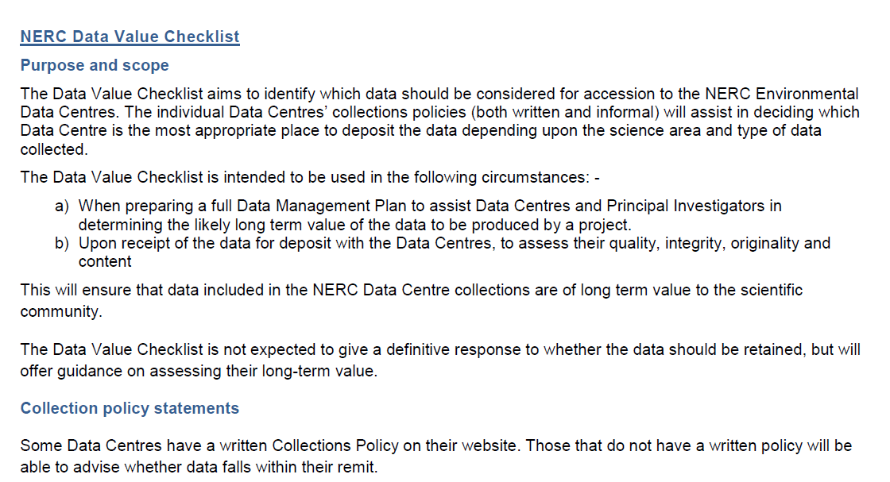
http://www.dcc.ac.uk/resources/how-guides
http://www.nerc.ac.uk/research/sites/data/documents/data-value-checklist.pdf
Notes:
Researchers and support staff might need guidance on what should be kept.
The NERC data value checklist is useful at the pre-award stage to identify any otuputs that may need to be retained. The checklist is also used to assess quality, integrity and originality of the data at the point of deposit into a data centre once the project has been completed.
Once the project has been completed, the DCC How-to select and appraise research data might be useful in identifying data that warrants longer-term retention and the associated investment .

Slide 25




Archiving – institutional data repositories
Not intended to replace national, subject or other established data collections
Acknowledge that we need to work in a hybrid environment
http://datashare.is.ed.ac.uk
Essex-RDR and
DataPool at Southampton
www.dspace.cam.ac.uk/
  https://databank.ora.ox.ac.uk
Notes:
Policies should include details on expectations regarding data cataloguing and deposit at the end of the project.
A number of UK HEIs are developing and testing data repositories and data catalogues to record data that is perhaps held outside the University (e.g., data centres).
A few institutions already run data repositories e.g. Edinburgh and Cambridge (both DSpace) . Others are piloting them e.g. Essex and Southampton (doing extensions to existing ePrints repositories as part of JISC MRD02 programme) and Databank at Oxford. Lincoln is piloting the use of CKAN.
Key thing is that none of these services intend to replace established data services. Where there are more appropriate disciplinary data centres, for example, the data should be submitted there.

Slide 26










Archiving – external data centres
  Structured databases
  Research funders’ data centres…
Registries of international
data centres
Disciplinary& community initiatives
Notes:
There are many external services – dedicated data centres supported by research funders and various structured databases and community initiatives.
Where funders have data centres, they generally expect data to be deposited at the end of the project. You don’t need to duplicate it locally. But, you will want to maintain a link between publications, grants and data.
Researchers may need support at the grant application stage to identify a possible home for their data if it will not be held within the instituion or by a funders’ data centre. Databib and Re3data can help you finds suitable repositories.

Slide 27
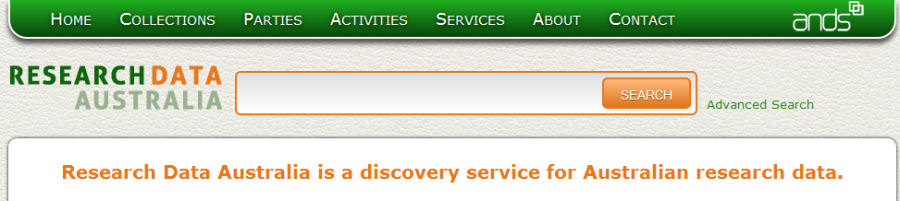
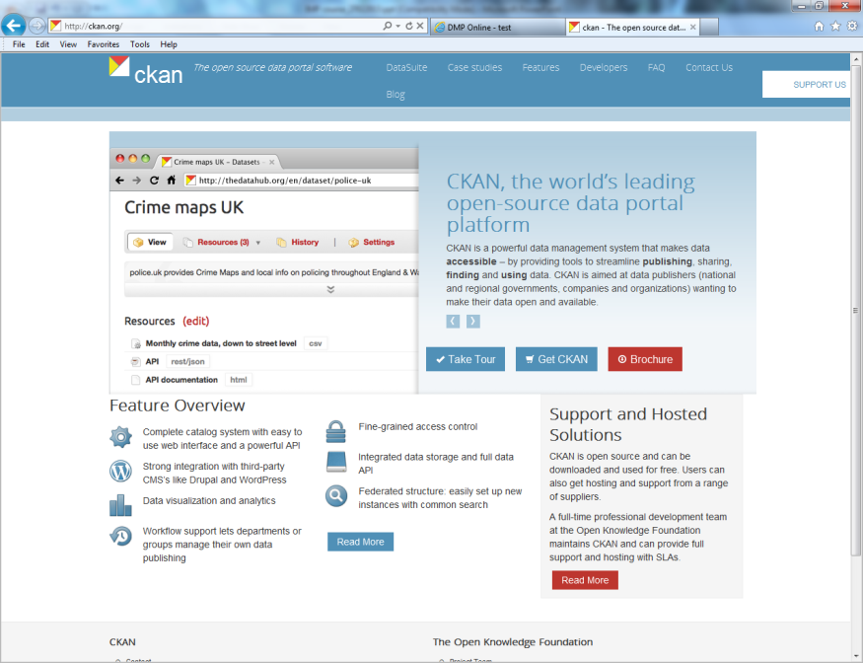
Data catalogues (finding data)
JISC & DCC planning
National coordination
Notes:
Many institutions are developing data catalogues to capture details of research data that has been generated through university research activity. These catalogues generally contain metadata about the data rather than the data itself.
A pertinent project to look at is C4D, which is developing an extension to the Cerif standard to record information on research data.
Jisc and DCC are developing a national research data registry which will harvest metadata from the institutional catalogues to make data more visible at the national level. We are using Research Data Australia – a discovery service for research data from Australian universities supported by ANDS – as the model for this pilot service.

Slide 28
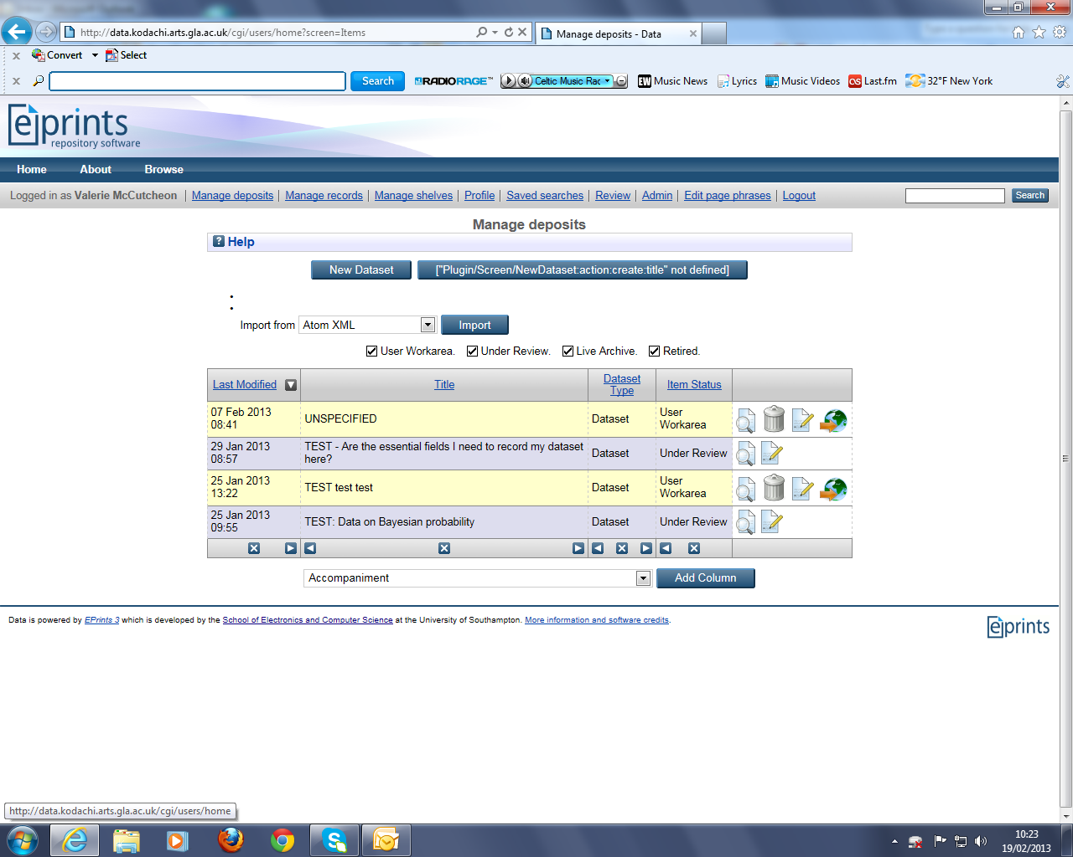
GU research data catalogue
Notes:
Example of the data registry being developed at Glasgow.

Slide 29
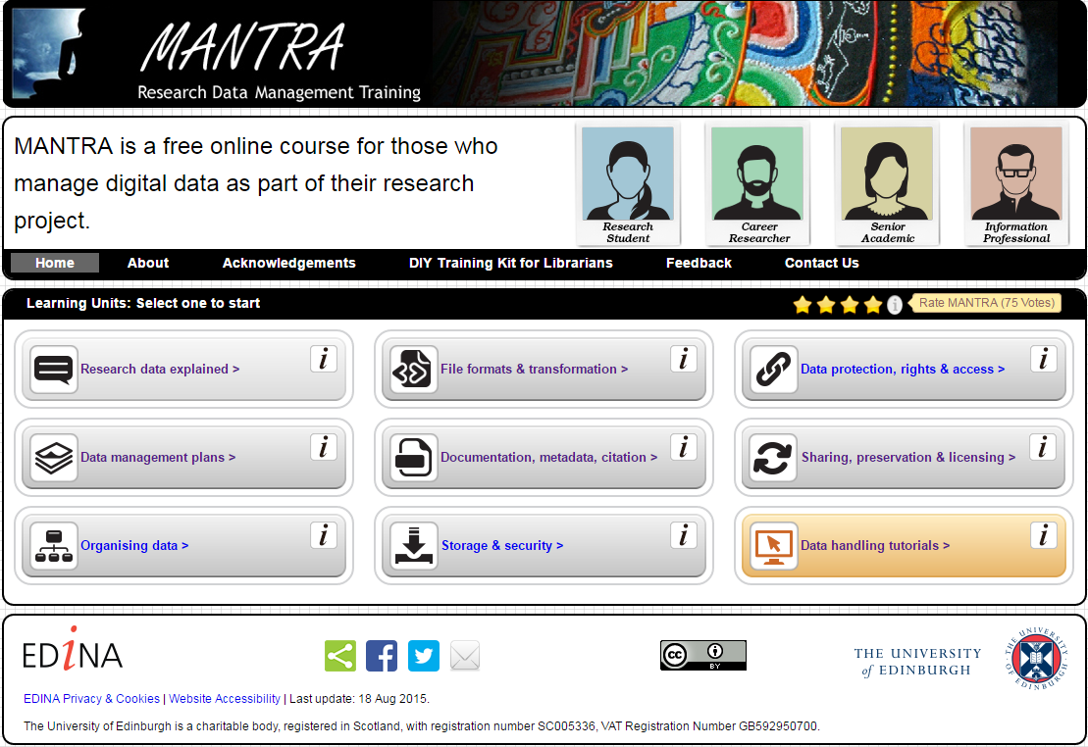
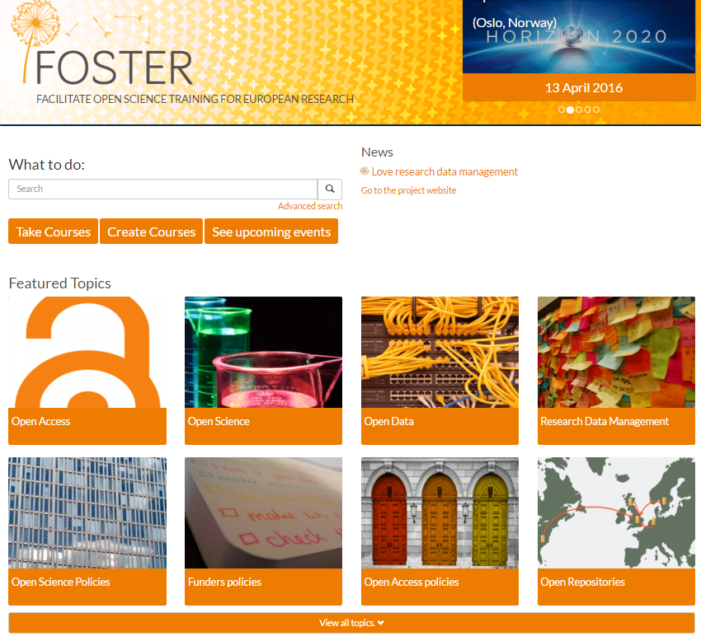
Guidance and training
http://datalib.edina.ac.uk/mantra/
https://www.fosteropenscience.eu/
Notes:
Remember to underpin your policy with guidance and training. The best systems and policies in the world are useless if researchers don’t know how and when to use them!
Make online training easily available – try to post support pages in places researchers can find them and pitch the guidance at the right level. At the University of Glasgow, the Incremental project pulled together details of existing support available. We included contact details so there were no dead ends.
In most cases, there will be a lot of existing guidance and support materials that can be adapted rather than creating new guidance from scratch. There are many examples of guidance and training – most are Creative Commons licensed so you can repurpose them.
New RDM Collection within Jorum.

Slide 30
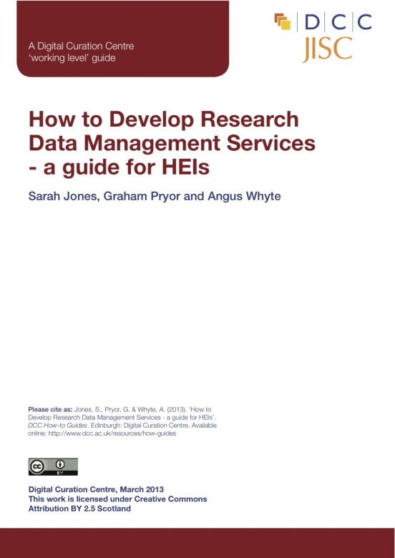
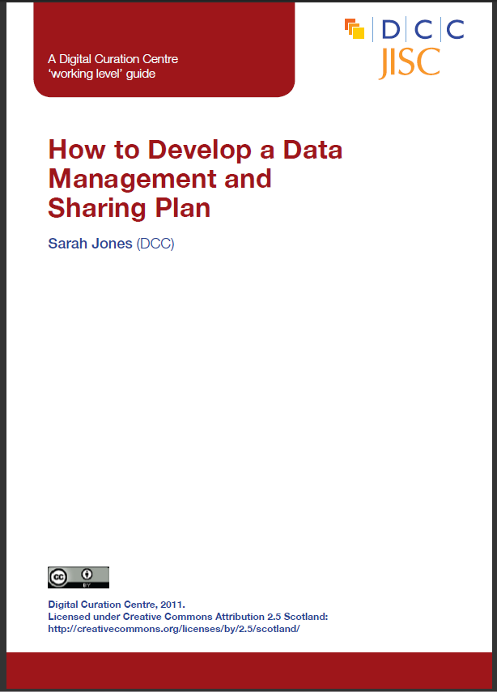

The DCC offers guidance, examples and tools to help with compliance
http://www.dcc.ac.uk/resources
Notes:
Hopefully you’ve got a better idea of what might need to be considered when developing and implementing RDM policies within your institution.
The Digital Curation Centre and the Jisc MRD projects have produced a lot of guidance and support materials and we encourage you to make use of these and to feed back any additional resources that may be needed.
On the training event webpages, you see links to lots of relevant DCC and external resources, tools and guidance.

Slide 31
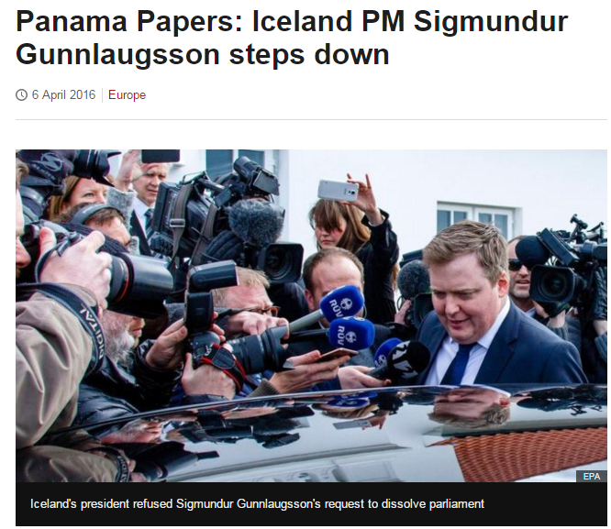

Things will change!
http://www.bbc.co.uk/news/world-europe-35966412
Image: http://webmaths.files.wordpress.com/2013/02/challenges.jpg
https://www.liberal.ca/
Notes:
Policies are not write once, leave forever!
Governments come and go, priorities change and the policies you develop will need to be reviewed and updated as things evolve. Policies should be specific enough to support requirements yet flexible enough to be adaptable as things change. Not always possible but best to avoid too much detail in policy that is unnecessary.
Was going to use Torry governemnt victory as an example, but this Canadian example is much more cheerful!
31

Slide 32

Thanks for listening!
joy.davidson@glasgow.ac.uk
www.dcc.ac.uk
Follow us on twitter:
@jd162a
@digitalcuration and #ukdcc

