Slide 1

Data Management Planning: an introduction
Joy Davidson
joy.davidson@glasgow.ac.uk
Notes:
This session will introduce participants from the research office to data management planning at the pre-award, in-award and post-award phases and consider some of the sign-posting and general advice that research office staff may need provide to researchers. We’ll explore what other support services in the university need to be joined up to assist researchers in completing a data management plans.
The session will illustrate the data management planning process using a generic institutional template in the DCC’s DMP Online tool. The tool allows researchers to complete, store and export data management plans.

Slide 2
Researchers view from the past . . .
Public Funder
Publisher
Funder
Researcher
Funding
Institution
Process and Compliance and the RCUK Policy: Funders’ Author Support Pages,
Bill Hubbard, Director, Centre for Research Communications, University of Nottingham
ARMA Workshop on Research Outputs and Data 4th March 2013
Notes:
A few years back, researchers had fewer pressures from their funding bodies and institutions. They needed to secure grants and publish a paper. Things have changed in the past few years.

Slide 3
Researchers view today...with publication
Public Funder
Publisher
with OA Option
Funder
Mandate
?
Open Access
Publisher
Researcher
Central/subject
Repository
Funding
?
Institutional
Repository
Mandate
Institutional
Database
Institution
Process and Compliance and the RCUK Policy: Funders’ Author Support Pages,
Bill Hubbard, Director, Centre for Research Communications, University of Nottingham
ARMA Workshop on Research Outputs and Data, 4th March 2013
Notes:
Lots of pressures on researchers now.
Plus, data management plans are now mandated by the majority of UK funders. On the horizon for EU as well.

Slide 4
Data management plans – what do funders want?
Notes:
One of the mandates researchers now have to comply with is the production of a data management plan at the grant application stage.

Slide 5
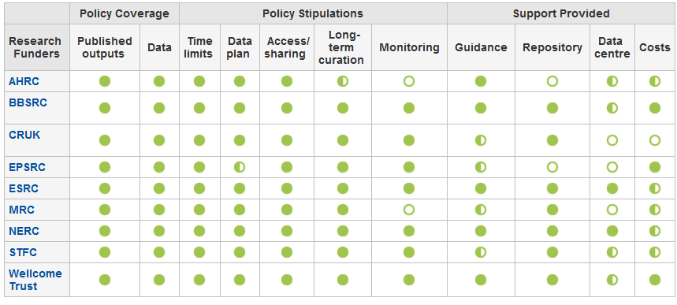
Which funders have DMP requirements?
http://www.dcc.ac.uk/resources/policy-and-legal/overview-funders-data-policies
Notes:
Researchers will need to determine whether their funder requires a data management plan at the grant application stage. As you can see, the majority of funders require researchers to submit a data management plan at the grant application stage.
EPSRC does not currently require a data management plan to be submitted with proposals. This is because EPSRC have issued nine clear expectations that they have for institutions in receipt of funding. These requirements are aimed at the HEI as a whole rather than individual researchers. Hypothetically, HEI compliance to these requirements would provide researchers with a working environment that would support support data management, sharing and longer-term preservation. HEIs are expected to progress towards compliance with EPSRC requirements by 2015. To see more about the requirements, go to http://www.epsrc.ac.uk/about/standards/researchdata/Pages/expectations.aspx.
The grants team may find this table that was developed by the Digital Curation Centre useful. It outlines the research data policies for a number of UK funders and details what is expected. If you click on any of the funders listed in the left hand column, you will see much more detail about their specific policies and requirements.
This grants team might consider pointing researchers to this table to help them determine what their funders expect.

Slide 6
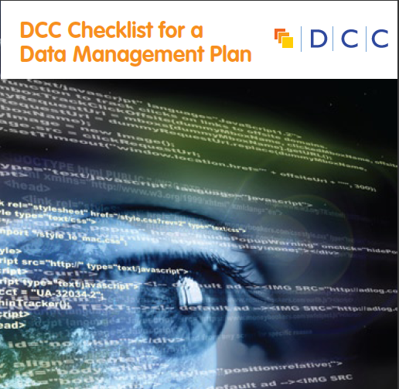
What do they want?
What data will be created (format, types, volume)
Standards and methodologies to be used (incl. metadata)
How ethics and Intellectual Property will be addressed
Plans for data sharing and access
Strategy for long-term preservation
Notes:
Essentially, most funders just want evidence at the grant stage that data has been considered – how much will be generated? What formats will be used? Where will it be stored? Can it be shared?
It is important to stress to researchers at the pre-award stage that funders aren’t expecting something carved in stone . Projects often change quite radically from what is submitted at the proposal stage and this is ok. Researchers just need to be able to provide evidence that they have thought about the data they might be generating and how it will be managed and shared.

Slide 7
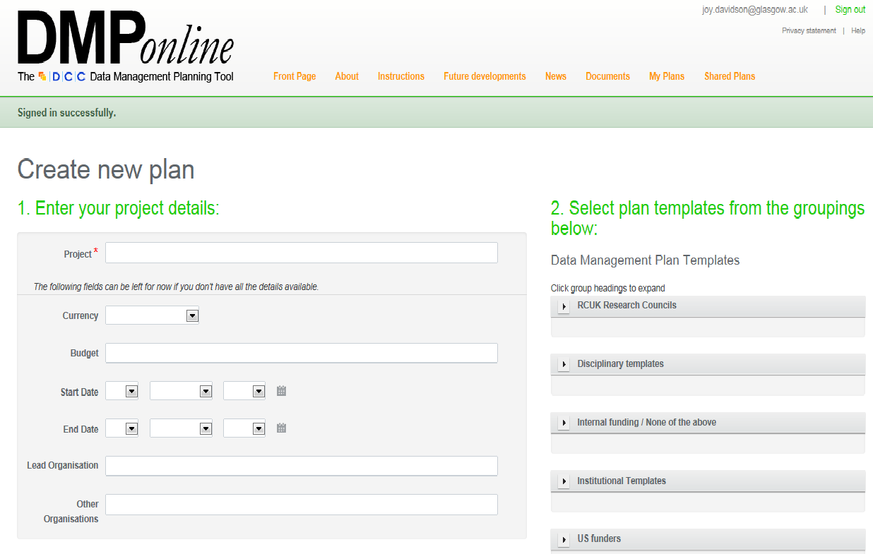
Researchers can select from funder templates, institutional templates, and discipline specific templates
Notes:
If researchers are required to produce a data management plan at the grant application stage, they can select a template in DMP Online that covers the specific questions the funder has relating to data management, sharing and access.
As many UK HEIs are moving towards compliance with EPSRC requirements, a number of universities are developing their own research data policies. Many HEIS policies require that a data management plan be produced for all new research being undertaken within the university. Some institutions’ polices include PhD students and unfunded research activity. Others are more geared towards funded research by academic staff. The DCC is collecting examples of explicit policies on research data and examples of existing policies amended to encompass research data. If you are looking to create your own policies, you are likely to find these examples useful.
http://www.dcc.ac.uk/resources/policy-and-legal/institutional-data-policies/uk-institutional-data-policies
DMP Online also allows universities to define and upload their own institutional templates so that any institutional policies and expectations can be clearly laid out.

Slide 8
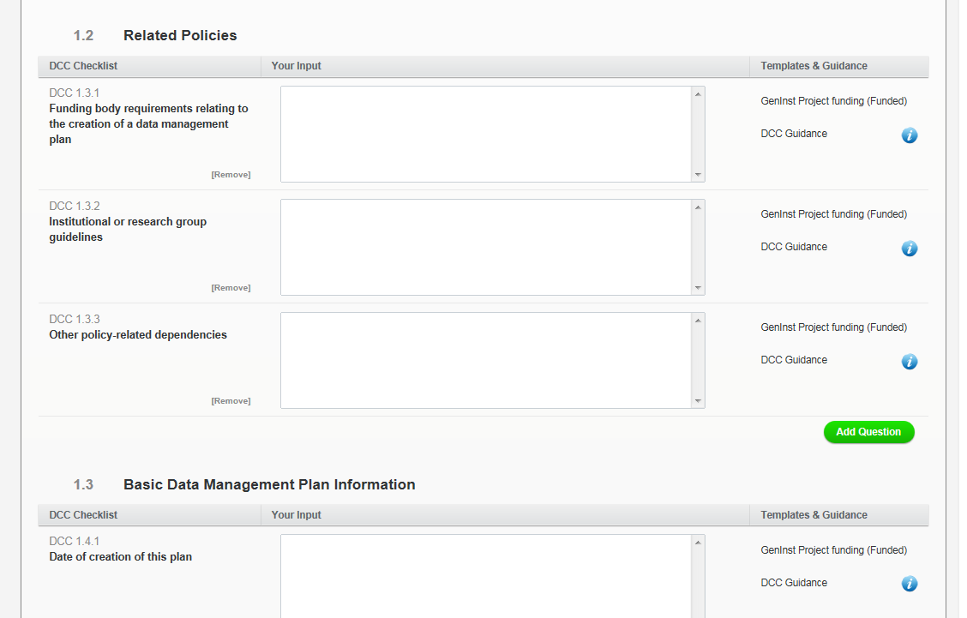
See DCC table for overview of funders’ requirements
These are sections that could draw upon boiler plate text developed by at the Research Group/School/College/Central levels
Notes:
Researchers need to be aware of what their funder expects at the grant application stage.
If there are institutional policies and practices that have to be followed, these should also be mentioned in this section. For example, if there is an institutional policy on research data management it could be cited in this section. Alternatively, there may be local working practices at the Research Group/School/College level that could be mentioned.
These might be provided as boiler-plate text to assist researchers to complete the data management plan.

Slide 9
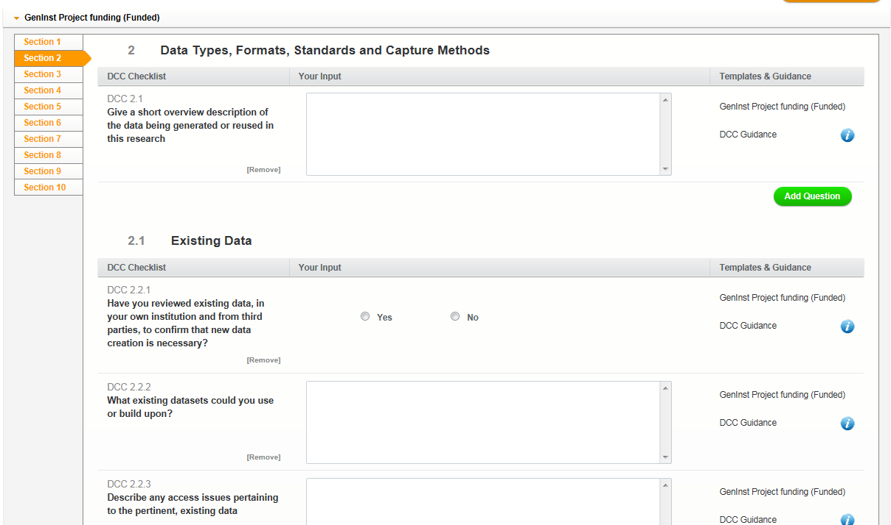
Researchers will need to complete this section
Data review - researchers may need input from Library and/or Repository staff here
Notes:
Researchers need to provide the details on what data might be captured, in what quantities, and what formats might be used. As noted previously, estimates at this stage are ok. Funders don’t expect everything to be carved in stone at the application stage and are merely looking for evidence that some consideration has been given to the nature and scale of the data that might be produced within the project and how this will be managed and shared.
Funders are keen to avoid funding new projects to reproduce data that has already been collected. At a minimum, it is a good idea for researchers to carry out a search of any data centres that are supported by the funder. For instance, researchers seeking ESRC funding should at least carry out a search of the data available in the UK Data Service. It might also be a good idea for researchers to consult subject librarians in their institutions for advice on other data sources to check.

Slide 10
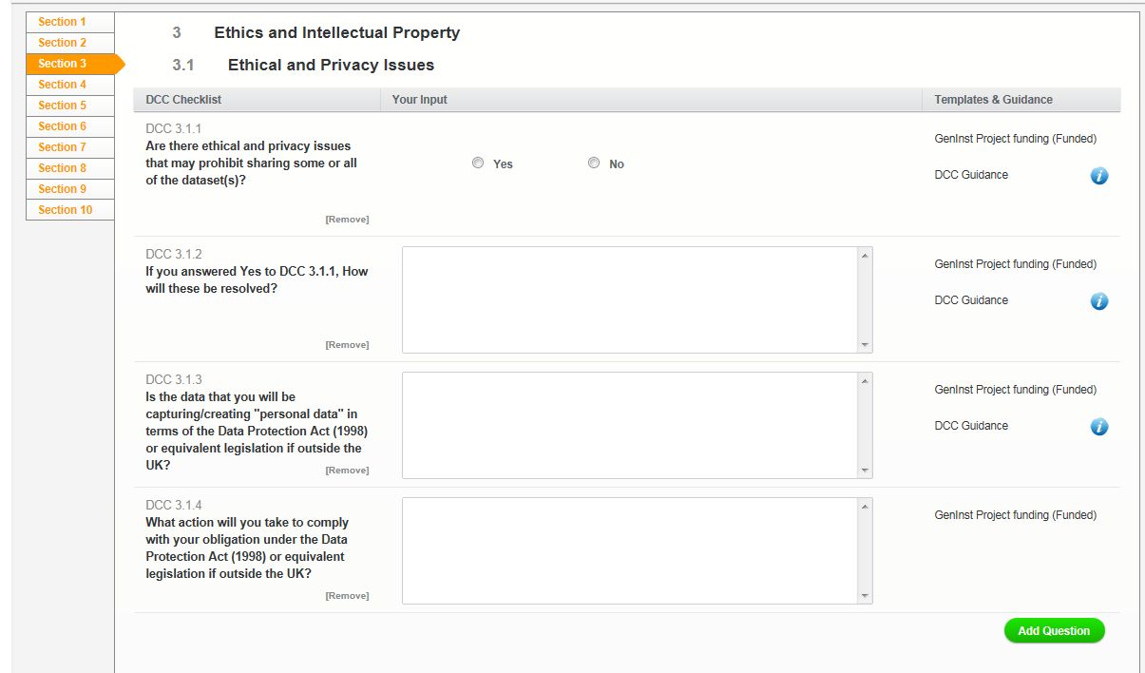
May need input from Ethics Committee or Data Protection Office here.
Notes:
If an ethics approval request is required prior to the grant application going in, it is important to note that much of the information provided could be reused within the data management plan. If ethics approval is carried out only once funding has been awarded, then similarly the information recorded in the pre-award data management plan might be reused. This will save the researcher from entering the information twice. If this information can be shared between research systems automatically that would be ideal. A CERIF-complaint version of DMP Online is being developed to help allow information to be shared between different research information systems.
It is crucial that researchers bear in mind any restrictions that are associated with consent forms used within the project and that the data management plans and pathway to impact statements do not contradict what is said in the consent form. For example, if the consent forms states that all data collected will be destroyed following the project, then this should be stated in the data management plan and pathway to impact statement. In many cases, different people may complete different parts of the grant application so ensuring that there is consistency between these three elements will be crucial. If working with sensitive personal data, it is a good idea to have someone from the ethics committee review the data management plan.

Slide 11
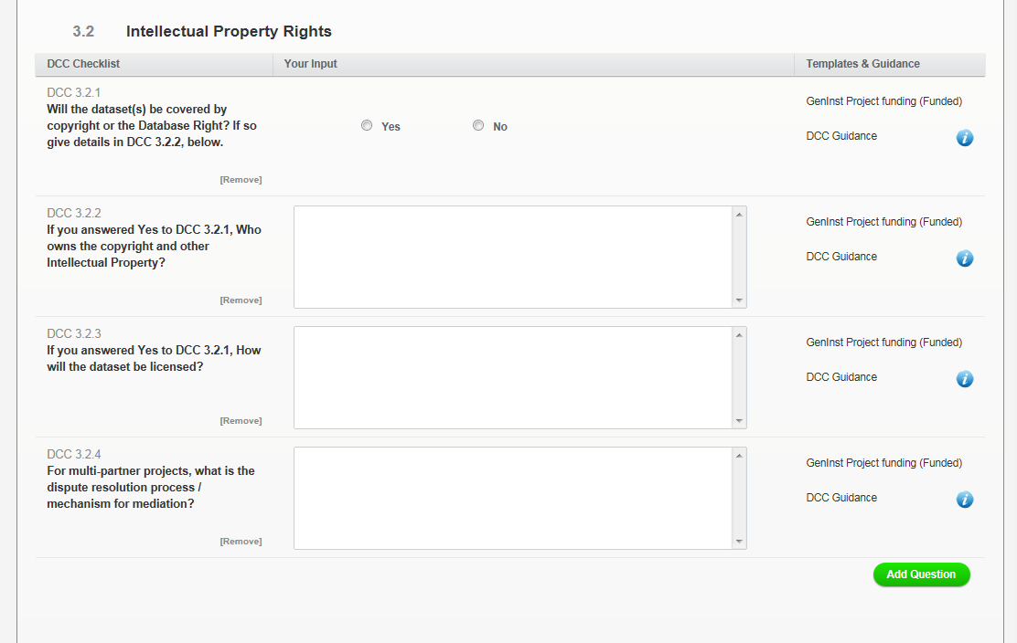
May need input from IP office or legal experts in the institution
Notes:
Funders recognize the need to protect sensitive personal data. Funders are also aware of the need to protect commercially sensitive data. It may be perfectly acceptable to state that access to the data will be not be possible. Funders are merely looking to have any restrictions on access to the data clearly explained in the data management plan.
For projects involving commercial partners, much of the information requested in the data management plan may be covered in industrial agreements that are drawn up either at the pre-award or in-award phases. Again, there may be potential to reuse the information provided in the data management plan for the industrial agreement and vice versa.

Slide 12
Most funders have expectations about sharing data and when data should be made available.
http://www.dcc.ac.uk/resources/policy-and-legal/overview-funders-data-policies
Notes:
Funders are quite clear about when the data resulting from the projects they fund should be made available. Most will allow an embargo period to allow researchers to benefit from first use. By clicking on the funder in the left column, you’ll see the details of when each funder expects data to be shared as well as any acceptable delays in sharing that will permitted to facilitate and embargo period.
Researchers should be explicit about any anticipated delays in data sharing at the grant application stage through their data management plan.

Slide 13
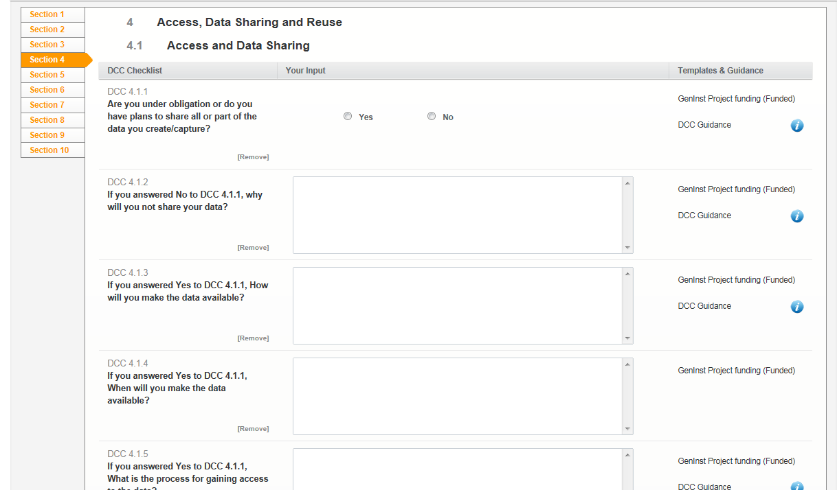
Check DCC policy table for funder requirements
Notes:
Researchers will need to complete the following sections. It will be important that researchers are aware of the expectations funders have on making the data available as well as adhering to any restrictions on making the data available as outlined in ethics approval procedures, consent forms etc.
If there are any requirements for making publications accessible in Open Access journals, this could be mentioned in this section as well. The RCUK Open Access policy was updated in July 2012 to specify that
‘As part of supporting the drive for openness and transparency in research, and to ensure that the researcher thinks about data access issues, the policy requires all research papers, if applicable, to include a statement on how any underlying research materials, such as data, samples or models, can be accessed. However, the policy does not require that the data must be made open. If there are considered to be good or compelling reasons to protect access to the data, for example commercial confidentiality or legitimate sensitivities around data derived from potentially identifiable human participants, these should be included in the statement.‘
http://www.rcuk.ac.uk/documents/documents/RCUKOpenAccessPolicyandRevisedguidance.pdf

Slide 14
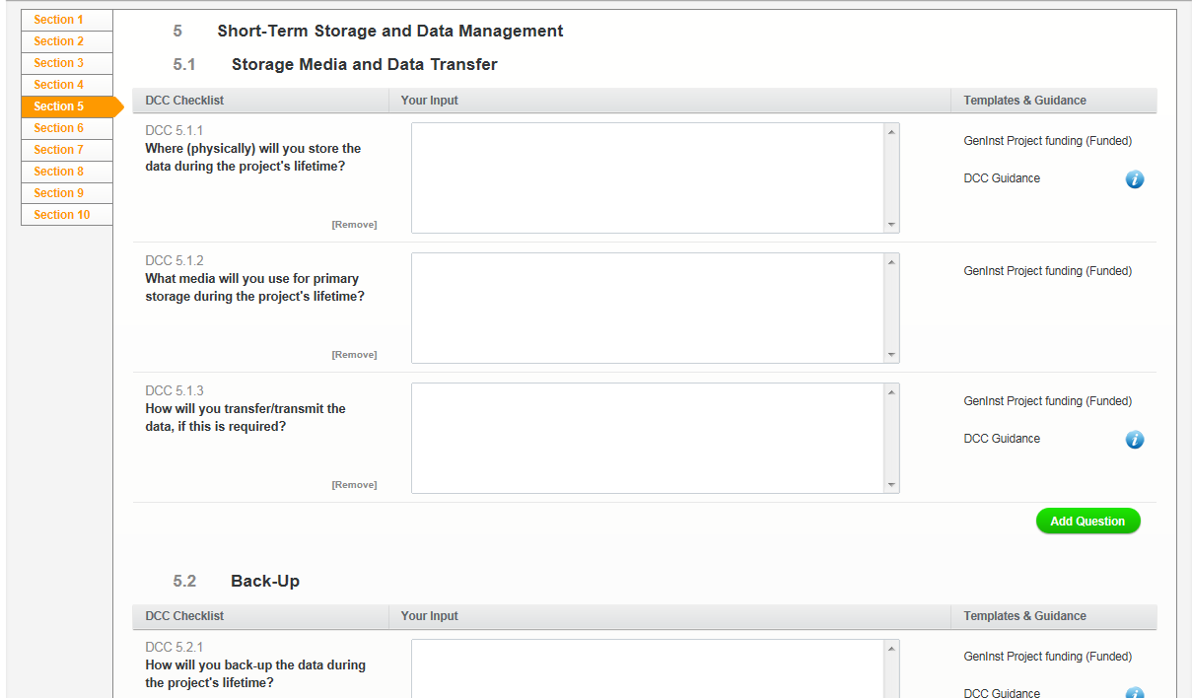
Researchers will need input from School/College/Central IT services for these sections.
Notes:
Researchers should contact local or central IT services for advice on short term and longer term storage requirements. It is important to get this started early enough to be able to identify any additional costs that may need to be factored into the grant application.
Researchers will need to think about how data will be backed-up if they plan to work outside the university system (i.e., remotely using laptops or personal devices).

Slide 15
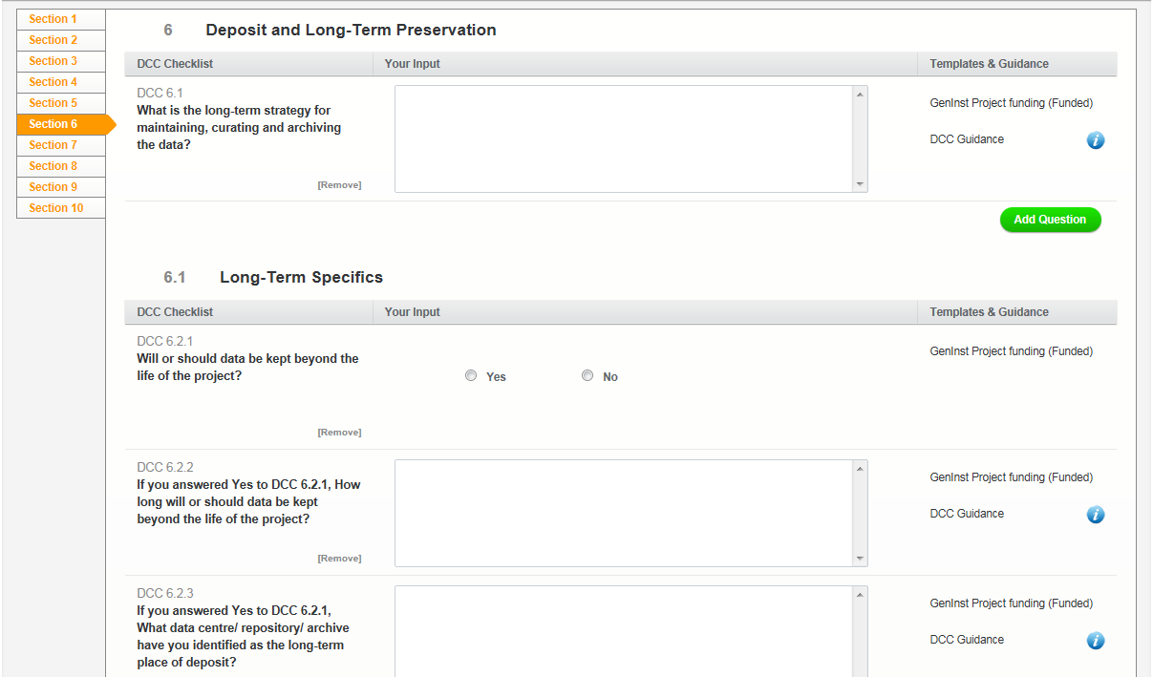
Researchers will need input from School/College/Central IT services for these sections.
Researchers must decide what to keep to validate research publications and findings or what might have longer term value
Check to see if there are external data centres that could be used
Notes:
Most funders are requiring that the data be retained for a period of about ten years after the project finishes. Researchers will need to be aware of this and ensure some means of facilitating this are in place at their institution.
However, it is not always the case that the data will need to be held at the university. Many funders support data centres and will expect that the data is deposited at the end of the project. In these cases, the researchers just need to be sure to register this with the university so that a link between the published output(s) and the underlying data are recorded to comply with the RCUK OA policy.
Selecting what data needs to be kept is something that only the researcher can do. Essentially, he/she will need to retain any data that underpins published findings to allow for validation of results. Additional data that is not required for validation purposes but is deemed to have longer-term value might also be worth keeping.

Slide 16
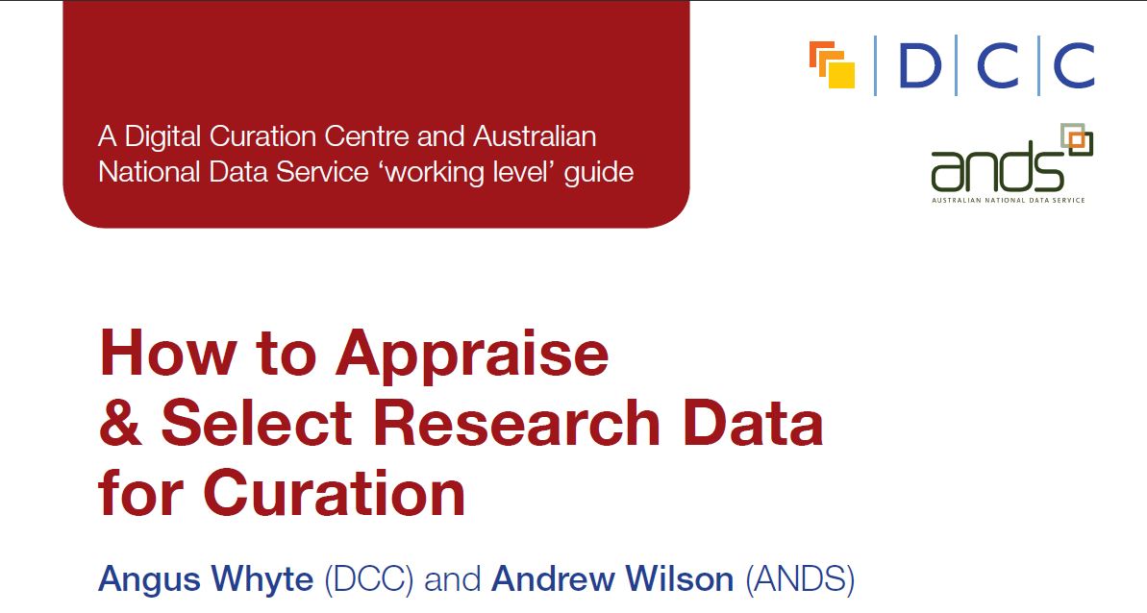
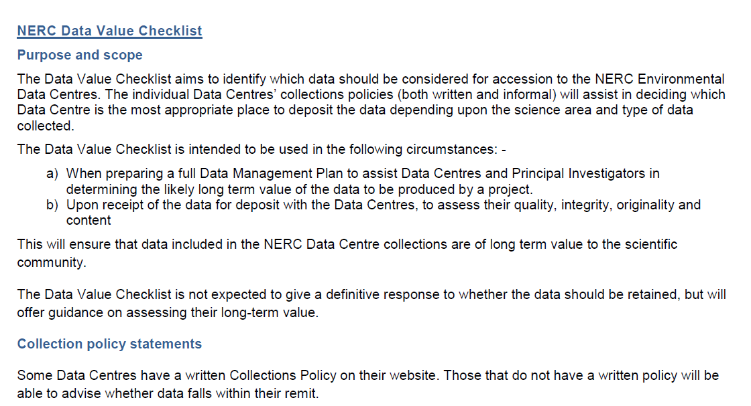
Guidance on selection and appraisal
http://www.dcc.ac.uk/resources/how-guides
http://www.nerc.ac.uk/research/sites/data/documents/data-value-checklist.pdf
Notes:
Researchers may find the NERC data value checklist useful at the pre-award stage. The checklist helps researchers to identify any potential outputs that may have longer term value and should be retained. The checklist is also used to assess quality, integrity and originality of the data at the point of deposit into a data centre once the project has been completed.
Once the project has been completed, the DCC How-to select and appraise research data might be useful in identifying data that warrants longer-term retention.

Slide 17
Funders may have data centres for deposit
http://www.dcc.ac.uk/resources/policy-and-legal/overview-funders-data-policies
Notes:
Research Office staff might want to point researchers to the DCC policy overview table to help them identify which funders mandate the deposit of data into a dedicated data centre. By clicking a funder in the left column, additional details about the data centres and their requirements for deposit will be provided.

Slide 18
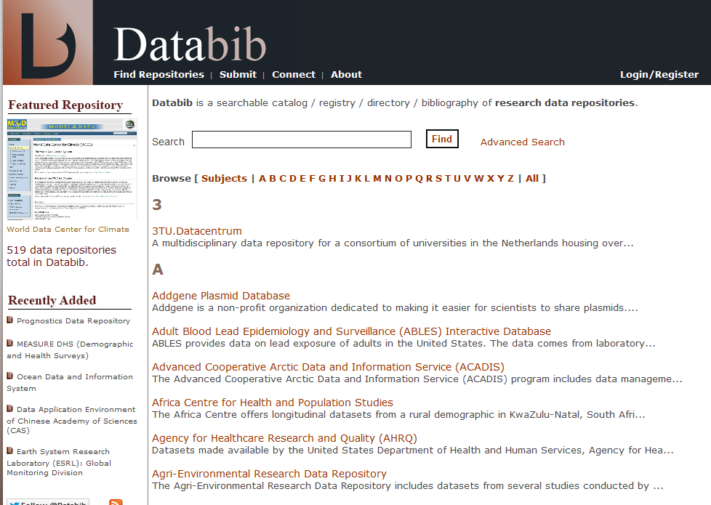
Look for other data centres that may accept data
http://databib.org/
Notes:
In the event that there is no dedicated data centre supported by the funder and the University is unable to accept the data at the end of the project, researchers may be able to find an alternative data centre in which to deposit their data. Databib provides a searchable list of data centres by name and by subject.

Slide 19
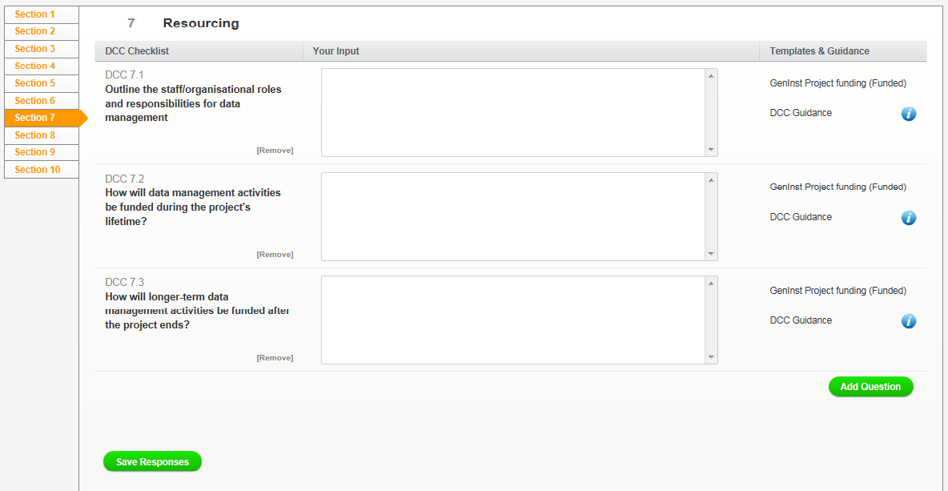
What will the University provide?
What additional costs need to be added in to the grant?
Notes:
Most funders will allow proposals to include a request for funding to cover some aspects of research data management and sharing. However, funders only cover in-project costs so the ongoing costs of maintaining access to data will need to be covered in other ways.
Researchers seeking additional funding for in-project activity and/or infrastructure will need to be explicit about what requested funds will cover.
It is helpful if infrastructure available to researchers (whether it is equipment, storage or support) can be identified at the Research Groups, School, College, and central levels. This will make it easier to identify what needs to be costed in over and above what is provided locally.
There are ongoing investigations into how research data management and sharing costs will be sustained over time and what costs are reasonably split between the funder and the institution.

Slide 20
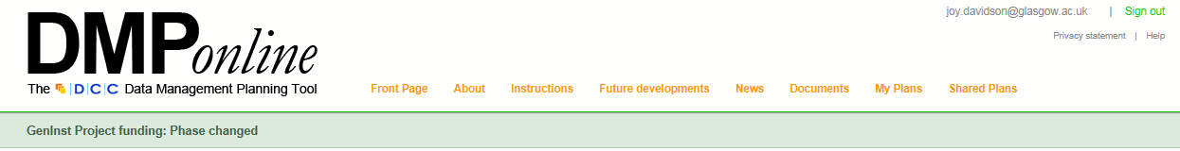
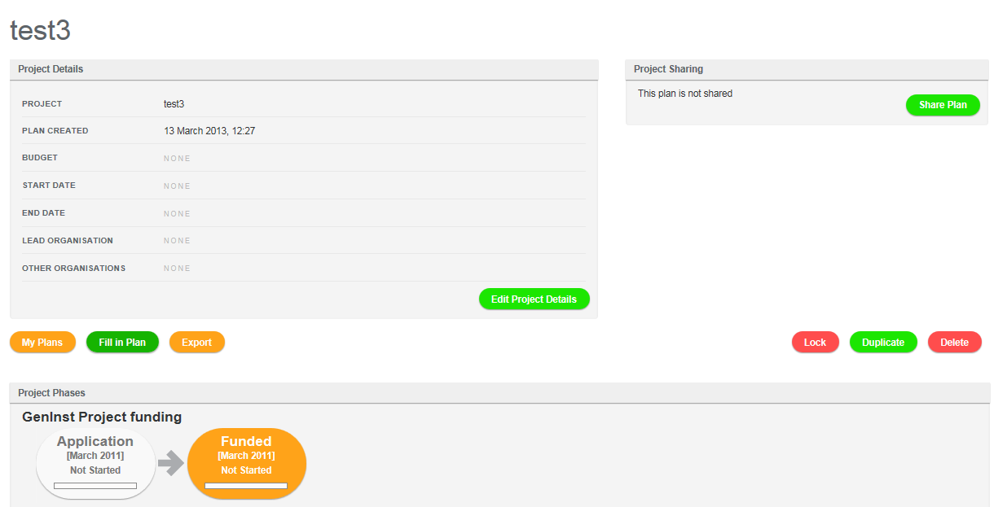
Once the project is funded
Update pre-award DMP with more detail
Include new grant identifier if necessary
Notes:
As noted earlier projects can change. Once funding has been secured an updated version of the data management plan should be produced. DMP Online allows the researcher to move from a pre-award version of the data management plan to an in-award version. This version should be updated as needed and is not meant to be a static document. Again, it is a good idea to record the grant identifier with all versions of the data management plan for consistency.
It can be helpful to have real examples of completed data management plans within the Research Group/School/College to help other researchers. It might be an idea to suggest that any institutional data management plan templates developed for use within your organisation include a tick box that allows researchers to state whether they are happy to make their data management plan visible to colleagues.

Slide 21
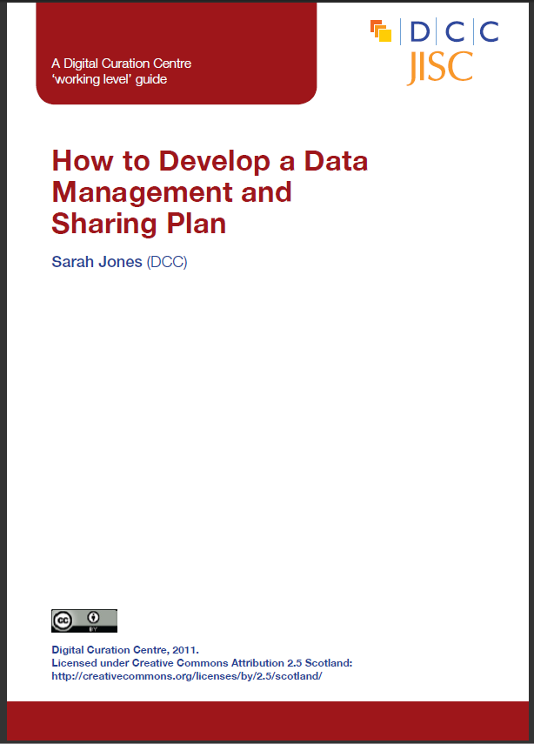

The DCC offers guidance, examples and tools to help with compliance
http://www.dcc.ac.uk/resources/data-management-plans
Notes:
Hopefully you’ve got a better idea of what a data management plan needs to include now and who might need to be involved in filling one in correctly.
Researchers need to know that the research office staff are not responsible for completing data management plans or for policing adherence to the plans during the in-award and post –award phases. This is the responsibility of the researchers on the project.
Research office staff might, however, need to make sure that researchers are aware of funders’ expectations and be able to point them to people who can help them to produce a realistically implementable plan.
The Digital Curation Centre has pulled together a lot of guidance and support and we encourage you to make use of these and to feed back any additional resources that may be needed.

Slide 22
Thanks!
Any questions?

