Slide 1


Customising DMPonline
Sarah Jones
sarah.jones@glasgow.ac.uk
Joy Davidson
Joy.davidson@glasgow.ac.uk
DCC curation webinars, 10th April 2014, www.dcc.ac.uk/training/webinars

Slide 2
Overview of options
Add your own template(s)
Add questions to other templates
Add custom guidance
Add dropdowns, examples, suggested answers...
Brand the tool (coming soon)

Slide 3
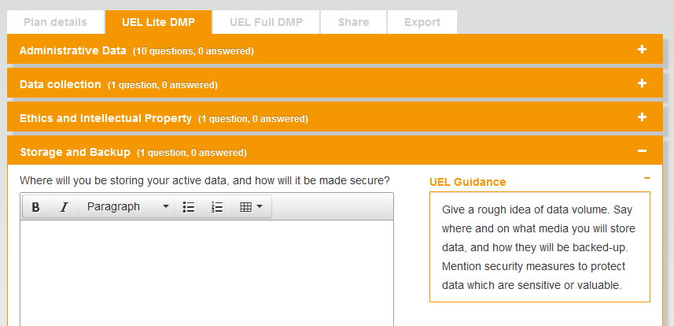
Unis can add their own DMP template

Slide 4
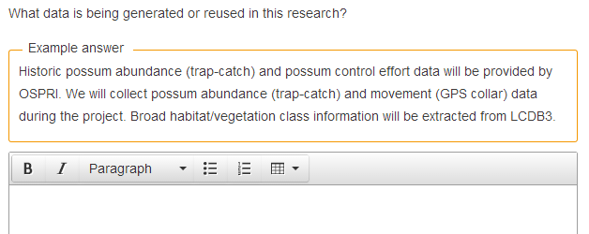
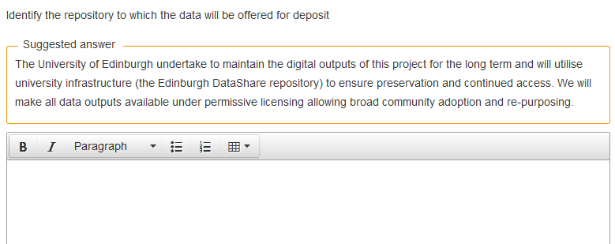
Provide examples and suggested answers

Slide 5
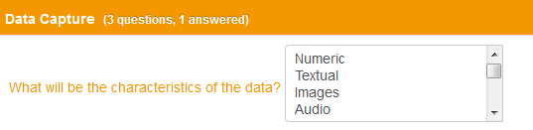
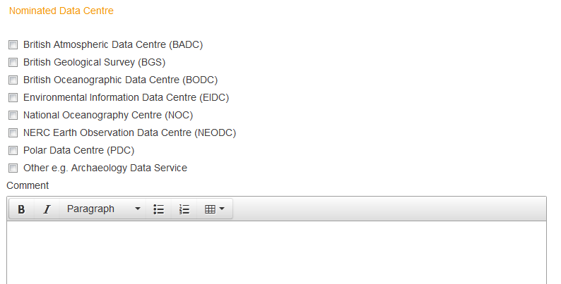
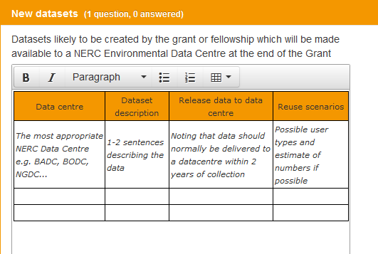
Dropdown options and default styles

Slide 6
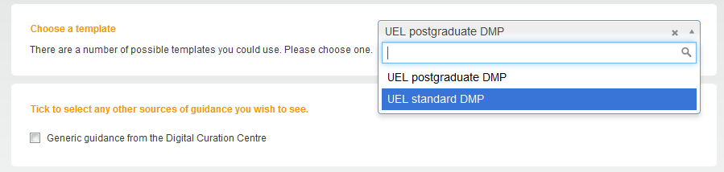
Unis can have more than one template
You may want to provide different templates for different audiences e.g. PhD students and research staff

Slide 7
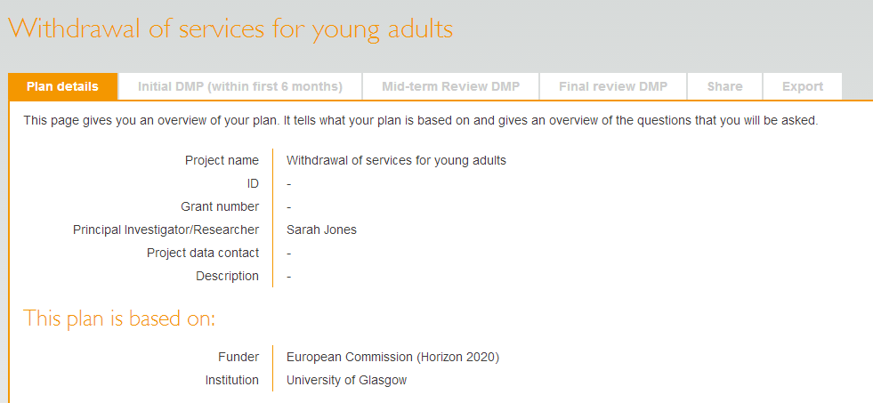
And templates can have multiple phases
Phases
This encourages researchers to actively update the Data Management Plan throughout the project

Slide 8
Adding questions to other templates
Things you need to know that funders don’t ask e.g.
  What volume of data will you create? Does it exceed X GB?
  Are there any training requirements?
  Would you like help with your DMP & details of support services?
We aim to build in flags/triggers so you can set alerts

Slide 9
Themes
Existing Data
Data Description
Data Format
Data Type
Data Volumes
Data Capture Methods
Documentation
Metadata
Data Quality
Ethical Issues
IPR Ownership and Licensing
Data Security
Storage and Backup
Expected Reuse
Discovery by Users
Method for Data Sharing
Timeframe for Data Sharing
Restrictions on Sharing
Managed Access Procedures
Data Selection
Period of Preservation
Preservation Plan
Data Repository
Responsibilities
Resourcing

Slide 10
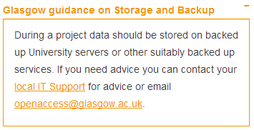
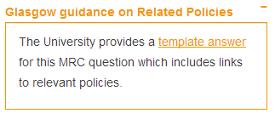
Organisational guidance
Guidance can be added by theme (to apply across the board) or can be written for specific questions
Themed guidance
Specific guidance
Guidance that pertains to MRC question 7 only
Guidance that is presented whenever researchers are asked about storage and backup

Slide 11
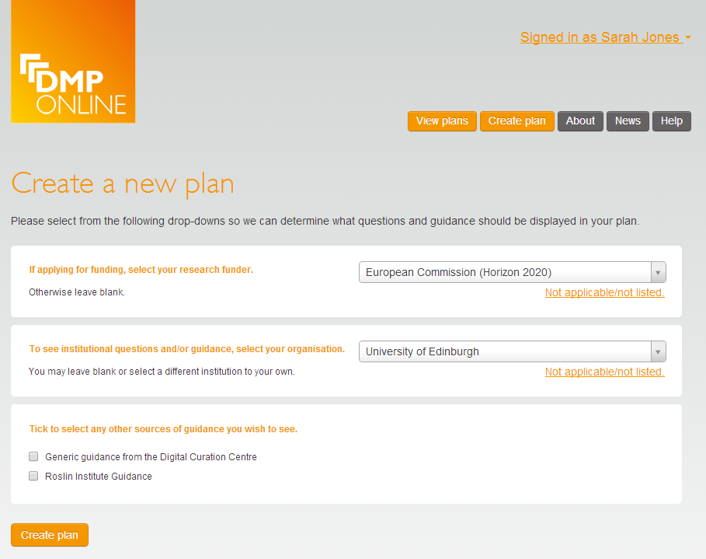
Guidance can be set at multiple levels
Options to have guidance at organisation and ‘unit’ level e.g. by discipline, group, department, institute…

Slide 12
Branding (coming soon)
Adding logos
High-level organisational summary
  Email address for RDM helpdesk
  Links to guidance webpages
  Details of uni policy
Custom URL e.g. dmponline.ed.ac.uk
Own stylesheet for uni colours / look & feel

Slide 13
And more is in development
Comment feature to discuss responses
Answer history
SWORD deposit
API
More export formats
Admin pages...

Slide 14
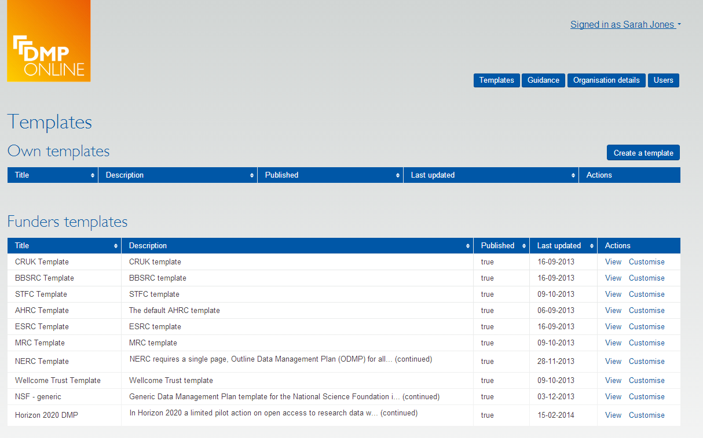

Admin interface
Allows you to add your own templates/guidance and view users

Slide 15
What to do next?
Define your requirements
Draft your institutional template
Review existing funder templates
Draft your guidance, examples and suggested answers
Provide the DCC with all the details
www.dcc.ac.uk/news/customising-dmponline
If you require DMPs

Slide 16
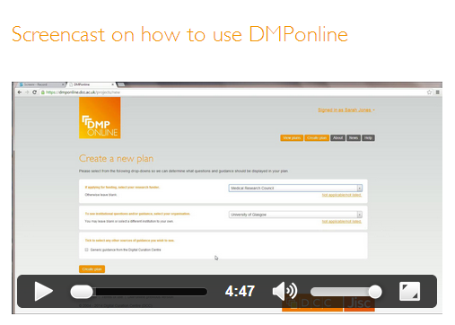
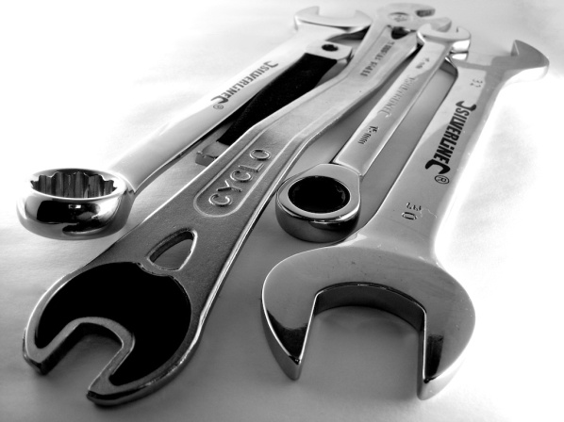

More information
Customising DMPonline
Blog post
www.dcc.ac.uk/news/ customising-dmponline
http://www.screenr.com/PJHN
Get the code, amend it, run a local instance, flag issues, request features... https://github.com/DigitalCurationCentre/DMPonline_v4

Slide 17
Ongoing cultural challenges
Need agreement on purpose of DMPs (validation, reuse, both)
Need agreed practices in storing versions of DMPs (where? who? for how long?)
Need agreement on sharing versions of DMPs (e.g., post award public facing DMP)
Need to wor towards integrating DMPs into institutional workflows (systems and process interoperabilty)
Agree mechanisms to review and reward DMP writing and implementation
Understand potential value of updating DMPs (e.g., with details of integrity, validation and reuse; how would this be captured?
Can DMPs provide better detail on costs and how these might be shared over lifecycle?

Slide 18
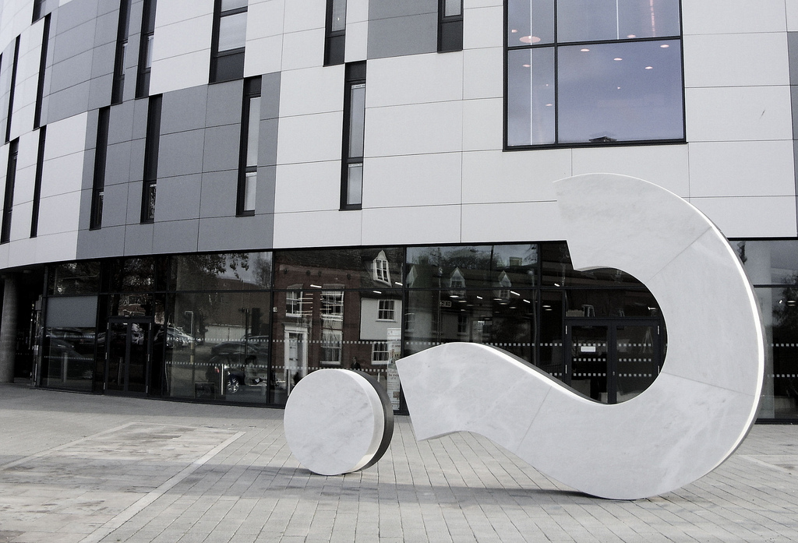

Q&A
Image credit: The original SimonB - www.flickr.com/photos/26565770@N02/6394748009

