Slide 1

DMPonline: basic demo
https://dmponline.dcc.ac.uk

Slide 2
What is DMPonline?
A web-based tool to help researchers write Data Management and Sharing Plans
Includes requirements and guidance from funders, universities and other groups
Developed by the Digital Curation Centre

Slide 3
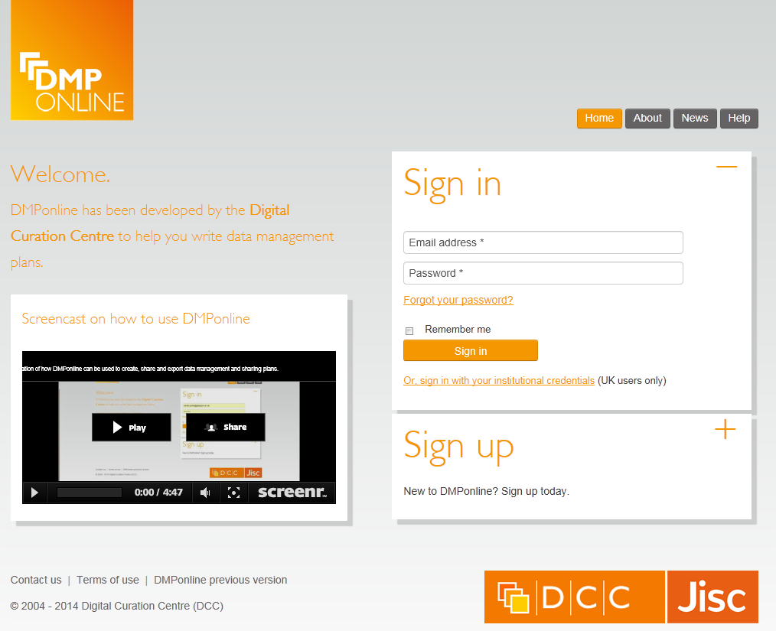
Sign up or sign in
Use your email and password to login
Or if you’re at a UK university, you can use your standard university login
Notes:
Writing a plan. Freely available tool that anyone can register to use.
Sign up with your email address, organisation and password.
Select ‘other organisation’ if yours is not listed.

Slide 4
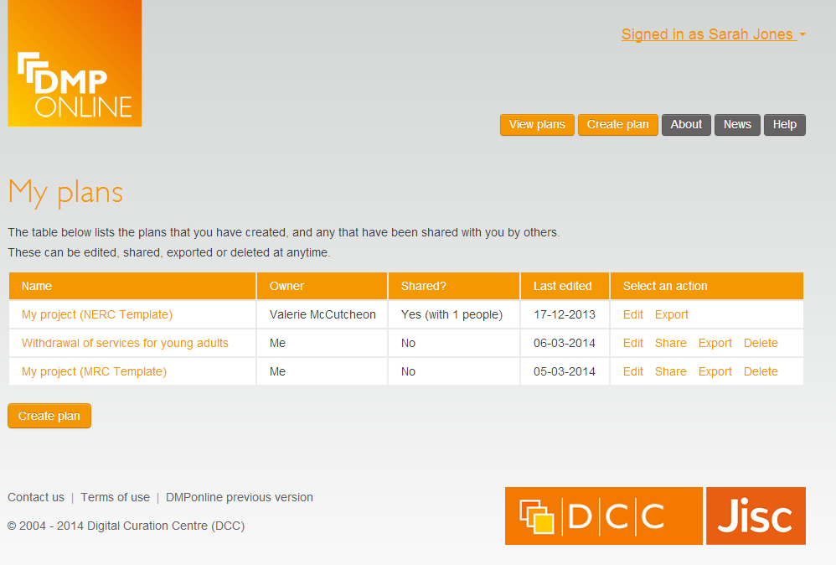
Returning users see ‘My plans’ page
Summary of the DMPs that you have created, or others have shared with you.
Note the varying permissions.
Notes:
You can start plans, save them and come back to them later. When you log in, you are taken to your ‘my plans’ page. Here, you’ll see all of the plans you’ve created. You’ll also see who owns the plan and if the plan has been shared.

Slide 5
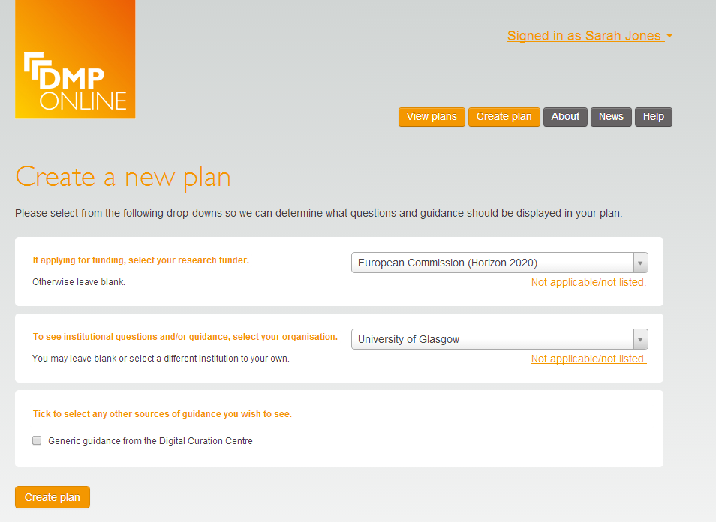
Creating a new plan
Select funder (if any)
Select organisation for additional questions and guidance
Select other sources of guidance
Notes:
If researchers are required to produce a data management plan at the grant application stage, they can select a template in DMP Online that covers the specific questions the funder has relating to data management, sharing and access.

Slide 6
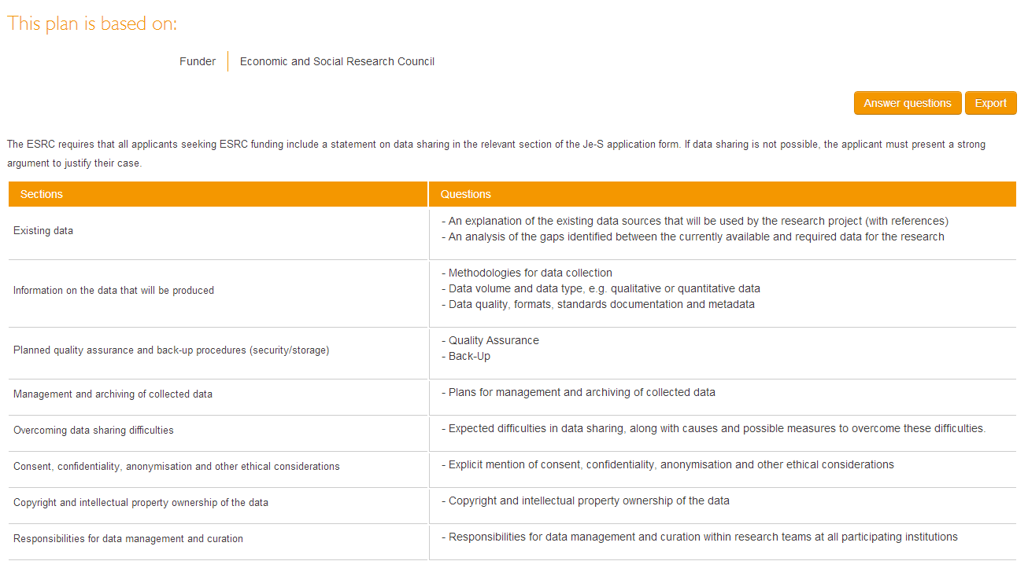
Plan details: summary
Summary of the sections and questions in your DMP
Notes:
Researchers can see a list of all the sections and questions they’ll have to answer for the funder they select. In this case, ESRC.

Slide 7
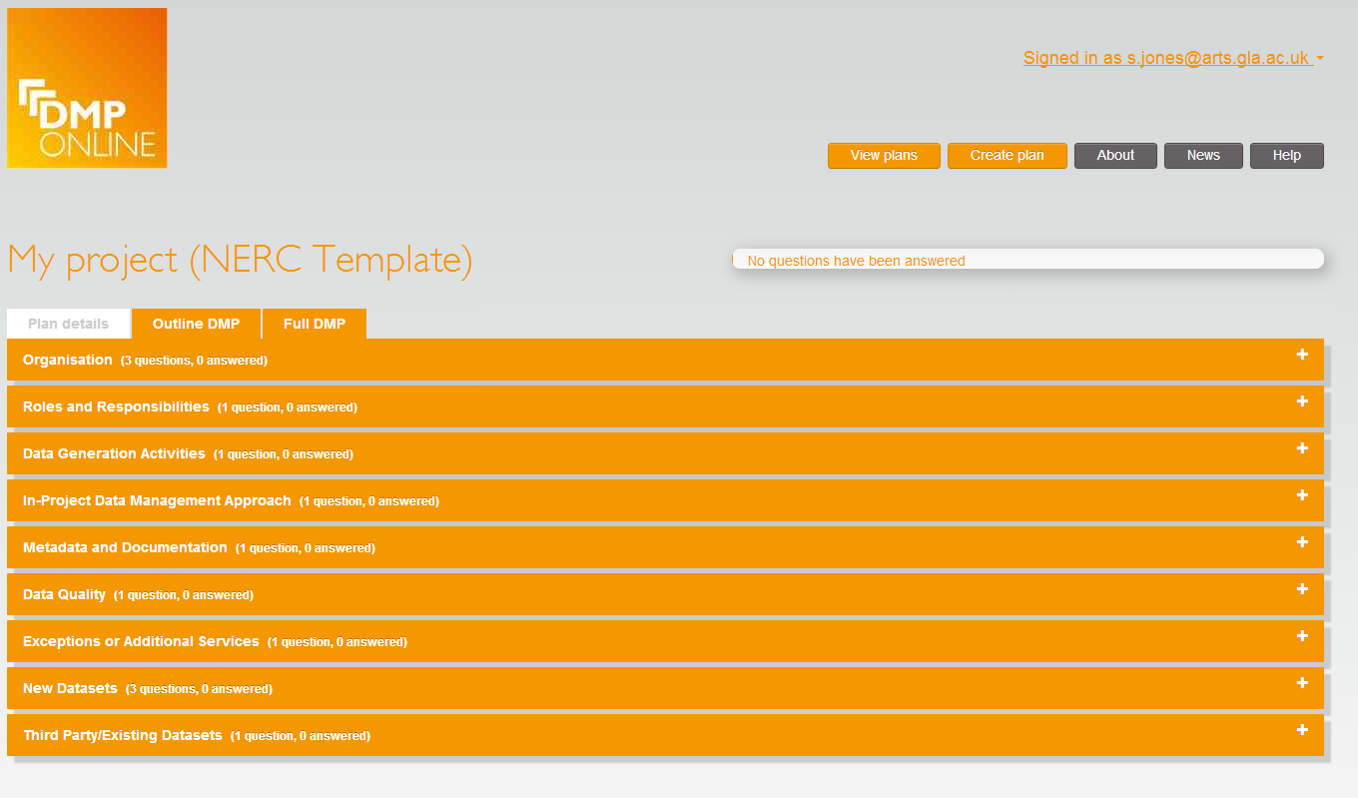
Overview of sections in a DMP
Enables multiple phases
Summary page with dropdown buttons to expand and answer each section
Notes:
Researchers can also see progress in terms of how many of the questions they’ve answered in each section. Much of the basic project information need to be provided by the researcher themselves. However, depending on how project approval processes are managed within your institution, it might be possible to duplicate this information from other application procedures (e.g., applying for ethics approval, raising a project approval form). This can help to ensure consistency across the project lifecycle.

Slide 8
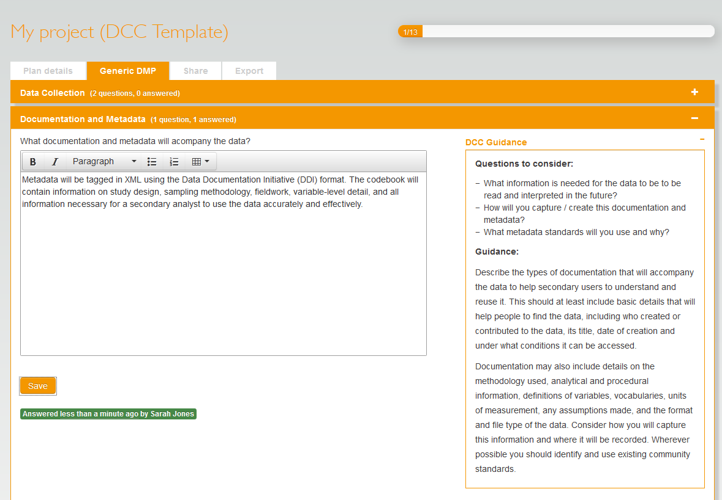
Answering questions
Notes who has answered the question and when
Progress bar updates how many questions remain
Notes:
Researchers need to provide the details on what data might be captured, in what quantities, and what formats might be used. As noted previously, estimates at this stage are ok. Funders don’t expect everything to be carved in stone at the application stage and are merely looking for evidence that some consideration has been given to the nature and scale of the data that might be produced within the project and how this will be managed and shared.
Researchers should contact local or central IT services for advice on short term and longer term storage requirements. It is important to get this started early enough to be able to identify any additional costs that may need to be factored into the grant application.
Researchers will need to think about how data will be backed-up if they plan to work outside the university system (i.e., remotely using laptops or personal devices).

Slide 9
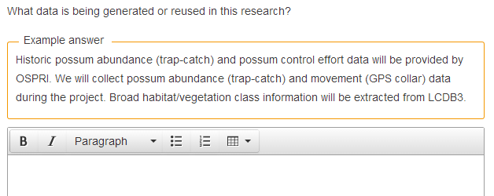
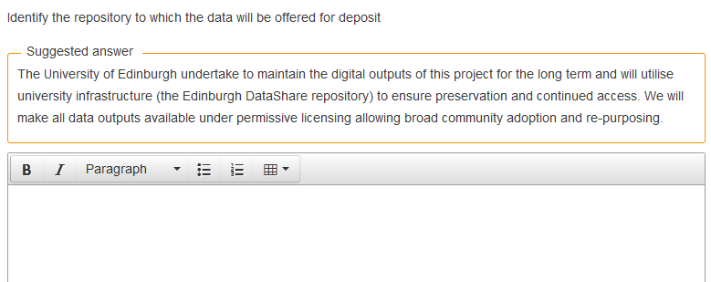
Institutions can provide examples and suggested answers
Notes:
HEIs can help researchers by providing local guidance and suggested answers.

Slide 10
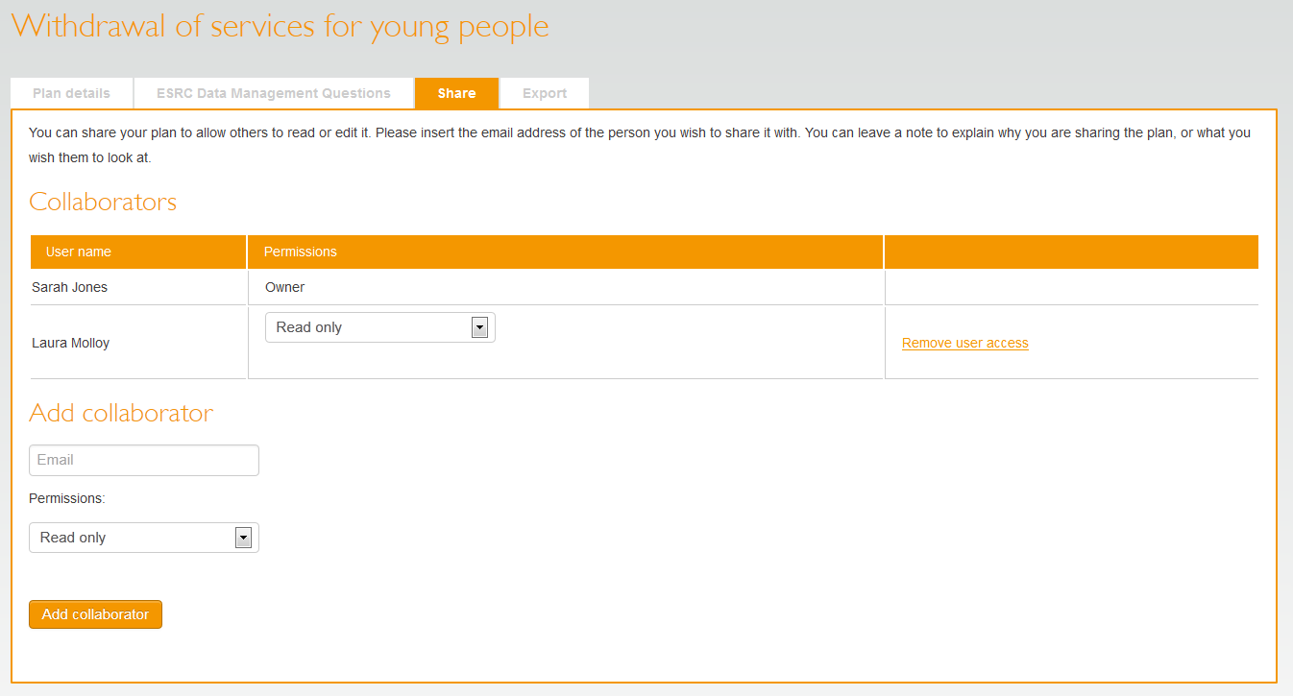
Sharing plans
Allow colleagues to read-only, read-write, or become co-owners
Internal and external partners
Notes:
DMP owners can share the plan – with staff at their own institutions (other research partners, library, IT, ethics, etc) or with partners outside the institution – even in other countries.
You can assign read only, read/write or co-owner status to those you invite to share the plan.

Slide 11
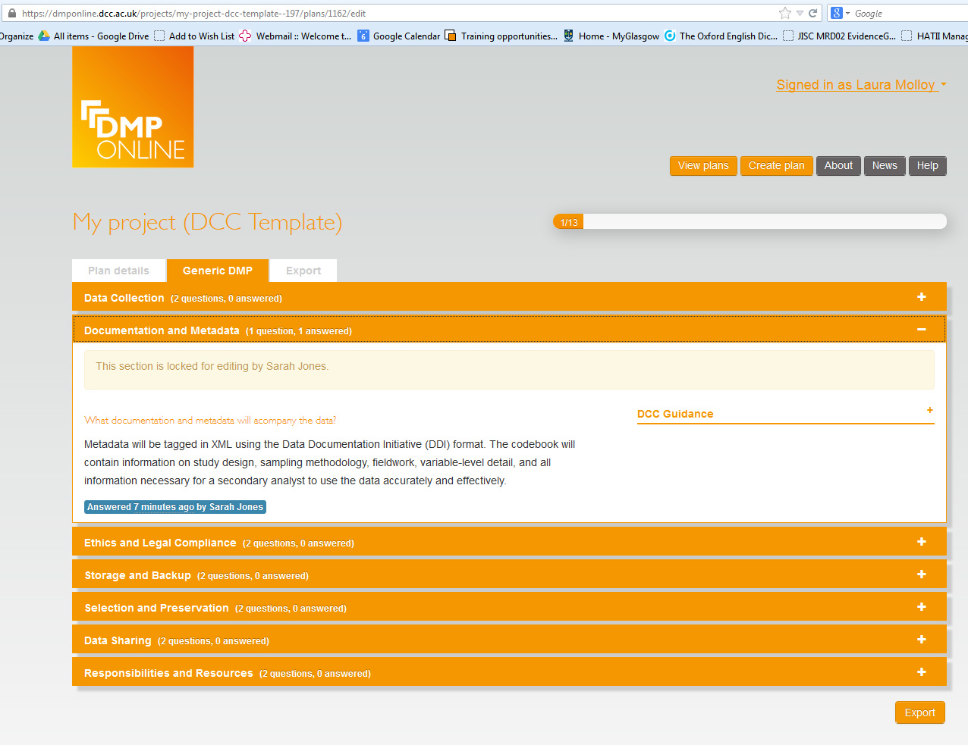
Collaborative writing of DMPs
Sections are locked for editing when they’re being worked on by colleagues
Notes:
When co-authoring DMPs, the tool allows authorised authors to see who has added information to the plan and when it was added.

Slide 12
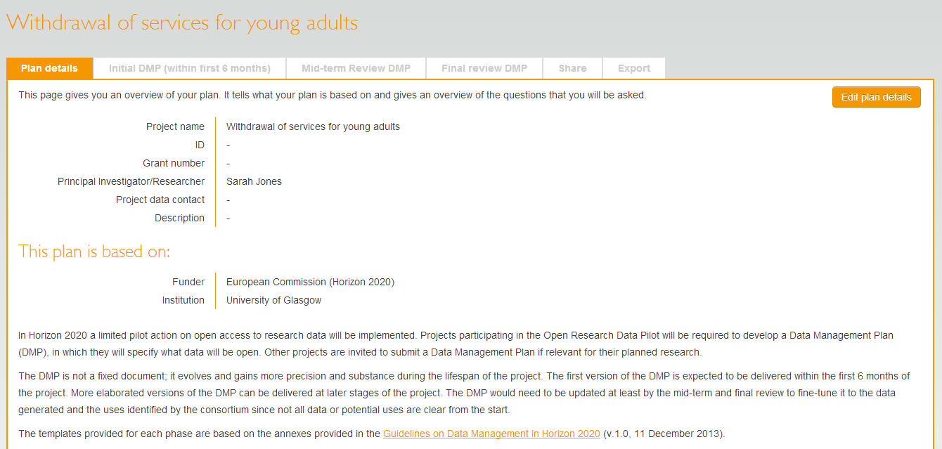
Templates can have multiple phases
Phases
Remember to update the DMP throughout the life of the project!
Notes:
Consider reviewing the plan at lease as often as you provide updates to your funder. Consider making your final phase DMP public via your institutional repository and link it to you publication and data set.
Consider publishing the final version DMP as a data paper – increasing number of peer reviewed data journals emerging. Good to get credit for your efforts!

Slide 13
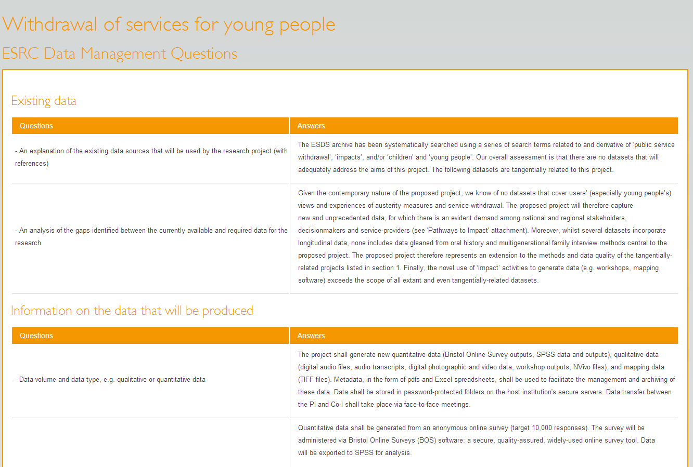
Exporting DMPs
Can export as plain text, PDF, html...
Notes:
If you choose to share your DMP at the end of the project, you can export it in a variety of formats.

Slide 14
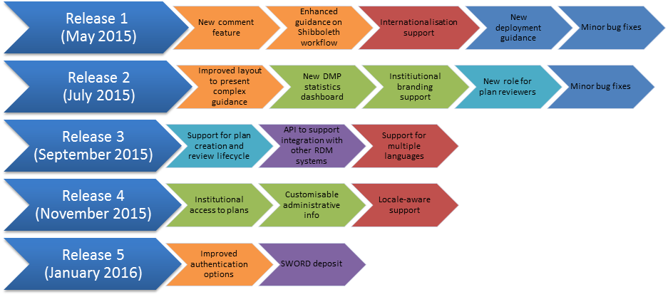
Roadmap for 2015
Notes:
Lifecycle:
Indicate different phases and versions of a plan
Flexible support for different institutional processes
When to provide institutional access to plans
Add review options
API for systems integration:
Determine the appropriate level of API for the community
Enable institutions to generate stats and mine content
Integrate with other university systems
Harvest core metadata from DMPonline
Export DMPs to collate a library of plans
Institutional enhancements:
Institutional branding
Customisable administrative data
Trigger alerts for event monitoring
Create a new template based on an existing one

Slide 15
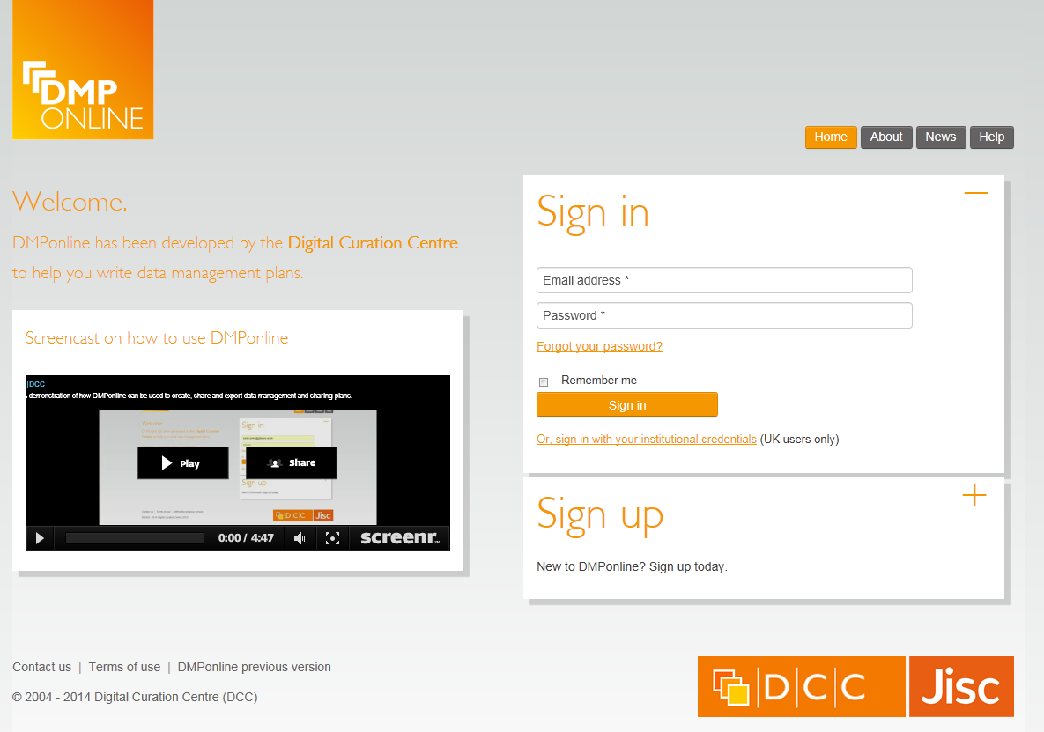
Try it out
https://dmponline.dcc.ac.uk

Slide 16
Thanks – any questions?
DMP guidance, tools and resources:
www.dcc.ac.uk/resources/data-management-plans
Follow us on twitter:
@digitalcuration and #DMPonline

