Slide 1

DMPonline: basic demo
https://dmponline.dcc.ac.uk

Slide 2
What is DMPonline?
A web-based tool to help researchers write Data Management and Sharing Plans
Includes requirements and guidance from funders, universities and other groups
Developed by the Digital Curation Centre

Slide 3
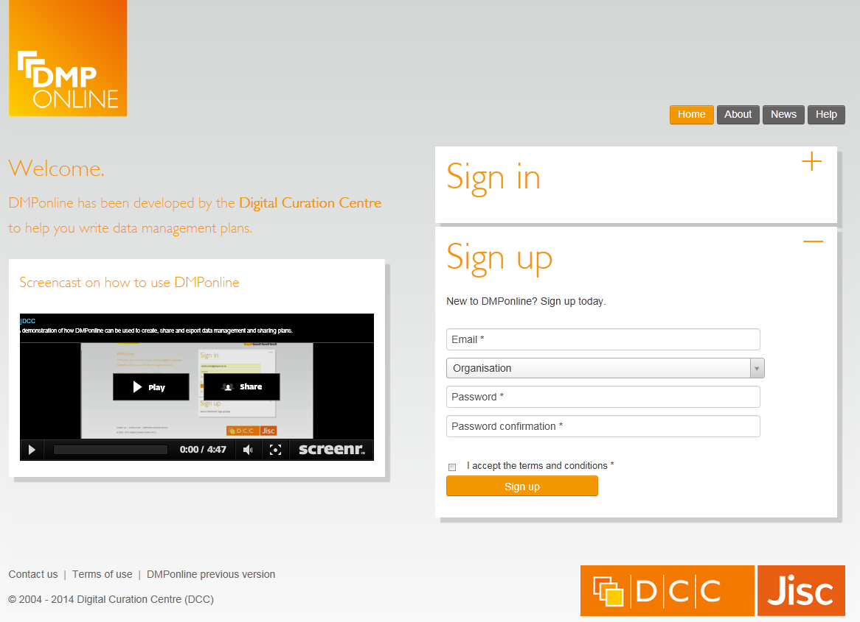
Registration
Sign up with your email address, organisation and password
Select ‘other organisation’ if yours is not listed

Slide 4
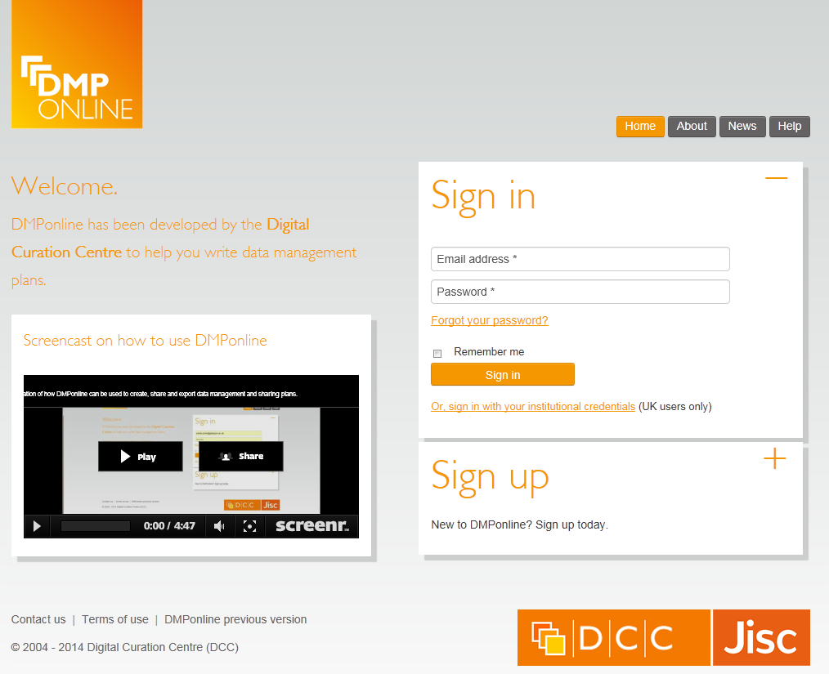
Sign in
Use your email and password to login
Or if you’re at a UK university, you can use your standard uni login

Slide 5
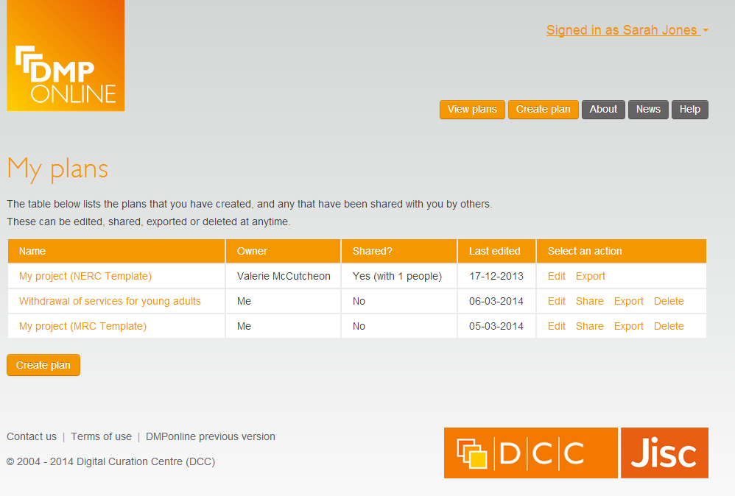
‘My plans’ homepage
Summary of the DMPs that you have created, or others have shared with you.
Note the varying permissions.

Slide 6
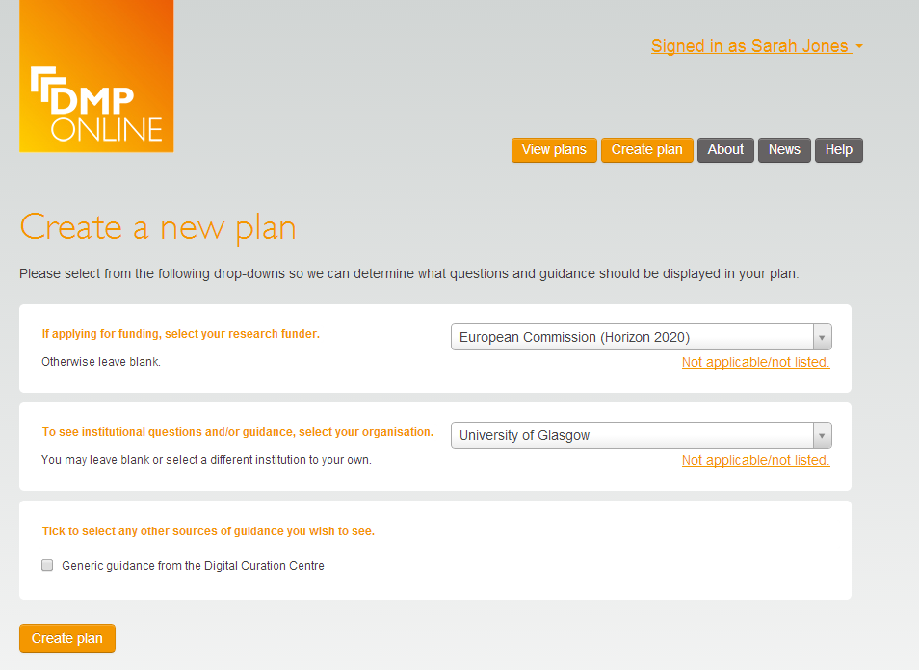
Creating a plan
Select funder (if any)
Select organisation for additional questions and guidance
Select other sources of guidance

Slide 7
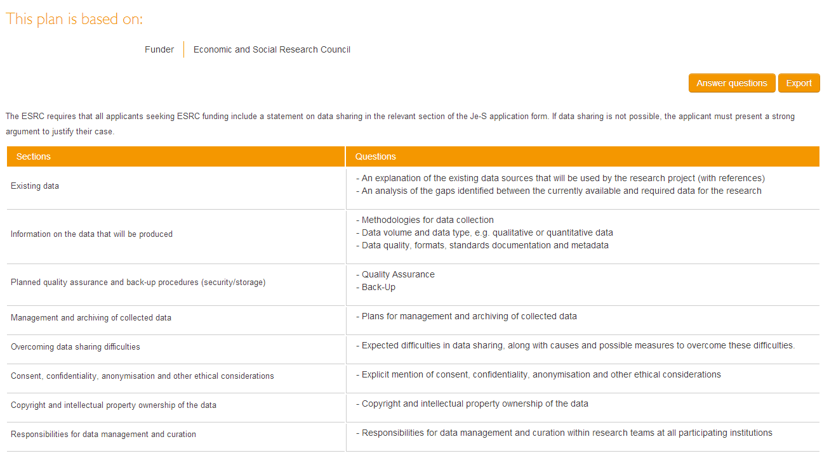
Plan details: summary
Summary of the sections and questions in your DMP

Slide 8
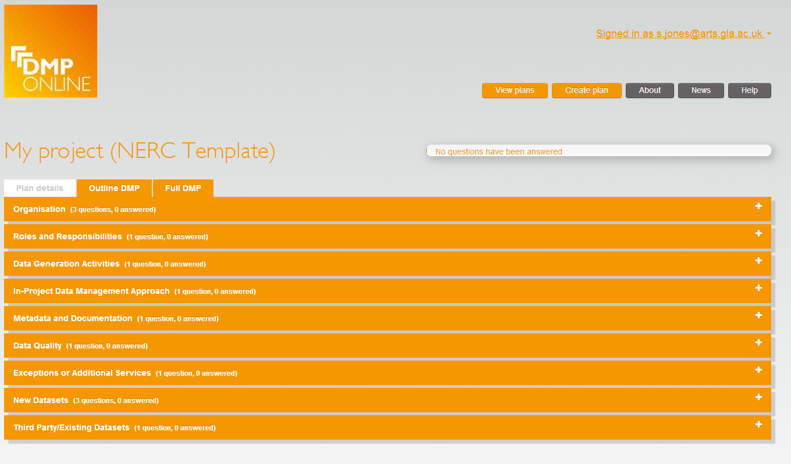
Overview of sections in a DMP
Enables multiple phases
Summary page with dropdown buttons to expand and answer each section

Slide 9
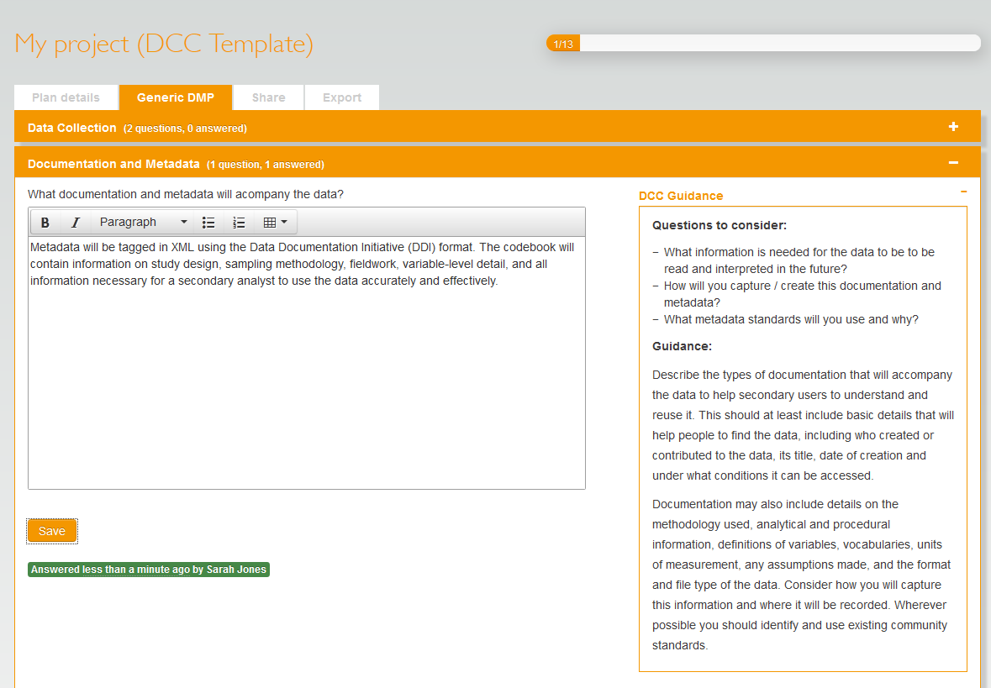
Answering questions
Notes who has answered the question and when
Progress bar updates how many questions remain

Slide 10
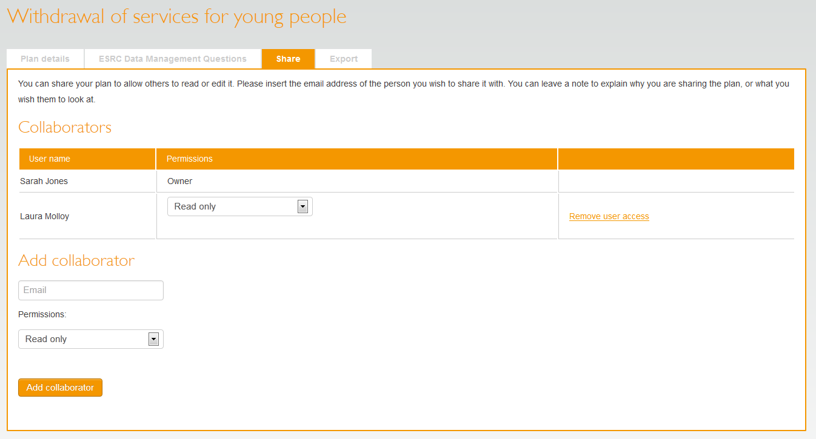
Sharing plans
Allow colleagues to read-only, read-write, or become co-owners

Slide 11
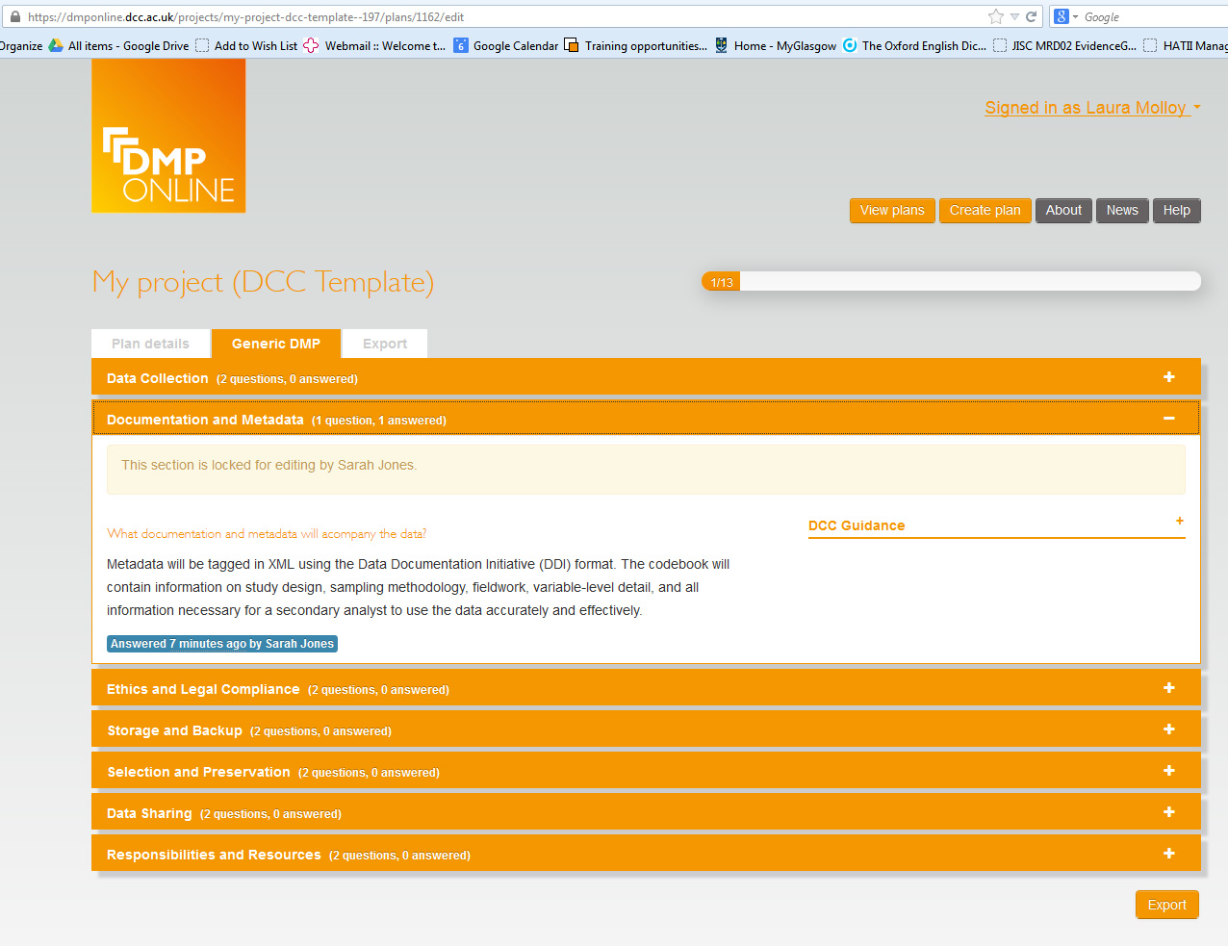
Co-writing DMPs
Sections are locked for editing when they’re being worked on by colleagues

Slide 12
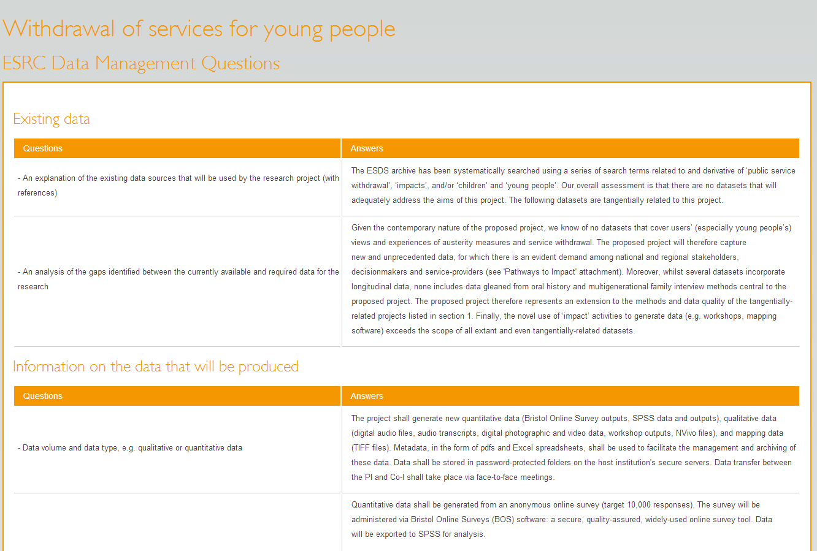
Exporting DMPs
Can export as plain text, PDF, html...

Slide 13
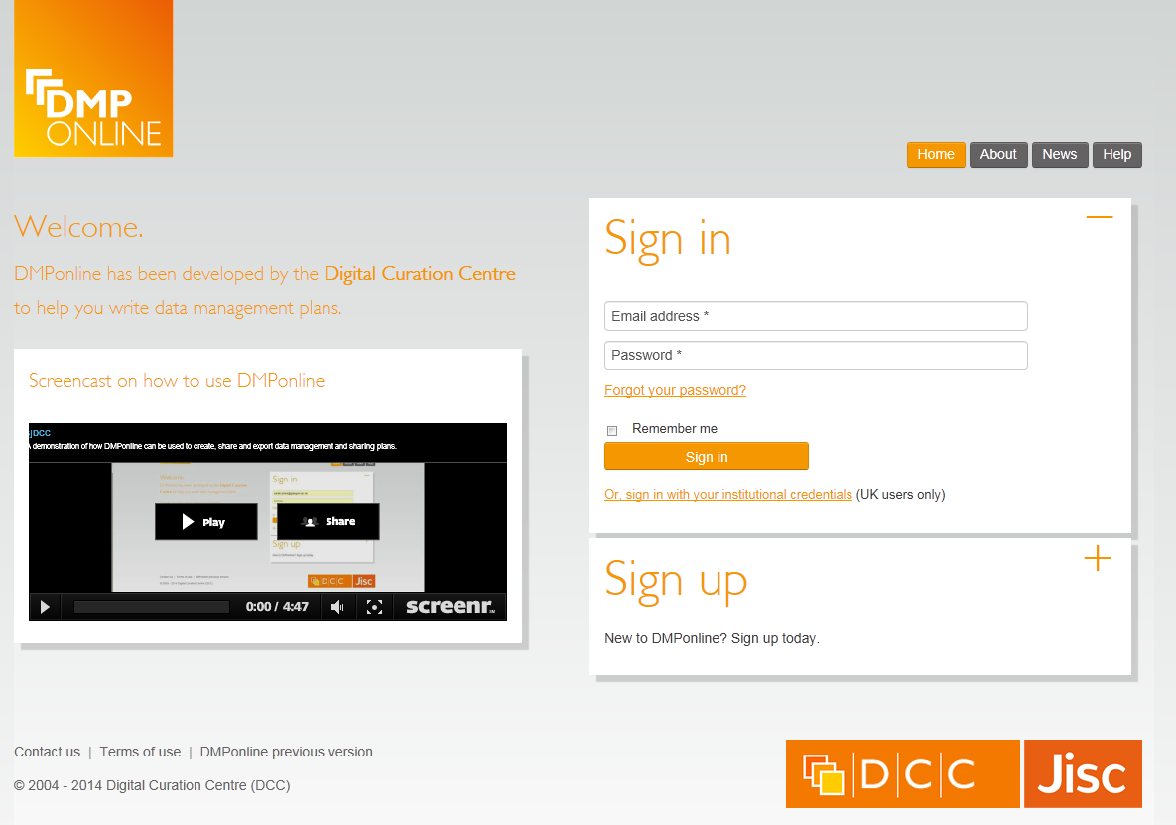
Try it out
https://dmponline.dcc.ac.uk

Slide 14
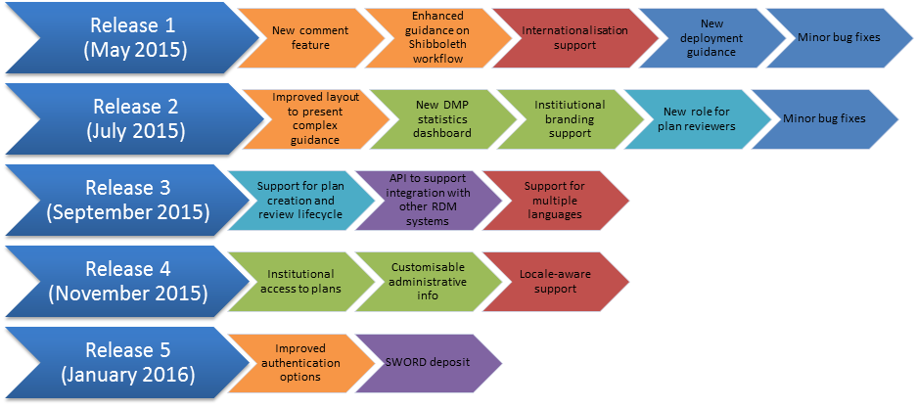
Roadmap for 2015

Slide 15
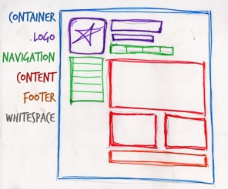
End-user improvements
Rethink layout/presentation of guidance
Display/hide options for user to focus effort
Give text boxes primacy of place
Allow multiple suggested answers
Revisit the ‘create plan’ wizard
Adding a comments feature

Slide 16
Lifecycle and review
Indicate different phases and versions of a plan
Flexible support for different institutional processes
When to provide institutional access to plans
Add review options
Initial DMP
Full DMP
Draft → Reviewed → Revised → Complete → Submitted

Slide 17

API for systems integration
Determine the appropriate level of API for the community
Enable institutions to generate stats and mine content
Integrate with other university systems
Harvest core metadata from DMPonline
Export DMPs to collate a library of plans

Slide 18

Institutional enhancements
Institutional branding
Customisable administrative data
Trigger alerts for event monitoring
Create a new template based on an existing one

Slide 19



Locale-aware support
Customised appearance & language based on IP address
Presentation of different (smaller set of) options based on location / organisation
Auto-select institution when registering via Shibboleth

Slide 20
DMPonline user group
Aims to make it easier for the community to feed in ideas and direct the development of DMPonline
We’ll post plans for consultation and periodically hold webinars or face-to-face meetings to gather input on specific aspects of implementation
Hope to get participants covering all roles e.g. researchers, RDM co-ordinators, administrators, developers, funders...
Subscribe to the user group listserv at:
  www.jiscmail.ac.uk/DMPONLINE-USER-GROUP

Slide 21
Thanks – any questions?
DMP guidance, tools and resources:
www.dcc.ac.uk/resources/data-management-plans
Follow us on twitter:
@digitalcuration and #DMPonline

