Slide 1


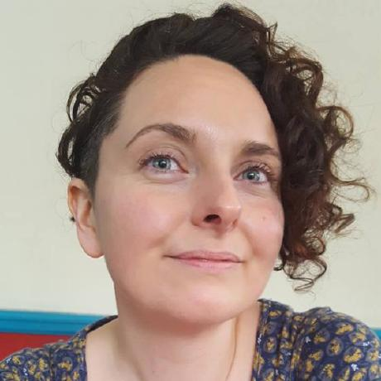


DMPonline user group https://dmponline.dcc.ac.uk
Sarah Jones, Sam Rust & Magdalena Drafiova
13 March 2019, University of Amsterdam

Slide 2
Preferred topics
Machine-actionable DMPs
  Priority system connections e.g. ethics review, RIM, repository…
Plan lifecycle
  Versioning of DMPs
  Notification of changes
  Archiving and publishing plans
Assessing the FAIRness of data plans
Usage statistics
Other?

Slide 3
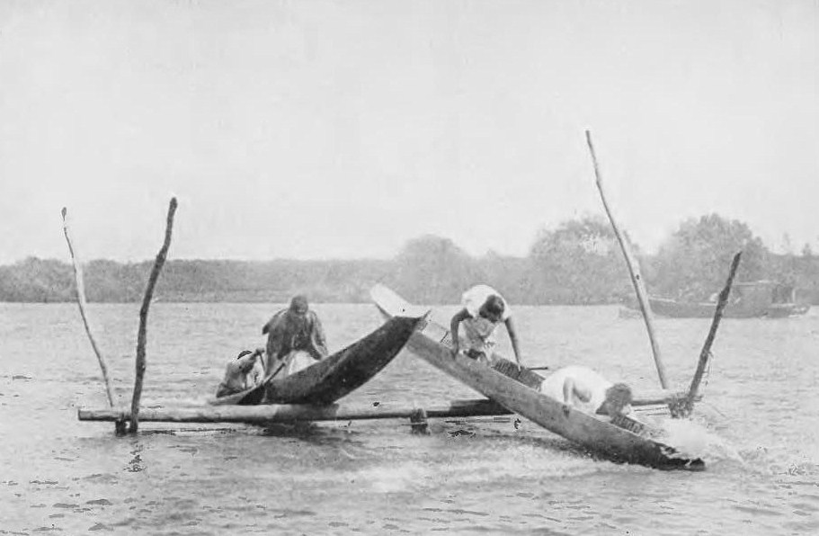
Machine-actionable DMPs
- Not this!
By Josiah Martin public domain
Notes:
What’s the issue we’re trying to address?
Most researchers see the DMP as yet another hurdle to overcome, an obstacle in the race to get grant funding.
In the UK we have a very compliance heavy landscape and it’s not always clear to what extent DMPs are being monitored so it encourages researchers to just pay lip service to the requirements

Slide 4
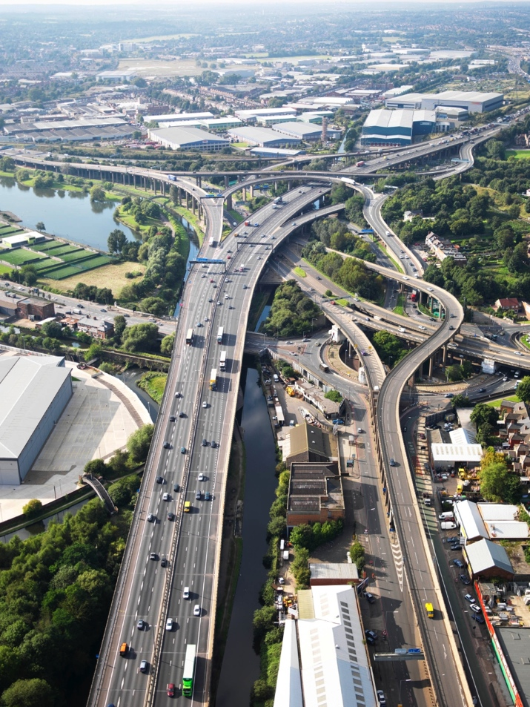
Why make DMPs machine-actionable ?
Promote information flow across systems to support:
Data discovery
Capacity planning
Aggregation/integration
Policy compliance
….
From Flickr by highwaysengland, CC BY 2.0
Notes:
Goal to think of DMPs as key elements of a networked data management ecosystem:
Connected via a shared vocabulary
Actionable by humans and software
Versioned – embedded in research workflows
Useful for all stakeholders
Activities are designed to hammer out the details of how we accomplish these things – identify where we should begin adapting tools and practices to make this a reality

Slide 5















What should connect? Priorities…
Planning & administration
Create, analyse, manage data
Publishing & reuse
Identifiers:
Notes:
Where we hope to get to eventually is to connect up DMPs with the wide range of systems researchers are using in the course of their work, so they act as more of a hub. This includes:
Research Information Management systems like Pure or Symplectic elements so administrative data from research offices can be pushed into DMPs and vice versa
Funder application systems like Je-S and the EC’s participants portal. While it’s very difficult to integrate with these, APIs could hopefully exchange some information and make the process more streamlined for researchers
Lab notebook systems like Jupyter
Storage and data management platforms like Dataverse and OSF
Journals like RIO and BMC research notes for publishing DMPs
Repositories (e.g. zenodo & figshare) to deposit DMPs alongside datasets and other outputs
Identifiers also play a key role to track assertions about people/organisations/grants etc, to trigger notifications and automate reporting activities. There are many different identifier systems that could be leveraged in DMPs e.g. fundref, RRID, DOIs, ORCIDs…
We also need to think about how we should exchange the information across systems e.g. with APIs, defining open format/protocol/standard

Slide 6
Who is working on this?
Research Data Alliance (RDA) is a global organisation supporting collaboration to promote data management and open sharing
Active DMPs Interest Group
Exposing DMPs Working Group
- develop use cases of what can be shared, when and with whom
- provide a reference model and alternative strategies for exposing DMPs
https://www.rd-alliance.org/groups/exposing-data-management-plans-wg
DMP Common Standards
Working Group
- develop a common data model with a core set of elements
- provide reference implementations of the data model
https://www.rd-alliance.org/groups/dmp-common-standards-wg

Slide 7

DMP Common Standards - Outputs
Common data model for machine-actionable DMPs
  to model information from standard DMPs
  NOT a template
  NOT a questionnaire
  modular design
    core set of elements
    domain specific extensions
Reference implementations
  ready to use models
    JSON, XML, RDF, etc.
Guidelines for adoption of the common data model
  requirements for supporting systems
  pilot studies

Slide 8
Example
Current DMPs – model questionnaires
<administrative_data>
<question>Who will be the Principle Investigator?</question>
<answer>The PI will be John Smith from our university.</answer>
</administrative_data>
Machine-actionable DMPs – model information
"dc:creator":[ {
"foaf:name":"John Smith",
"@id":"orcid.org/0000-1111-2222-3333",
"foaf:mbox":"mailto:jsmith@tuwien.ac.at",
"madmp:institution":" AT-Vienna-University-of-Technology"
} ],
Principles
Reuse existing standards, e.g. Dublin Core, PREMIS
Use PIDs whenever possible, e.g. ORCID
Use controlled vocabularies
Develop own concepts and vocabularies only when needed
Notes:
dc, foaf – reuse existing standards
madmp – create own when needed
AT Vienna – use controled vocabularies when possible or PIDs for instituion
ORCID – use PIDs when possible

Slide 9
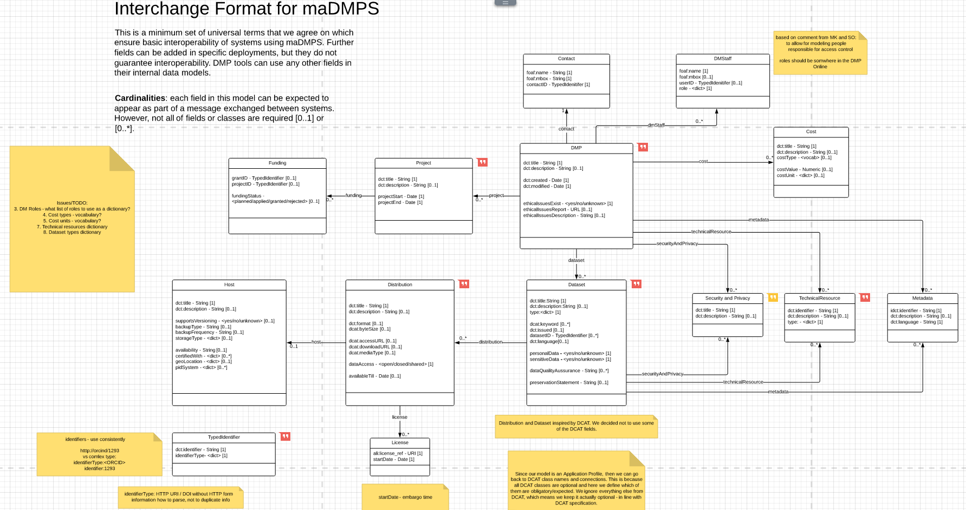
Model in consultation: DCC plans to test
https://www.lucidchart.com/invitations/accept/ee26bc71-01a6-442a-b946-5b9c910fb926

Slide 10
Machine-actionable DMP discussion
What are the priority systems to connect with?
  Research information systems? Which?
  Repositories? Which?
  Ethics processes?
  Other?
What information do you want to extract from DMPs?
What information can feed into DMPs and when?
Other questions / comments?

Slide 11
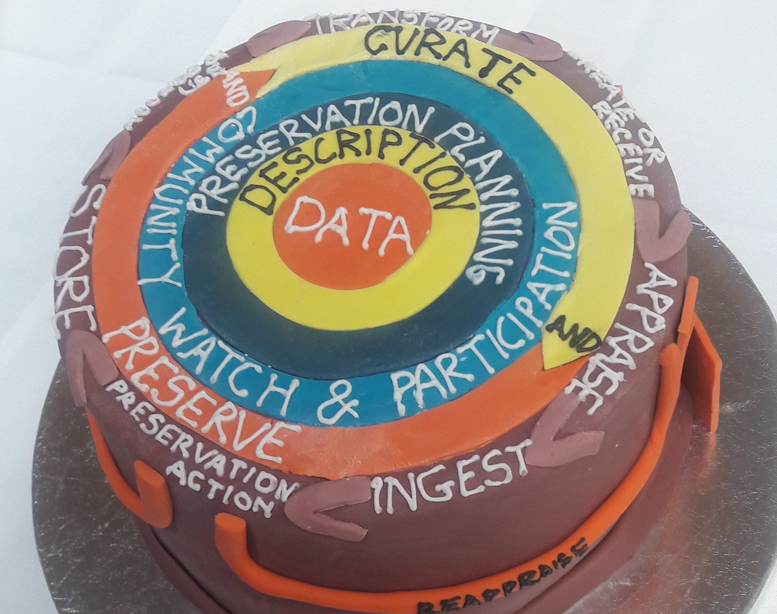
Lifecycle…

Slide 12
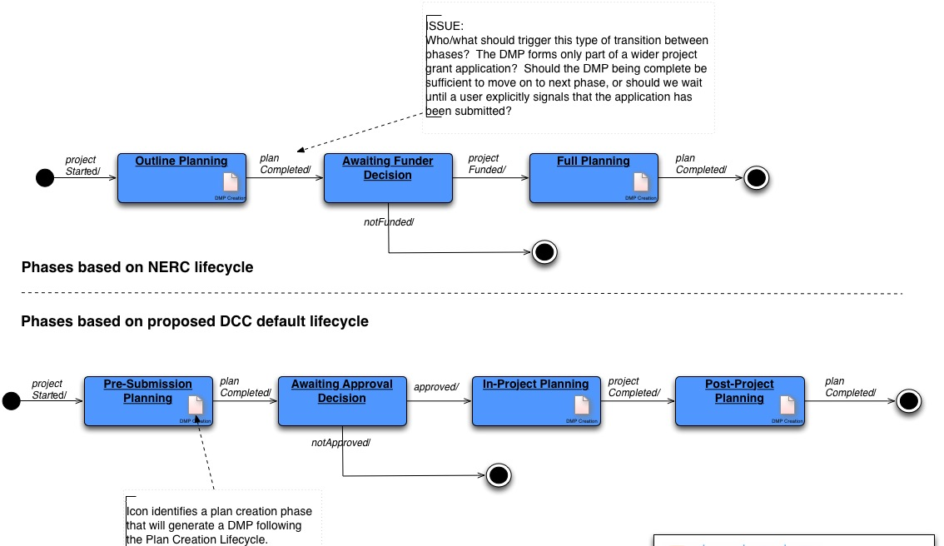
Potential lifecycle

Slide 13
Questions…
What stages / statuses need to be defined?
Draft
Submitted (to funder? for internal review/approval?)
‘Active’ (an accepted DMP in progress / post-award)
Final DMP / research project finished
Others?
Version control
Should versions save at given status points?
Should users be able to save a snapshot at any time?
Should users / administrators archive a copy of DMPs?
Other requirements
Should funders / admins / others be notified of changes?

Slide 14
Publishing plans
Publish via DMPonline
  Does this need to be more formal with DOIs?
Export to repositories e.g. Zenodo
Submit to journals e.g. RIOjournal
Others?

Slide 15

Assessing the FAIRness of data plans
Image CC-BY CC-BY by Andy Middleton https://www.flickr.com/photos/andymiddletonphotography/3360336905

Slide 16
What makes data FAIR?
FOSTER advice to EC project officers on the six main questions in H2020 DMP to emphasise in review:
1.c description of data types and formats
2.1.a unique and persistent identifiers (PIDs)
2.1.d rich metadata
2.2.c repository deposit
2.3.a data and metadata standards for interoperability
2.4.a data licensing
ZonMw key items:
Persistent identifier
Digital repository, preferably certified
Online catalogue where data is registered (may be repository)
Terms and conditions of use
Data format (preferably machine-readable)
The terminology for the data (code, classification, ontology)
Metadata schema

Slide 17
Lessons: some aspects are more important
Rich documentation
Standardised metadata, use of controlled vocabularies
Accepted (open, well-known) data formats
Deposit in a trusted repository
Clear licensing, ideally open / unrestrictive
Assigning PIDs
Can we collect this data in a structured way in DMPs so potential FAIRness can be automatically assessed?

Slide 18
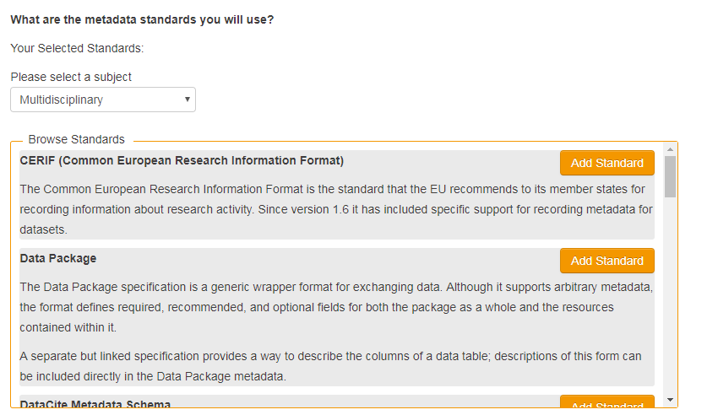
MSD added as an answer type
Tool pulls in information from the API to let users browse and select metadata standards

Slide 19
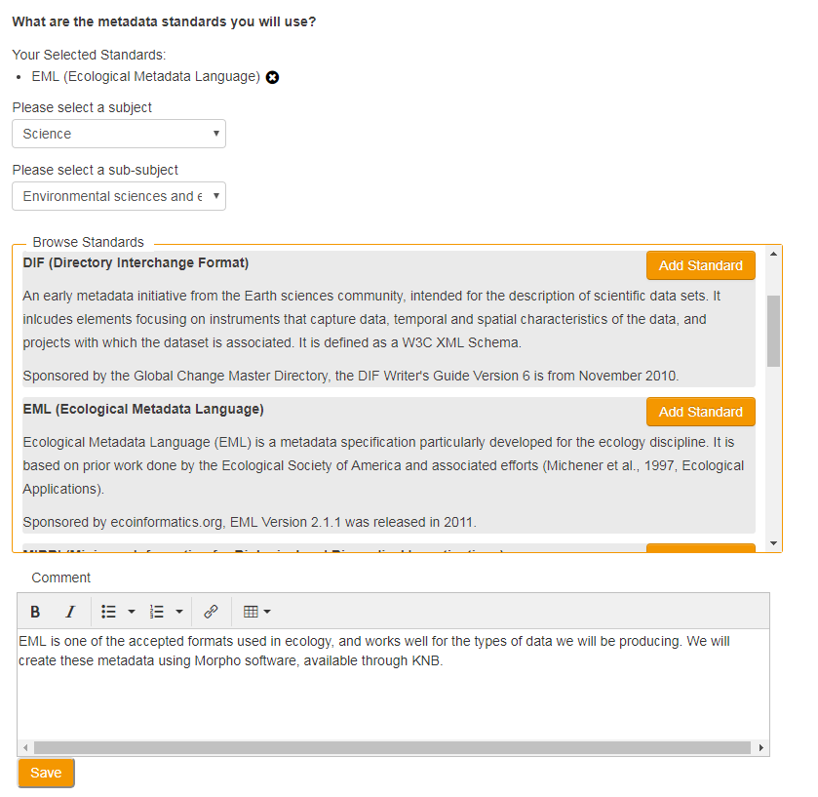
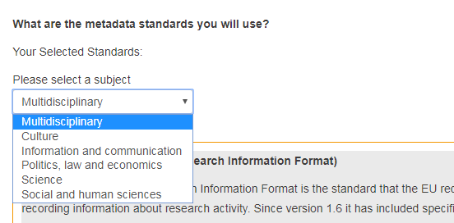
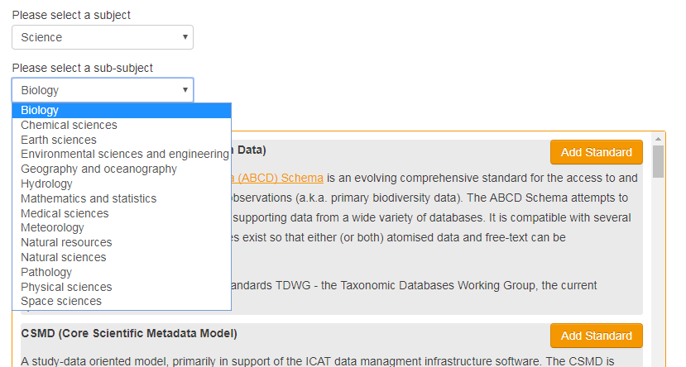
Select standards and add comments

Slide 20



Potential to integrate others
Suggest standards
Recommend repositories
Pulling in grant numbers
….

Slide 21
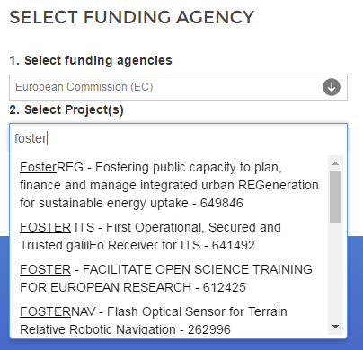
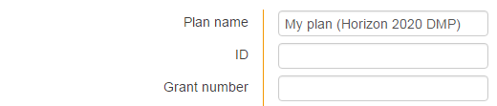

Utilising EC grant IDs in plans
Harvest grant IDs from OpenAIRE API
Provide look up when entering project details
Enables join up of DMP with other outputs
Notes:
Grant IDs can also be pulled into DMPs. For the EC for example, we could use the OpenAIRE API to harvest these and provide a look up when researchers are creating their plan at month 6. This also allows us to connect up the DMP with other outputs to assist in reporting

Slide 22

FAIR and DMPs?
Can we get insights into the prospective FAIRness of the data via DMPs?
What are the key aspects to check?
Where should we focus efforts?
What are your needs?
Image CC-BY-SA by SangyaPundir

Slide 23
Usage statistics
DMPonline currently offers:
  Total users (by month and adjustable date range)
  Total plans (by month and adjustable date range)
  Global usage statistics for comparison
  Access to plan content for review
  Download of basic plan metadata
What else do you need to know?
How else do you want to use the API?

Slide 24

Other things we need to discuss?

Slide 25
Connect & stay in touch
Helpdesk
Twitter
Blog
User group
Github
Slack
DMPonline@dcc.ac.uk
@DMPonline and #ActiveDMPs
http://www.dcc.ac.uk/news/DMPonline
http://tiny.cc/DMPonline-user-group
https://github.com/DMPRoadmap
http://tiny.cc/DMPRoadmap-slack

