Slide 1



What you can do with DMPonline https://dmponline.dcc.ac.uk
Sarah Jones
Digital Curation Centre, Glasgow
sarah.jones@glasgow.ac.uk
Twitter: @sjDCC
Using DMPonline to support data management and FAIR data
13 March 2019, University of Amsterdam
http://www.dcc.ac.uk/events/workshops/using-dmponline-support-data-management-and-fair-data

Slide 2






How does DMPonline work?
Online tool to support researchers to develop Data Management Plans, tailored to their context
Requirements from funders, institutions and others
DMP
Guidance and examples from funders, unis, research disciplines and others
Create
Share
Review
Download
Update
…..

Slide 3

Orgs can customise DMPonline
Create your own template(s)
Customise funder templates
Provide tailored guidance
Add logos, local branding and links
Offer feedback on DMPs
Review usage statistics

Slide 4

Defining your template
Planning what questions and guidance to add
Image under licence by DCC

Slide 5
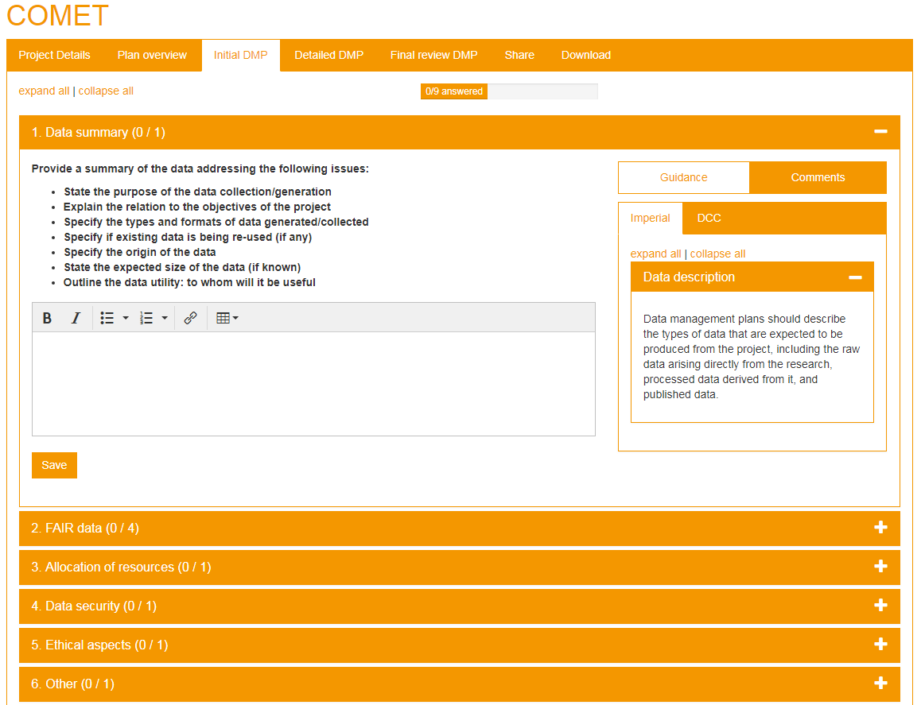
The hierarchy of a template
Templates can have one or more phases e.g. for the grant application stage and during the project
Within each phase, there are a series of sections.
You can have any number of questions within each section. Tag with themes.
Guidance is applied by question or by theme.

Slide 6
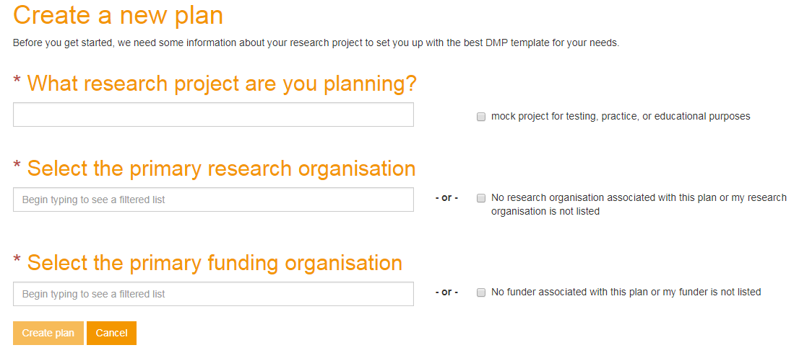
How templates are selected
ZonMw policy changes may require changes to this logic
If researchers specify a funder, we present the funder template
(plus any guidance and questions from their institution)
If no funder is given, we present the institutional template
If no funder or institution is applicable, we present the generic DMP template

Slide 7
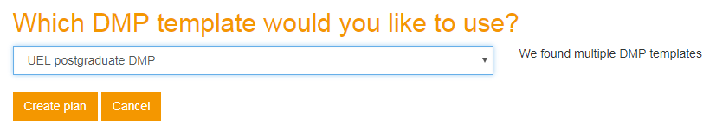
You can add more than one template
You may want to provide different templates for different audiences e.g. PhD students and research staff
If so, an additional question will appear in the create plan wizard after the 3 selections have been made

Slide 8
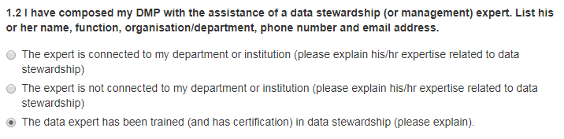
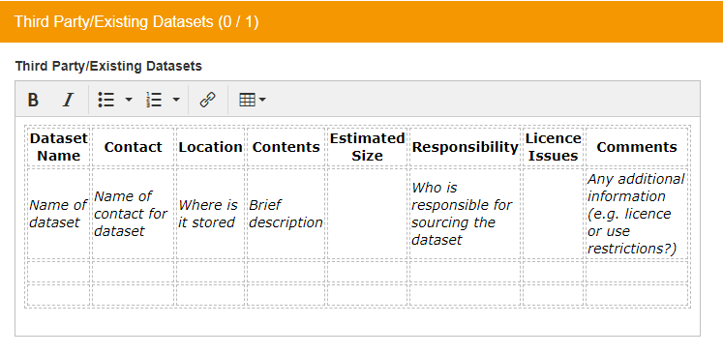
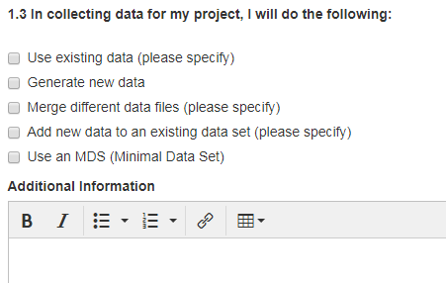
Question styles within a template
Text field (short answer)
Text area (long answer)
Checkbox (multiple choice)
Radio buttons or dropdown (1 choice)
RDA metadata standards (API integration which displays registry)
Also default answers to
Add text into answer box like in NERC example below

Slide 9
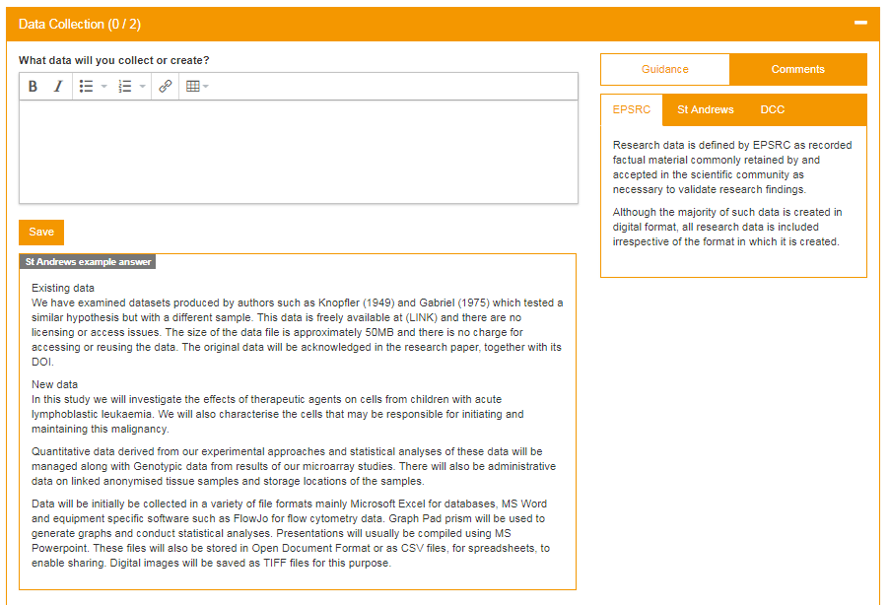
Provide examples answers

Slide 10
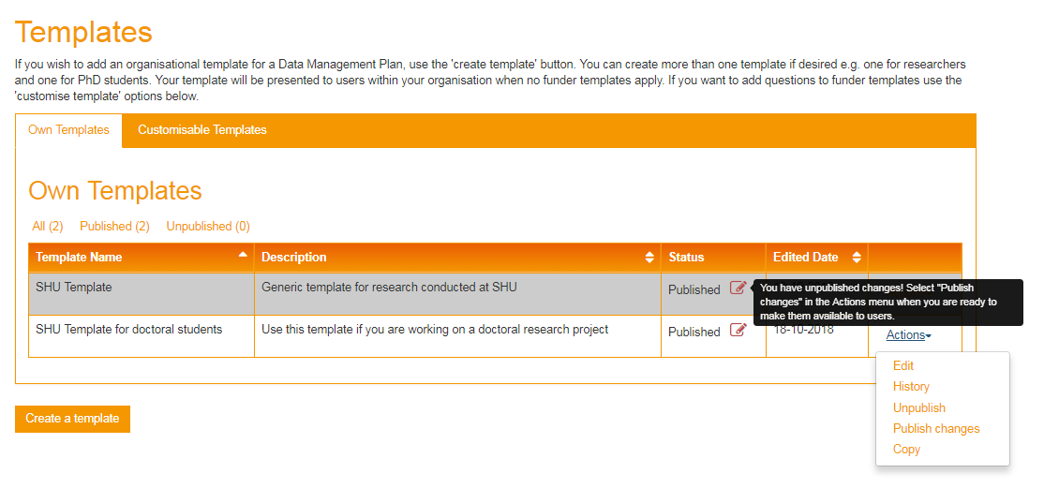
Template versioning & history
See a table of historic (uneditable) versions
System records changes as draft. Version creates on publishing
Can copy templates for ease of creation / editing

Slide 11

Customising funder templates
Adding what you need to know for your organisation
Image CC-BY-SA by Lauren www.flickr.com/photos/cuttlefish/4543879132

Slide 12
Making things easier for researchers
DMPonline combines institutional content with funder templates so researchers only have to write one DMP to satisfy multiple requirements
Universities can add 1 or more sections with additional questions to funder templates
Can add example answers to each question
Can add specific guidance per question
Themed guidance will automatically overlay

Slide 13
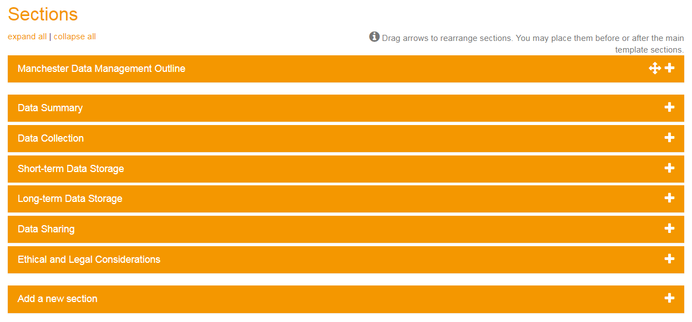
Adding sections to funder templates
Drag and drop feature to easily re-order template sections
Can add multiple sections, but only have 1 in first position

Slide 14
What you may need to know
Data storage volumes for allocations and costing
Whether personal or sensitive data are being used
Any support and training needs
Commitments being made on behalf of uni
….

Slide 15
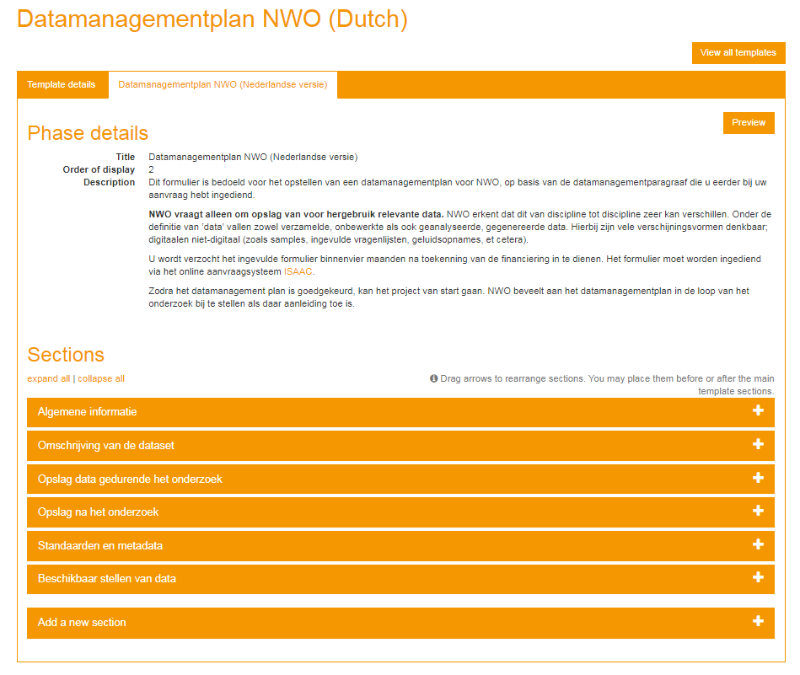
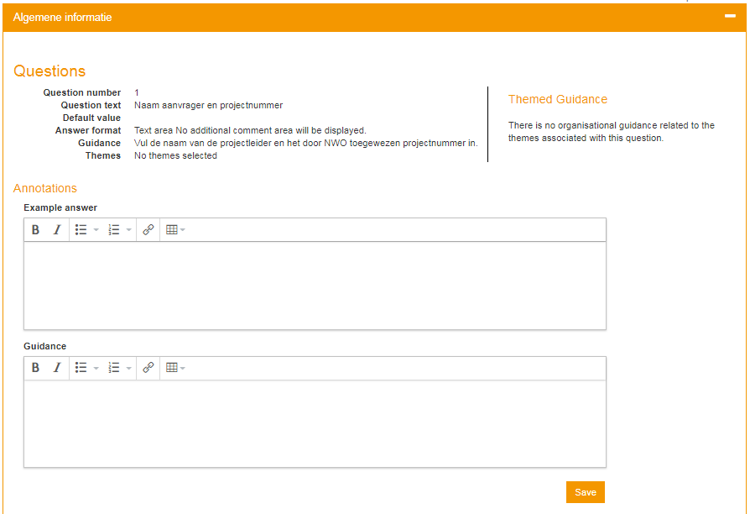
Adding guidance and examples

Slide 16

Providing guidance
Signposting help and giving examples
Image ‘Pioneer signpost’ CC-BY-NC-ND by Spencer Goad www.flickr.com/photos/spgoad/12998899453

Slide 17
Guidance in DMPonline
Guidance for each question
Specific guidance for the question
Themed guidance by organisation
Themed guidance from other sources

Slide 18
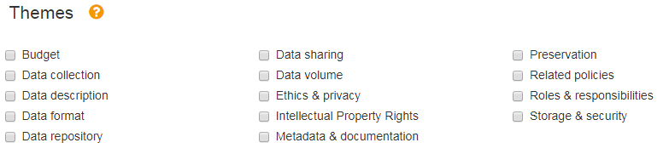
Themes used in DMPonline
The themes represent common topics addressed in DMPs
They allow questions and guidance to be tagged and matched
We reviewed the DMP themes internationally in 2016 to converge on a smaller number
http://www.dcc.ac.uk/blog/dmp-themes-and-then-there-were-14

Slide 19
How themes work
QUESTIONS IN FUNDER TEMPLATES THEMES CUSTOM GUIDANCE
Wellcome Trust
When will you share the data?
Your guidance on the theme:
‘Data sharing’
BBSRC
Timescales for public release of data
Data sharing
MRC
The study team’s exclusive use of the data
STFC
Specify and justify the length of any proprietary period
Your guidance for STFC question 6
You can add guidance by theme or by question

Slide 20
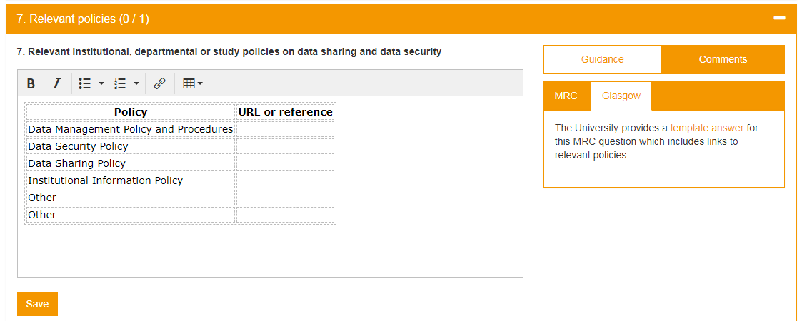
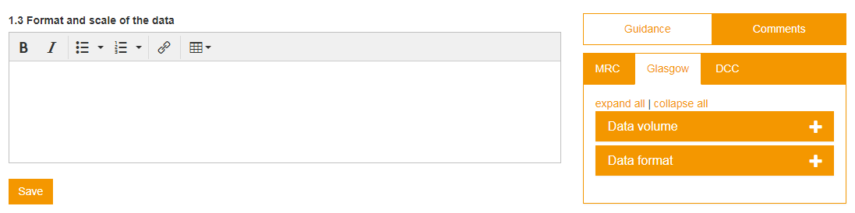
Themed and question guidance
Specific guidance
Guidance that pertains to MRC question 7 only
Guidance that is presented whenever researchers are asked about data volumes and format

Slide 21
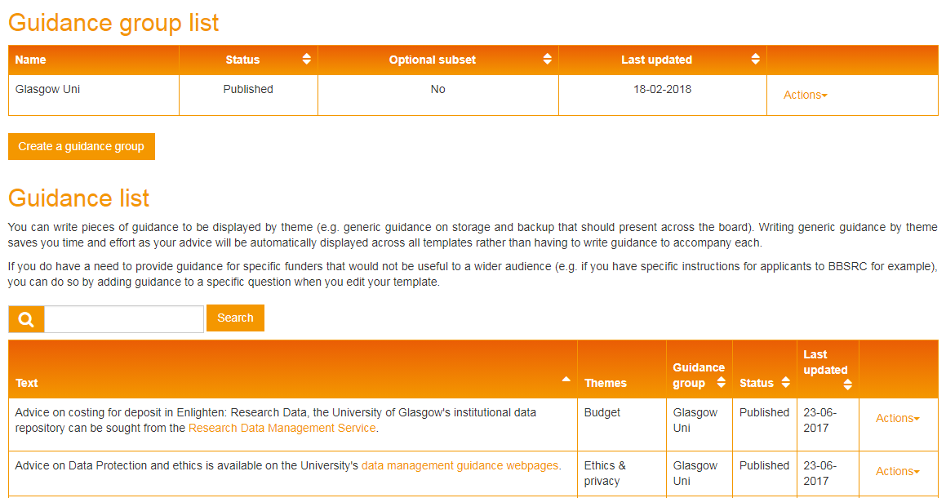
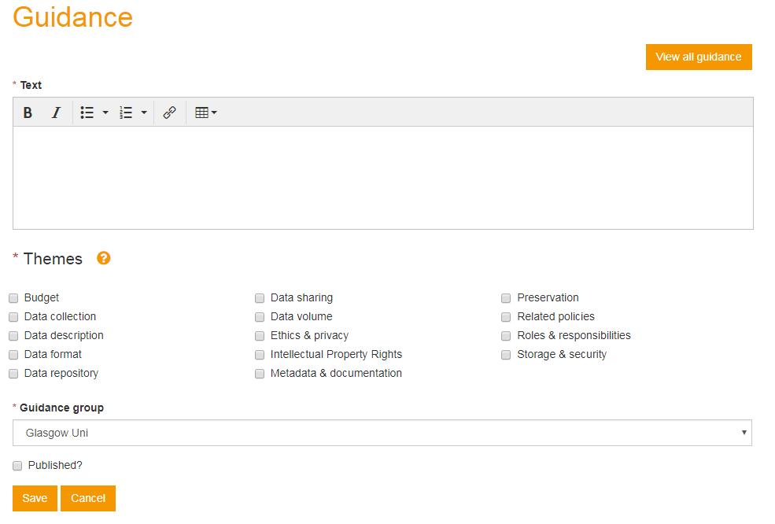
Adding themed guidance
Create a guidance group to define whether your guidance applies to the organisation or a subset e.g. department or group
Add guidance and select associated theme & group

Slide 22
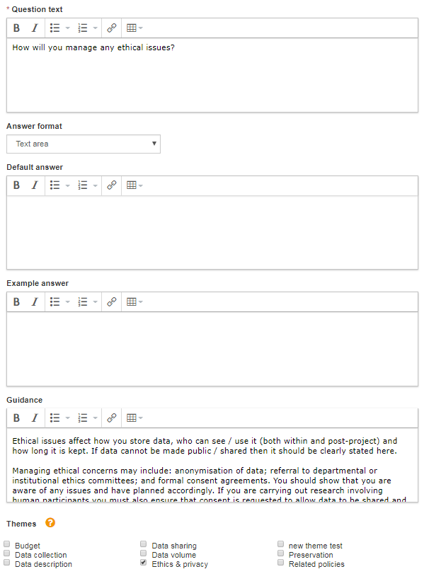
Adding guidance by question
Add as part of question editing when creating your own templates
Add as part of customising a funder template

Slide 23
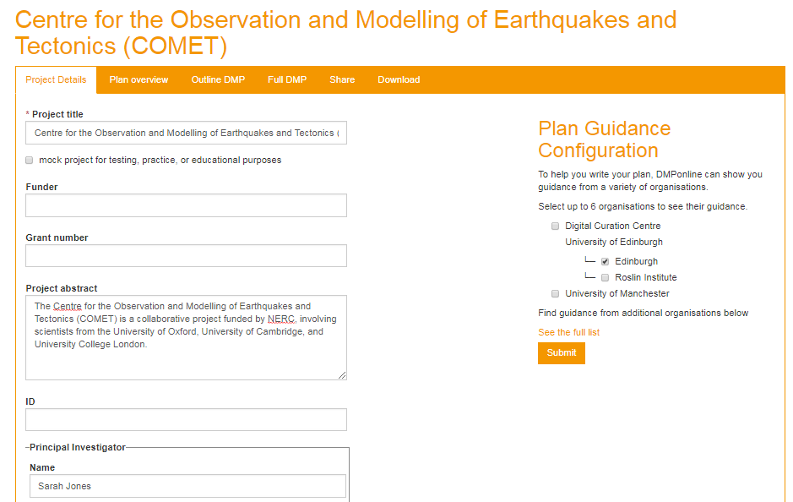
Guidance is configurable by end-user
Choose different organisations e.g. research partners
Turn guidance on/off as you write plan

Slide 24

Other new features
Image “BalloonFest” by alanszalwinski CC-BY-SA www.flickr.com/photos/alanszalwinski/17117984129

Slide 25
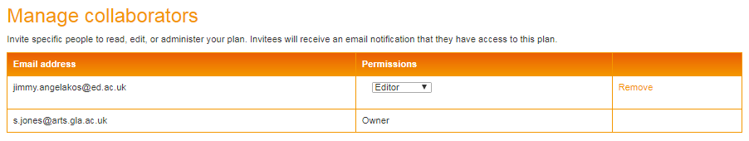
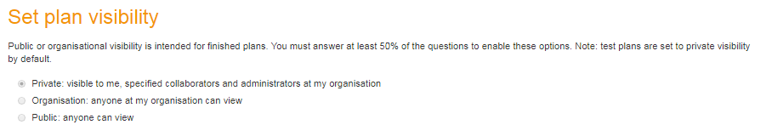
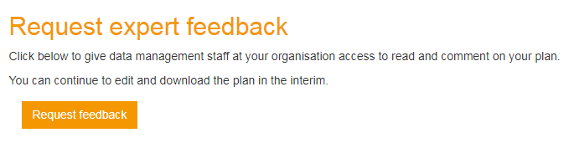
Sharing DMPs: plan visibility
Plans are private by default, but can be shared institutionally or made public.

Slide 26
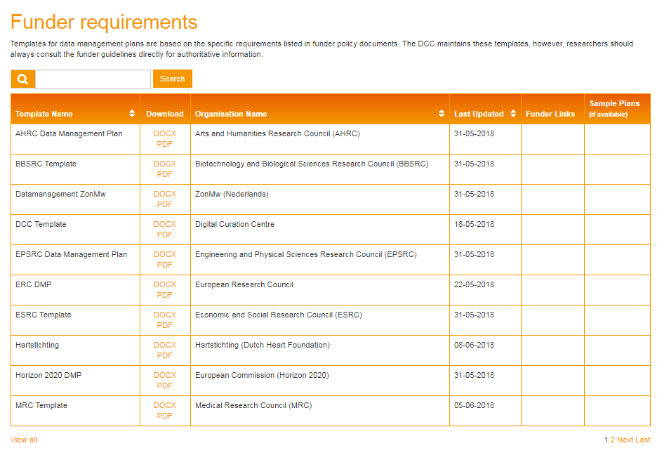
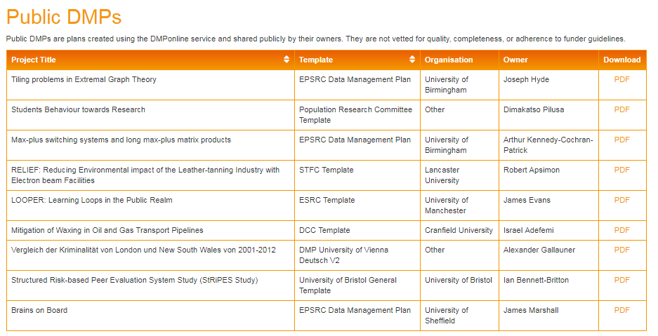
Public DMPs & templates pages

Slide 27
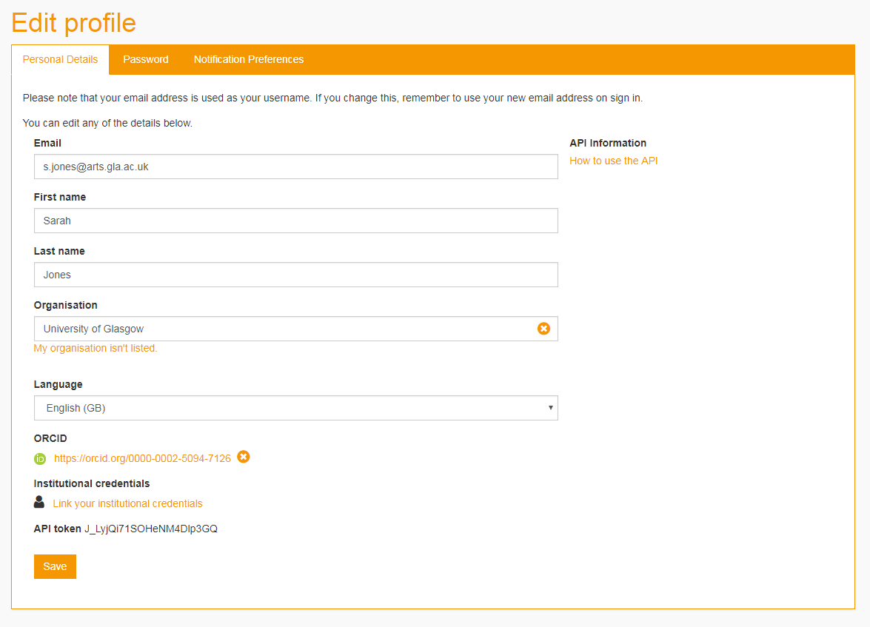
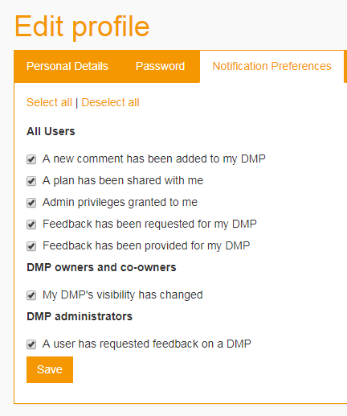
Email notification settings

Slide 28
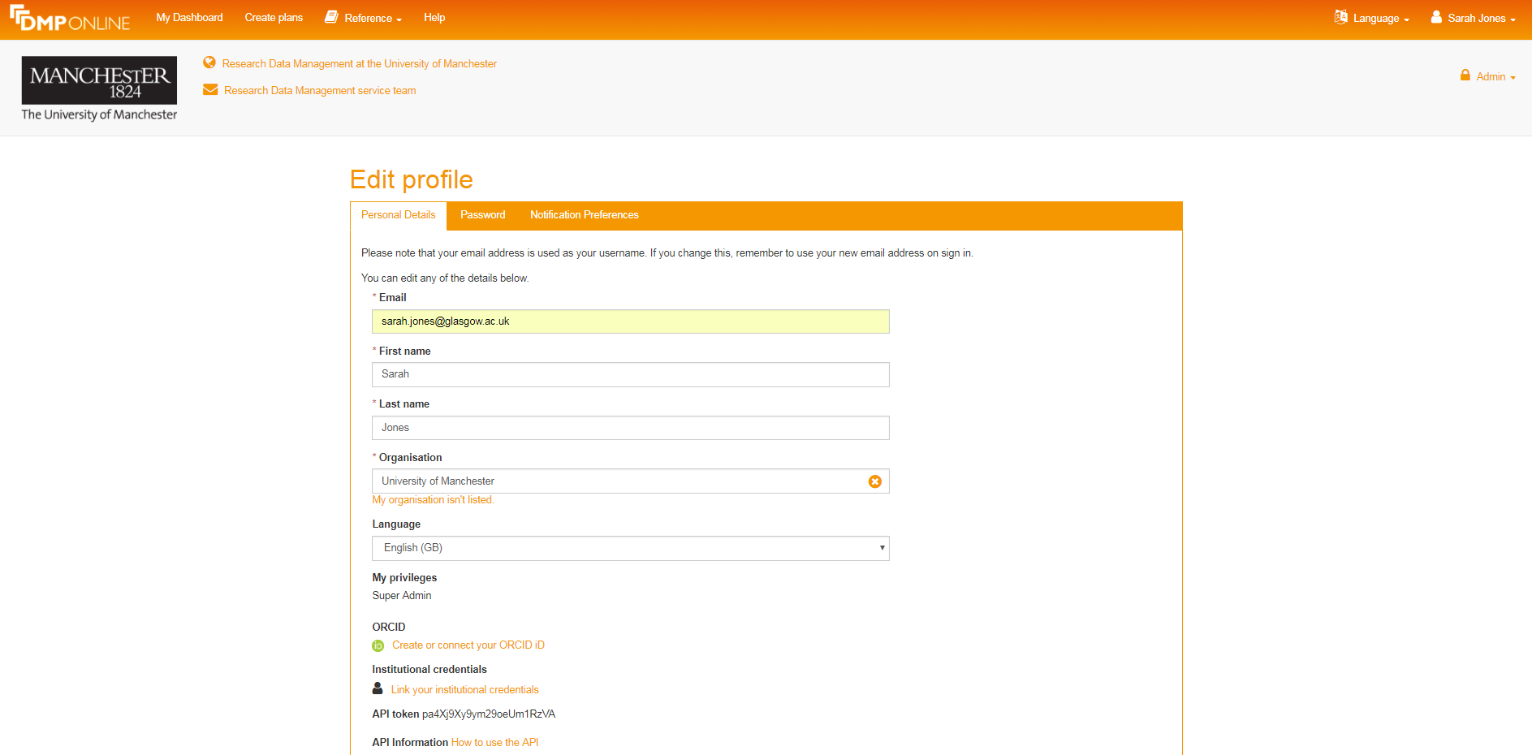
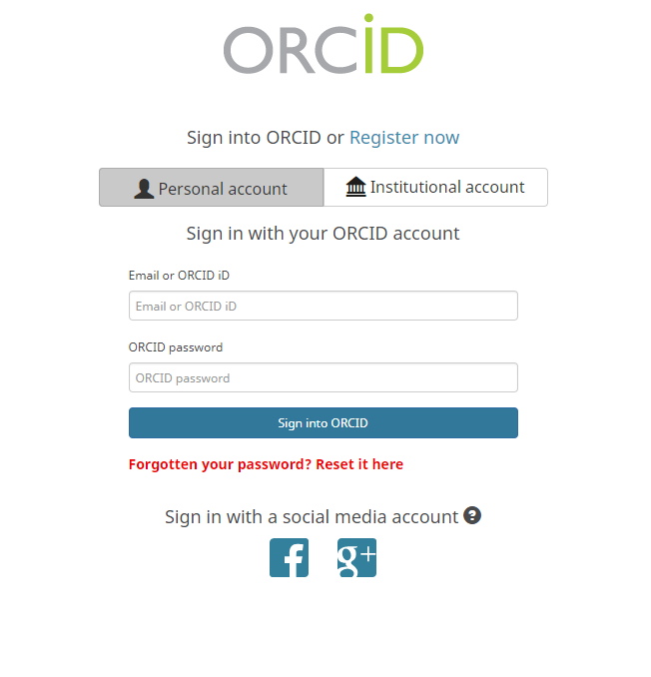
ORCID integration

Slide 29
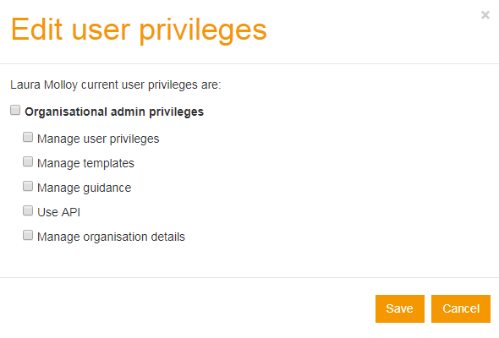

Improved admin controls
Assign privileges to others in your org (user tab)
Upload your own logo, links & abbreviations (org tab)
Easier template publishing and versioning
Versioning on customisations of funder templates

Slide 30
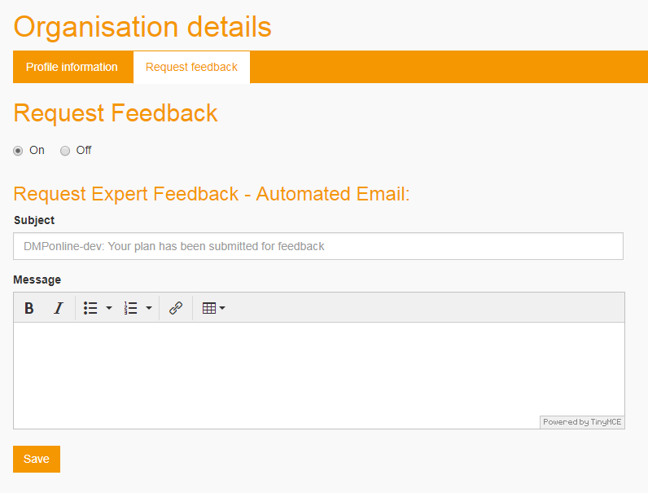
Offering feedback on plans
Organisations can choose to offer feedback on DMPs. If enabled, users get an option to submit plans for feedback.
Admins are alerted to requests and comments are left using the ‘share note’ field.

Slide 31
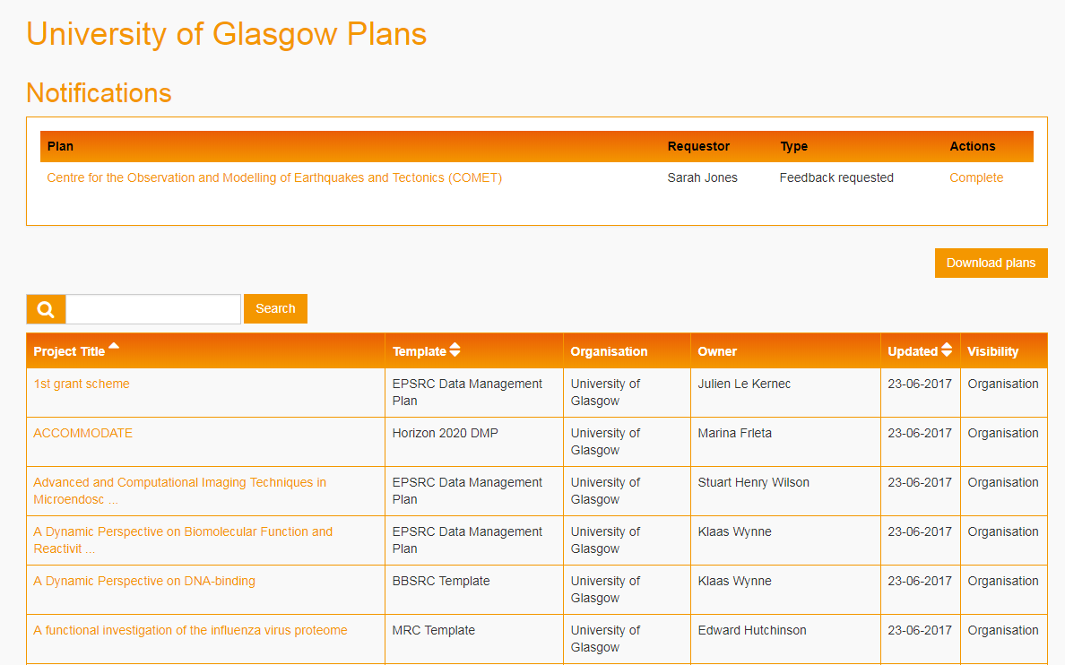
Admin view of all org plans

Slide 32
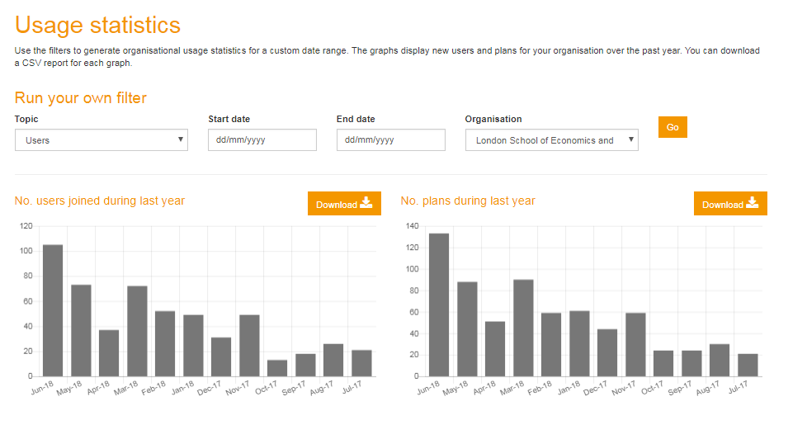
Usage dashboard

Slide 33
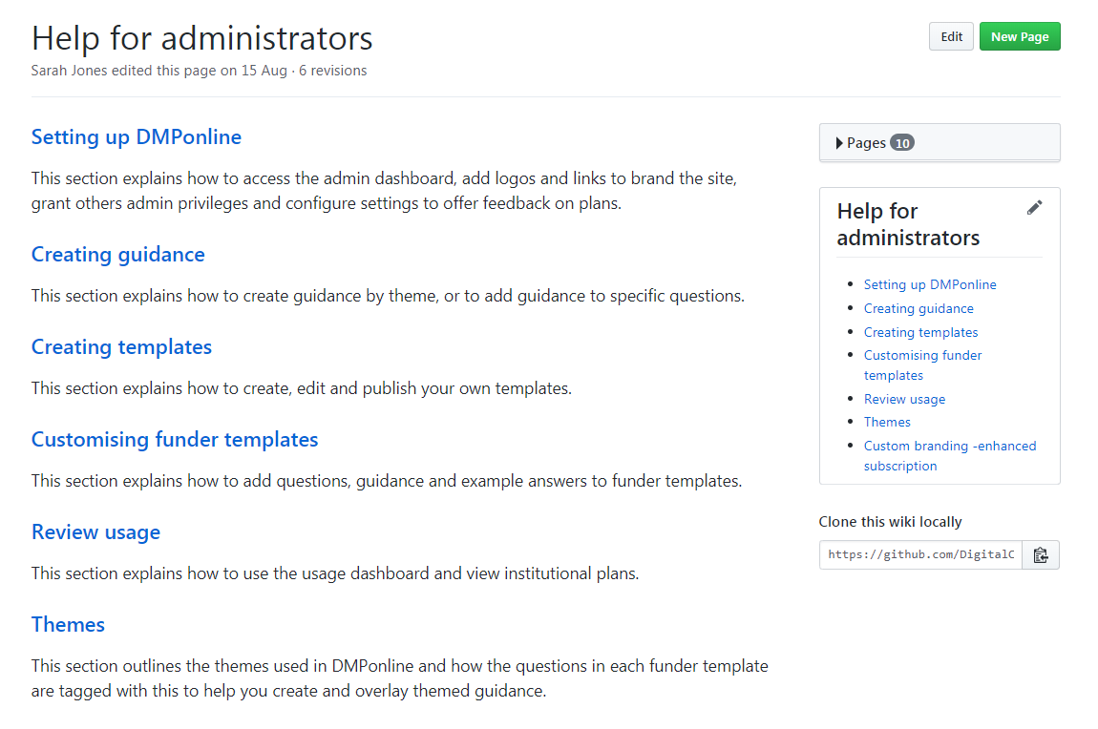
User guide and training
https://github.com/DigitalCurationCentre/roadmap/wiki/Help-for-administrators

Slide 34
Connect & stay in touch
Helpdesk
Twitter
Blog
User group
Github
Slack
DMPonline@dcc.ac.uk
@DMPonline and #ActiveDMPs
http://www.dcc.ac.uk/news/DMPonline
http://tiny.cc/DMPonline-user-group
https://github.com/DMPRoadmap
http://tiny.cc/DMPRoadmap-slack

Slide 35
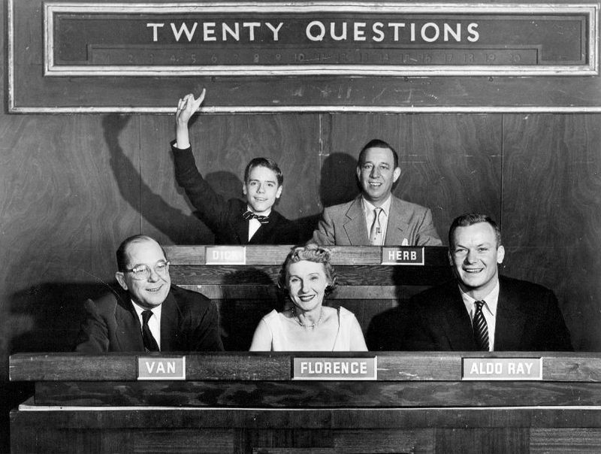
Thanks for listening
Follow us on twitter: @DMPonline and #ActiveDMPs

