Slide 1



New procedures for datamanagement in ZonMw’s projects
Margreet Bloemers (ZonMw)
DMPonline workshop Amsterdam_ZonMw 13.03.2019
Notes:
Workshop Research Institutions and Libraries and the role of Funders in the European Open Science Cloud
Vraag aan publiek:
Wie heeft wel eens een dmp van een onderzoeksfinancier moeten invullen?
Welke?
Kan de onderzoeker ermee overweg?
Kan hij de weg vinden naar jou e/o andere ondersteuning
Vandaag: uitleg over de bedoeling van DM
geen bureaucratie
Wel goed onderzoeken daar hoort DM bij
Oog voor uitdagingen >> kom met vragen
Work in progress

Slide 2
Outline
Why does a funder require datamanagement?
ZonMw’s policy - requirements
Moving to a new procedure:
  why – what – how - with whom
Future opportunities
We invite you to join this developement !!

Slide 3
Discussion DMPonline future developments
ZonMw template
Institutional templates
Improving the templates > HOW?
  Does your template enable the researcher to meet the key items?
How are we going to get most out of it!!
Which elements will we need to align / combine?
Who is taking action? How do we know?

Slide 4





The context of open science for ZonMw
EOSC
NPOS
LCRDM
OAP
FAIR data
Reward
Citizen science
ZonMw speerpunt Open Science
Notes:
GoFAIR implementation networks prevent reinventing the wheel

Slide 5
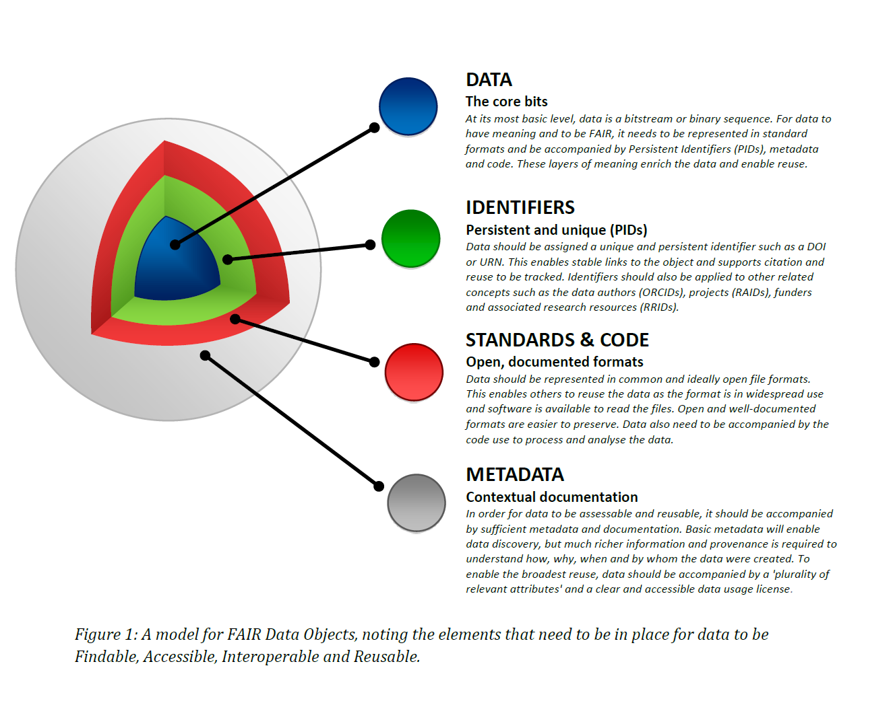
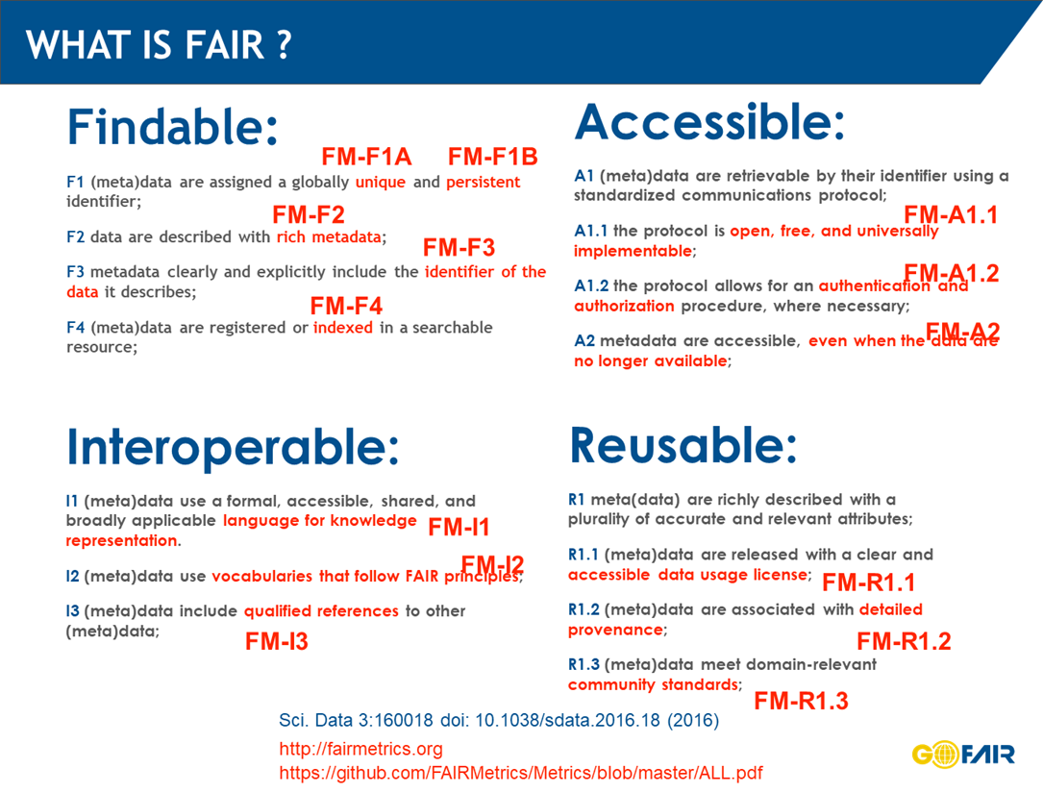
ZonMw requires you to make your data
REUSABLE!
What do we need for that?
Datamanagement
Datastewardship
FAIR principes
Findable – vindbaar
Accessible – toegankelijk
Interoperable – uitwisselbaar
Re-usable – herbruikbaar (duurzaam opgeslagen)
Notes:
Tekst:
Zie creating data
Over het inpakken van de data

Slide 6
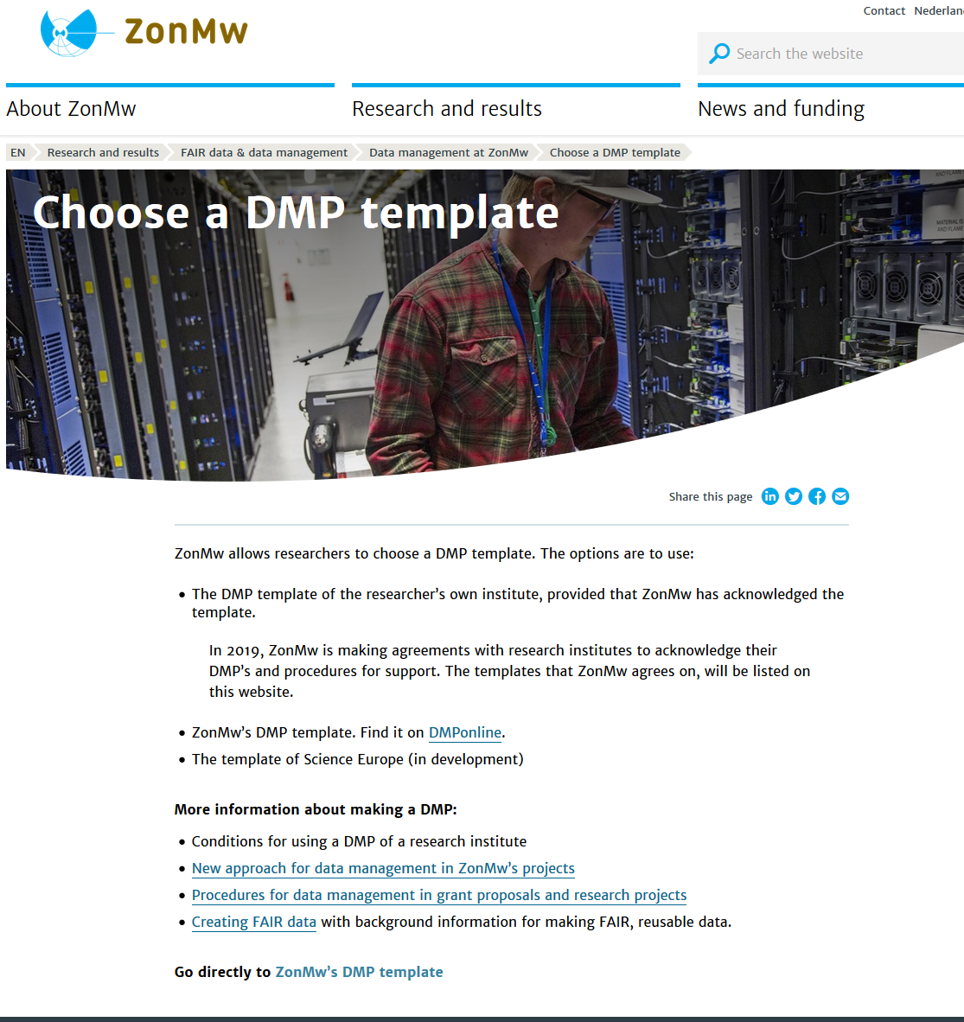
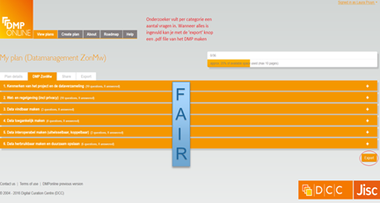
How do we get researchers to produce FAIR data?
Subsidiebepaling artikel 20 Databestanden
Relevantiecriterium
Onderzoeker moet een DMP maken DMPonline

Slide 7
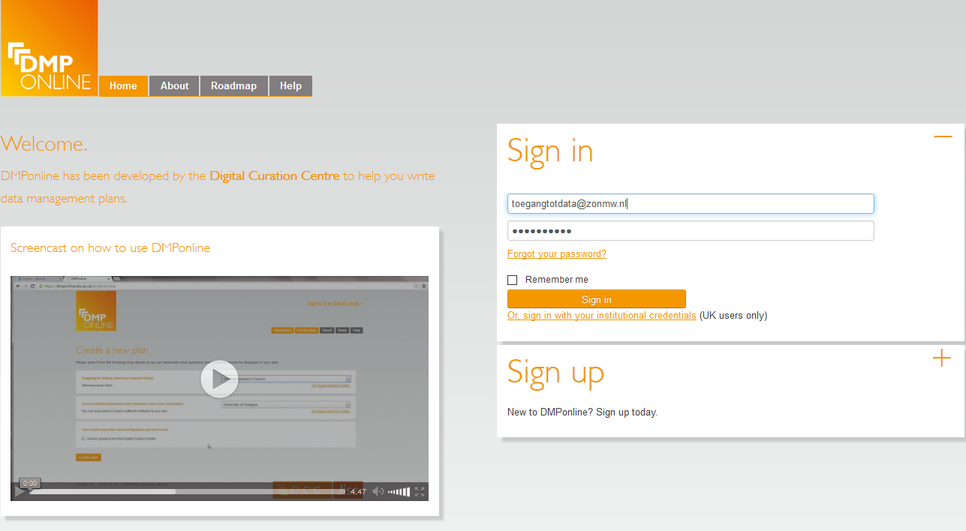
HOE? – DMPonline > de onderzoeker moet inloggen met eigen- of instellingsaccount
Zelf kijken? Zie de instructie op www.zonmw.nl/toegangtotdata
Username: toegangtotdata@zonmw.nl
Password: TTDzonmw15
25

Slide 8
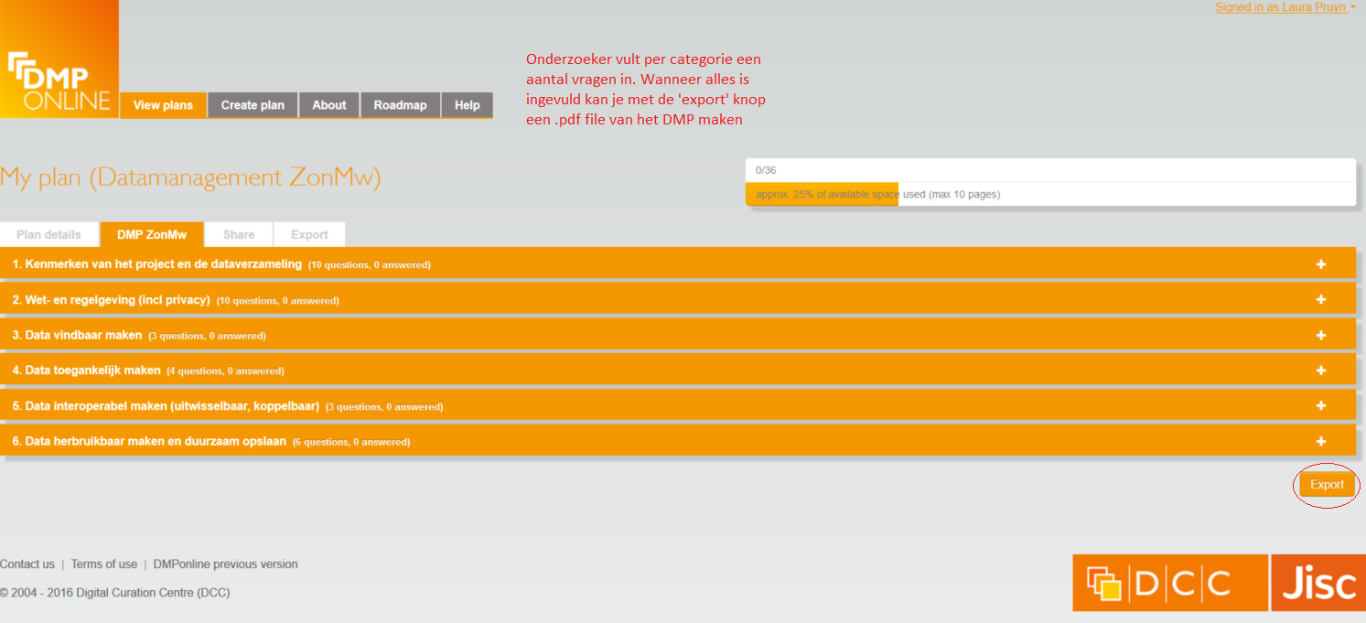
HOE? – DMPonline > de onderzoeker moet datamanagementplan invullen
F
A
I
R
26

Slide 9

How does ZonMw monitor the outcome of a researcher’s DM efforts?
Monitoring KERNGEGEVENS (key items)
  Persistent Identifier refering to the dataset
  Link to the repository or digital archive
  Search engine of repository/ online catalogue/ web portal
  Terms of Use of dataset
  Machine readable data format
  Standardized terminology for data
  Metadata scheme
How FAIR are the data?
>> key items give some indication of ‘FAIRness’
Findable
Accesible
Interoperable
Reusable
Notes:
Kerngegevens
https://www.zonmw.nl/fileadmin/zonmw/documenten/Toegang_tot_data/Key_items_overview_short_guidance_versie_1.0_text_file.pdf

Slide 10
Datamanagement at ZonMw:
Procedure 2016 - 2018
1. Call > project idea:
  Researcher must explain: do you reuse existing data?
2. Call > full grant proposal:
  ZonMw encourages researcher to consult a data steward, and check DMPonline for planning+budgetting the project;
  ZonMw does not yet require a DMP
3. When grant is awarded: make a DMP + submit to ZonMw!
  Researcher must use ZonMw’s template for DMP on DMPonline
4. Feedback on DMP from ZonMw
5. Monitor progress during project & output from DM in final report
  Key items showing some ‘F-A-I-Rness’
  Submit final version of DMP
Notes:
NO part of grant review procedure
AIM is to get good quality research through god DM

Slide 11

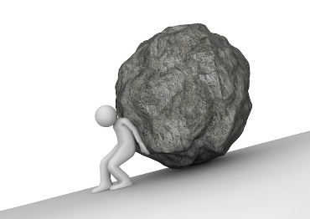
Until sofar ……. BUT……. It’s a burden!

Slide 12

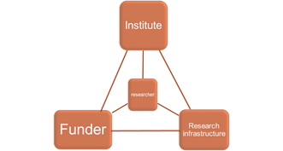
WHO? FAIR data on the work floor
Research FUNDING organisations
RI service providers
LIBRARIES,
ELIXIR, BBMRI, EATRIS, CORBEL’s CoS, ….
Stimulate use of RI services
Training
education
Researcher
(producer & reuser)
Datamanagement
for FAIR data
Universities
(and their Data stewards)
In short:
Notes:
We are not alone! We all want it! >> the scientific community, stakeholders (their role and responsibility > we all need to move)
Bij klik 1: en 2: Note that the funder is an improtant driving force!
That is the essence related to the title of my presentation.
It is also the point where you can have impact with your international programme.
Funders set requrements, they make researchers do DM, oblige them to share their data, stimulate them to reuse data.
Most funders, at least in the Netherlands, have this in their grant condtitions.
Uitleg:
In het realiseren van herbruikbare data en nieuwe kennis, staat de onderzoeker centraal
Die wordt door o.a. ZonMw gestimuleerd om state of art onderzoek te doen voor optimale innovatie
En wordt daarbij ondersteund door diverse experts en RI’s.
Ieder vanuit eigen rol draagt bij aan optimaal gebruik van data en bijbehorende RI’s
ZonMw ziet een rol voor zich weggelegd in het gebruik en het versterken van RI’s: (klik om sheet op te bouwen)
Zorg dat data en samples uit ZonMw onderzoek optimaal herbruikbaar zijn: in ieder onderzoeksproject van ZonMw moet datamanagement uitvoeren cf. FAIR principles (subsidiebepaling vraagt daarvoor een datamanagementplan)
Stimuleer standaardisering en interoperabiliteit binnen (within scientific communities) onderzoeksdisciplines en -thema’s: ZonMw verkeert in de bijzonder positie dat wij met onze programmaclusters contact hebben op dat niveau.
ZonMw is nu ervaring aan het opdoen om binnen clusters van projecten rond eenzelfde thema, onderzoekers bijeen te brengen om dergelijke afspraken te maken.
Hierbij samenwerking met HealthRI partners; zij zetten hun expertise en infrastructuur in.
Voorbeelden op volgende sheet
3. Met onze projectsubsidies willen we onderzoekers stimuleren om gebruik te maken van de RI’s.
Zo kan ZonMw bijdragen aan een versterking van de infrastructuur voor state of art onderzoek.

Slide 13
DM in ZonMw-projects
The procedure
2016-2018
& the obstacles:
FAIR data
Research infrastructure
Research infrastructure
researcher
DMP
DMP
Funder
(ZonMw)
Institute

Slide 14
Challenges and solutions in the new procedure
  What we want to achieve:
  DM becomes integral activity in stead of hurdle
  Added value for research, quality
  For innovative research (& improving health !)
  Through:
  Tailoring DM requirements
  Contributing to standardisation
  New tools
  Research institutes are responsible for DM
  Machine actionable DMP
  FAIR funding model / pilot
Notes:
Anticipating the future opportunities and ambitions

Slide 15
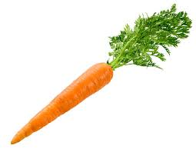
DM in ZonMw-projects > new procedure
Updated guidance
>> DMPonline ZonMw template
How FAIR should it be? >> ZonMw KERNGEGEVENS,
(Machine actionable) information
>> metadata
FAIR data
Research infrastructure
researcher
Kerngegevens
DMP
Create & Select feasible key items / metrics
>> use for monitoring output from DMP
ZonMw
Institute
Notes:
Benefits:
Tailored guidance
Added value for research(er)
Input from research community
Information exchange (machine actionable)
Contributing to standardisation

Slide 16
March 14: My talk stopped here, and we continued with discussion. Some issues I want clarify here: about the DMP
Q1: Why does ZonMw still ask for a DMP, while its new policy is to make the researcher responsible for its own DMP?
  A: Two reasons:
  Administrative: check whether a DMP is made
  Informative: DM is more than a couple of key items. We want to learn from DM methods, tools and standards that are applied in projects. That way, we can further improve / tailor DM procedures for our research programmes.
Q2: Why does ZonMw stop reviewing the DMP’s? What if a researcher delivers bad quality?
  A: As for all aspects of research planning & granting, it is the researcher who is responsible for the quality of his own research. We therefore trust that it is also his own benefit to make a good DM planning. In addition, we make agreements with the research support offices of the research institutes about DM planning, support and quality.

Slide 17
March 14: My talk stopped here, and we continued with discussion. Some issues I want clarify here: about the key items
Q3: What is the purpose of the key items of ZonMw?
  A: Two reasons (similar to the reasons for asking a DMP)
  Administrative: check whether a the DMP has been carried out: ZonMw will monitor the progress during a project: what information is already available at the start and halfway a project? What is the complete information at the end?
  Informative: The key items are in fact a minimal dataset about the outcome of your DM. We want to learn from DM methods, tools and standards that are applied in projects. That way, we can further improve / tailor DM procedures for our research programmes. Also, we can stimulate the use of standards within research communities.
Q4: The key items are far too ambitious. Most research is not yet ready to meet them. Or they simply do not fit the practice of a research community. How does ZonMw deal with this problem?
  A: The key items are desirable topics for reasons stated in Q3. At the same time, we realise that there is still al lot to be developed for RDM. In our scheme for the key items, there is an option to state “not available”/ “not applicable”, and the reason for this. All this information is input for further, community specific developments in our procedures.

Slide 18
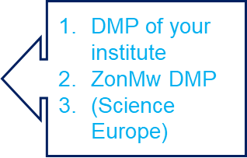
Datamanagement at ZonMw:
Procedure 2019
1. Call > project idea:
  Researcher must explain: do you reuse existing data?
  ZonMw sets requirements for output from DM
  through (a selection of) key items
2. Call > full grant proposal:
  Same as current procedure
3. When grant is awarded: make a DMP + submit to ZonMw!
  Researcher may choose a DMP template
  must use ZonMw’s template for DMP on DMPonline
4. Feedback on DMP from ZonMw research support at res’s own institute
5. Monitor progress during project & output from DM in final report
  Key items showing some ‘F-A-I-Rness; submit final version of DMP
Notes:
NO part of grant review procedure
AIM is to get good quality research through god DM
(and selection of FAIRmetrics)

Slide 19

Datamanagement: from burden to benefit
Benefits for researcher:
Adding value, Improve data sharing
Efficiency: no double DMP
ZonMw trusts researchers to be responsible for quality of research project
Tailored requirements; fit the prupose in research communities
Standardisation > interoperability
Machine actionable metadata
> information exchange – automatic workflow
Notes:
Benefits for researcher:
Aiming at research communities
Tailored requirements
Added value & quality of research project
Improve data sharing within research community
Contributing to standardisation > interoperability
Machine actionable metadata > information exchange – automatic workflow

Slide 20
Datamanagement: from burden to benefit
Benefits for ZonMw:
Efficiency: reduce work load at ZonMw
ZonMw recognises the value of DM support at research institute
Tailoring requirements
Improve research outcome (+ impact):
  Reusable data - Standardisation in research communities
Machine actionable metadata > improve efficiency: information exchange – automatic workflow
Notes:
Benefits for ZonMw:
Tailoring requirements in research programmes
Delegate DM support to research institute:
Reduce burden at ZonMw - Improve quality DMP
Improve research outcome (+ impact):
Reusable data - Standardisation in research communities
Improve efficiency: information exchange – automatic workflow

Slide 21
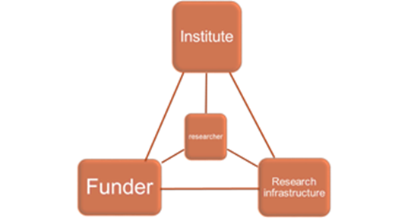
State of art introducing the new approach
Continuing to develop procedures/methods/tools together with institutes and RI’s
Acknowledging institutional dmp’s
DMPonline
Key items
Next sheets are about future opportunities:
FAIRmetrics > more precise tailoring
FAIR funders model
> automation, standardisation, evaluation

Slide 22
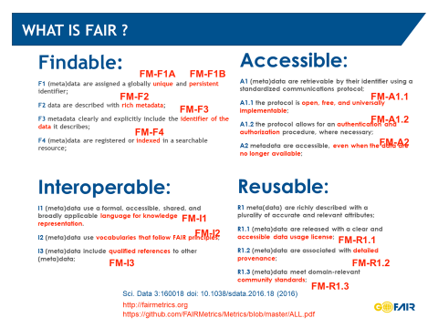
In future calls for proposals: Tailoring the requirements for DM
Develop community
specific FAIRmetrics >
Make a selection for a call >
requirements >
criteria for monitoring
DM in research projects
2. Promote the use of standards
within a research community;
Provide information through
machine actionable metadata.
(more info soon to come on
ZonMw webpage for FAIR data)

Slide 23
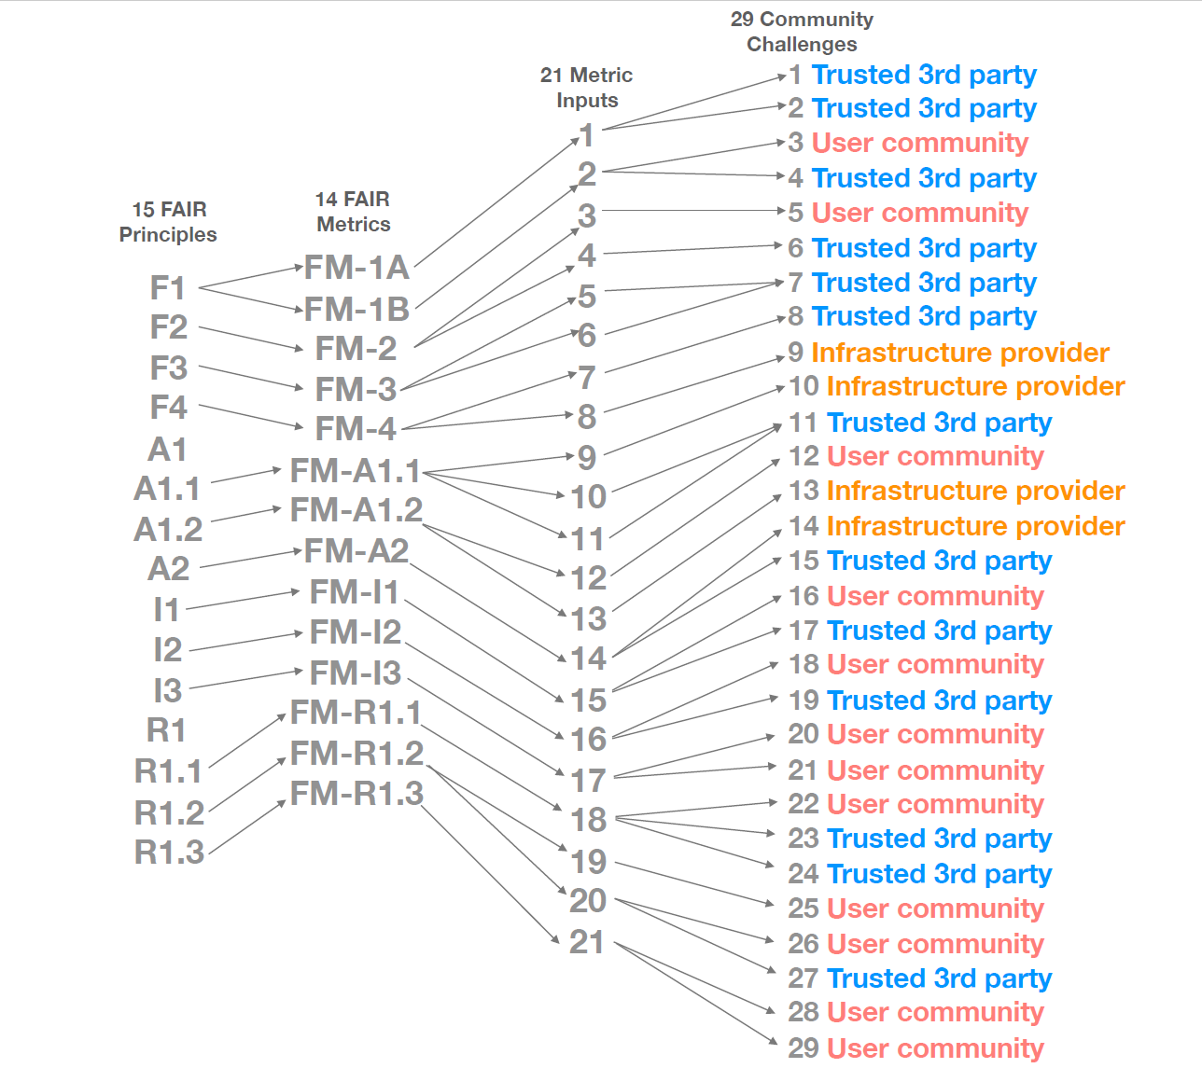
FAIR principles > FAIRmetrics > community challenges > community specific metrics

Slide 24
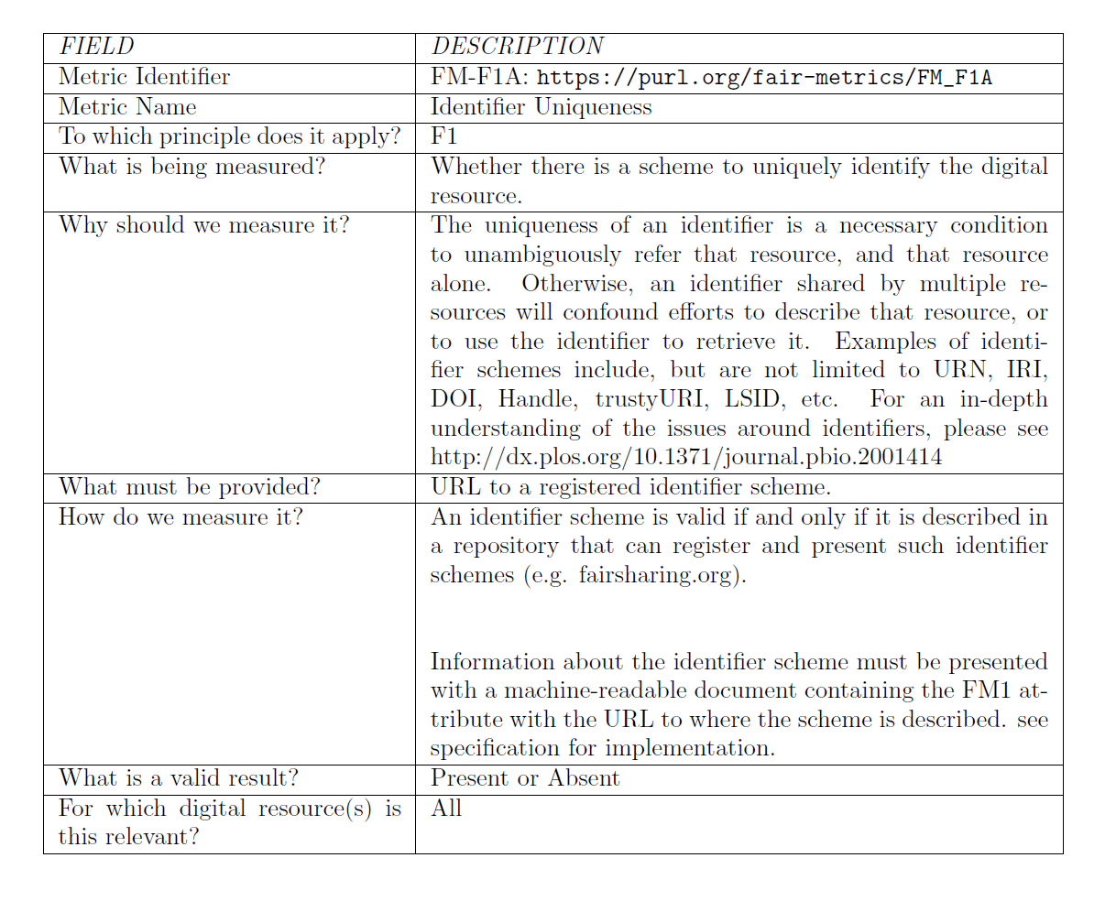
A framework to develop community specific, machine actionable FAR metrics

Slide 25
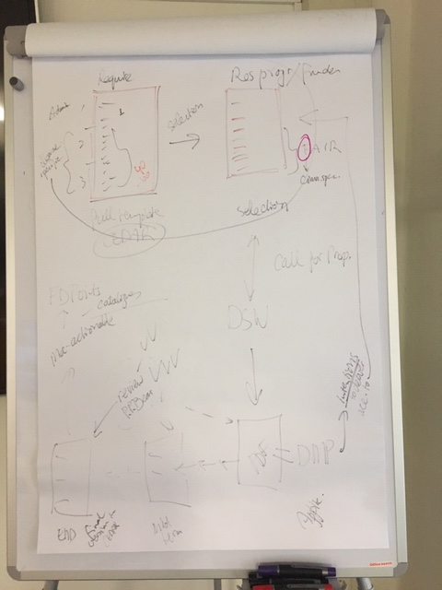
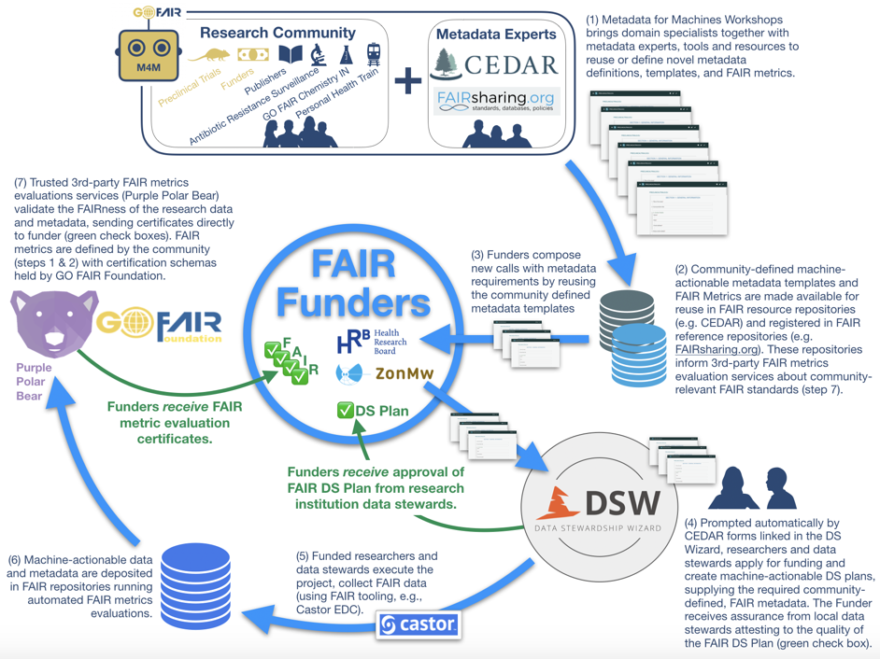
GO FAIR M4M
FAIR funder pilot

Slide 26
ZonMw
Margreet Bloemers
Bas de Waard
toegangtotdata@zonmw.nl
Read more about Datamanagement at ZonMw
(More to come, when we finish our new website)

