Slide 1


DMPonline at the University of Manchester
Rosie Higman, Research Services Librarian
@RosieHLib
9th April 2019

Slide 2
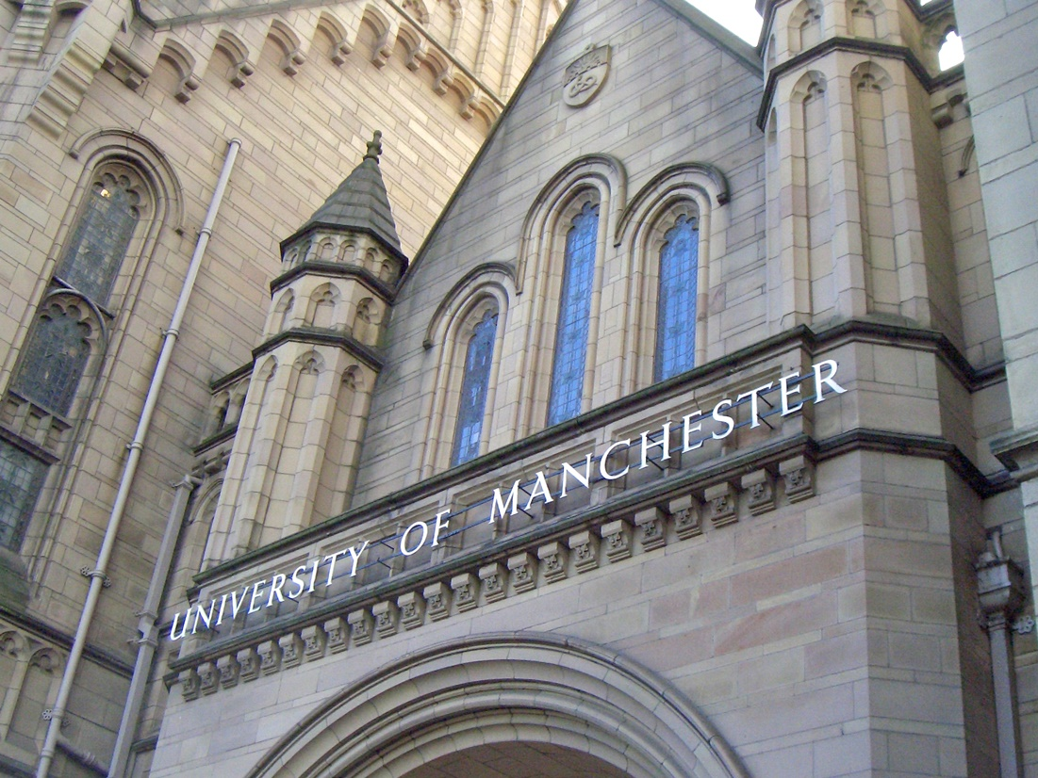
3,625 research students
6,685 research and academic staff
£331m research funding

Slide 3
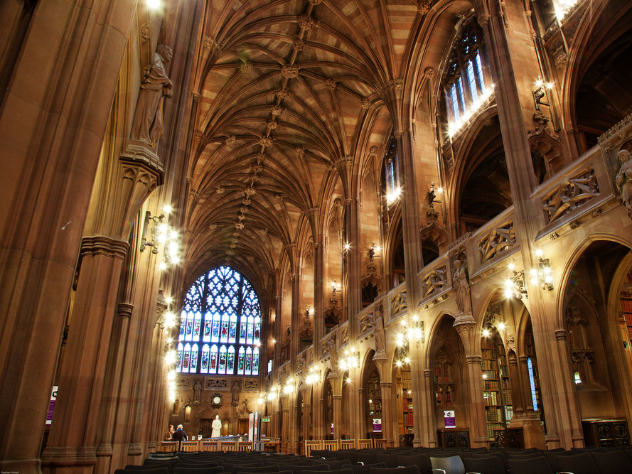
3 Faculties:
Humanities
Science and Engineering
Biology, Medicine and Health

Slide 4


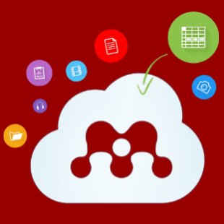



Planning
Storing, computing, analyzing, visualising
Publishing
Recording
My Research Essentials

Slide 5
Data management plans at Manchester
Mandatory for every research project
~60% Compliance with this policy
Aiming to use as:
  Educational tool
  Asset register for GDPR
  Contact point for starting conversations with researchers

Slide 6
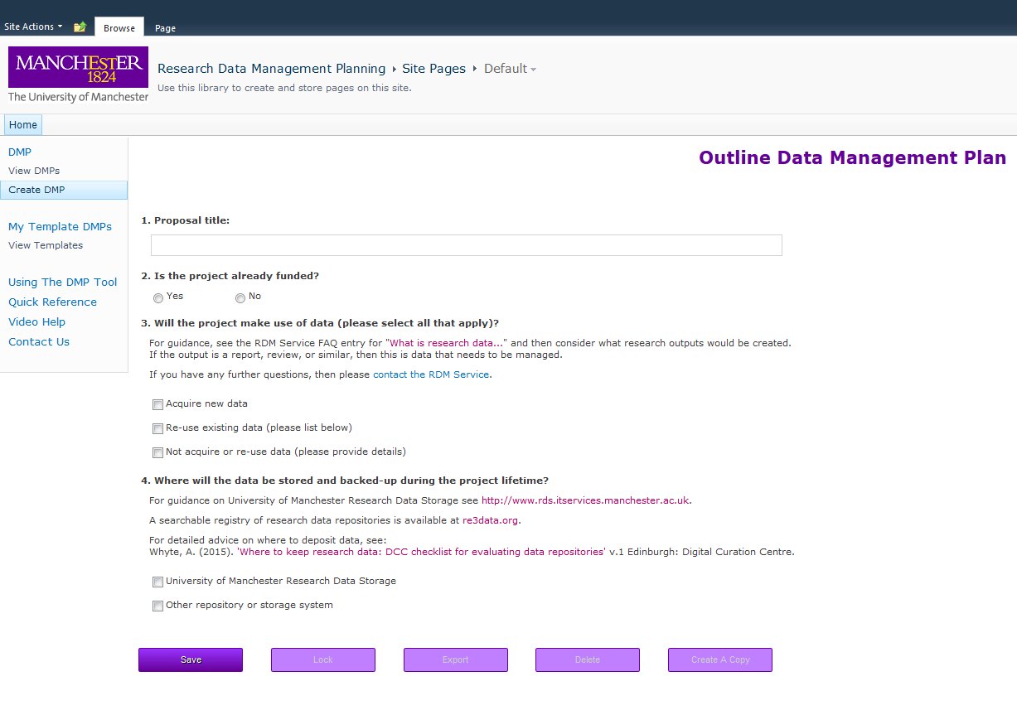
Changing how researchers write DMPs

Slide 7
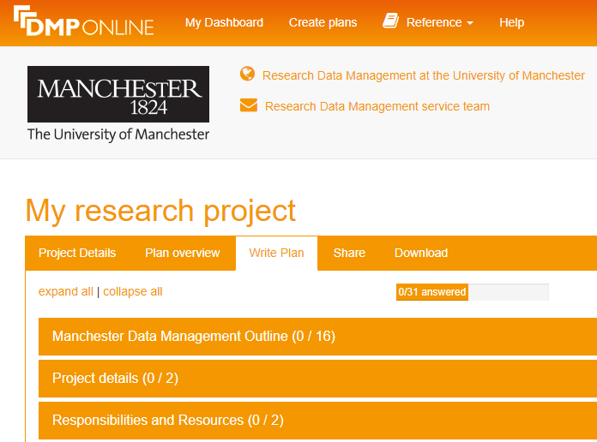
Changing how researchers write DMPs

Slide 8
Manchester Data Management Outline
Internal questions
Inform service provision
Manage risk (GDPR!)
Tick-box or short answer
Themes:
  Funder
  Collaboration or single-institution project
  Whether data will be created or re-used
  Storage
  Retention
  Levels of data sensitivity
  Handling of sensitive data
  Data custodian

Slide 9
Data management planning process
Researcher writes DMP

Slide 10
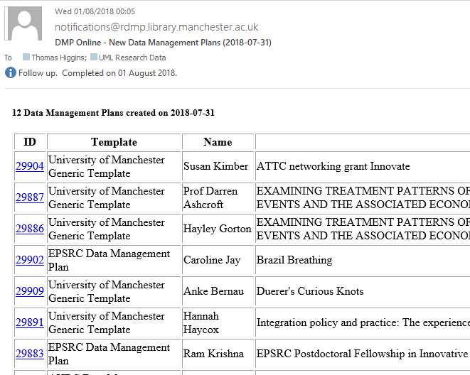
Behind the scenes – outline check

Slide 11
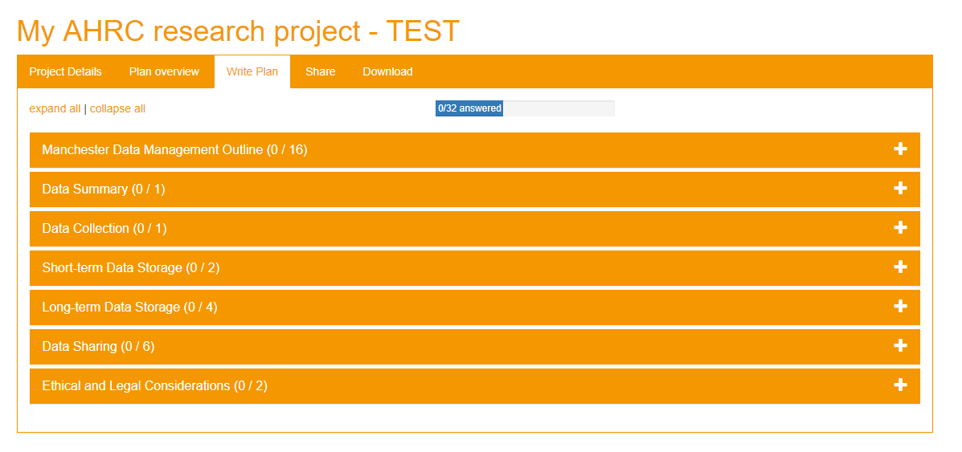
Behind the scenes – outline check

Slide 12
Data management planning process
Data management outline checks
Researcher writes DMP

Slide 13
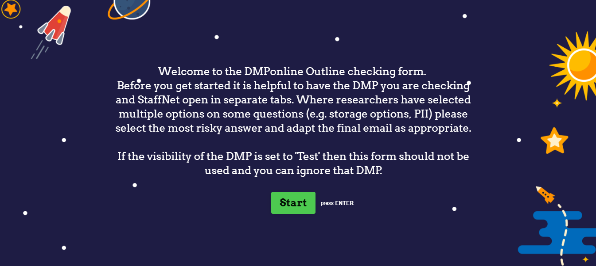
Behind the scenes - DMP outline check

Slide 14
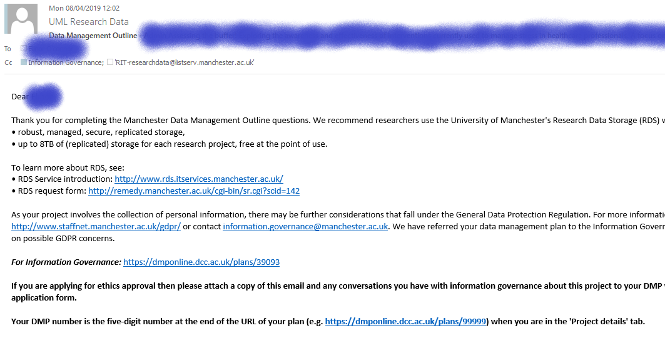
Behind the scenes – feedback email

Slide 15
Data management planning process
Research IT
Information Governance
Feedback
Data management outline checks
Researcher writes DMP

Slide 16
Behind the scenes - Chasing DMPs
Outline check
Not enough questions answered
Record in Typeform
Export records on a weekly basis
Check ‘empty’ DMPs after 2 weeks
‘Nudge’ researchers if still not answered questions

Slide 17
Data management planning process
Research IT
Information Governance
Feedback
Data management outline checks
Researcher writes DMP
Feedback
Full data management plan review

Slide 18
Behind the scenes – full review process
Initial check
Final Check
Complete
Research Services Officer
5 day SLA
Research Services Librarian
5 day SLA
Mark as complete in DMPonline

Slide 19
Data management planning process
Research IT
Information Governance
Feedback
Data management outline checks
Researcher writes DMP
Ethics
Research Approval Form & RDS
Feedback
Full data management plan review

Slide 20
DMPonline at the University of Manchester
Notes:
3000+ plans, 2000+ users

Slide 21
Future work
Customised homepage
Rationalising internal questions
  Would like to add conditional questions to make this easier
Making process more flexible
  NIHR and H2020 causing particular issues
Compliance checking
Better integration with Pure

Slide 22
DMPonline at the University of Manchester
Thank you for listening!
Contact:
rosie.higman@manchester.ac.uk
researchdata@manchester.ac.uk
@RosieHLib
@UoMLibResearch
With thanks to:
Helen Dobson, Chris Gibson, Tom Higgins, Jessica Napthine-Hodgkinson, Mary McDerby, Laurence King, Cath Barrow, Lynne McCrae, April Lockyer & Hannah Pope

