Slide 1


Options for customising DMPonline
Sarah Jones
Digital Curation Centre, Glasgow
sarah.jones@glasgow.ac.uk
Twitter: @sjDCC
Advanced DMPonline workshop, 16 February 2016, Ormskirk

Slide 2
Organisations can do a range of things
Create your own template(s)
Provide tailored guidance
Customise funder templates
Add logos and details in a banner

Slide 3

DEFINING YOUR TEMPLATE
Planning what questions and guidance to add
Image under licence by DCC

Slide 4
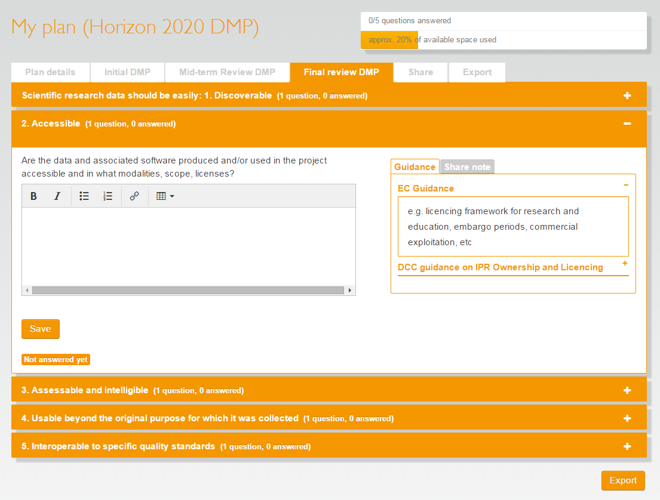
The hierarchy of a template
Templates can have one or more phases e.g. for the grant application stage and during the project
Within each phase, there are a series of sections. Plans are locked for editing by section.
You can have any number of questions within each section.
Guidance is applied by question or by theme.

Slide 5
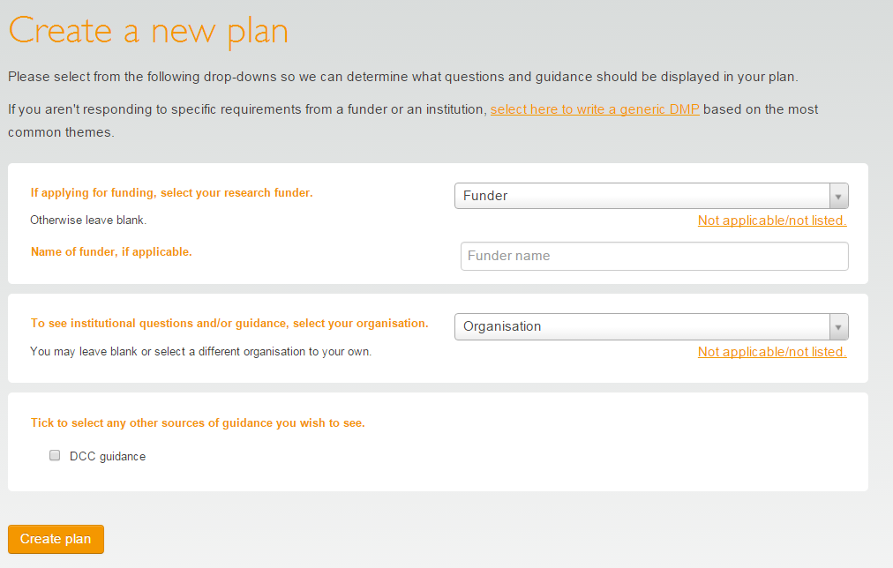
How templates are selected
If researchers specify a funder, we present the funder template
(plus any guidance and questions from their institution)
If no funder is given, we present the institutional template
If no funder or institution is applicable, we present the generic DMP template
Guidance is displayed based on the organisation listed and any optional extras chosen

Slide 6
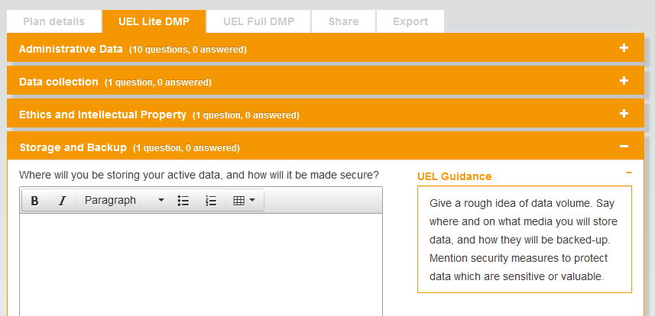
Organisations can add DMP template(s)

Slide 7
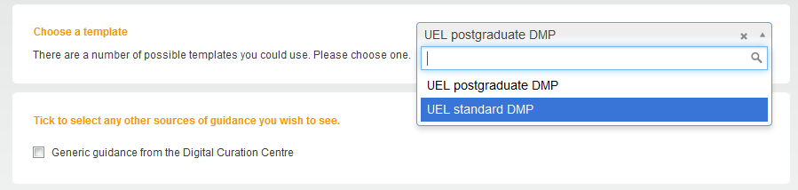
You can have more than one template
You may want to provide different templates for different audiences e.g. PhD students and research staff

Slide 8
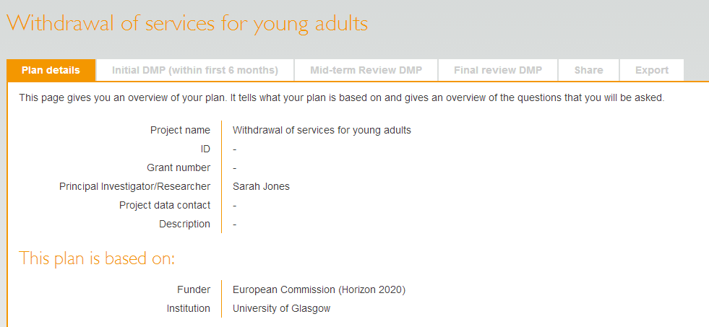
And templates can have multiple phases
Phases
This encourages researchers to actively update the Data Management Plan throughout the project

Slide 9
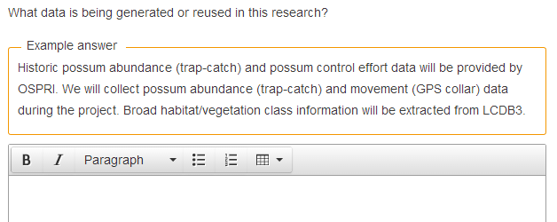
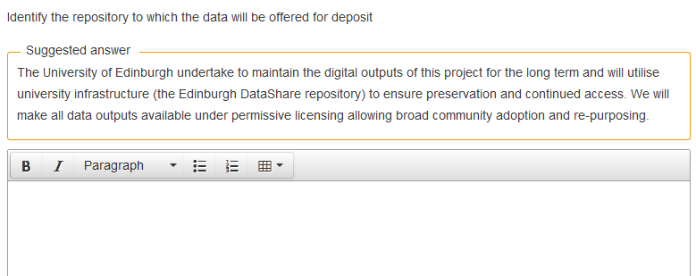
Provide examples and suggested answers

Slide 10
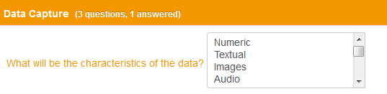
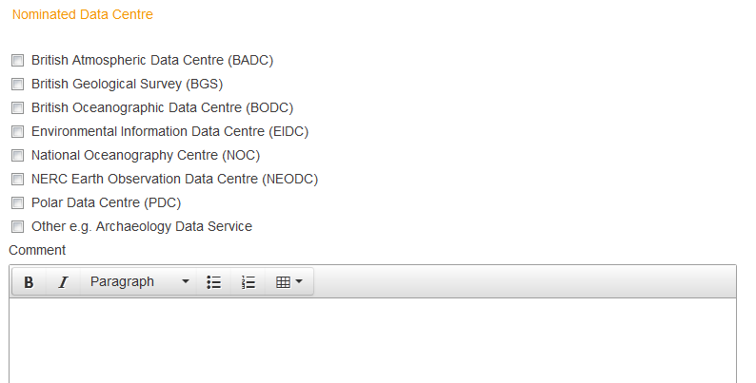
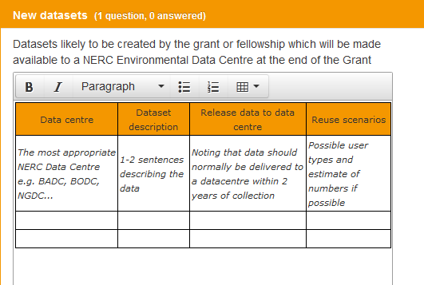
Dropdown options and default styles

Slide 11

Let’s try it out…

Slide 12
Creating new versions
When you make changes to a published template, you’ll be asked if they are big or small changes
Big changes | Small changes
New sections, new questions, rewording questions in a way that changes meaning | Fixing typos, minor changes to questions
Affects any existing DMPs | Existing DMPs still valid
New version created | Edits to existing version allowed

Slide 13
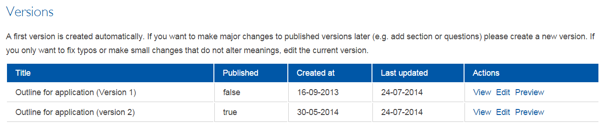
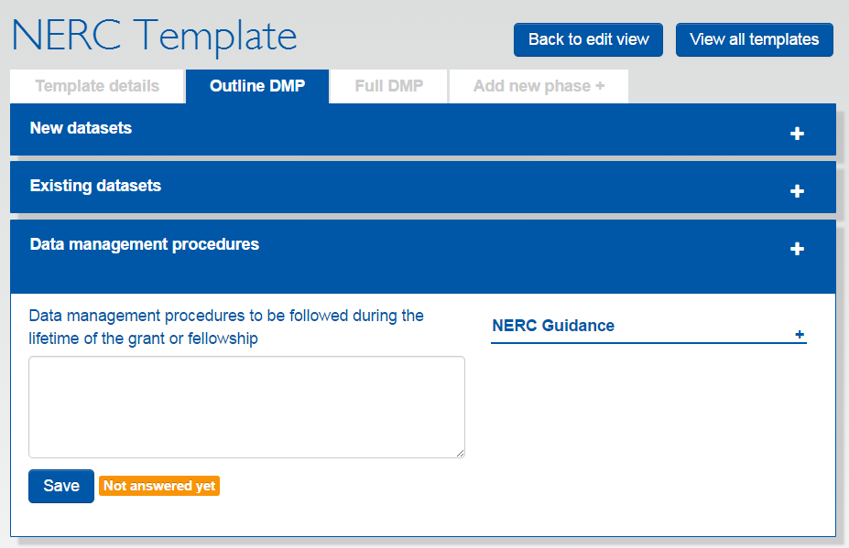
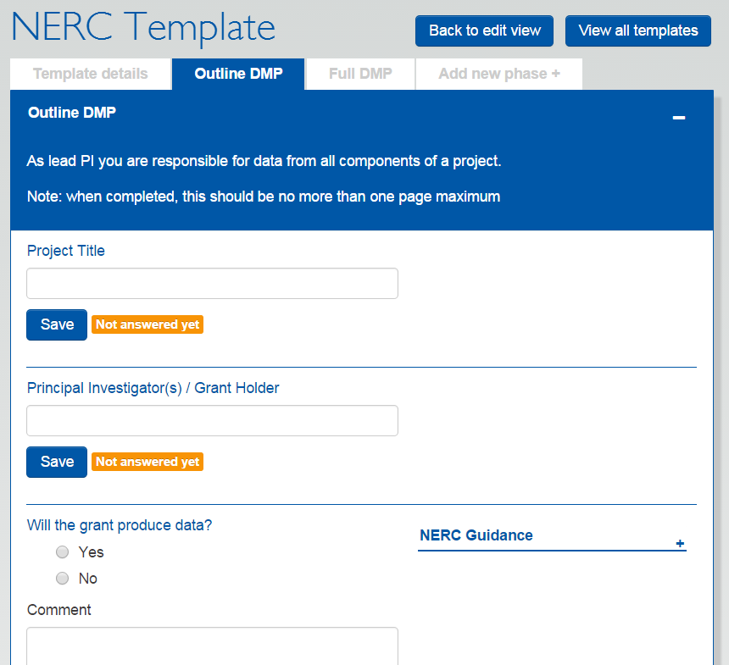
Earlier versions are retained
Version 1 Outline DMP now unpublished
Version 2 of the Outline DMP currently in use

Slide 14
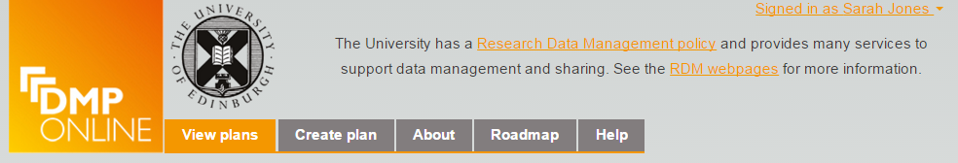
Institutional banner
Add your institutional logo
Provide some high-level text
Link to key resources e.g. RDM policy and webpages

Slide 15
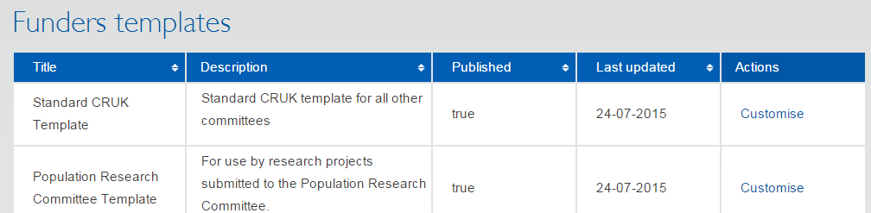
Customising funder templates
Add things you need to know that funders don’t ask e.g.
  What volume of data will you create? Does it exceed X GB?
  Are there any training requirements?
  Would you like help with your DMP & details of support services?
We plan to build in flags so you can trigger alerts

Slide 16
Let’s try it out…

Slide 17
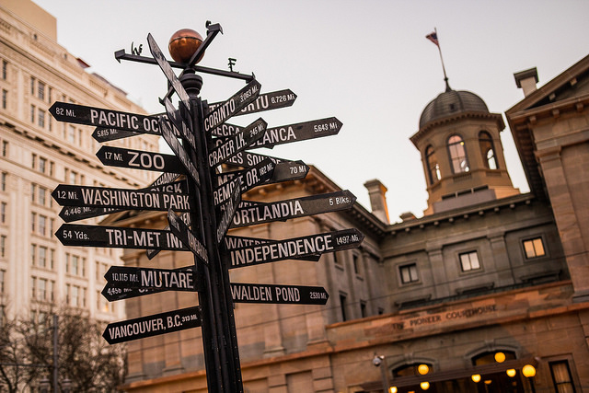
PROVIDING GUIDANCE
Signposting help and giving examples
Image ‘Pioneer signpost’ CC-BY-NC-ND by Spencer Goad www.flickr.com/photos/spgoad/12998899453

Slide 18
Guidance in DMPonline
Guidance for each question
Specific guidance for the question
Themed guidance by organisation
Themed guidance from other sources

Slide 19
Themes used in DMPonline
Expected Reuse
Discovery by Users
Method for Data Sharing
Timeframe for Data Sharing
Restrictions on Sharing
Managed Access Procedures
Data Selection
Period of Preservation
Preservation Plan
Data Repository
Responsibilities
Resourcing
Existing Data
Data Description
Data Format
Data Type
Data Volumes
Data Capture Methods
Documentation
Metadata
Data Quality
Ethical Issues
IPR Ownership and Licensing
Data Security
Storage and Backup

Slide 20
How themes work
QUESTIONS IN FUNDER TEMPLATES THEMES CUSTOM GUIDANCE
Wellcome Trust
When will you share the data?
Your guidance on the theme ‘Timeframe for data sharing’
BBSRC
Timescales for public release of data
Timeframe for data sharing
MRC
The study team’s exclusive use of the data
STFC
Specify and justify the length of any proprietary period
Your guidance for STFC question 6

Slide 21
Which themes are used where?
Details are provided in the admin interface user guide
Appendix 1: themes used in DMPonline
  (with mappings to specific funder questions)
Appendix 2: funder questions
  (with mappings of themes associated with each)
www.dcc.ac.uk/sites/default/files/documents/tools/dmpOnline/DMPonline-admin-interface-guide.pdf

Slide 22
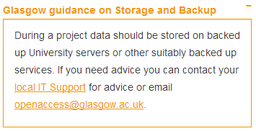
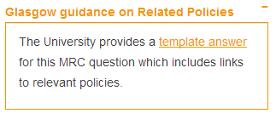
Organisational guidance
Guidance can be added by theme (to apply across the board) or can be written for specific questions
Themed guidance
Specific guidance
Guidance that pertains to MRC question 7 only
Guidance that is presented whenever researchers are asked about storage and backup

Slide 23
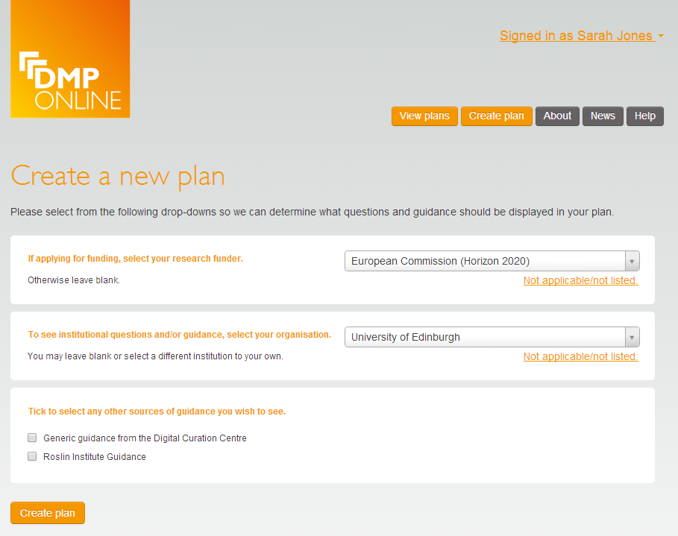
Guidance can be set at multiple levels
Options to have guidance at organisation and ‘unit’ level e.g. by discipline, group, department, institute…

Slide 24
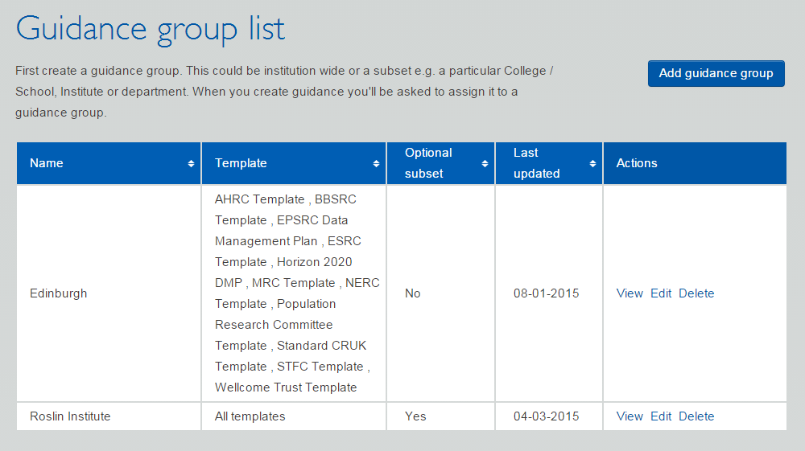
Adding guidance
Create a guidance group to define whether your guidance applies to the organisation or a subset
Add guidance by theme or by question

Slide 25
Let’s try it out…

Slide 26

GETTING STARTED
What to think about first?
Image ‘Go !!’ CC-BY-NC-ND by Cédric Fettouche www.flickr.com/photos/cedmars/5405223203

Slide 27
What to do to customise DMPonline?
Define your requirements
Draft your institutional template
Customise existing funder templates
Draft your guidance, examples and suggested answers
Add content to DMPonline via the admin interface
If you require DMPs

Slide 28
1. Define your requirements
Does your institution encourage/require that researchers write Data Management Plans, even if their funder does not require one? If so, what information are researchers asked to provide?
Do DMPs submitted to research funders supply the information your institution asks for (if any), or are there additional questions that you want to ask?
What guidance, examples and suggested answers can you provide to help researchers write DMPs

Slide 29
2. Draft your institutional template
Begin by reviewing any existing guidance you provide. Your Research Data Management policy or guidance webpages may give some indication of what should be included in a DMP
Think about what your institution needs to know to support researchers with research data management. Use this information to pull together a set of questions and guidance.
Consult existing templates and guidance for ideas.

Slide 30
3. Customise funder templates
Compare your institutional template to each of the funder templates.
Are there any questions missing that you would need answers to? If so, add these.
Add guidance, examples and suggested answers where possible to help researchers write the DMP.

Slide 31
4. Draft your guidance and examples
Consider what level(s) of guidance you want to add e.g. institutional, departmental, discipline-specific…
Write generic themed guidance and/or specific pieces of advice to accompany individual questions
Try to make your guidance as rich as possible by providing links, contact details, recommendations and example answers.

Slide 32
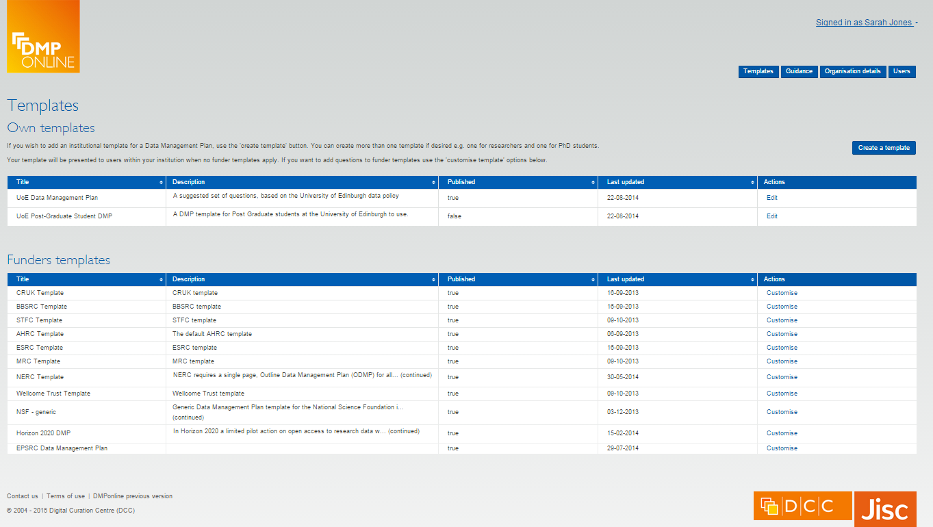
5. Add content via the admin interface
Allows you to add your own templates/guidance and view users

Slide 33
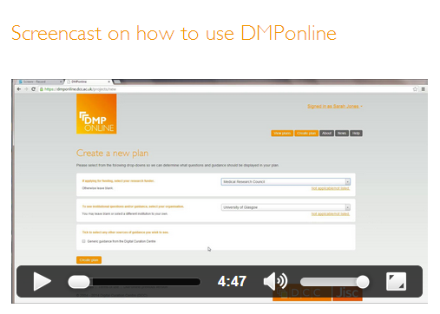


More information
Customising DMPonline
www.dcc.ac.uk/news/customising-dmponline-admin-interface-launches
http://www.screenr.com/PJHN
Get the code, amend it, run a local instance, flag issues, request features... https://github.com/DigitalCurationCentre/DMPonline_v4

Slide 34

Thanks for listening
DCC resources on DMPs:
www.dcc.ac.uk/resources/ data-management-plans
Follow us on twitter:
@digitalcuration and #ukdcc

