Slide 1


Where next with DMPonline?
Sarah Jones
Digital Curation Centre, Glasgow
sarah.jones@glasgow.ac.uk
Twitter: @sjDCC
Advanced DMPonline workshop, 12 July 2016, London

Slide 2
Current work
General maintenance and updates (Jisc supported)
API development
Internationalisation
RDA collaboration project
Alignment with DMPTool
Ongoing roadmap – priority features

Slide 3



Supporting DMPonline in the UK
Please contact the DCC team for:
Admin rights to customise the tool
Advice on using DMPonline
To suggest new features
To alert us to bugs
….
dmponline@dcc.ac.uk
Diana Sisu
Sarah Jones
Marta Ribeiro

Slide 4

API development
Support to integrate DMPonline with other university systems and make better use of content
Have consulted with user group and specified work to develop a RESTful API for 3 initial use cases
  Create a plan (IN)
  Export guidance (OUT)
  Basic statistics (OUT) - in collaboration with Lancaster Uni
Ready for testing soon so get in touch to feed back
Will also be exporting DMPs to Zenodo (part of OpenAIRE)

Slide 5



Internationlisation
Support for foreign languages
Presentation of different (smaller set of) options based on location / organisation / affiliation
Single sign-on for non-UK contexts

Slide 6
Priorities identified at user group
Complete internationalisation to provide multi-lingual support
Provide guidelines to translate DMPonline and establish a library of translation files
Enable a group of organisations, funders and templates to be defined for a given locale.
Allow contact details to be specified for a locale and for the contact us page to be updated in this case
Extend the ‘edit profile’ functionality to allow users to set their preferred language and locale
Enable non-UK federations to use single sign on
Provide a template export/import option

Slide 7
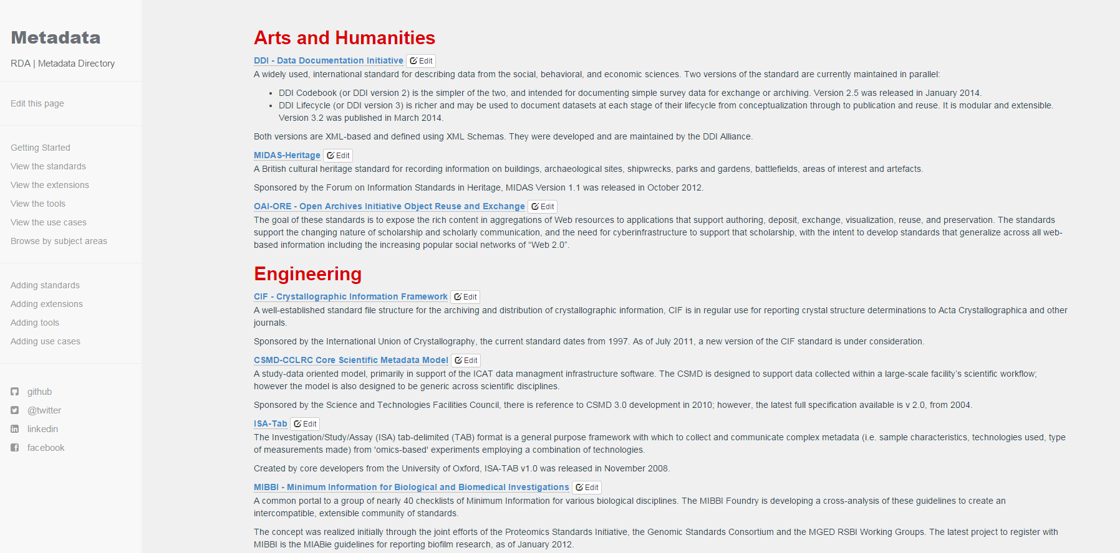

RDA Europe collaboration project
Integrate the Metadata Standards Directory into DMPonline
http://rd-alliance.github.io/metadata-directory/standards

Slide 8
Benefits of the MSD integration
Increase researchers awareness of relevant metadata standards
Allow funders, institutions and other administrators to perform compliance checks
Produce DMPs more suitable for machine analysis and action
Demonstrate the utility of integration between DMP tools with other catalogues and systems

Slide 9
Closer join-up with DMPTool
Common activities and interests:
How to monitor policies and update templates
Liaison & engagement with research funders
Supporting institutions to customise the tool and use the content in DMPs to full effect
Alignment and integration with other tools & systems
Moving DMPs beyond compliance checkboxes to actually support open practices
http://blog.dmptool.org/2016/02/10/dmps-are-going-global

Slide 10


A single platform for all things DMP
Agreed to converge on a single codebase, based on DMPonline with additional features from DMPTool
Bring together features and strengths of each tool
Co-manage, co-develop and issue joint roadmap
DMP Roadmap: https://github.com/DMPRoadmap

Slide 11
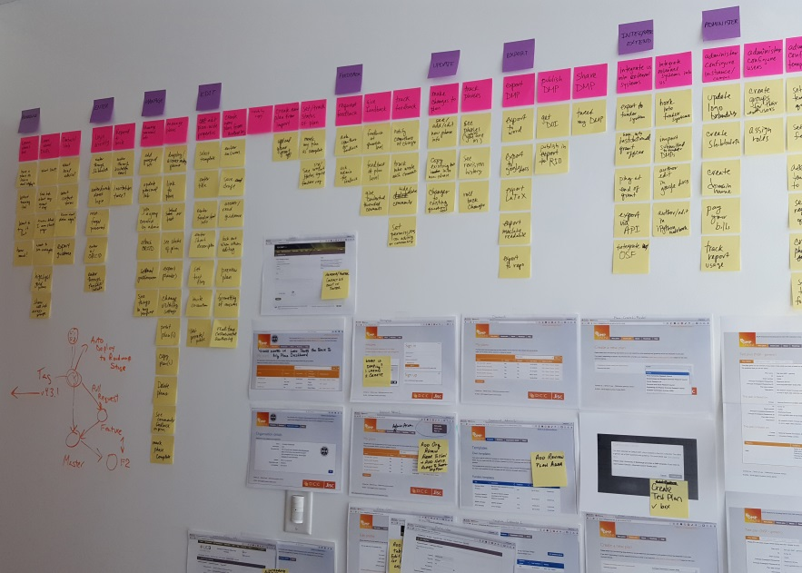
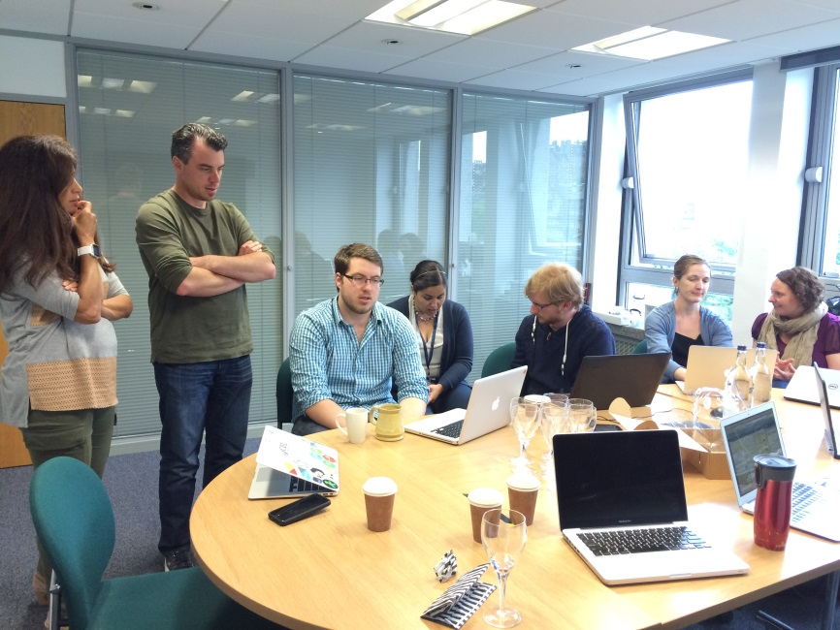
Recently held reciprocal visits
Developing a roadmap
Review work & plan sprint
https://blog.dmptool.org/2016/05/24/ roadmap-team-building-exercises-us-edition
www.dcc.ac.uk/blog/2051-sprint-roadmap-team-building-uk-edition

Slide 12
What will be in the first release?
Existing DCC activities
Migration to Rails v.4.2
Internationlisation & locale filters
Single-sign-on through eduGain
APIs
Small additions and improvements
OAuth link for ORCID
Email notification system
Institutional banner for branding
Copy plan option for new plans
Optimize performance
Admin interface
Admin controls for assigning admin rights to others
Copy template option for creating new templates
Export template with guidance / page of funder requirements
Major new features
A lifecycle to indicate the status of plans and allow institutional access to plans
Flag test plans (exclude from stats)
Support for reviewing plans
Public sharing option > Public DMPs library

Slide 13
DMP lifecycle
Define status of plan
Draft → In review (optional) → Complete → Submitted
Support transition between phases
Enable institutional access to plans
Initial DMP
Full DMP
Focus on DMP as a ‘living document’ in projects

Slide 14

Plan review
Flexible, optional process
Leave control in hands of researchers
Institutions can offer service and define email to be alerted to submitted plans
Will make use of existing commenting feature

Slide 15

Public sharing of DMPs
Three visibility settings:
Public
Institutional
Private
Current default in DMPTool is private. Planning to change this to public once plan is ‘complete’ with chance to opt out or make it institutional.
Based on feedback to pilot and consultation in UK/EU, we may implement the same in Europe

Slide 16
Rethinking themes for DMPs
Are refining the current list of themes down
Merging similar concepts e.g. documentation and metadata
Want fewer themes to make it easier for users
Will be consulting on what themes are needed and appropriate names e.g. resourcing → costs
www.dcc.ac.uk/sites/default/files/documents/publications/ DMP-themes.pdf

Slide 17
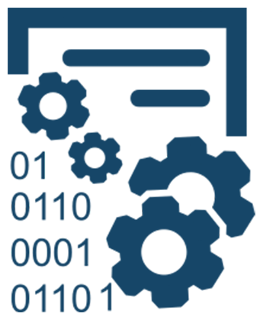
Machine-actionable DMPs
RDA/US Data Share Fellowship
Using themes to standardise and structure DMPs
Proposing use cases e.g. using an actionable list of repositories like Re3data so we can send notifications and/or update DMP
Talks at CERN workshop on DMPs

Slide 18
DMPonline user group
Aims to make it easier for the community to feed in ideas and direct the development of DMPonline
We post plans for consultation and periodically hold sessions to gather input on specific aspects of implementation
Hope to get participants covering all roles e.g. researchers, RDM co-ordinators, administrators, developers, funders...
Subscribe to the user group listserv at:
  www.jiscmail.ac.uk/DMPONLINE-USER-GROUP

Slide 19

Thanks for listening
DCC resources on DMPs:
www.dcc.ac.uk/resources/ data-management-plans
Follow us on twitter:
@digitalcuration and #ukdcc
@DMPonline and #DMPonline

Slide 20
Discussion
What is needed to improve customisation?
  More options?
  Better workflow / usability?
  Rethink guidance / themes?
What are your key priorities & feature requests?

