Slide 1


Where next with DMPonline
Sarah Jones
Digital Curation Centre, Glasgow
sarah.jones@glasgow.ac.uk
Twitter: @sjDCC
Advanced DMPonline workshop, 16 February 2016, Ormskirk

Slide 2
Current work
General maintenance and updates (Jisc supported)
API development
Locale-aware support
RDA collaboration project
Potential alignment with DMPTool
Ongoing roadmap – priority features

Slide 3



Supporting DMPonline in the UK
Please contact the DCC team for:
Admin rights to customise the tool
Advice on using DMPonline
To suggest new features
To alert us to bugs
….
dmponline@dcc.ac.uk
Diana Sisu
Sarah Jones
Marta Ribeiro

Slide 4

API development
Support to integrate DMPonline with other university systems and make better use of content
Have consulted with user group and specified work to develop a RESTful API for 3 initial use cases
  Create a plan (IN)
  Export guidance (OUT)
  Basic statistics (OUT) - in collaboration with Lancaster University
Will also be exporting DMPs to Zenodo (part of OpenAIRE)

Slide 5



Locale-aware support
Supported by innovation fund at University of Edinburgh
Presentation of different (smaller set of) options based on location / organisation / affiliation
Single sign-on for non-UK contexts
Support for foreign languages

Slide 6
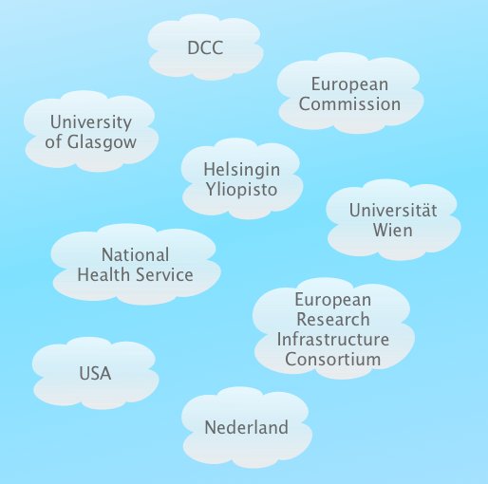
Supporting locale-aware DMPonline
Understand the range of contexts (locales) in which DMPonline is/will be used
Understand the service needs for different locales

Slide 7
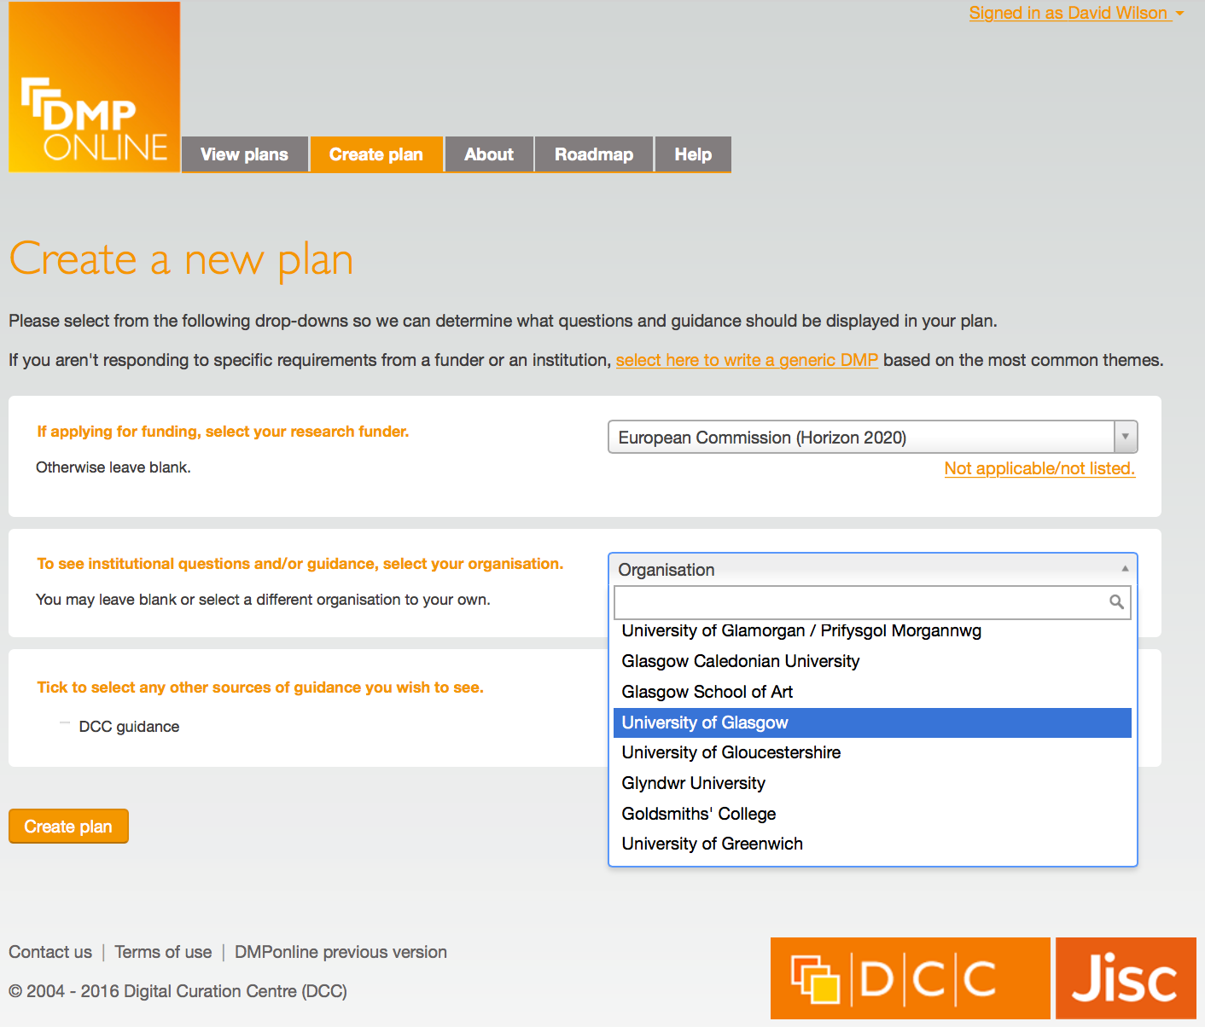
Range of locale-specific features
User sign-in mechanism
Document & guides language
User interface language and data formatting
Funder lists and DMP template lists
Institution lists
Text entry language

Slide 8
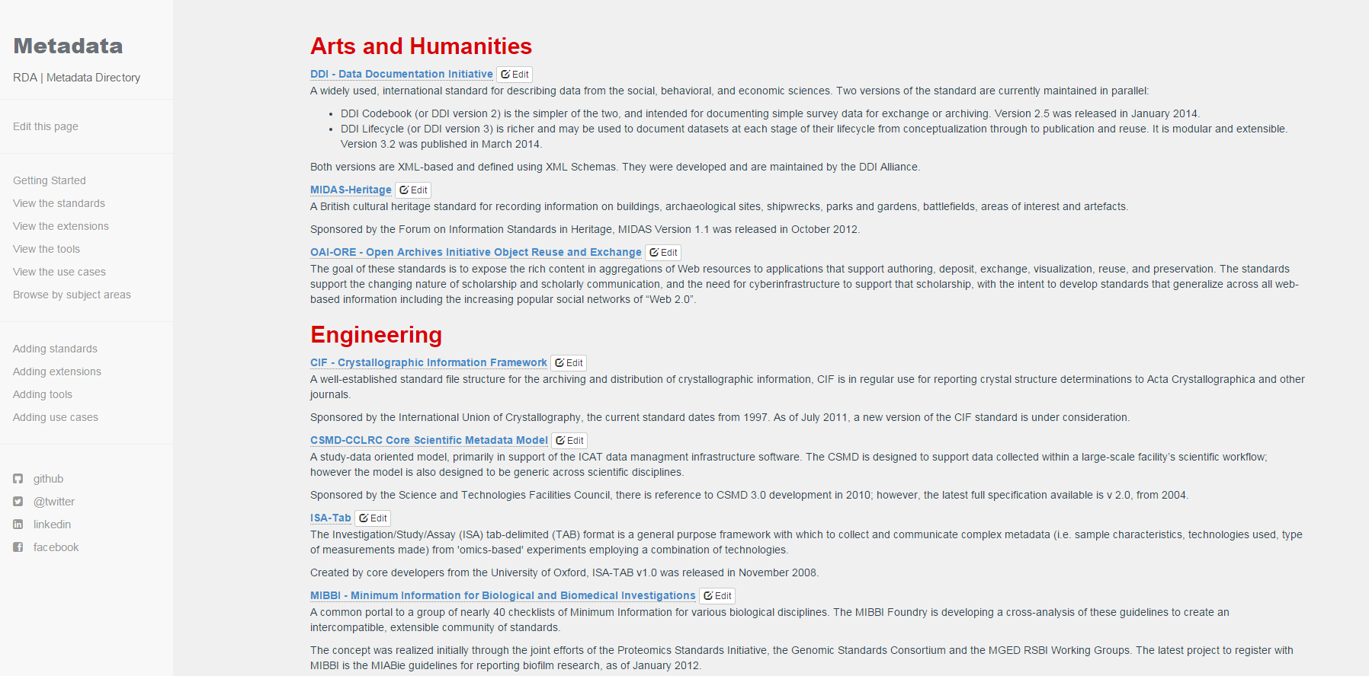

RDA Europe collaboration project
Integrate the Metadata Standards Directory into DMPonline
http://rd-alliance.github.io/metadata-directory/standards

Slide 9
Benefits of the MSD integration
Increase researchers awareness of relevant metadata standards
Allow funders, institutions and other administrators to perform compliance checks
Produce DMPs more suitable for machine analysis and action
Demonstrate the utility of integration between DMP tools with other catalogues and systems

Slide 10
Closer join-up with DMPTool
Common activities and interests:
How to monitor policies and update templates
Liaison & engagement with research funders
Supporting institutions to customise the tool and use the content in DMPs to full effect
Alignment and integration with other tools & systems
Moving DMPs beyond compliance checkboxes to actually support open practices
http://blog.dmptool.org/2016/02/10/dmps-are-going-global

Slide 11


A single platform for all things DMP?
Currently investigating options to converge on a single codebase with DMPTool team
Benefit from pooling resource and expertise
Bring together features and strengths of each tool
Co-manage, co-develop and issue joint roadmap

Slide 12
Roadmap for 2015
Usability enhancements
Release 1
(May 2015)
New features
Release 2
(August 2015)
New features
Maintenance
Maintenance
New features
Maintenance
DMP lifecycle and review
API for system integration
Institutional enhancements
Locale-aware support

Slide 13
Lifecycle and review
Indicate different phases and versions of a plan
Flexible support for different institutional processes
When to provide institutional access to plans
Support for reviewer role & alerts / notifications
Initial DMP
Full DMP
Draft → Reviewed → Revised → Complete → Submitted
Focus on DMP as a ‘living document’ in projects

Slide 14
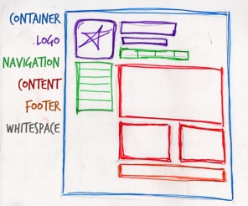
Usability enhancements
Rethink layout/presentation of guidance and themes
Display/hide options for user to focus effort
Allow multiple suggested answers
Revisit the ‘create plan’ wizard
Export own templates and guidance
Create a new template based on an existing one

Slide 15
DMPonline user group
Aims to make it easier for the community to feed in ideas and direct the development of DMPonline
We post plans for consultation and periodically hold sessions to gather input on specific aspects of implementation
Hope to get participants covering all roles e.g. researchers, RDM co-ordinators, administrators, developers, funders...
Subscribe to the user group listserv at:
  www.jiscmail.ac.uk/DMPONLINE-USER-GROUP

Slide 16

Thanks for listening
DCC resources on DMPs:
www.dcc.ac.uk/resources/ data-management-plans
Follow us on twitter:
@digitalcuration and #ukdcc

Slide 17
Discussion
What is needed to improve customisation?
  More options?
  Better workflow / usability?
  Rethink guidance / themes?
What are your key priorities and feature requests as we rework the roadmap?

