Slide 1


Exercise: writing a DMP
Cranfield University, 10th September 2013
Sarah Jones and Alex Ball
Digital Curation Centre

Slide 2
Data Management Plans
DMPs are often submitted with grant applications, but are useful whenever you are creating data to:
Make informed decisions to anticipate and avoid problems
Avoid duplication, data loss and security breaches
Develop procedures early on for consistency
Ensure data are accurate, complete, reliable and secure
Save time and effort – make your life easier!

Slide 3
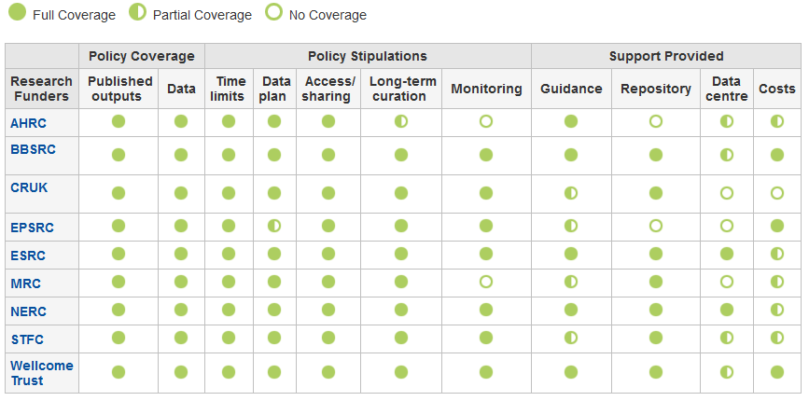
Which funders require a DMP?
www.dcc.ac.uk/resources/policy-and-legal/ overview-funders-data-policies

Slide 4
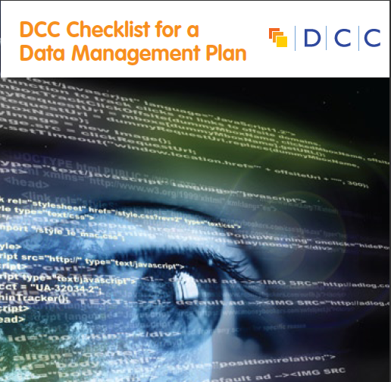
Five common themes
  Description of data to be collected / created
  (i.e. content, type, format, volume...)
  Standards / methodologies for data collection & management
  Ethics and Intellectual Property
  (highlight any restrictions on data sharing e.g. embargoes, confidentiality)
  Plans for data sharing and access
  (i.e. how, when, to whom)
  Strategy for long-term preservation

Slide 5
Exercise: writing a DMP
Pick one or two sections from the DMP Checklist that you’d like to respond to and consider:
What is your current practice?
Are there any issues or areas to improve?
Who may be able to help and support you?
www.dcc.ac.uk/sites/default/files/documents/resource/DMP_Checklist_2013.pdf

Slide 6
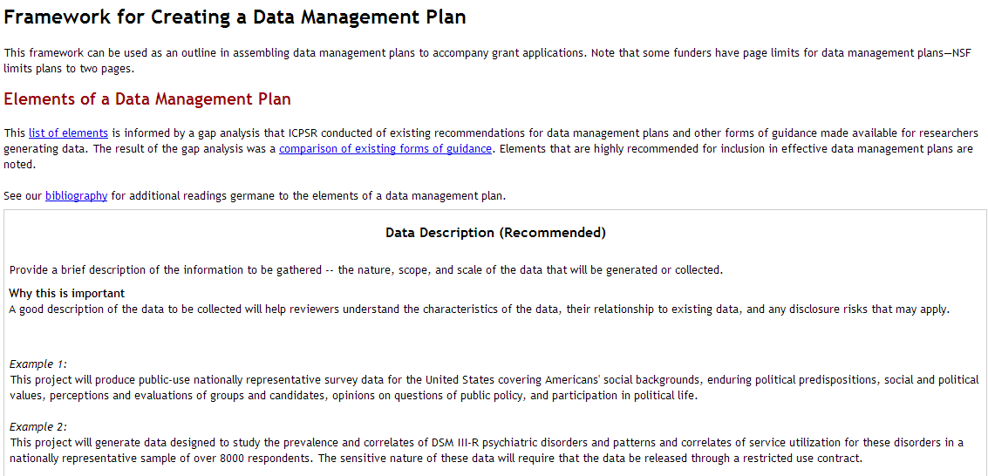
A useful framework to get started
Think about why the questions are being asked
Look at examples to get an idea of what to include
www.icpsr.umich.edu/icpsrweb/content/datamanagement/dmp/framework.html

Slide 7
Useful guidance and examples
How to develop a DMP
www.dcc.ac.uk/resources/how-guides/develop-data-plan
FAQ on Data Management Plans
http://www.dcc.ac.uk/resources/data-management-plans/faq-dmps
Summary of funder requirements
www.dcc.ac.uk/sites/default/files/documents/resource/policy/FundersDataPlanReqs_v4%204.pdf
DMPonline (web-based tool for writing DMPs)
https://dmponline.dcc.ac.uk
UCSD example DMPs (20+ scientific plans for NSF)
http://rci.ucsd.edu/dmp/examples.html

