Slide 1


Research Data Management
Cranfield University, 10th September 2013
Sarah Jones
Digital Curation Centre
sarah.jones@glasgow.ac.uk
Twitter: sjDCC

Slide 2
RISKS, Benefits & drivers FOR RDM

Slide 3
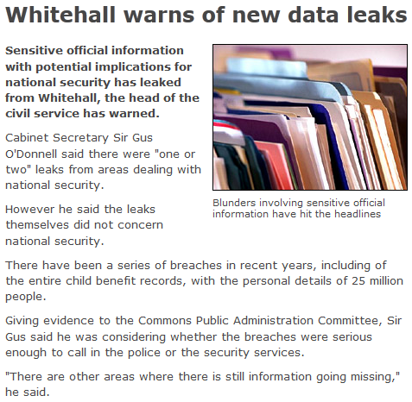
What if your data fell into the wrong hands?
http://news.bbc.co.uk/1/hi/uk/8332445.stm

Slide 4
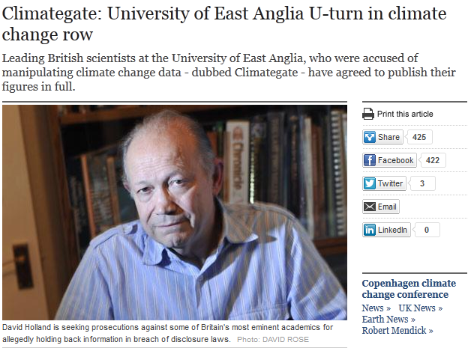
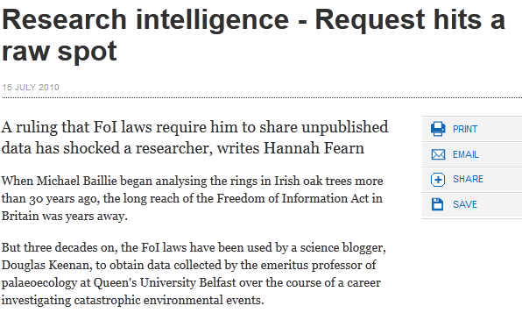


What if you had to produce your data?

Slide 5
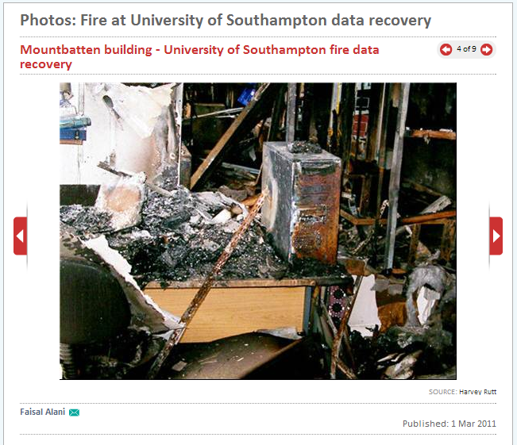
What if this was your desk?
www.computerweekly.com

Slide 6
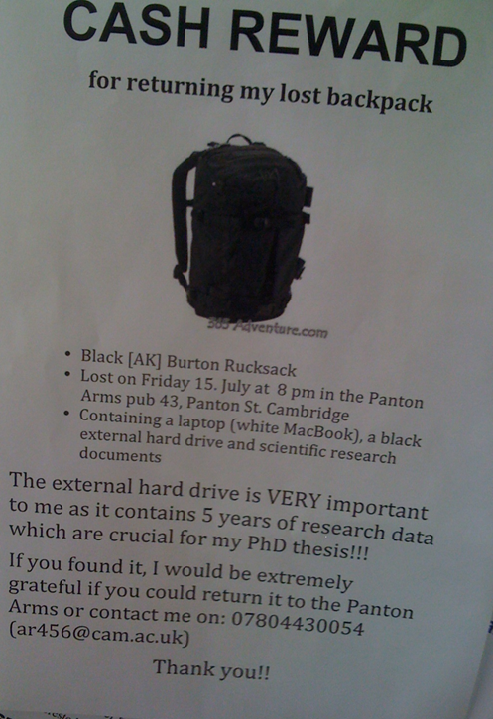
What if this was your backpack?
Why YOU need a Data Management Plan
http://blogs.ch.cam.ac.uk/pmr/
2011/08/01/why-you-need-a-
data-management-plan

Slide 7
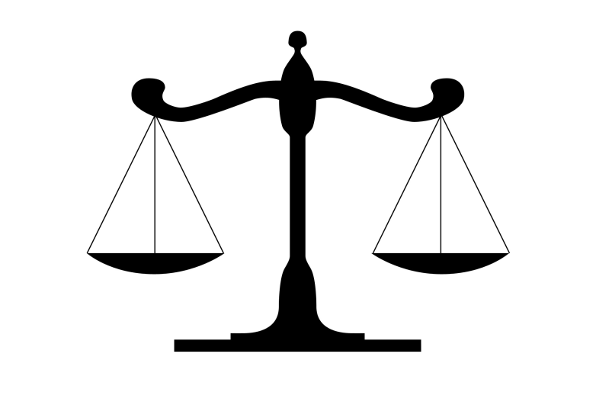
Good data management is about making informed decisions

Slide 8
There are also benefits for you...
To make your research easier!
To stop yourself drowning in irrelevant stuff
To avoid accusations of fraud or bad science
To share your data for others to use and learn from
To get credit for producing it

Slide 9
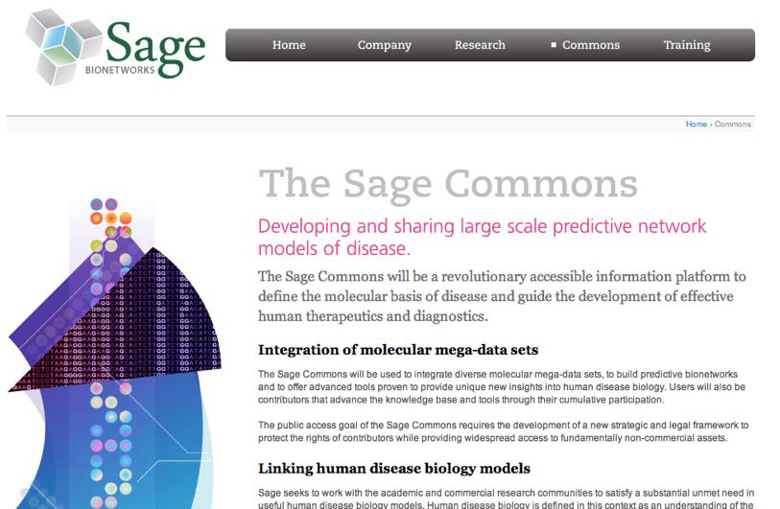
Sharing leads to impact
Data sharing builds communities
Stronger networks
More collaboration
Better science
Only way to tackle ‘grand challenges’

Slide 10
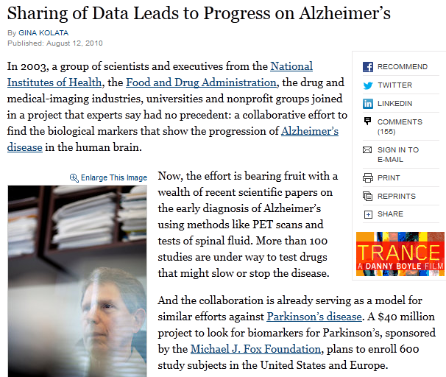
Enables scientific breakthroughs
“It was unbelievable. Its not science the way most of us have practiced in our careers. But we all realised that we would never get biomarkers unless all of us parked our egos and intellectual property noses outside the door and agreed that all of our data would be public immediately.”
Dr John Trojanowski, University of Pennsylvania
www.nytimes.com/2010/08/13/health/research/13alzheimer.html?pagewanted=all&_r=0

Slide 11

More citations for you
“Publicly available data was significantly (p=0.006) associated with a 69% increase in citations independent of journal impact factor, date of publication, and author country of origin.”
Piwowar H. et al. “Sharing detailed research data is associated with increased citation rate” PLoS One 2010. DOI: 10.1371/journal.pone.0000308
9% - 30% increase found in later study across varied disciplines
Notes:
The original study was on gene expression microarray data. Later studies have looked at a range of disciplines and found substantial increases.

Slide 12

Drivers: expectation of public access
“Publicly funded research data are a public good, produced in the public interest, which should be made openly available with as few restrictions as possible in a timely and responsible manner that does not harm intellectual property.”
RCUK Common Principles on Data Policy
http://www.rcuk.ac.uk/research/Pages/DataPolicy.aspx

Slide 13
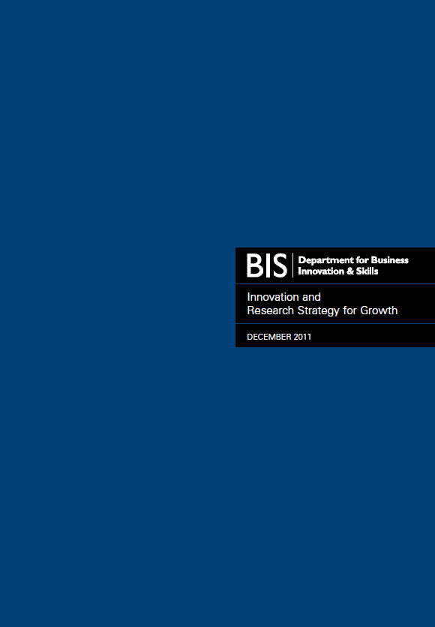

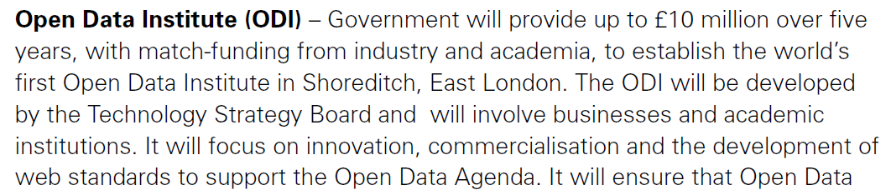
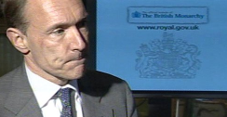
…innovation
http://www.bis.gov.uk/innovatingforgrowth
Notes:
13

Slide 14
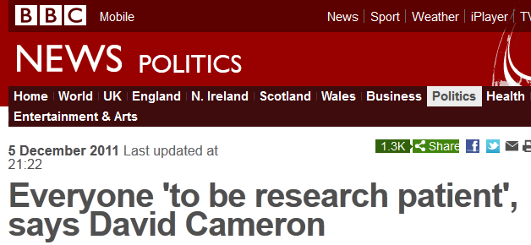
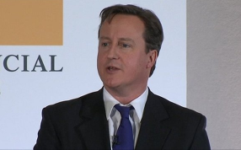

...sharing data for research benefits
Notes:
14

Slide 15
Research data management
- Things to think about

Slide 16
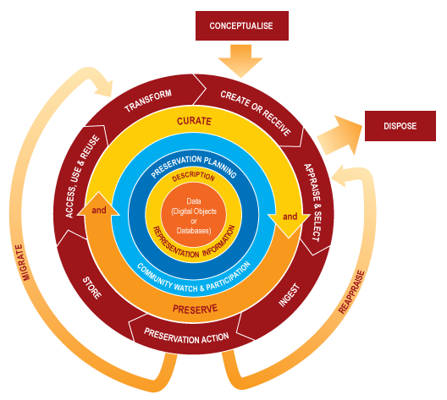
What is data management?
“the active management and appraisal of data over the lifecycle of scholarly and scientific interest”
Digital Curation Centre
Data management is just part of good research practice

Slide 17
What is involved in RDM?
Data Management Planning
Creating data
Documenting data
Accessing / using data
Storage and backup
Sharing data
Preserving data
Create
Document
Use
Share
Preserve
Store

Slide 18
If you plan to share your data....
Have you got consent for sharing?
Do any licences you’ve signed permit sharing?
Is your data in suitable formats?
Decisions made early on affect what you can do later

Slide 19
File formats for long-term access
Unencrypted
Uncompressed
Non-proprietary/patent-encumbered
Open, documented standard
Standard representation (ASCII, Unicode)
Type | Recommended | Avoid for data sharing
Tabular data | CSV, TSV, SPSS portable | Excel
Text | Plain text, HTML, RTF PDF/A only if layout matters | Word
Media | Container: MP4, Ogg Codec: Theora, Dirac, FLAC | Quicktime H264
Images | TIFF, JPEG2000, PNG | GIF, JPG
Structured data | XML, RDF | RDBMS
Further examples: http://www.data-archive.ac.uk/create-manage/format/formats-table

Slide 20
Documentation
What would someone unfamiliar with your data need in order to find, evaluate, understand, and reuse it?
Consider the differences between someone inside your research group, someone outside your group but in your field, and someone outside your field.
Two parts: metadata and methods

Slide 21
Metadata
About the project
  Title, people, key dates, funders and grants
About the data
  Title, key dates, creator(s), subjects, rights, included files, format(s), versions, checksums
Keep this with the data

Slide 22
Methods
Reason #1 for not reusing someone else’s data: “I don’t know enough about how it was gathered to trust it.”
Document what you did. (A published article may not be enough.)
Document any limitations of what you did.
If you ran code on the data, document the code and keep it with the data.
Need a codebook or a data dictionary?
  If I can’t identify at sight what each bit of your dataset means, yes, you do need a codebook or data dictionary.
  DO NOT FORGET THE UNITS!

Slide 23
Standards
Why reinvent the wheel? If there’s a standard format for your data or how to describe it, use that!
The tricky part is finding the right standard.
  Standards are like toothbrushes...
  But using standards is good hygiene!
  Your librarian can often help you find relevant standards.
  Also check out the DCC catalogue of disciplinary metadata
    http://www.dcc.ac.uk/resources/metadata-standards

Slide 24
Where to store your data?
Your own drive (PC, external hard drive, usb...)
  And if you lose it? Or it breaks?
Departmental servers or central IT provision
“Cloud” drive
  Do they care as much about your data as you do?

Slide 25
How to backup?
3… 2… 1… backup!
  at least 3 copies of a file
  on at least 2 different media
  with at least 1 offsite
Use managed services where possible e.g. University filestores rather than local or external hard drives
Ask central IT team for advice

Slide 26
What to keep?
It’s not possible to keep everything. Select based on:
  What has to be kept e.g. data underlying publications
  What can’t be recreated e.g. environmental recordings
  What is potentially useful to others
  What has scientific, cultural or historical value
  What legally must be destroyed
  ...
How to select and appraise research data:
www.dcc.ac.uk/resources/how-guides/appraise-select-research-data

Slide 27
How to share/preserve data?
What is required?
  By your funder
  By your publisher
  By your uni
What subject repositories, data centres and structured databases are available?
  http://databib.org

Slide 28
Acknowledgement
Thanks in particular to Dorothea Salo, Ryan Schryver and colleagues for content from the “Escaping Datageddon” presentation, available at: http://www.slideshare.net/cavlec/escaping-datageddon
    And to the Research360 project at the University of Bath for the “Managing your research data” presentation, available at: http://opus.bath.ac.uk/32296

Slide 29

Thanks – any questions?
DCC guidance, tools and case studies:
www.dcc.ac.uk/resources
Follow us on twitter:
@digitalcuration and #ukdcc

