Slide 1


Research Data Management for researchers
Sarah Jones & Joy Davidson
Digital Curation Centre

Slide 2
About this course
Short presentations with exercises and discussion
  Overview of research data management landscape (Joy Davidson)
  Data sharing exercise
  Introduction to data management planning (Sarah Jones)
  Data management planning exercise
  RDM support and activity at Glasgow (Valerie McCutcheon)
Coffee break halfway through, after data sharing exercise
But first...

Slide 3
Quiz: What do research funders expect?
Funders’ expectations with regards to data management and sharing have
changed quite dramatically over the past few years.
Take ten minutes to complete this quick
quiz to see how familiar you are with these
new requirements.

Slide 4
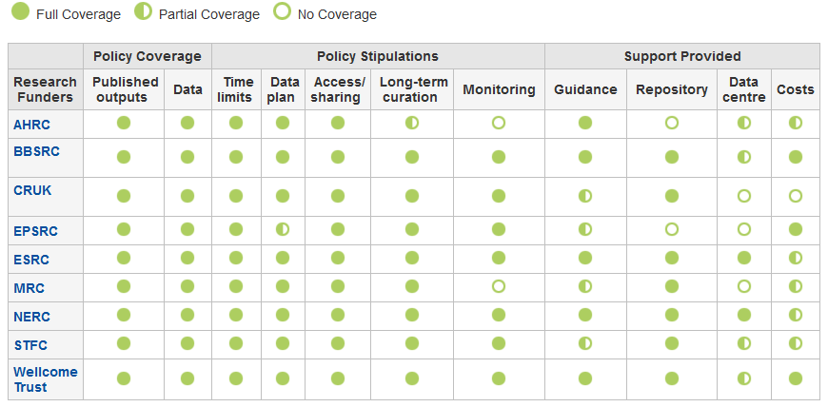
What do research funders expect?
www.dcc.ac.uk/resources/policy-and-legal/overview-funders-data-policies
Notes:
As noted, funders’ requirements have changed in recent years. If in doubt, it is always advisable to check to ensure that you understand what is expected of you.
The DCC has produced an at-a-glance overview of UK funders’ policies with regards to data management planning and sharing.
If you click on any of the funders on the left hand side of the screen, you will find more detailed information about what that funder expects.
DCC updates this table frequently.

Slide 5
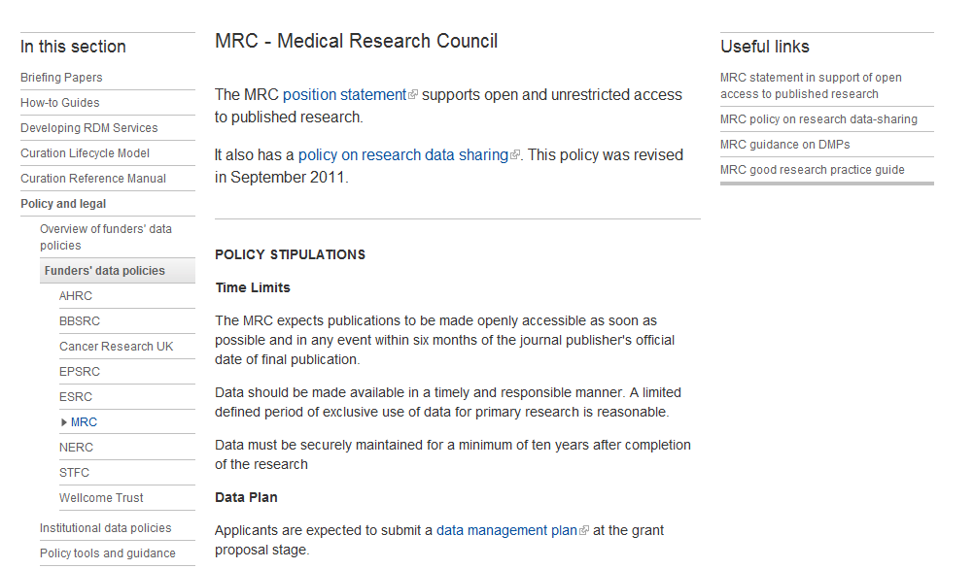
Notes:
Here is an example of the more detailed information you’ll find if you click on any of the funders in the policy overview table.
DCC provides a collection of useful links to funder guidance and other external resources.

Slide 6
Why is sharing data an issue all of a sudden?
“Publicly funded research data are a public good, produced in the public interest, which should be made openly available with as few restrictions as possible in a timely and responsible manner that does not harm intellectual property.”
“There needs to be a culture of
open access”
“Publishing results in the
public arena is a moral obligation”.
Notes:
Has been growing over the past decade. As far back as 2007, OECD declared that publicly funded research is a public good.
First quote, from RCUK Common principles.
Second and third quotes from Health Research Authority (HRA) press release, May 13, 2013 about plans for promoting transparency around publication of health research findings.
Based on HRA workshops with patient groups and the public, clear that patients and the public expect more openness with research findings.
The workshops were run in 2013 as part of a public dialogue project and were supported and funded by Sciencewise Expert Resource Centre, which is the UK’s national centre for public dialogue in policy making involving science and technology issues.
www.sciencewise-erc.org.uk

Slide 7
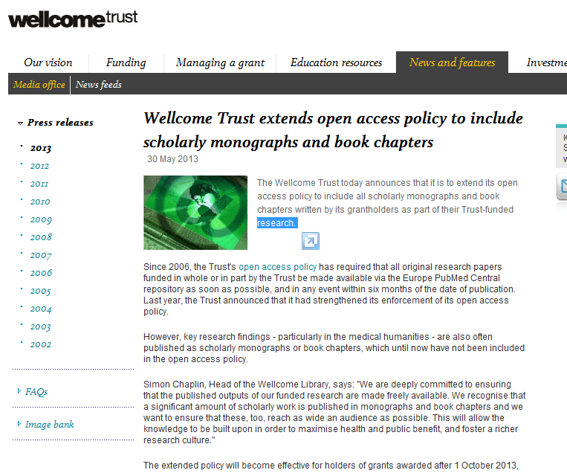
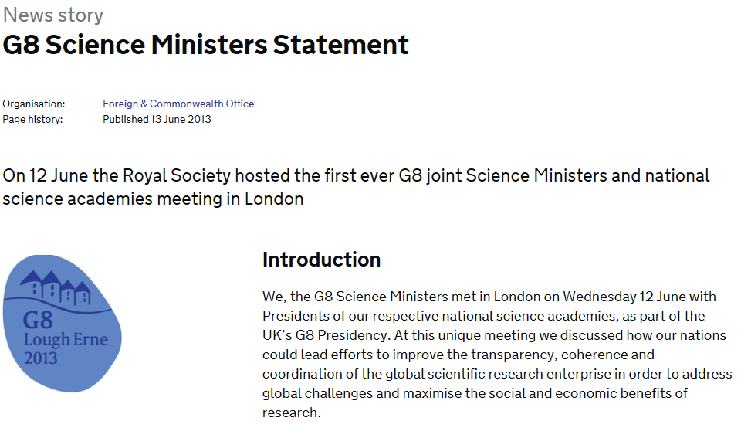
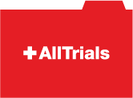


‘Conducting research on existing data sets less expensive than setting up new studies and novel linkage can widen focus’
Dr Jim Lewsey, Statistical Analysis of Linked Health Data (SALHDa), Launch of HEHTA
https://www.gov.uk/government/news/g8-science-ministers-statement
Notes:
RCUK OA policy revised in 2012 to require a statement in published papers on how to access the underlying data.
MRC Strategic Plan (2009-2014) states that data are at the heart of MRC’s ability to improve the understanding of human health,.
Wellcome Trust has recently extended the OA mandate to include monographs as well as articles.
AllTrials is working to make clinical trial data more accessible and has support from the majority of funding bodies.
G8 Science Ministers statement in June 2013, open data is a key goal.
‘To the greatest extent and with the fewest constraints possible publicly funded scientific research data should be open, while at the same time respecting concerns in relation to privacy, safety, security and commercial interests, whilst acknowledging the legitimate concerns of private partners.’
Here in Glasgow University, there is also recognition that sharing data can reduce costs and increase potential for novel research. Health Economics and Health Technology Assessment (HEHTA) was launched in March 2012.

Slide 8
Defining research data
Research data are collected, observed or created,
for the purposes of analysis
to produce and validate original research results
Notes:
Important to remember that research data may include bits of software and algorithms that are developed to perform analysis or to visualise the data. In many cases, these are of higher value than the data themselves (e.g., in some gene sequencing projects the algorithms are the main research output – not the genetic code data itself).
‘In the context of these Principles and Guidelines, “research data” are
defined as factual records (numerical scores, textual records, images and
sounds) used as primary sources for scientific research, and that are
commonly accepted in the scientific community as necessary to validate
research findings. A research data set constitutes a systematic, partial representation
of the subject being investigated.’
OECD PRINCIPLES AND GUIDELINES FOR ACCESS TO RESEARCH DATA FROM PUBLIC FUNDING – © OECD 2007

Slide 9

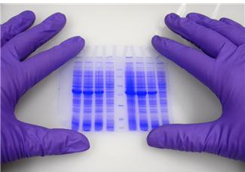
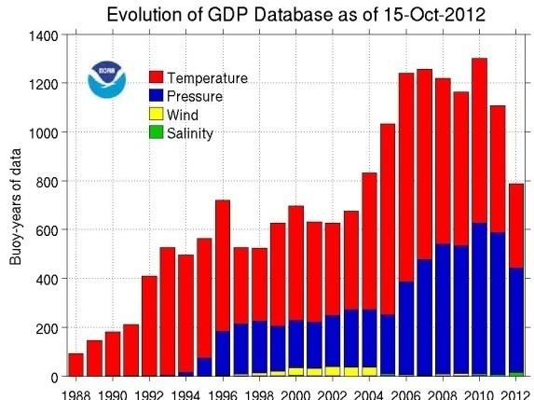


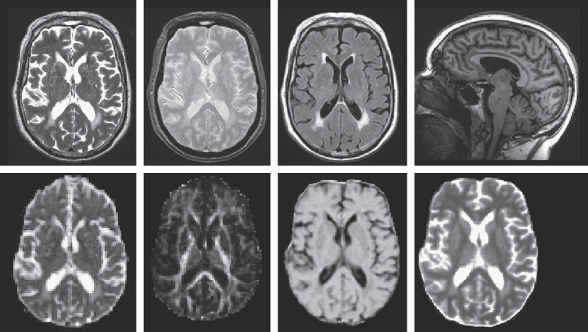

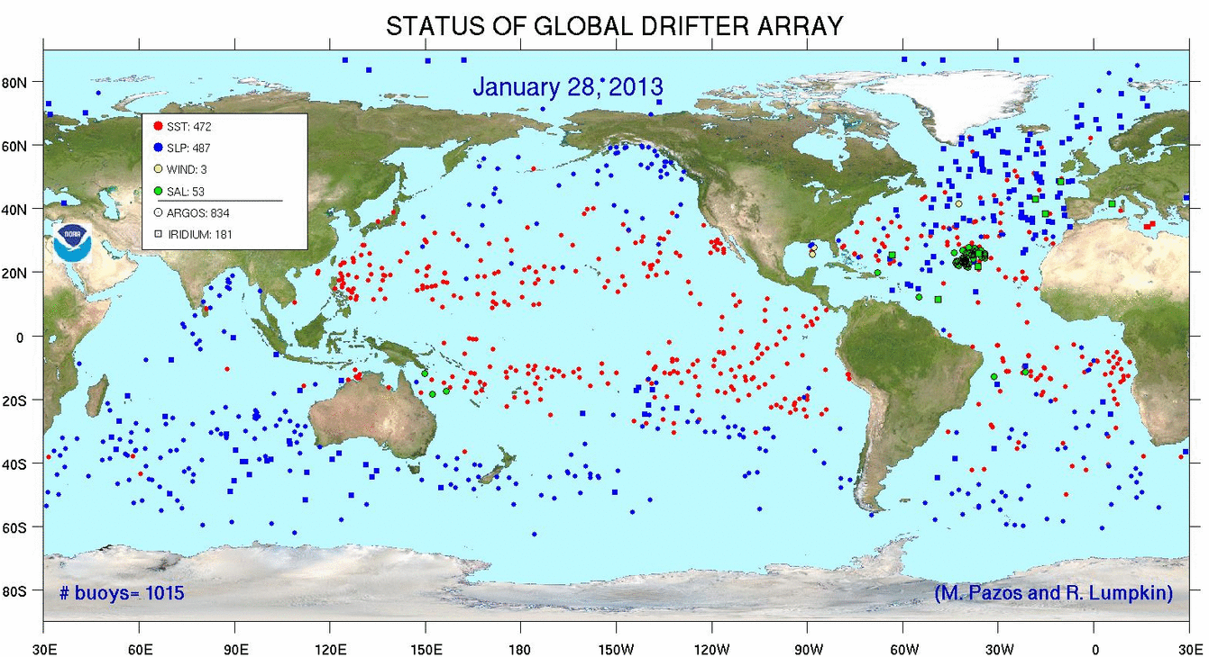
So, what might this include?
http://www.aoml.noaa.gov/phod/dac/array_growth.html
http://www.sbirc.ed.ac.uk/documents/lbc_protocol.pdf
Anything & everything produced in the course of research
http://www.aoml.noaa.gov/phod/graphics/dacdata/globpop.gif
Notes:
Instrument measurements
Experimental observations
Still images, video and audio
Text documents, spreadsheets, databases
Quantitative data (e.g. survey data)
Survey results & interview transcripts
Simulation data, models & software
Slides, artefacts, specimens, samples
Questionnaires
Sketches, diaries, lab notebooks …

Slide 10
What activities are involved in research data management (RDM)?
Data Management Planning
Creating data
Documenting data
Accessing / using data
Storage and backup
Sharing data
Preserving data
Create
Document
Use
Share
Preserve
Store
Notes:
Essentially, research data management covers all aspects of research planning, creation, storage, sharing and longer-term preservation, discovery and reuse.
Data management planning stage:
Researchers need to provide the details on what data might be captured, in what quantities, and what formats might be used. As noted previously, estimates at this stage are ok. Funders don’t expect everything to be carved in stone at the application stage and are merely looking for evidence that some consideration has been given to the nature and scale of the data that might be produced within the project and how this will be managed and shared.
Data management planning will be covered in more detail by Sarah in the next session.

Slide 11
Data creation
Decide what data will be created and how - this should be communicated to the whole research team
Develop procedures for consistency and data quality
  Choose appropriate software and formats - some are better for long-term preservation and reuse
  Ensure consent forms, licences and partnership agreements don’t limit options to share data if desired
Notes:
Clarify copyright before research starts
Consider licensing options e.g. Creative Commons
When starting a new project, it is important to check to see if the work is duplicating data that has already been collected/generated. Funders are keen to avoid funding new projects to reproduce data that has already been collected. At a minimum, it is a good idea for researchers to carry out a search of any data centres that are supported by the funder they are seeking support from. For instance, researchers seeking ESRC funding should at least carry out a search of the data available in the UK Data Service. It might also be a good idea for researchers to consult subject librarians in their institutions for advice on other data sources to check.
It is crucial that researchers bear in mind any restrictions that are associated with consent forms used within the project and that the data management plans and pathway to impact statements do not contradict what is said in the consent form. For example, if the consent forms states that all data collected will be destroyed following the project, then this should be stated in the data management plan and pathway to impact statement. In many cases, different people may complete different parts of the grant application so ensuring that there is consistency between these three elements will be crucial. If working with sensitive personal data, it is a good idea to have someone from the ethics committee review the data management plan.

Slide 12
Documentation
Collect together all the information users would need to understand and reuse the data
Create metadata at the time - it’s hard to do later
Use standards where possible
Name, structure and version files clearly
Notes:
Hertfordshire also provide a standard folder structure to researchers to use in new projects to help organise their data during the active phase.
It is a good idea to use standards when collecting and documenting data. For example, the Data Documentation Initiative (DDI) which is an international metadata standard for the social and behavioural sciences may be a useful metadata standard to use for population health studies.
MRC provides some excellent guidance on standards that might be relevant for health researchers in its Policy and Guidance on Sharing of Research Data from Population and Patient Studies, v01-00, 23 November 2011

Slide 13
Access and use
Restrict access to those who need to read/edit data
Consider the data security implications of where you store data and from which devices you access files
Choose appropriate methods to transfer / share data
  filestores & encrypted media rather than email & Dropbox
Notes:
UK Data service (formerly UKDA) provides excellent guidance on how to anonymise data and, more importantly, tips on what data to collect to avoid a vast amount of effort going into redacting data to allow it to be shared (i.e., assessing whether you need to collect certain fields of information early can mean you avoid having to redact it out later at a cost).
Determinants of young Adult Social well-being and Health (DASH) study group here at Glasgow has some very good advice on data sharing processes that can reduce accidental dissemination of sensitive data.
DASH Data Sharing Policy November 2012 version 1_draft 2

Slide 14
Storage and backup
Use managed services where possible e.g. shared drives rather than local or external hard drives
Ask the local IT team for advice
3… 2… 1… backup!
  at least 3 copies of a file
  on at least 2 different media
  with at least 1 offsite
Notes:
Researchers should contact local or central IT services for advice on short term and longer term storage requirements. It is important to get this started early enough to be able to identify any additional costs that may need to be factored into the grant application.
Most researchers work using collaborative tools such as DropBox and Google Docs. Janet are offering some more secure cloud-based spaces to help researchers. Talk to IT support to make sure what you plan to use is fit for purpose.
Researchers will need to think about how data will be backed-up if they plan to work outside the university system (i.e., remotely using laptops or personal devices).

Slide 15
Data selection
It’s not possible – or desirable - to keep everything.
Select based on:
  What has to be kept e.g. data underlying publications
  What legally must be destroyed
  What can’t be recreated e.g. environmental recordings
  What is potentially useful to others
  The scientific or historical value
Notes:
Active selection – not just at the end of the project!
At a minimum, researchers should ensure that any data required to validate published research findings are retained in line with funders’ mandates.
It is a good idea for central support to work with researchers in specific disciplines to determine what level of data would be required – raw data, algorithms, visualisations?
Leeds example
A researcher who images spines always captures more of the spinal area than he needs at a higher resolution than is needed as the image preparation phase is more expensive than the image capture phase.

Slide 16
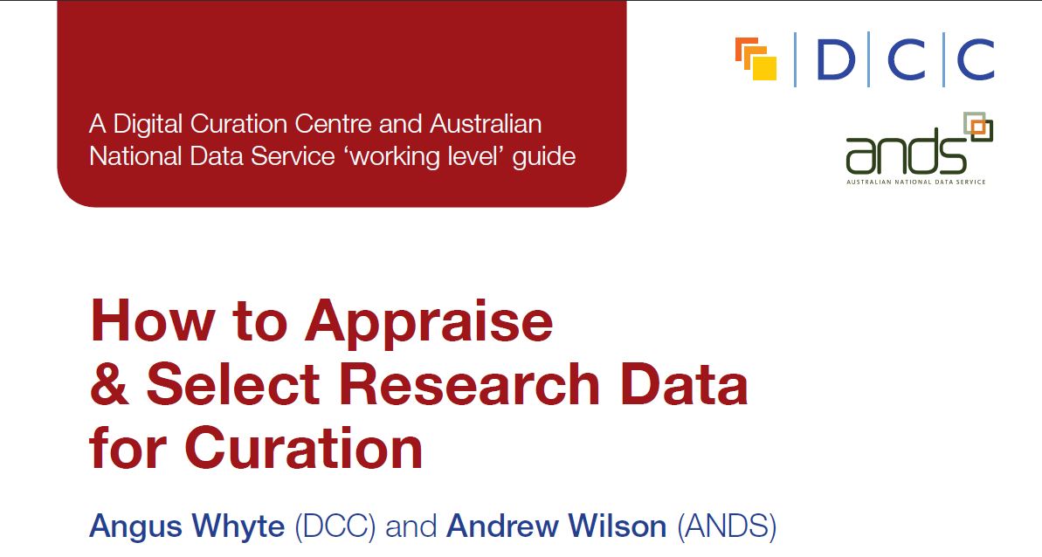
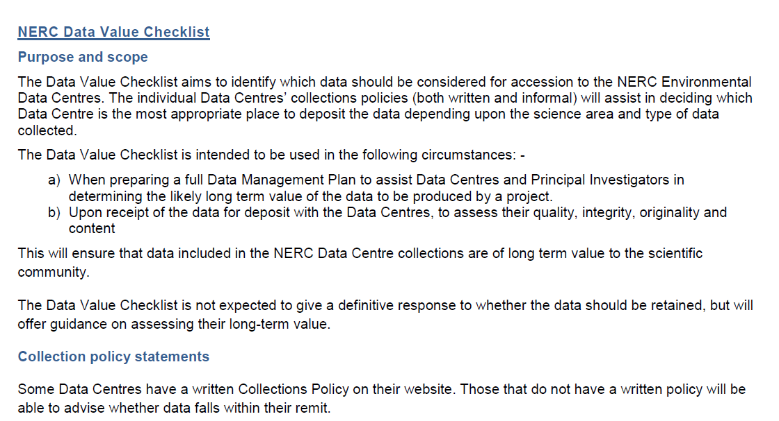
Guidance on selection and appraisal
http://www.dcc.ac.uk/resources/how-guides
http://www.nerc.ac.uk/research/sites/data/documents/data-value-checklist.pdf
Notes:
Researchers may find the NERC data value checklist useful at the pre-award stage. The checklist helps researchers to identify any potential outputs that may have longer term value and should be retained. The checklist is also used to assess quality, integrity and originality of the data at the point of deposit into a data centre once the project has been completed.
Once the project has been completed, the DCC How-to select and appraise research data might be useful in identifying data that warrants longer-term retention.

Slide 17
Data preservation
Be aware of requirements to preserve data
Consult and work with experts in this field
Use available subject repositories, data centres and structured databases
  http://databib.org
  http://www.re3data.org/
Notes:
A number of UK HEIs are developing and testing data repositories and data catalogues to record data that is perhaps held outside the University (e.g., data centres). Valerie will talk about some of the work being done here at Glasgow a bit later. Jisc and DCC developing a national research data registry to assist with visiblity.
However, it is not always the case that the data will need to be held at the university. Many funders support data centres and will expect that the data is deposited at the end of the project. In these cases, the researchers just need to be sure to register this with the university so that a link between the published output(s) and the underlying data are recorded to comply with the RCUK OA policy.
In the event that there is no dedicated data centre supported by the funder and the University is unable to accept the data at the end of the project, researchers may be able to find an alternative data centre in which to deposit their data. Databib provides a searchable list of data centres by name and by subject.

Slide 18
What is data sharing?
  “… the practice of making data used for scholarly
  research available to others.” [Wikipedia]
Who’s involved?
  the data sharer
  the data repository
  the secondary data user
  support staff!
Notes:
Funders don’t just want the data to be retained for validation but also to enable reuse.
There is no point in investing in retaining the data if it can’t be used. Consider who will need or want to access the data and ensure that you are aware of your funders’ expectations.

Slide 19
Exercise: barriers to data sharing
List one or two of the reasons that researchers might feel restrict their ability to share their data.
Are there any actions that could be taken to reduce or overcome these restrictions?
You have 15 minutes
Constraints on data sharing | Possible solutions / approaches

Slide 20

Reasons to share data
BENEFITS
Avoid duplication
Scientific integrity
More collaboration
Better research
Increased citation
9-30% increase shown in
study
(Piwowar H. and Vision T.J 2013 , https://peerj.com/preprints/1.pdf)
DRIVERS
Public expectations
Government agenda
RCUK Data Policy
  www.rcuk.ac.uk/research/Pages/DataPolicy.aspx
UKRIO Code of Practice for Research
  www.ukrio.org/what-we-do/code-of-practice-for-research/
Notes:
Always going to be a blanace for health researchers between access and data protection. But there are ways to share if you put a bit of effort into it.
If you do put in the effort, there can be rewards.
Remember – access doesn’t have to mean that people have to mean barrier-free. You can set up terms and conditions and registration pages.

Slide 21
How to share research data
Use appropriate repositories and data catalogues
  MRC data gateway - https://www.datagateway.mrc.ac.uk/
  Databib - http://databib.org
  Re3data - http://www.re3data.org/
  Jisc/DCC research data registry (coming soon!)
License the data so it is clear how it can be reused
  www.dcc.ac.uk/resources/how-guides/license-research-data
Make sure it’s clear how to cite the data
    http://www.dcc.ac.uk/resources/how-guides/cite-datasets
Consider publishing a data paper based on your DMP http://metajnl.com/

Slide 22
Data Management Planning

Slide 23
What is a DMP?
A short plan that outlines
what data you will create and how
how you will manage it
(storage, back-up, access…)
plans for data sharing and preservation
DMPs are often submitted as part of grant applications, but are useful whenever you’re creating data.
Create
Document
Use
Share
Preserve
Store

Slide 24
Why develop a DMP?
to help you manage your data
to provide guidelines for everyone to work to
to anticipate and avoid problems
to avoid duplication, data loss & security breaches
to comply with funders requirements...

Slide 25
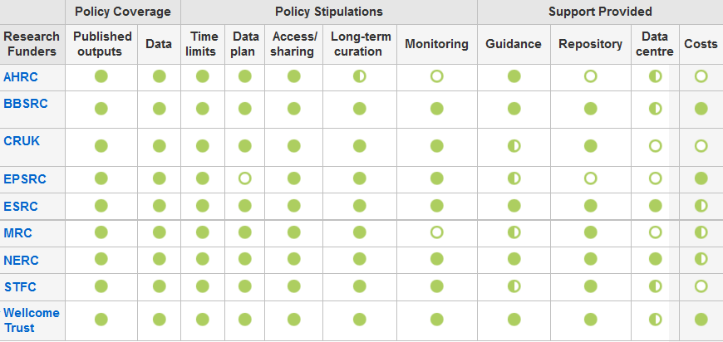
Funders have DMP requirements
www.dcc.ac.uk/resources/policy-and-legal/overview-funders-data-policies

Slide 26


Data sharing plan
Covering:
Dataset
Standards
Metadata
Preservation
Data sharing
  method
  timescale
  restrictions
  agreements
Data Mgmt Plan
Covering:
Data
Data sharing
  when?
  where?
  how?
  restrictions?
Preservation
Resources
Data Mgmt Plan
Covering:
Data
Data collection
Management
Security
Data sharing
Responsibilities
Related policies
Admin details

Slide 27
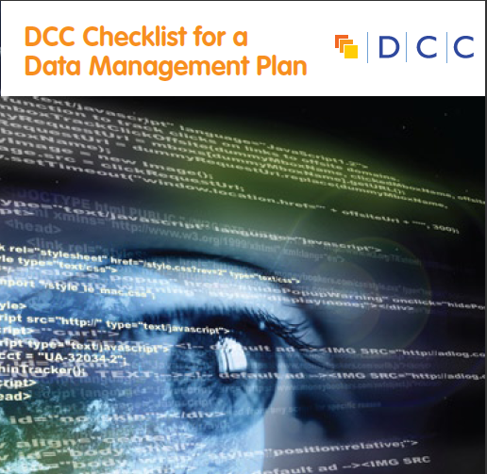
They typically want a short (c.1-2pp) statement covering:
  What data will be created (format, types, volume...)
  Standards and methodologies to be used (incl. metadata)
  How ethics and Intellectual Property will be addressed
  Plans for data sharing and access
  Strategy for long-term preservation

Slide 28

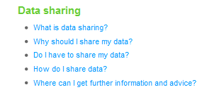
Some funders don’t ask for a DMP but still have expectations
Researchers applying for an HTA grant should consider data sharing in their proposals
Don’t prescribe sharing but expect researchers to consider and plan for it as appropriate
Follow DOH Research Governance Framework and MRC guidelines for Good Research Practice
www.hta.ac.uk/funding/troubleshooting/index.html
Notes:
In the FAQs for the Health Technology Assessment Programme, NHS clarifies that...

Slide 29
DoH Research Governance Framework
“The appropriate use and protection of patient data is paramount. All those involved in research must be aware of their legal and ethical duties. Particular attention must be given to systems for ensuring confidentiality of personal information and to the security of those systems.”
“When established, findings (including negative findings) are published in ways that allow critical review and dissemination to those who could benefit from them. Other researchers have access to the data on which the findings are based.”
Department of Health, Research Governance Framework for Health and Social Care, Second edition, 2005 www.gov.uk/government/uploads/system/ uploads/attachment_data/file/139565/dh_4122427.pdf

Slide 30
Responsibilities of researchers
The arrangements and resources proposed will allow the collection of high quality, accurate data, and the systems and resources proposed are those required to allow appropriate data analysis and data protection.
Procedures are kept in place to ensure collection of high quality, accurate data and the integrity and confidentiality of data during processing and storage.
There are appropriate arrangement to archive the data when the research has finished, and to make it accessible.
Plan
Create
Share
Notes:
The DOH Research Governance Framework lists the following things as responsibilities of researchers.
Although they don’t ask for DMPs, they clearly expect researchers to think about (and plan for) data management throughout the lifecycle.

Slide 31
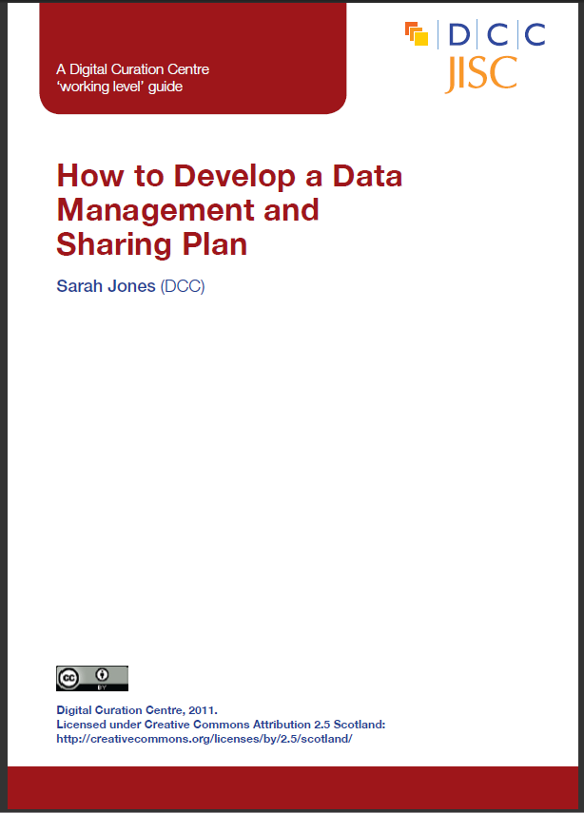

DCC offers DMP guidance and tools
www.dcc.ac.uk/resources/data-management-plans

Slide 32
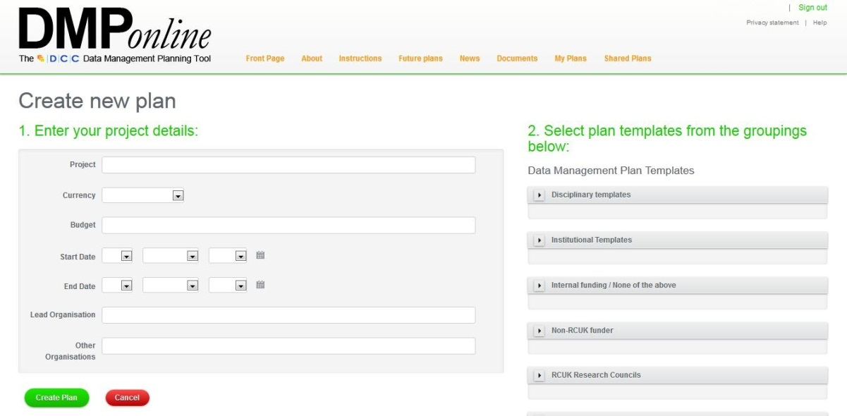
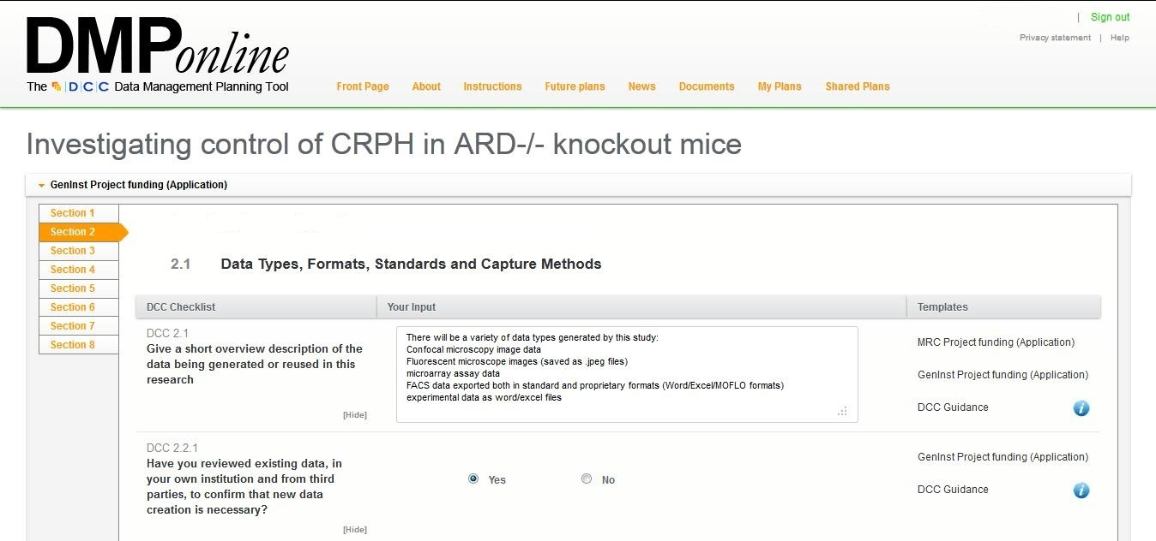
How DMPonline works
Create a plan based on relevant funder / institutional templates...
...and then answer the questions using the guidance provided

Slide 33
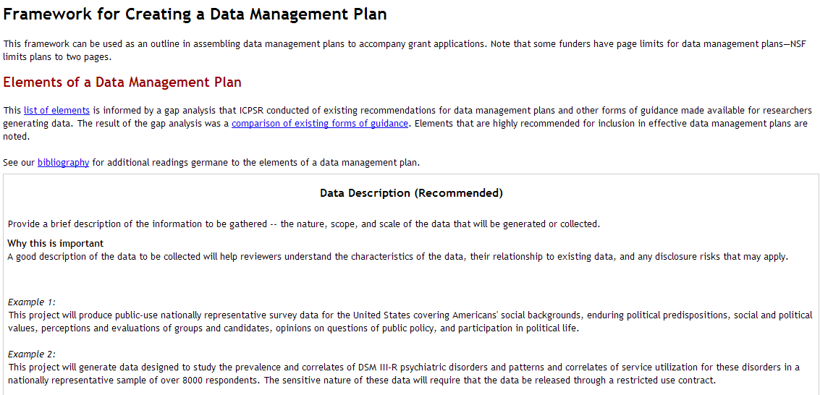
A useful framework to get started
Think about why the questions are being asked
Look at examples to get an idea of what to include
www.icpsr.umich.edu/icpsrweb/content/datamanagement/dmp/framework.html
Notes:
I recommend this ICPSR resource
It explains the importance of different questions as a pointer to how to answer
Examples are given. This is the most frequent request we get at DCC - examples help researchers think of what to write for their context

Slide 34
Tips for writing DMPs
  Start early - don’t wait until the last minute to plan!
  Seek advice from colleagues, ethics, IT, library, DP/FoI...
  Base plans on available skills & support
  The plan will - and should - change over life of project
  Use plan as a communication tool with partners, funders and yourself!

Slide 35
MRC advice on writing plans
What to include in a DMP for the MRC
    http://www.youtube.com/watch?v=ukVHHKp6sck&feature=c4-overview&list=UULTOHF6qQrYhEvQzbu03tTg
Advice on writing plans
http://www.youtube.com/watch?v=7OJtiA53-Fk&feature=c4-overview&list=UULTOHF6qQrYhEvQzbu03tTg
Including costs in DMPs
http://www.youtube.com/watch?v=nKeVPpupsYI&feature=c4-overview&list=UULTOHF6qQrYhEvQzbu03tTg

Slide 36
Data management planning exercise
Read through the satirical DMP overleaf. (5 minutes)
In pairs or small groups, highlight examples of bad practice and suggest alternative methods / approaches (15 minutes)
Feed back (10 minutes)

Slide 37
RDM at Glasgow

