Slide 1


Horizon 2020 & Open Research
Sarah Jones
Digital Curation Centre, Glasgow
sarah.jones@glasgow.ac.uk
Twitter: @sjDCC
Supporting Open Research, 26 January 2017, Amsterdam

Slide 2
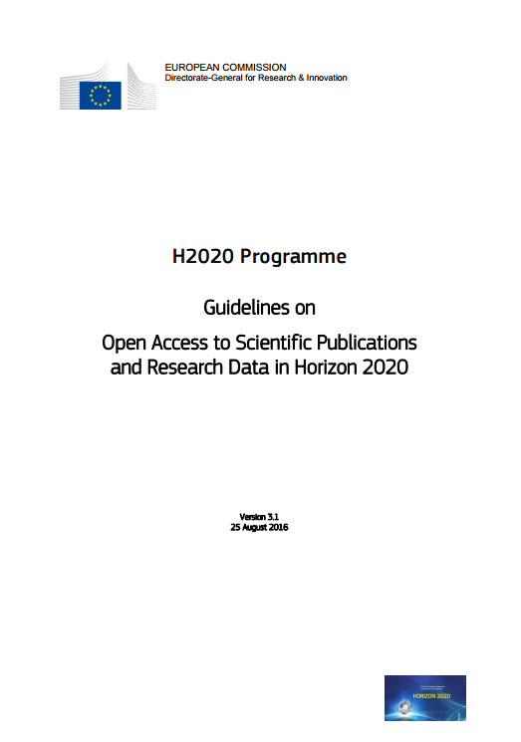
Why open access and open data?
“The Commission considers that there should be no need to pay for information funded from the public purse each time it is accessed or used. Moreover, it should benefit European businesses and the public to the full.”
https://ec.europa.eu/research/participants/data/ref/h2020/grants_manual/hi/oa_pilot/h2020-hi-oa-pilot-guide_en.pdf
Notes:
The background to this is about making the most of the data that has been created through publicly funded research. The guidelines speak of:
Improved quality of results
Greater efficiency
Faster to market = faster growth
Improved transparency of the scientific process

Slide 3
Some benefits of openness
You can access literature – not behind pay walls
Ensures research is transparent and reproducible
Increased visibility, usage, impact, citations...
New collaborations and research partnerships
Helps accelerate the research process
Economic benefits
Notes:
- Validation of results and cutting down on fraud
– Products to market faster, scientific breakthroughs

Slide 4

Development of EC Open Access policy
Pilot in FP7
Provision of support
OA mandate in H2020
Trialled in 7 areas
Expected to:
Deposit articles into a repository
Attempt to make these OA within 6 or 12 months
OA fees are eligible for reimbursement
Pilot supported and monitored through OpenAIRE
Each beneficiary must:
Deposit machine-readable electronic copy in repository by the date of publication
Ensure OA via green/gold routes within 6 or 12 month embargo
Ensure bibliographic metadata is OA
Aim to deposit research data
Notes:
Moving from a ‘best-effort’ in FP7 to an ‘obligation’ under Horizon 2020

Slide 5
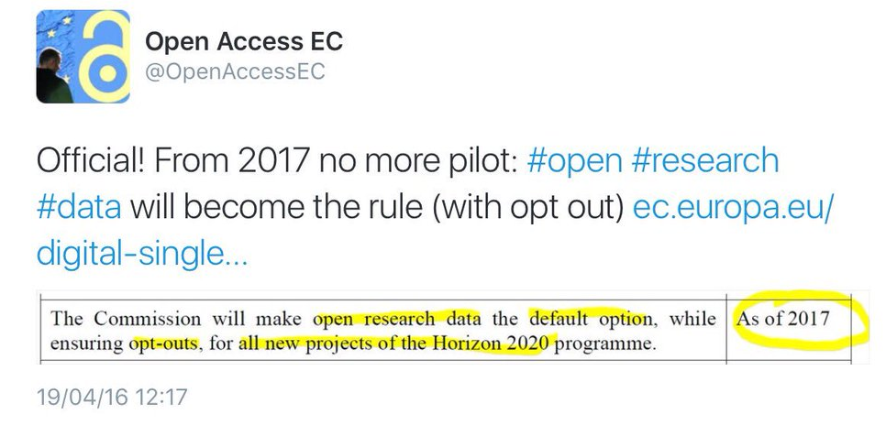
H2020 open data pilot
Guidelines on FAIR Data Management in Horizon 2020
http://ec.europa.eu/research/participants/data/ref/h2020/grants_manual/hi/oa_pilot/h2020-hi-oa-data-mgt_en.pdf
Pilot in H2020
Provision of support
?
Expanded to open data by default

Slide 6
The EC Open Research Data pilot
Key sources of information
Guidelines on Open Access to Scientific Publications and Research Data in Horizon 2020
  http://ec.europa.eu/research/participants/data/ref/h2020/grants_manual/hi/oa_pilot/h2020-hi-oa-pilot-guide_en.pdf
Guidelines on FAIR Data Management in Horizon 2020
  http://ec.europa.eu/research/participants/data/ref/h2020/grants_manual/hi/oa_pilot/h2020-hi-oa-data-mgt_en.pdf
Annotated model grant agreement, clause 29.3 http://ec.europa.eu/research/participants/data/ref/h2020/grants_manual/amga/h2020-amga_en.pdf
New infographic summarising key policy points http://ec.europa.eu/research/press/2016/pdf/opendata-infographic_072016.pdf
Notes:
6

Slide 7
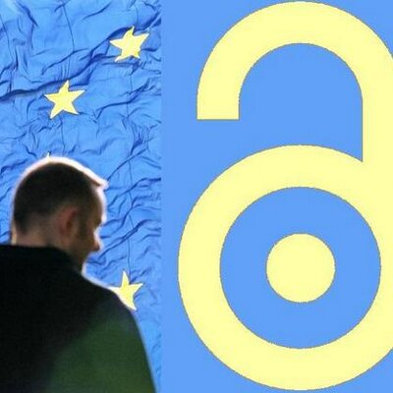
The following European Commission branded slides come from the EC’s open access team and provide an overview to the key points. Content from Jean-Francois Dechamp and colleagues.
Mail: RTD-open-access@ec.europa.eu
Web: http://ec.europa.eu/research/openscience/index.cfm
Twitter: @OpenAccessEC

Slide 8
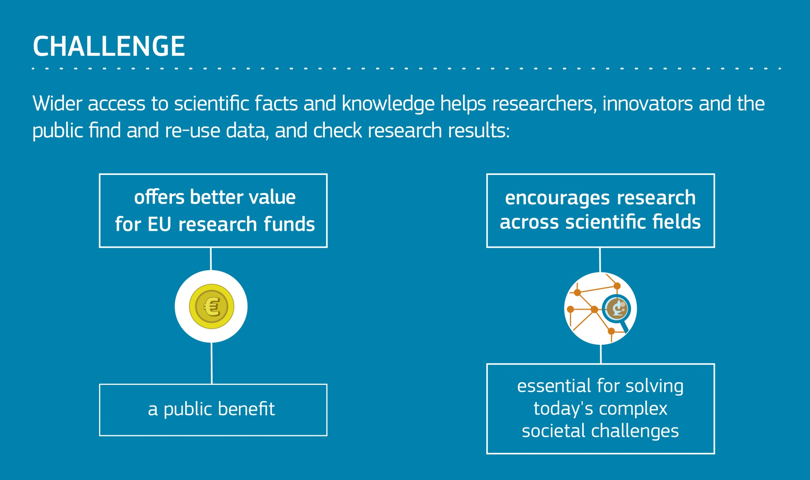

Slide 9
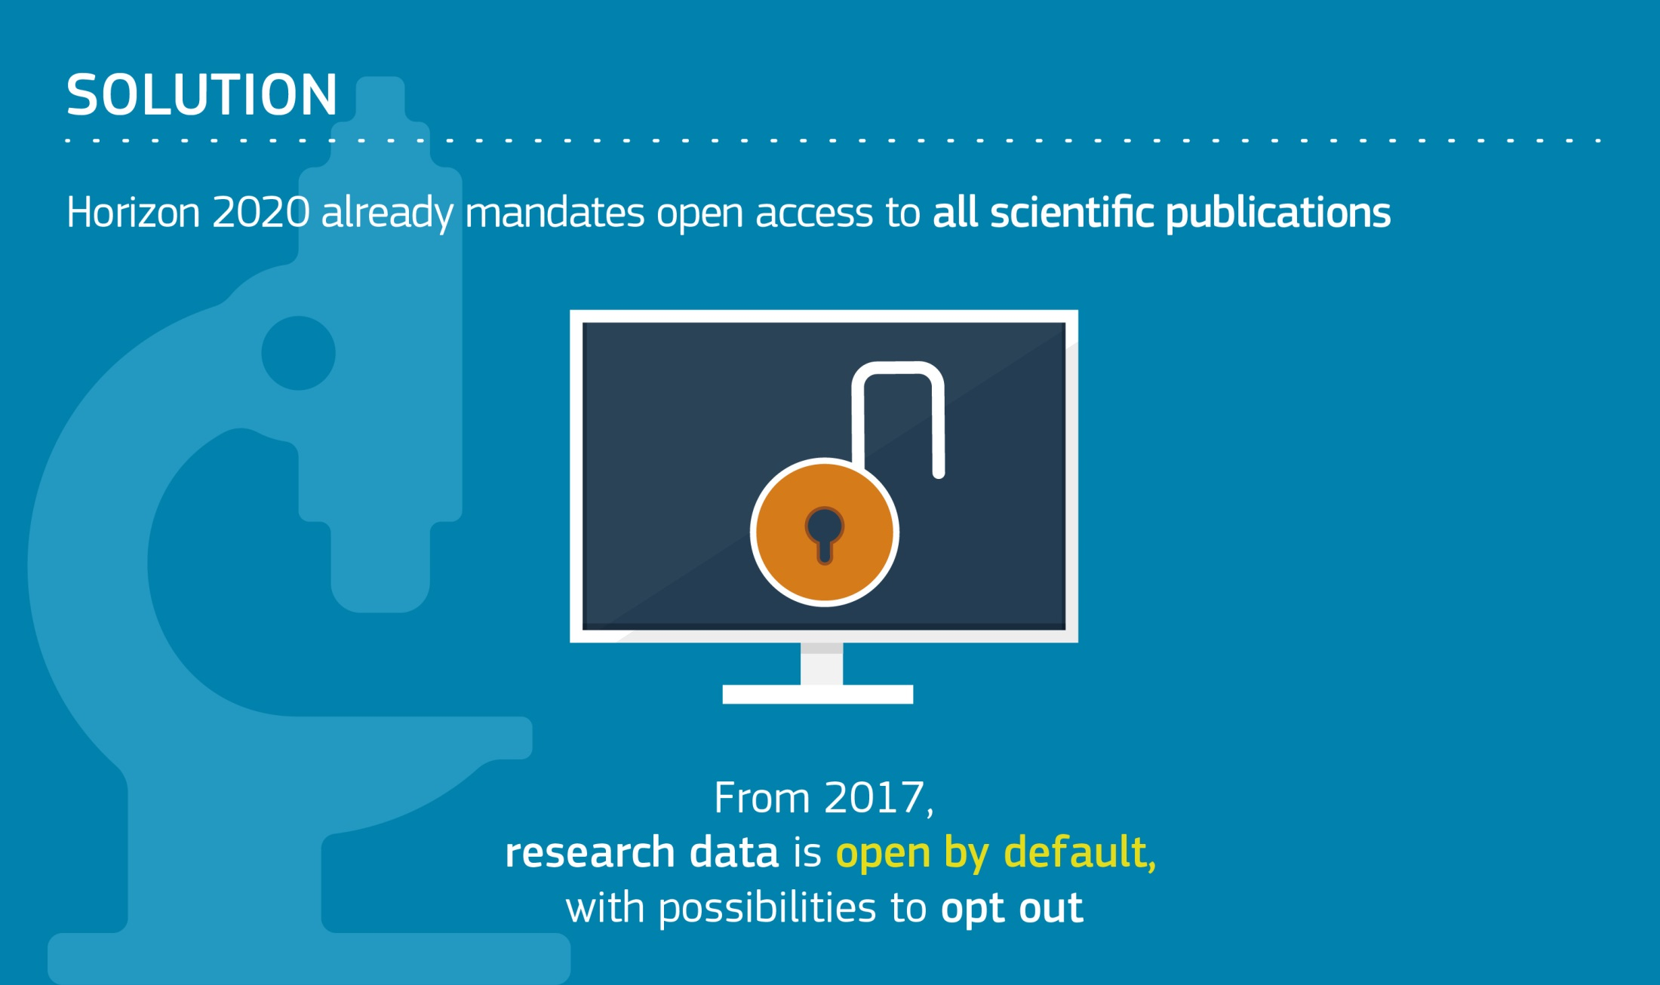

Slide 10
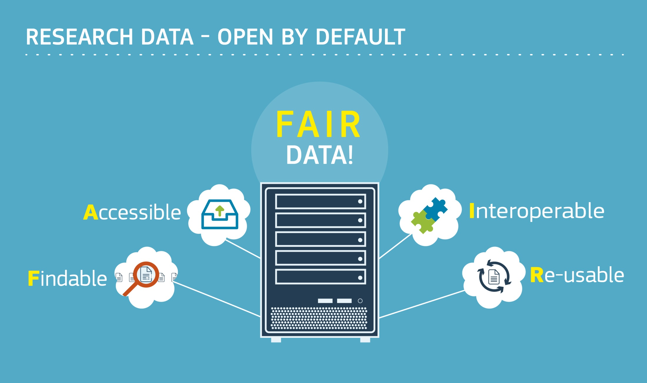

Slide 11
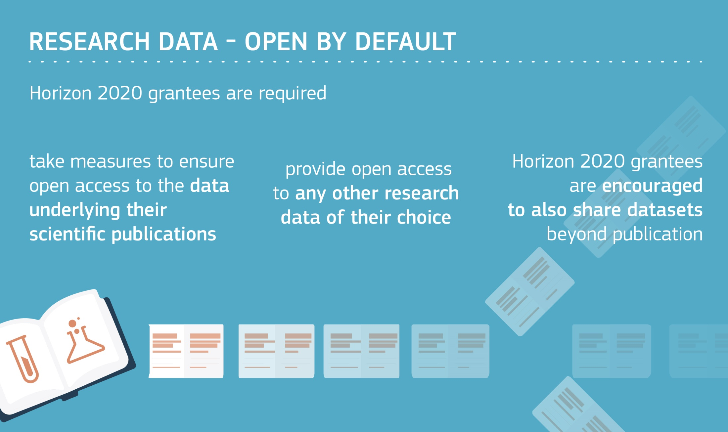

Slide 12
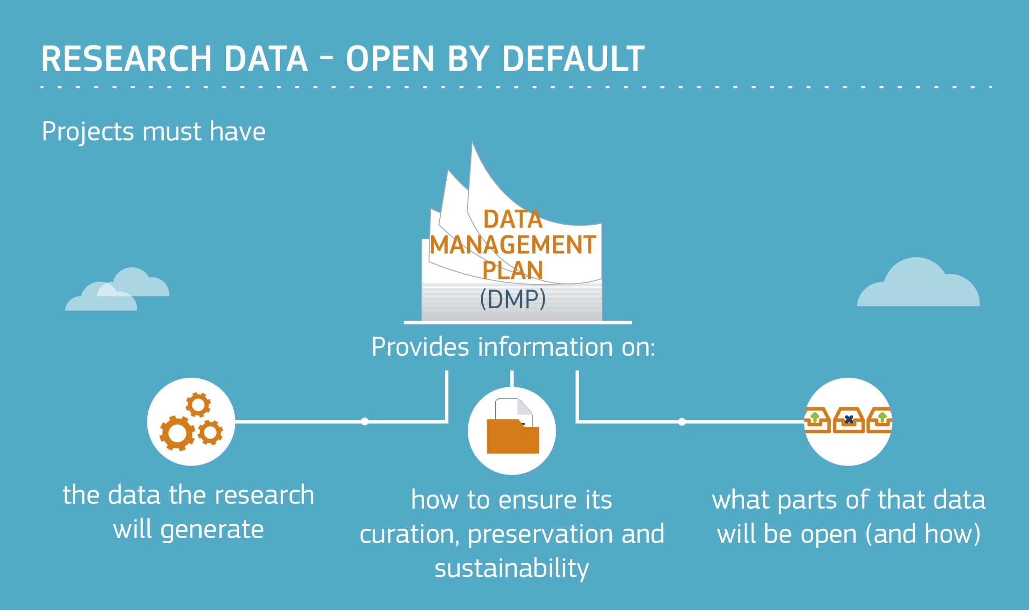

Slide 13
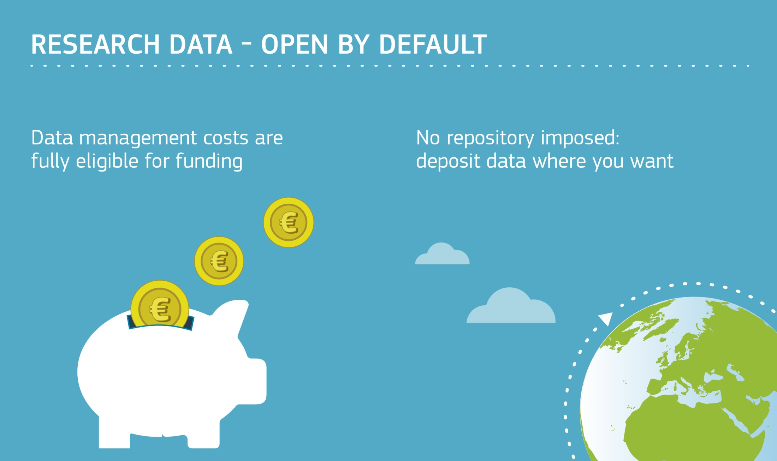

Slide 14
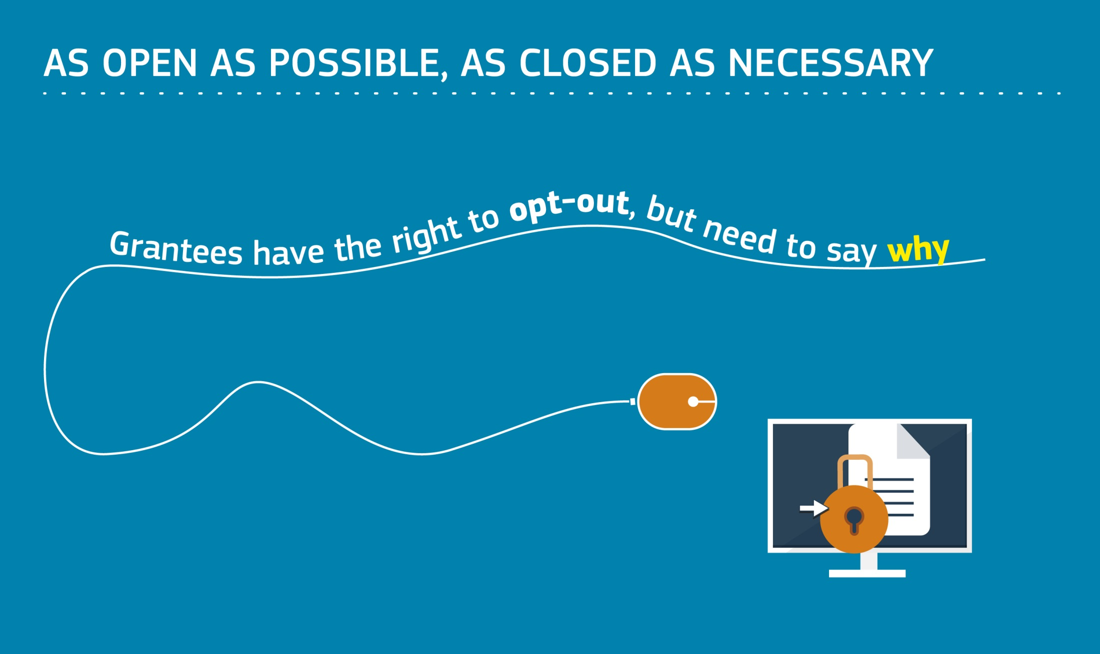

Slide 15
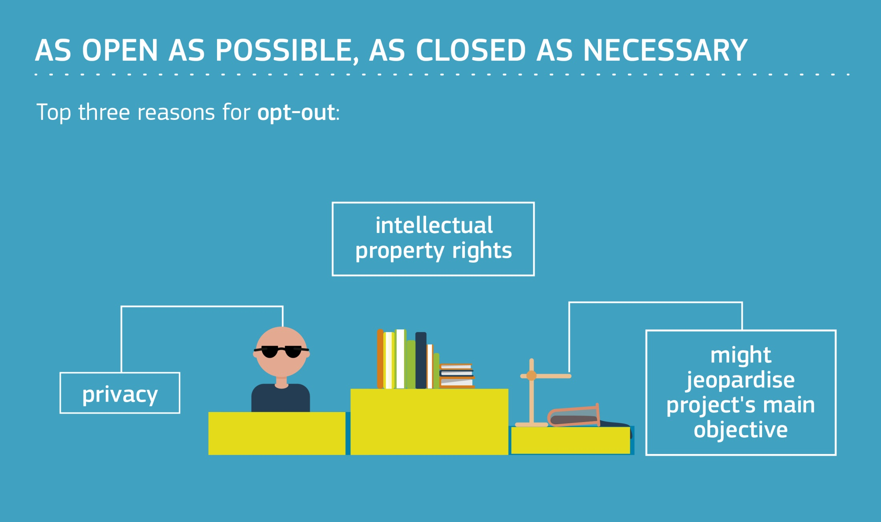

Slide 16
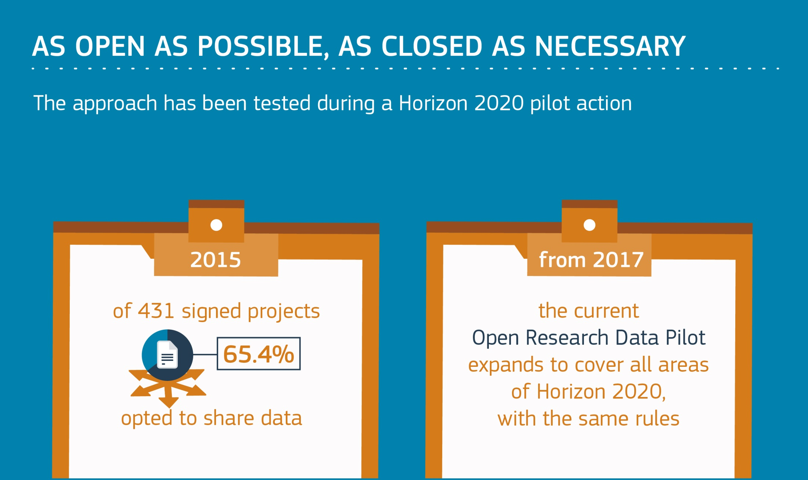

Slide 17
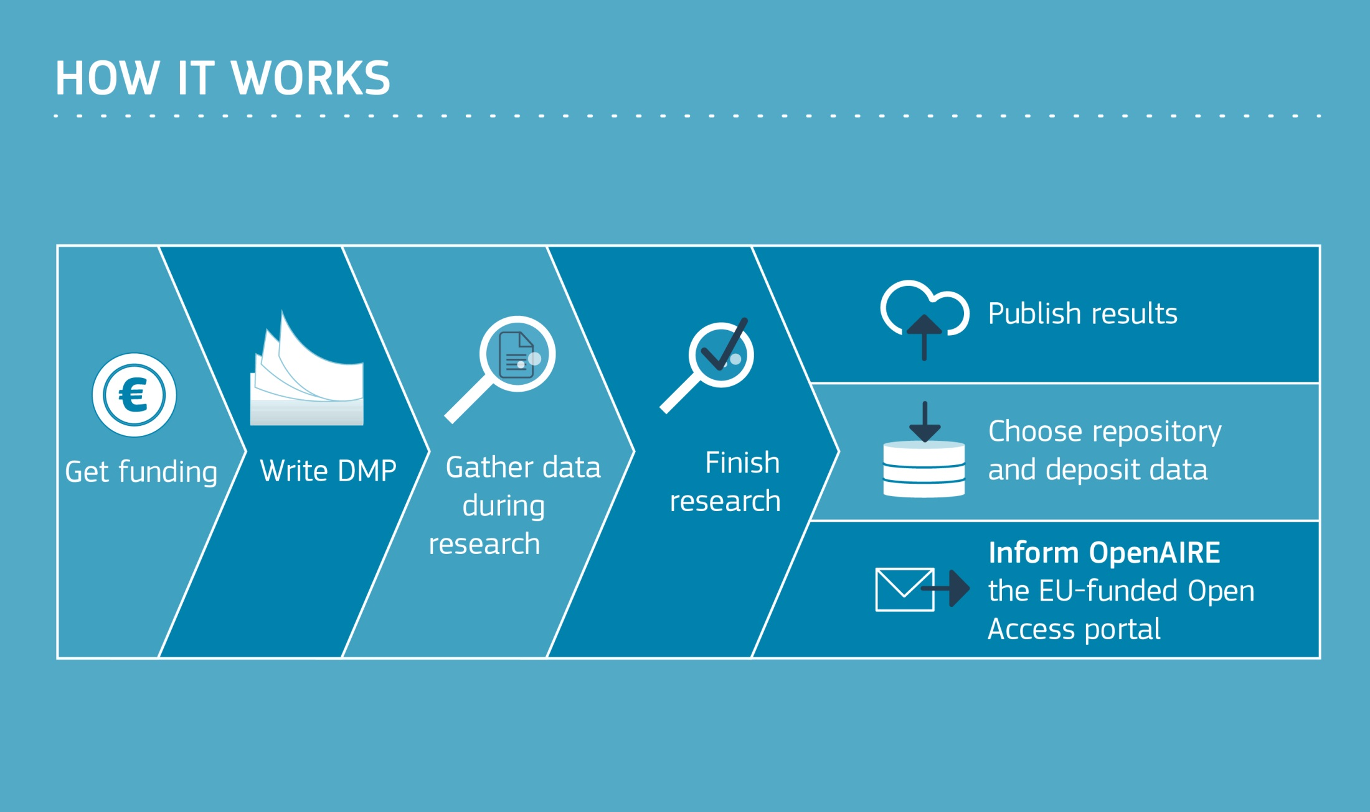

Slide 18
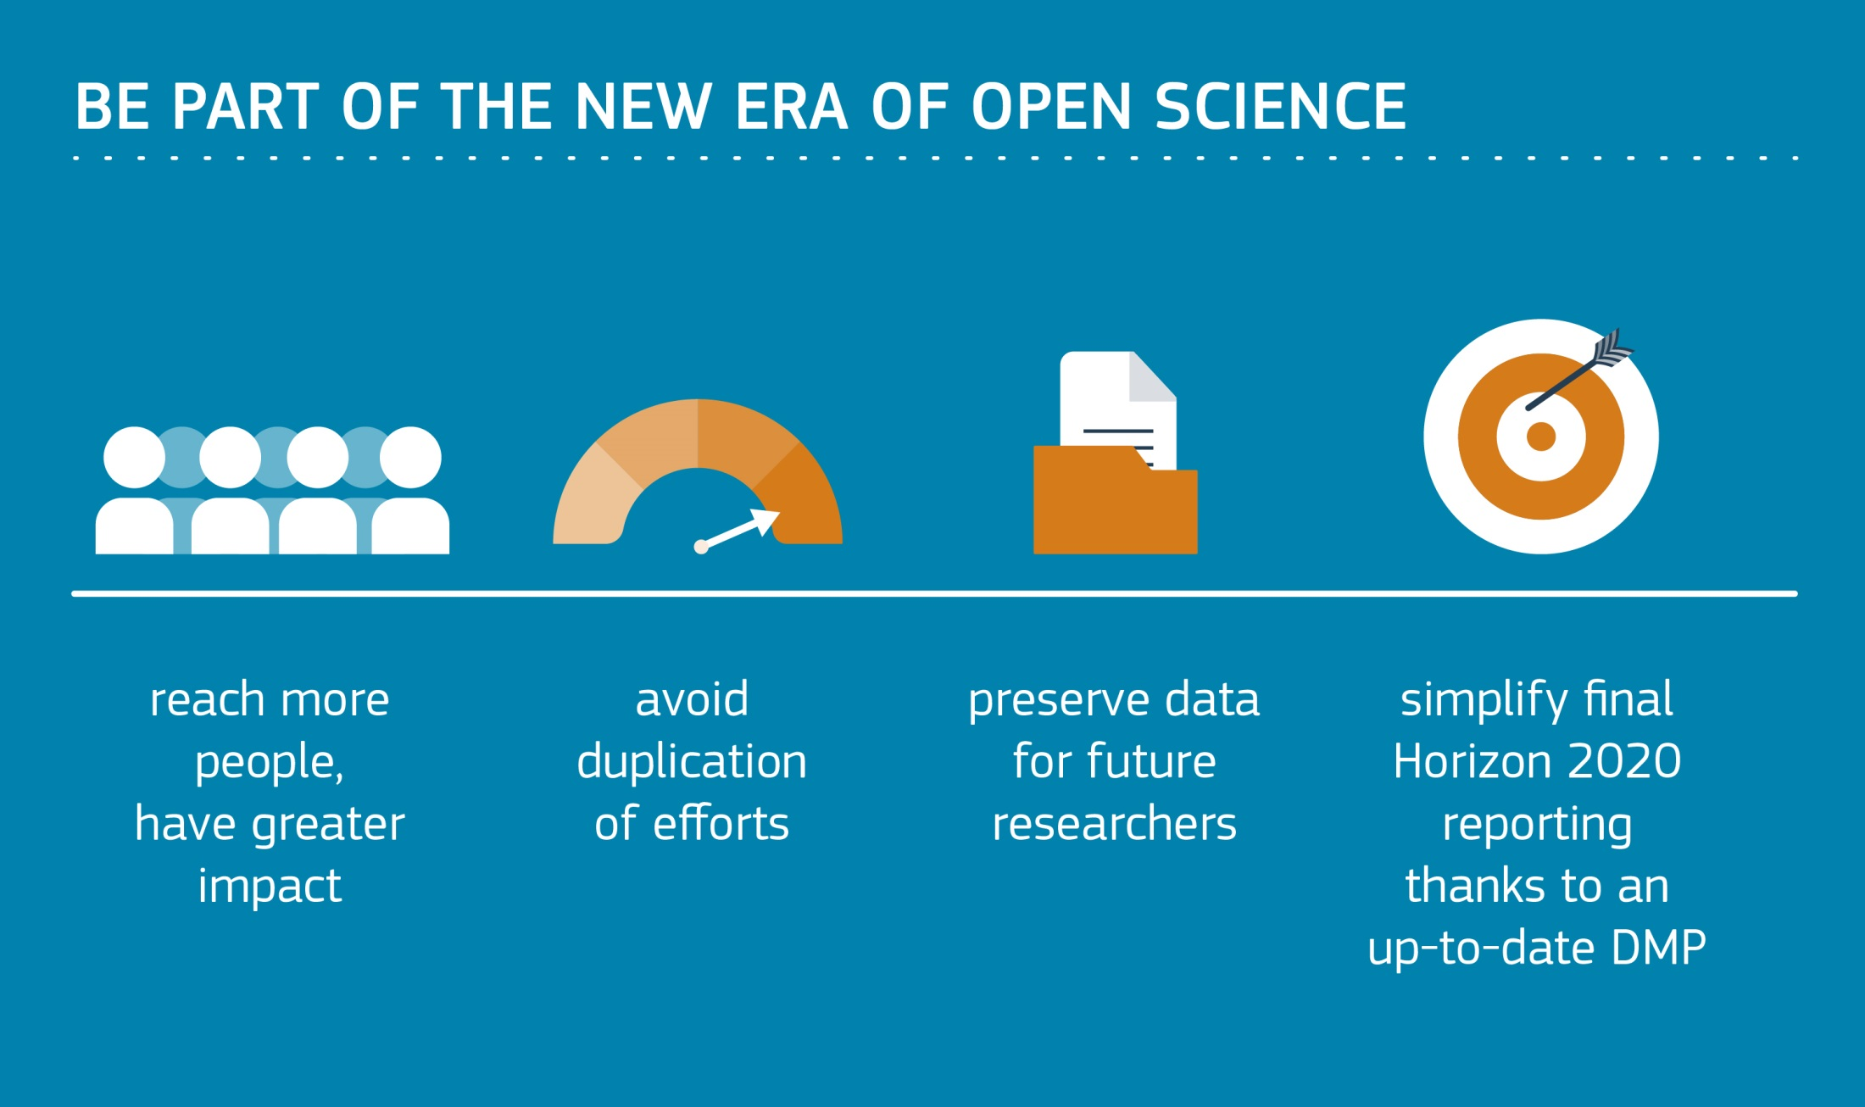

Slide 19

Requirements in a nutshell
Develop a DMP
Share details about the tools and instruments used to allow verification
Select which data to make open
Use established community standards for interoperability
Deposit in a data repository
License data openly for the widest reuse
Provide metadata for data discovery and reuse

Slide 20
Key DMP differences in H2020
The Commission does NOT require applicants to submit a DMP at the proposal stage.
A DMP is therefore NOT part of the evaluation.
DMPs are a deliverable (due by month 6).
The EC requires updates. A DMP is a living or “active” document.

Slide 21
A FAIR approach to DMPs
Findable
  Assign persistent IDs, provide metadata, register in a searchable resource...
Accessible
  Retrievable by their ID using a standard protocol, metadata remain accessible even if data aren’t...
Interoperable
  Use formal, broadly applicable languages, use standard vocabularies, qualified references...
Reusable
  Rich metadata, clear licences, provenance, use of community standards...
www.force11.org/group/fairgroup/fairprinciples
Notes:
21

Slide 22
H2020 template
Data summary
FAIR data
  2.1 Making data findable, including provisions for metadata
  2.2 Making data openly accessible
  2.3 Making data interoperable
  2.4 Increase data re-use (through clarifying licences)
Allocation of resources
Data security
Ethical aspects
Other issues
http://ec.europa.eu/research/participants/data/ref/h2020/grants_manual/hi/oa_pilot/h2020-hi-oa-data-mgt_en.pdf

Slide 23
Example H2020 DMPs
Several examples linked to from the DCC website
www.dcc.ac.uk/resources/data-management-plans/guidance-examples
Share yours, publish in RIOjournal or deposit in Zenodo
www.dcc.ac.uk/share-DMPs

Slide 24
Lessons the EC has drawn (1)
  Explantation is paramount!
    Misperception that 'open' bias will be evaluated positively
    Confusion: DMP versus data management section at submission stage
    Need to state that not everything must be open. In theory, it is possible to be in the ORD Pilot and not open any data.
    Emphasise flexibility (many opt-out / opt-in mechanisms)
  Emphasise the importance of feedback for policy in the next Framework Programme: being in the Pilot means co-shaping European policy on opening up research data
Content taken from slides by Daniel Spichtinger, Celina Ramjoue, Jarkko Siren and Jean-Francois Dechamp

Slide 25
Lessons the EC has drawn (2)
  Helps to re-frame ORD Pilot as "Data Management Pilot"
      Stress the fact that researcher has freedom and responsibility via DMP. Excellent research must include excellent data management.
      Underline overall aim: kick-start a virtous circle and change of culture
  Questions about eligibility of data management costs
  Tools and support needed for data management / DMPs
Content taken from slides by Daniel Spichtinger, Celina Ramjoue, Jarkko Siren and Jean-Francois Dechamp

Slide 26
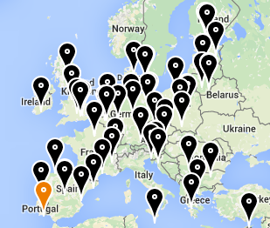
FOSTER and FOSTER+
Facilitate Open Science Training for European Research
Network of open access trainers
Programme of open science courses
Portal to training materials
E-learning courses
Focus on disciplinary materials in FOSTER+
www.fosteropenscience.eu

Slide 27
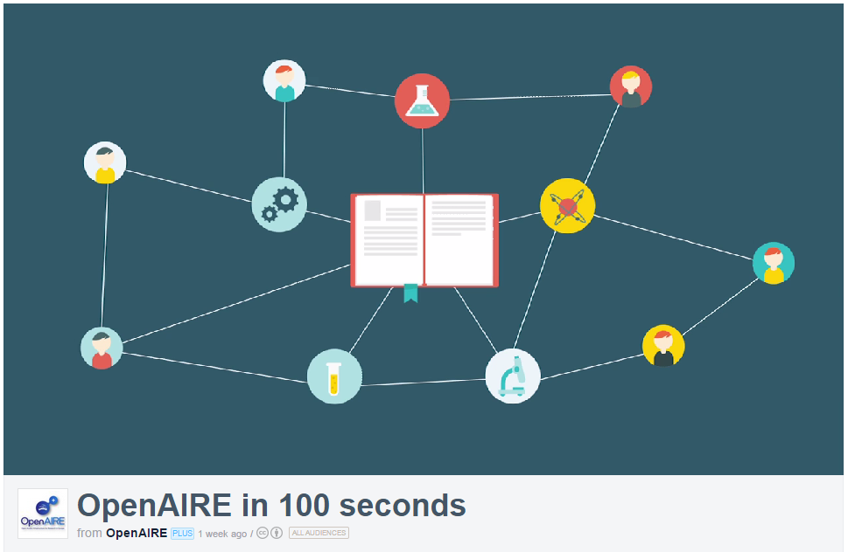
OpenAIRE
Open Access Infrastructure for research in Europe
aggregates data on OA outputs
mines & enriches it content by linking thing together
provides services & APIs e.g.
to generate publication lists
or support EC reporting
lots of guidelines on H2020
Open Data pilot and DMPs
  www.openaire.eu
http://vimeo.com/108790101
Notes:
OpenAIRE is also worth checking out. This is an EC-funded project to provide infrastructure for open access. They’ve recently released a short video that tells you how they can help.
Essentially OpenAIRE aggregates metadata from different repositories to compile a complete list of publications and related outputs. They mine and enrich the content, de-duplicating entries and linking together publications with data, details about the project, authors, funders etc. OpenAIRE also provides a number of useful services & APIs, for example you can embed a publication list for your project in your website that is automatically updated whenever someone adds a new paper to a repository (this is harvested into OpenAIRE and pushed out to your list).

Slide 28
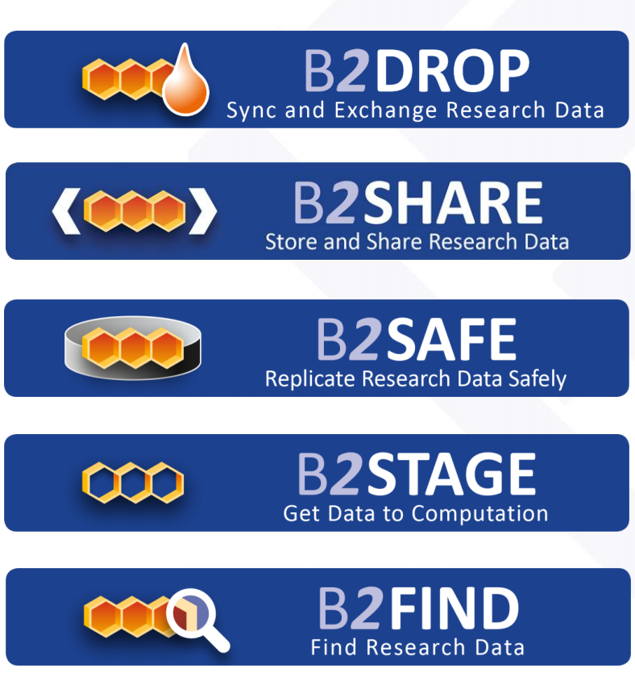

EUDAT services
EUDAT offers a pan-European solution, providing a generic set of services to ensure minimum level of interoperability
Building common data services in close collaboration with 25+ communities
www.eudat.eu
Notes:
All share common challenges:
– Reference models and architectures
– Persistent data identifiers
– Metadata management
– Distributed data sources
– Data interoperability

Slide 29





Discipline-specific infrastructure
ELIXIR in life sciences
BBMRI-ERIC (biobank and biomedical resources)
Euro Argo ERIC (oceanography)
CLARIN for language resources
DARIAH-EU for arts and humanities

Slide 30




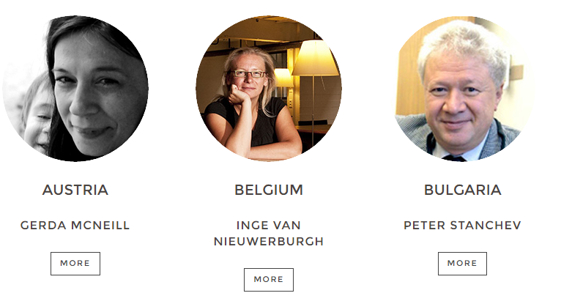

Tap into national & local support!
https://www.surf.nl
www.langzeitarchivierung.de
https://dans.knaw.nl/en
http://openscience.fi
www.openaire.eu/contact-noads

Slide 31

Thanks for listening
DCC resources on Data Management
www.dcc.ac.uk/resources
Follow us on twitter:
@digitalcuration and #ukdcc

