Slide 1


Developing and Reviewing Data Management Plans
Sarah Jones
Digital Curation Centre, Glasgow
sarah.jones@glasgow.ac.uk
Twitter: @sjDCC
Supporting Open Research, 26 January 2017, Amsterdam

Slide 2
What will we cover?
Developing DMPs
How are funders currently evaluating DMPs
What makes a ‘good’ DMP
Lessons from DART and UK reviewing
Exercise

Slide 3
What is a DMP?
A DMP is a brief plan to define:
how the data will be created
how it will be documented
who will be able to access it
where it will be stored
who will back it up
whether (and how) it will be shared & preserved
DMPs are often submitted as part of grant applications, but are useful whenever researchers are creating data.
Notes:
A Data Management Plan is often written early on in the research process to determine what data will be created and how it will be managed. Sometime you are asked for a DMP as part of a grant application, but they are useful to write regardless as it helps to develop consistent procedures from the outset.

Slide 4
Benefits of DMPs for institutions
Opportunity to engage with researchers and improve RDM practice
Raise awareness of support available
Collate information to inform service delivery
Ensure the University is not exposed to risk
Ability to recover costs via grants

Slide 5
Costs to write into DMPs
Charges for additional storage
    5TB free, then £1500 per TB at Bristol
    0.5TB free, then £175 per TB per annum at Edinburgh
Deposit charges for preservation
    £4/GB for datasets above 20GB at Cambridge
    For data packages in excess of the 20GB size limit, submitters will be charged $50 for each additional 10GB, or part thereof at Dryad
    Zenodo currently accept up to 50GB per dataset, but cannot offer infinite space for free, so donations from heavy users towards sustainability are encouraged.
Staff time for data management support, or outsourcing certain activities e.g. transcription...
UK Data Service costing checklist - http://www.data-archive.ac.uk/create-manage/planning-for-sharing/costing
Anticipating the costs of RDM activities, University of Bristol guide - https://drive.google.com/drive/folders/0B-sxe4ro-QTTSzlIRDBUeHlGY0U

Slide 6
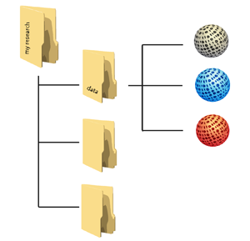

Planning trick 1: think backwards
What data organisation would a re-user like?
CREATING DATA
PROCESSING DATA
ANALYSING DATA
PRESERVING DATA
GIVING ACCESS TO DATA
RE-USING DATA
Notes:
Let’s adopt the perspective of a future data user – maybe yourself: what should your data organisation – folders with data, metadata and documentation – look like at the moment that you start sharing - outside your team - and archiving?
When you are part of a large project which has been going on for some years already, this may be obvious, but for many researchers it isn’t clear from the start.
To answer that broad question, you want to come up, at an early stage, with answers regarding:
Types and formats of data;
New and/or existing;
Expected size;
Metadata;
Documentation;
Software.

Slide 7
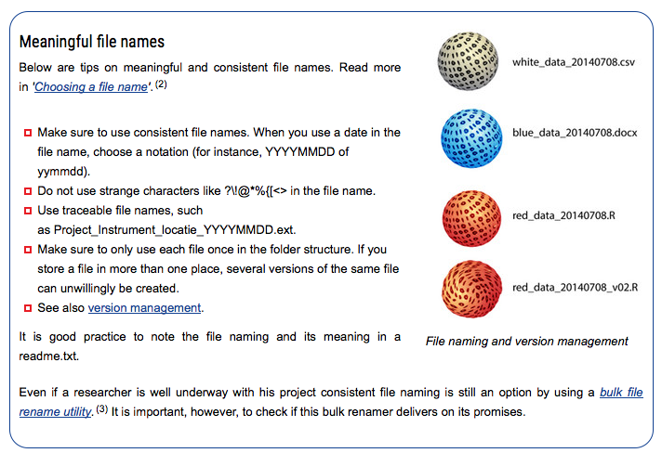
Data organisation
http://datasupport.researchdata.nl/en/start-de-cursus/iii-onderzoeksfase/organising-data

Slide 8
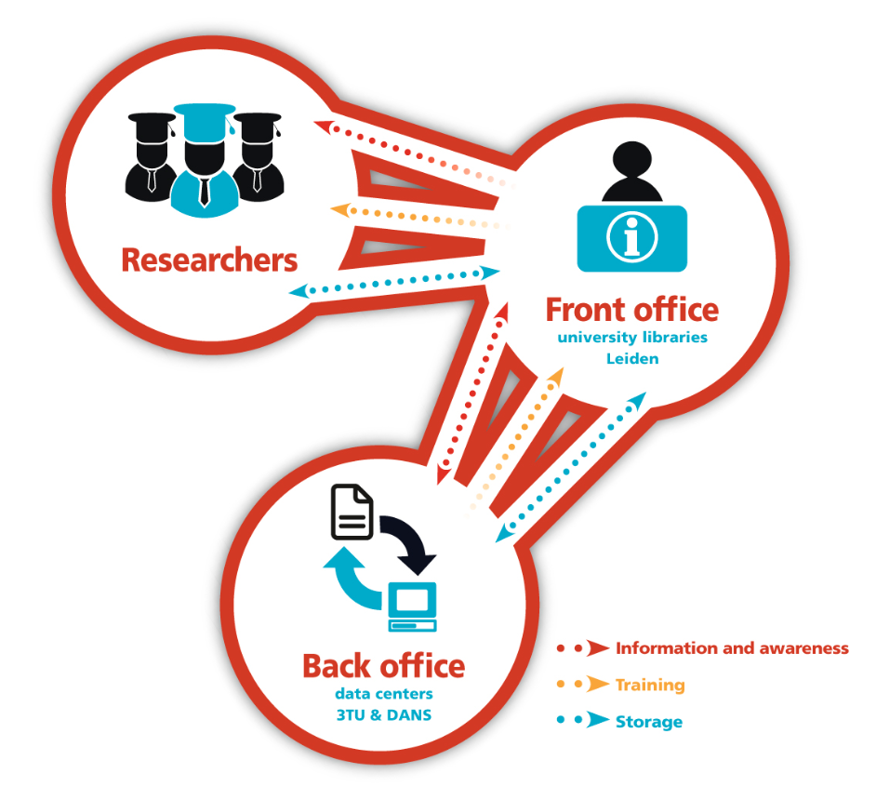



Planning trick 2: include RDM stakeholders
Commercial partners
Institution
RDM policy
Facilities
Publishers
Data Availability policy
€$£
Research funders
www.openaire.eu/briefpaper-rdm-infonoads
Notes:
It’s no fun to do the exercise by yourself, so use this as a communication opportunity.

Slide 9


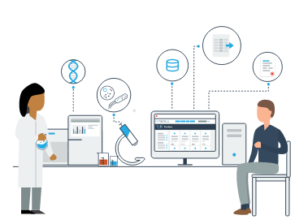

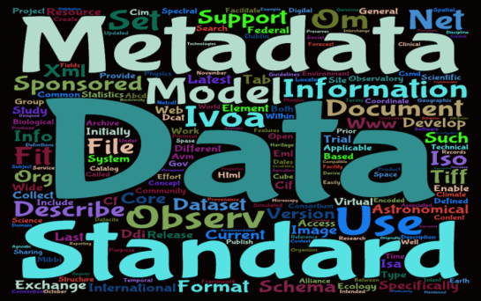
Planning trick 3: ground your plan in reality
Base plans on available skills, support and good practice for the field – show it’s feasible to implement

Slide 10
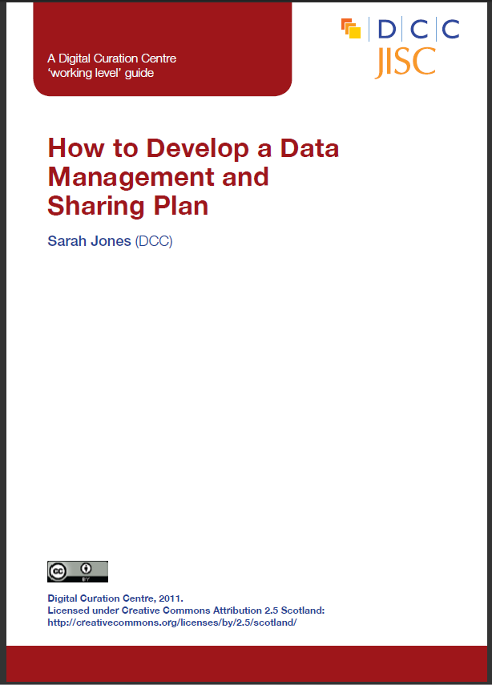
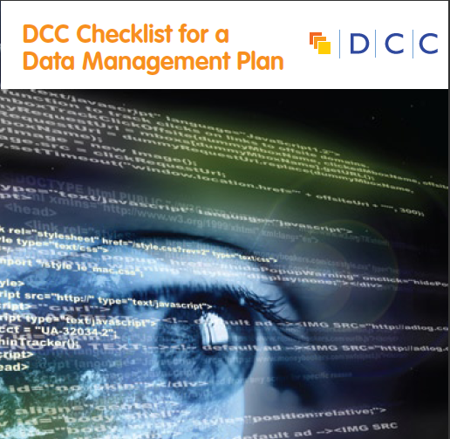

DCC support on DMPs
Webinars and training materials
How-to guides and other advisory documents
Checklist on what to cover in DMPs
Example DMPs
DMPonline
www.dcc.ac.uk/resources/data-management-plans

Slide 11

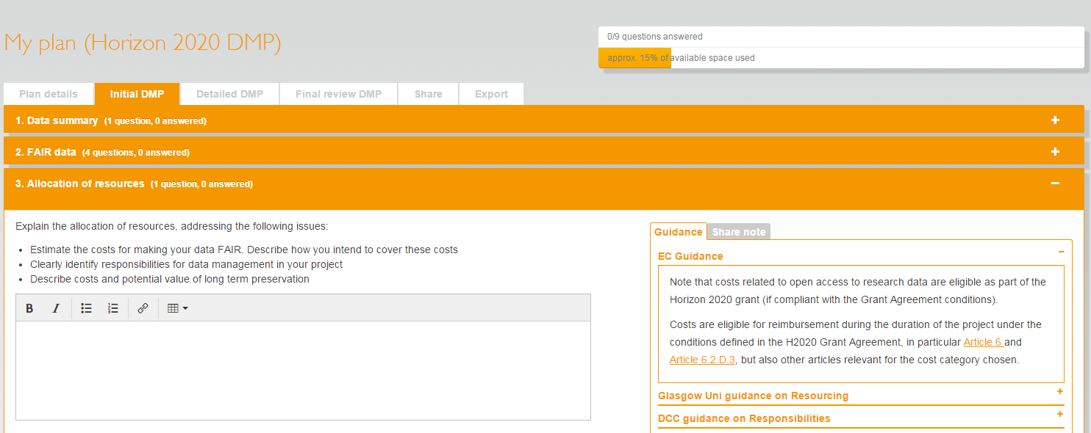
What is DMPonline?
A web-based tool to help researchers write DMPs
Includes a template for Horizon 2020
https://dmponline.dcc.ac.uk

Slide 12





Reviewing DMPs
Lots of funders have DMP requirements but the picture in terms of review differs and monitoring is patchier still

Slide 13
AHRC
Established a technical peer review college
If a proposal has a significant technical component, 1 of the 4 reviewers will be a technical reviewer
Reviewers see technical plan AND full application. They submit a written technical review, but don’t sit on academic review panel.
A poor DMP can be a reason for rejecting a proposal, but conditional awards are more likely
www.ahrc.ac.uk/funding/research/researchfundingguide/ attachments/technicalplan

Slide 14
BBSRC
An application’s Data Management Plan will be assessed by reviewers and BBSRC responsive mode Research Committees or assessment Panels. The plan will be considered separately from the scientific excellence of the proposed research; however, an application’s credibility will suffer if peer review agrees the statement is inappropriate. In the case where a highly-rated proposal has an inappropriate Data Management Plan, Research Committees and Panels may choose to offer conditional awards and/or provide specific feedback to the applicants. Appropriate plans are expected to be those where the proposed data sharing activities are in-line with current best practice in the field and both the scientific and cost benefits are considered.
www.bbsrc.ac.uk/funding/apply/application-guidance/data-management

Slide 15
Horizon 2020
DMPs are a deliverable, checked primarily by project officers and in some cases external reviewers too
Guidelines are being developed to give reviewers pointers on what to check. These are based on the template.
The reviewer has access to the full project documentation
Process is only just evolving and this is a pilot so feedback may be variable initially

Slide 16
NWO
Grant proposal template contains data section with 4 questions. The data section plays no role in grant decision.
“Referees and selection committees of NWO can, however, issue advice about the data management section. Their input will be communicated to applicants as feedback.”
DMP should be written post-award. The project can start once the DMP has been accepted.
The (still internal) evaluation guidelines focus on specificity, plausibility, and indications that the team has been in touch with the local IT office, library and/or service provider.
www.nwo.nl/en/documents/nwo/data-management/data-management-plan-form
www.nwo.nl/en/policies/open+science/data+management

Slide 17
Example guidelines for reviewers
Economic and Social Research Council – DMP guidance for peer-reviewers
http://www.esrc.ac.uk/files/funding/guidance-for-peer-reviewers/data-management-plan-guidance-for-peer-reviewers
Reviewers worksheet developed by Johns Hopkins based on US funder requirements
http://dms.data.jhu.edu/data-management-resources/plan-research/write-a-data-management-plan/grant-reviewers-guide

Slide 18
What makes a good DMP?
Has the researcher taken time
to reflect on what to do?
There are no absolute right answers.
You want to be reassured that due consideration has been given and the approach seems reasonable.
Look for proper engagement with the issues.

Slide 19
Key things to check
Is the plan appropriate?
    adopting relevant standards
    practices in line with norms for that field
    use of support services e.g. university storage, subject repositories…
Does it seem feasible to implement?
Has sufficient detailed information been provided?
Has advice been sought where needed?
Are restrictions and costs properly justified?

Slide 20
Is the information specific enough?
“we will use suitable formats to ensure that our data can be preserved and sustained over the long term”
Which formats? Name them!
Does the team know which are suitable?
Does the chosen repository have preferences?

Slide 21
Are decisions justified?
“data will be made available upon request to
bona fide medieval historians”
Why is it restricted?
Could other communities not reuse the data?
Will the research team be around to handle access requests in the future?

Slide 22
A better response…
“We will provide MP3 audio files for online dissemination. While this is not an open format, it is well-established and the most widely supported. High-resolution WAV files will be used for the archival master recordings.”
Be clear, specific and detailed
Justify decisions

Slide 23
Make it easy for reviewers to evaluate
“Online resource development will cost £21,000”
versus
“Online resource development, 60 days at £350”
Don’t make reviewers dig around for information
Be consistent in what you say in DMP and proposal

Slide 24
Advice from reviewers
First impressions count
  Stick to page limits, follow the template if mandated, provide information in the relevant section…
Beware blanket copy/paste
  A limited amount of information can be provided as boilerplate text. Always read and adjust to your project.
Avoid hyperbole, buzzwords and jargon
  Stick to clear statements and the strength of your technical approach will evidence itself. Remember to explain abbreviations.
Be clear and inspire trust in your plan
  Mention the agreements you have made with service providers
  Make all project partners contribute and commit to the DMP
  Mention community procedures or good practices, but avoid lip service

Slide 25
Common themes to cover
Data Description
Standards and Metadata
Data Sharing
Archiving and preservation

Slide 26
Data Description
Is there a full description of the data to be produced? Statistics about the size, quantity and duration help reviewers to get a proper sense of scale.
If third-party data will be reused, or the project will work with human subjects, has sharing been considered in the consent and licence agreements?

Slide 27
Standards and Metadata
Are metadata standards being used?
Will sufficient metadata and documentation be provided to allow others to find, understand and reuse the data?
Is the choice of file format explained, so it is clear that appropriate decisions have been made?

Slide 28
Data Sharing
Is it clear which data will be shared and with whom?
        Are opportunities to share data openly maximised? e.g. by seeking consent to share, anonymising data…
        If data can’t be shared, are the reasons why explained?
How will the data be shared? e.g. deposit in repository
If an embargo period is planned, is that in line with norms for that discipline?

Slide 29
Archiving and Preservation
Will the research data be deposited in a suitable community database, repository or archive?
Is it clear which data should be preserved and for how long?
Are there any costs associated with preservation, and if so, how will these be covered?

Slide 30

DART - DMPs as A Research Tool
A 3 year IMLS funded project run across 5 US unis
Developed an analytic rubric to standardize the review of data management plans
Analysed DMPs to inform expansion or development of research data services at academic libraries
https://osf.io/kh2y6

Slide 31
Lessons from DART
Lots of useful info about what is going well and not
  Basics often missing, 20-50% of plans didn’t mention file formats
  Data sharing most formalised in Geo and Bio (high use of repos)
  Many others proposed to share via website or on request
  Metadata wasn’t addressed in majority of plans
Analysing DMPs can help you to target support services
When evaluating, assess what the DMP guidelines stipulate, not what you think the DMP should include!
www.dcc.ac.uk/sites/default/files/documents/IDCC16/Workshop8 /Whitmire_DARTPres.pdf

Slide 32
UK rubrics project
Collaboration established by Mary Donaldson to develop rubrics for major research funders.
All RCUK
CRUK
Wellcome
NIHR
H2020
A rubric for the 'ideal' non-funded DMP
https://research-data-network.readme.io/docs/compliance-tools

Slide 33
Basic framework
Performance criteria (based on funder reqs ) | Detailed | Performance Levels Incomplete | Not addressed
1. Summary of digital outputs and technologies | Plan provides a clear description … | There is insufficient information to assess whether the overall plans are sound. | It is unclear what will be created or how.
2a. Standards and formats
2b. Hardware and software
2c....

Slide 34

Thanks for listening
DCC resources on DMPs:
www.dcc.ac.uk/resources/
data-management-plans
Follow us on twitter:
@DMPonline and #ukdcc

Slide 35
Exercise on reviewing DMPs
(Skim) read one of the H2020 plans to get a sense of the project, the data and plans for sharing
Assess the DMP against the rubric
Identify key strengths and weaknesses
Suggest changes / revisions

