Slide 1

Classifying RDM training content and resources
Sarah Jones
DCC, University of Glasgow
Notes:
This presentation will cover potential ways to classify training material (lifecycle models and DMP frameworks) and profile materials emerging from the UK

Slide 2
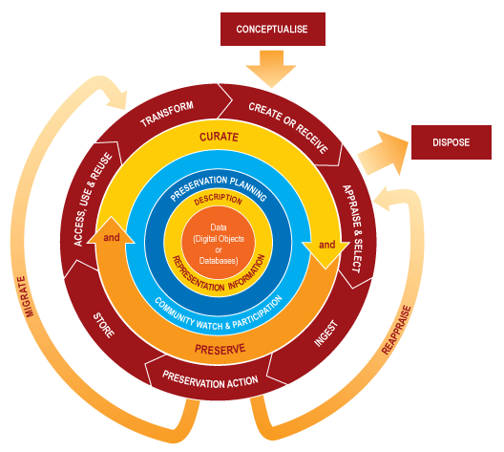
The DCC lifecycle model
http://www.dcc.ac.uk/resources/curation-lifecycle-model
Notes:
The DCC lifecycle model is a way to think about the roles and activities involved in curation
Terminology is best suited to information professionals

Slide 3
Managing Research Data resources
Five disciplinary training projects in first MRD programme:
CAIRO - performing arts
DataTrain - archaeology and social anthropology
DATUM for health - health studies
DMTpsych - psychology
Research Data MANTRA - geosciences, social science & clinical psychology
http://www.jisc.ac.uk/whatwedo/programmes/mrd.aspx
Notes:
JISC has funded two MRD programmes. The first programme supported five disciplinary training projects.
These produced a variety of reusable training materials, some are online courses (e.g. MANTRA and CAIRO).

Slide 4
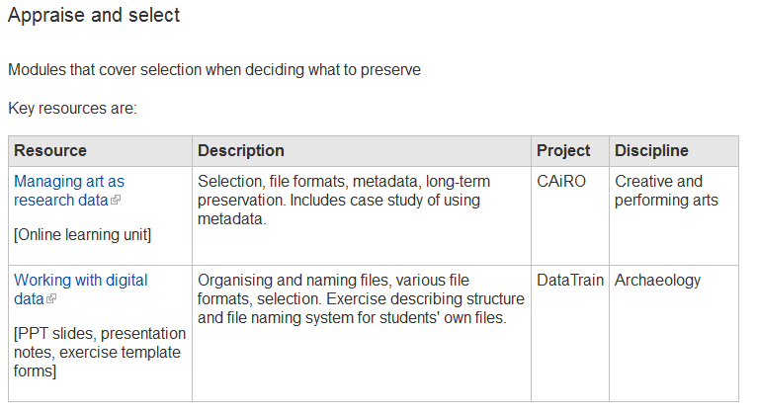
MRD materials mapped to lifecycle
http://www.dcc.ac.uk/training/train-trainer/disciplinary-rdm-training
Notes:
To help people find relevant content, the DCC has mapped all the materials to the lifecycle model

Slide 5
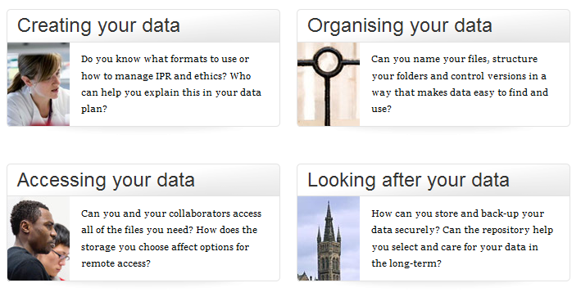
Researcher friendly lifecycle
http://www.glasgow.ac.uk/datamanagement
Notes:
The Incremental project used a simpler lifecycle model to be more researcher friendly
The website provides simple, accessible guidance and profiles support available at the University of Glasgow

Slide 6
Simplifying terminology
Metadata → documentation and context
Appraisal → selection, choosing what to keep
Preservation → looking after your data
avoid jargon
explain what you mean
keep things simple!
Notes:
We moved away from information science terms to simpler language.
Case studies and examples bring out the disciplinary focus too, making the guidance easier for researchers to apply to their context

Slide 7
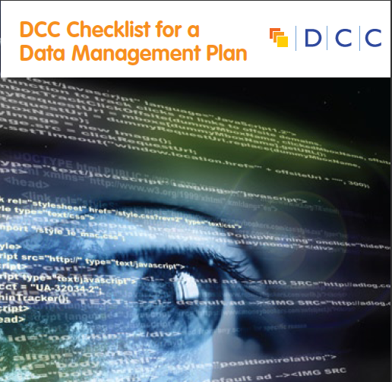
DMP requirements
Funders typically want a short statement covering:
What data will be created? (format, types, volume)
What standards and methodologies will be used?
How will you manage ethics and Intellectual Property?
What are the plans for data sharing and access?
What is the strategy for long-term preservation?
http://www.dcc.ac.uk/resources/data-management-plans
Notes:
In the UK, many funders expect DMPs to be submitted in grant applications.
The coverage of these may well be a useful framework to understand the skills and support required

Slide 8
Skills and training needed
What data will be created? (format, types, volume)
- Knowledge of formats, handling large volumes...
What standards and methodologies will be used?
- Metadata, methods / good practice, data handling....
How will you manage ethics and Intellectual Property?
- Consent agreements, security, licensing, legal expertise...
What are the plans for data sharing and preservation?
- Data centres, repositories, preservation approaches...
Notes:
Based on the main themes / questions asked in DMPs, here are some ideas of the knowledge and skills support staff may require

Slide 9
Roles and responsibilities for RDM
Librarians, archivists, information professionals
Senior managers
Data centres
Researchers
Lawyers, copyright experts
Ethics advisors
IT experts
Training for researchers and all those who support them
Notes:
Many people have a stake in Research Data Management – primarily researchers, but also a raft of people who support them
The DCC has two main categories of requests for training. Training for researchers and for all those who support them.

Slide 10
New MRD training projects
RDMTPA - Postgrad and ECRs in physics & astronomy
SoDaMaT - Sound Data Management Training
TraD: psychology, computer science & research support
RDMRose – iSchool course for liaison librarians
http://tiny.cc/RDMTrain02
Watch this space!
Notes:
The second MRD programme has funded four training projects. These cover new disciplines and focus on training for research support staff.
Outputs will be available next Spring.

Slide 11
Thanks - any questions?
For DCC guidance, tools and case studies see:
www.dcc.ac.uk/resources

