Slide 1

Research Data management: What edinburgh is already doing and how it’s working
Open University Seminar
Research School & Library Services
20 October,2011
Robin Rice
University of Edinburgh

Slide 2

Overview: What is Edinburgh doing in research data mgmt?
Develop university policy
Develop online guidance
Develop training
Develop services & support

Slide 3
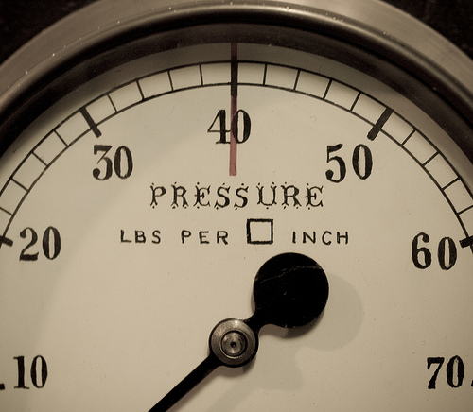
Pressure for change
Research funders seeking to add value
Publishers responding to demand
Public wanting access to publicly funded data
Universities reluctant to step up to challenge?
Wwarby on flickr
Notes:
The pressure brought to bear on researchers to improve their data management and data sharing practice has come from research funders seeking to add value to expensive research and solve cross-disciplinary grand challenges; publishers seeking to be responsive to calls for transparency and reproducability of the scientific record; and the public seeking to gain and re-use knowledge for their own purposes using new online tools.
Higher education institutions have been rather reluctant to assert their role in either incentivising or supporting their academic staff in meeting these more demanding requirements for research practice

Slide 4
Seeking win + win + win + win + win……
Where do I safely keep my data from my fieldwork, as I travel home?
How do we ensure we have access to our research data after some of the team have left?
How can our research collaborations share data, and make them available once complete?
How can I best keep years worth of research data secure and accessible for when I and others need to re-use it?
How do we ensure compliance to funders’ requirement for several years of open access to data?
PhD student
individual researcher
research team
supra-university
university
LEVEL

Slide 5
University Research Data Management Policy
The policy for management of research data was approved by the University Court on 16 May, 2011.
Vice-Principal Jeff Haywood was a champion for the University of Edinburgh to develop the first RDM policy in the UK

Slide 6
Events influencing the policy
Recent adoption of the Code of Practice for Research (UK Research Integrity Office, 2009) by the university’s research office, obligating the institution to provide support for retention and access to data underlying published research.
‘Climategate’ email review at East Anglia University highlighting the reputational risk and legal accountability associated with staff not being forthcoming in response to Freedom of Information (FOI) requests for data from the public.

Slide 7
The 10 Policy Principles
Research data will be managed to the highest standards throughout the research data lifecycle as part of the University’s commitment to research excellence
Responsibility for research data management through a sound research data management plan during any research project or programme lies primarily with Principal Investigators (PIs).
All new research proposals must include research data management plans or protocols that explicitly address data capture, management, integrity, confidentiality, retention, sharing and publication.
The University will provide training, support, advice and where appropriate guidelines and templates for the research data management and research data management plans.
The University will provide mechanisms and services for storage, backup, registration, deposit and retention of research data assets in support of current and future access, during and after completion of research projects.

Slide 8
The 10 Policy Principles
Any data which is retained elsewhere, for example in an international data service or domain repository should be registered with the University.
Research data management plans must ensure that research data are available for access and re-use where appropriate and under appropriate safeguards.
The legitimate interests of the subjects of research data must be protected.
Research data of future historical interest, and all research data that represent records of the University, including data that substantiate research findings, will be offered and assessed for deposit and retention in an appropriate national or international data service or domain repository, or a University repository.
Exclusive rights to reuse or publish research data should not be handed over to commercial publishers or agents without retaining the rights to make the data openly available for re-use, unless this is a condition of funding.

Slide 9
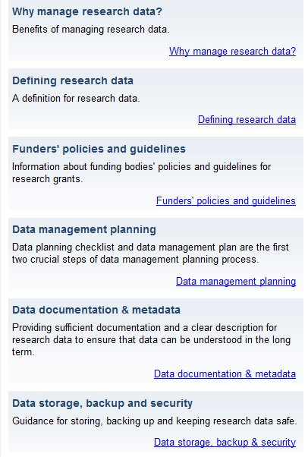
Web guidance
Online suite of web pages for University academic staff
http://www.ed.ac.uk/is/data-management

Slide 10
Training: MANTRA for Change
Raising the standards of data management practice by contributing to long-term culture change.
Creation of a new PhD training course to promote data management skills

Slide 11


Research Data MANTRA (MANagement TRAining)
Creation of open online learning materials in RDM for postgrads and early career researchers
Grounded in three disciplines, working with graduate schools
Video stories from researchers in variety of settings
Data handling exercises in four data analysis environments: R, SPSS, NVIVO and ArcGIS
.ash on flickr (CC-BY-ND)

Slide 12
Online learning materials
Eight units with activities, scenarios and videos:
  Research data explained
  Data management plans
  Organising data
  File formats & transformation
  Documentation & metadata
  Storage & security
  Data protection, rights and access
  Preservation, sharing and licensing
Used Xerte Online Toolkits to create – University of Nottingham

Slide 13

Project success factors
1. The commitment of academic staff to the project
2. Positive feedback from user testing
3. Increased advocacy and awareness of research data management best practice across the University.
4. Evidence that the course is useful and used in other contexts outwith the University of Edinburgh.
Curlew, Mikebaird on flickr

Slide 14
Research data services

Slide 15

What is a data library?
A data library refers to both the content and the services that foster use of collections of numeric, audio-visual, textual or geospatial data sets for secondary use in research.
Focus on re-use of data
Notes:
A data library is normally part of a larger institution (academic, corporate, scientific, medical, governmental, etc.) established to serve the data users of that organisation.

Slide 16
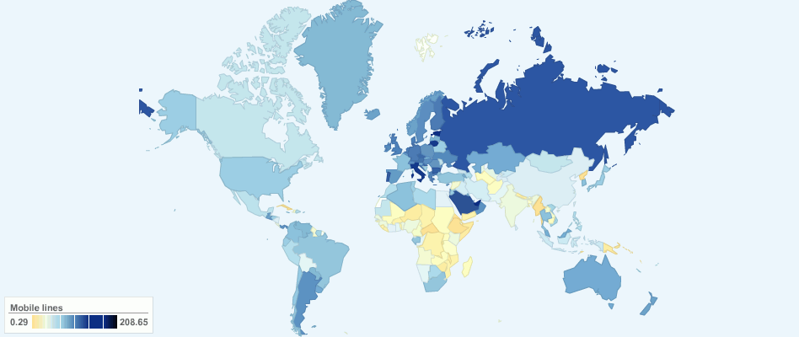
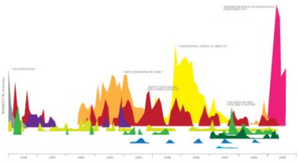
Data Library service at UoE:
Research data support within IS
finding…
accessing …
using …
teaching …
managing
iStock Photo, ChartsBin and mkandlez on flickr

Slide 17
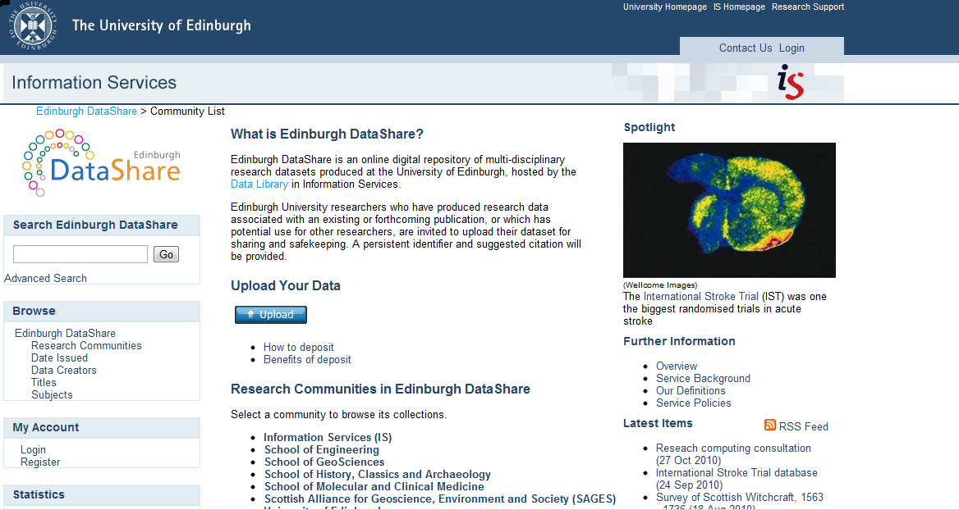
Data repository service

Slide 18
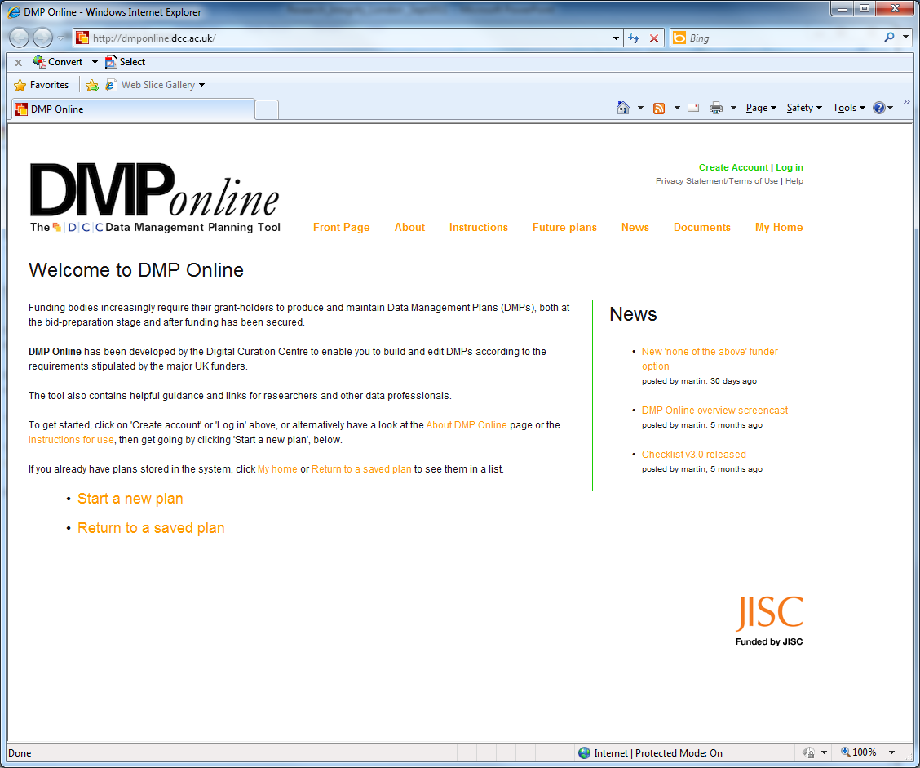

Slide 19
Research data storage strategy
In parallel with the work that led to the research data policy last year, another working group was set up to define

Slide 20
Emerging RDS Strategy & Plan (Recommendations from RDS WG)
Archiving of research data [= repository+?]
Accessibility of research data to all virtual collaborators, facilitating extra-institutional collaboration
Globally accessible cross-platform file store
Backup/synchronisation of data on mobile devices
Federated structure for local data storage
Establishing networks of knowledge
Plus
Baseline 0.5TB for all; automated transfer to right ‘latency layer’; beyond-Edinburgh cloud as part of solution;

Slide 21
Challenges ahead:
Funding, funding, funding – sustainable models
Integration with current domain-specific practices
Support staff skills for new area of work
Encouraging, bribing & cajoling engagement from key researchers & groups
Staying abreast of national developments / maintaining agility whilst waiting…

Slide 22
Links
MANTRA course
  http://datalib.edina.ac.uk/mantra
Data Library service
  http://www.ed.ac.uk/is/data-library
Research data management guidance pages
  http://www.ed.ac.uk/is/research-data-management
University data policy
http://www.ed.ac.uk/is/research-data-policy
  R.Rice at ed.ac.uk

