Slide 1
Research Data mantra (management training) project at Edinburgh
DCC Roadshow
24 June,2011
Robin Rice
University of Edinburgh

Slide 2
Research Data MANTRA (MANagement TRAining)
Proposal to JISC, May 2010
The project will be a partnership between Information Services, the Institute of Academic Development, the Graduate Schools of Social and Political Science and GeoSciences along with the Clinical and Health Psychology Professional Doctorate in the University of Edinburgh.
Online learning materials in research data management will be created which are grounded in the best practice of the respective disciplines, provide examples based on video interviews of senior researchers, and provide interactive components for postgraduate students, including data handling exercises in four software analysis packages.
The resulting materials will be embedded in the three participating postgraduate programmes, ported into a University VLE for use by all postgraduate and early career researchers and deposited with an open license in JorumOpen.

Slide 3
Context of the MANTRA Project
How did we get here?

Slide 4

Data Library services and projects
Data Library & consultancy
Edinburgh DataShare
JISC-funded projects
DISC-UK DataShare (2007-2009)
Data Audit Framework Implementation (2008)
Research Data MANTRA (2010-2011)

Slide 5
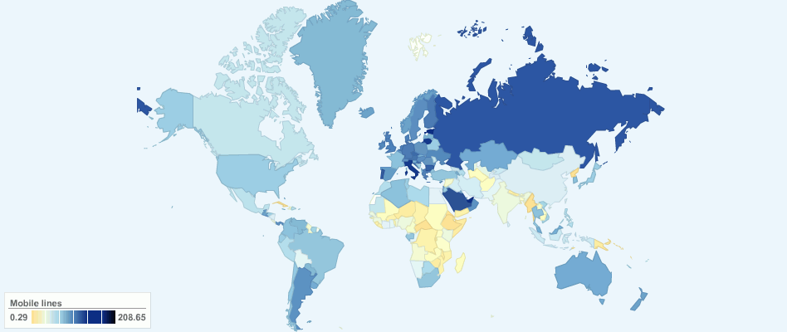
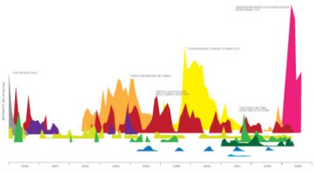
Data Library service at UoE
finding…
accessing …
using …
teaching …
managing
iStock Photo, ChartsBin and mkandlez on flickr

Slide 6
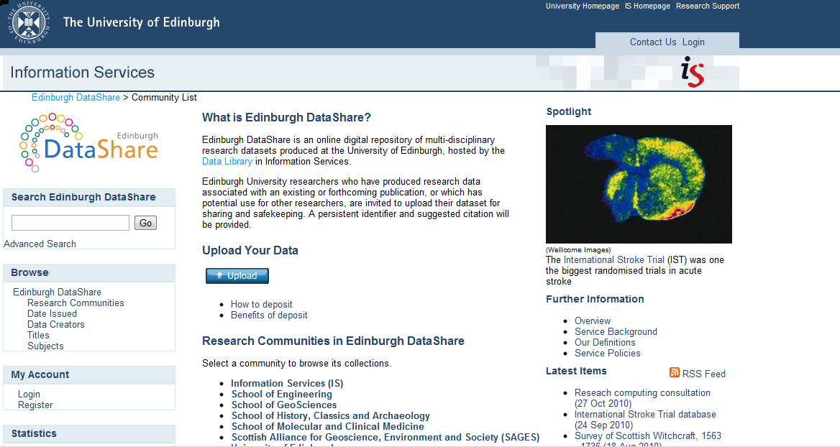
‘New’ data repository service

Slide 7

DataShare project findings - e.g. barriers to deposit
Lack of clarity about ethics, rights, ownership
Fear of errors found by users
Fear of ‘scooping’
Poor documentation
Lack of incentives / reward
Donald McLeod on flickr

Slide 8

Findings from 5 DAF case studies in UoE
Storage provision often insufficient
Long retention periods needed for high value data
Ad-hoc practices; no formal data mgmt plans
Lack of standardised procedures in creating and storing data
Minimal metadata; much effort expended in finding extant data on servers
European Parliament on flickr

Slide 9

Responses to past project findings
Develop online guidance
Develop training
Develop university policy
Develop services & support for research data management (in partnership with rest of IS)

Slide 10
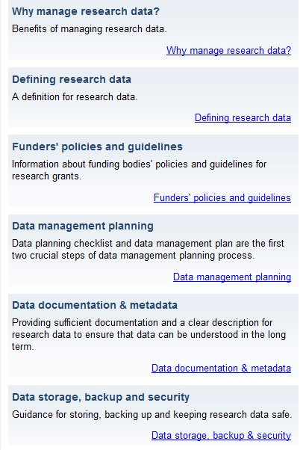
Web guidance
Online suite of web pages for IS website developed in 2009 (will be revamped this summer)
http://www.ed.ac.uk/is/data-management

Slide 11
Training: MANTRA for Change
What are the key features of the MANTRA project and online course?

Slide 12


Research Data MANTRA (MANagement TRAining)
Creation of open online learning materials in RDM for postgrads and early career researchers
Grounded in three disciplines, working with graduate schools
Video stories from researchers in variety of settings
Data handling exercises in four data analysis environments: R, SPSS, NVIVO and ArcGIS
.ash on flickr

Slide 13
Online learning materials
Eight units with activities, scenarios and videos:
Research data explained
Data management plans
Organising data
File formats & transformation
Documentation & metadata
Storage & security
Data protection, rights and access
Preservation, sharing and licensing
Keep it Simple (Stupid)
Used Xerte Online Toolkits – University of Nottingham

Slide 14

Selling RDM as a Transferrable Skill (voluntary participation)
The FRUIT principles:
Fun
Feedback
Relevant
Real
Useful
Interesting
Timely
Green Apple by Image Editor, flickr

Slide 15
Stepping back
What have the challenges been?
How will we know if we succeeded?

Slide 16
Overcoming challenges (1 of 2)
Time (no staff allocated more than 20%)
Authoring content – not an easy task
Needs assessment – what do they really want?
Setting up Xerte on server (security issues)

Slide 17
Overcoming challenges (2 of 2)
Getting software practicals commissioned, reviewed
User testing – book token bribes
Video interviews – preparation & editing
Putting it all together – delivery, packaging up
How to evaluate?

Slide 18

Critical success factors
1. The commitment of academic staff to the project
2. Positive feedback from user testing
3. Increased advocacy and awareness of research data management best practice across the University.
4. Evidence that the course is useful and used in other contexts outwith the University of Edinburgh.
Curlew, Mikebaird on flickr

Slide 19
News: a University Data Policy
This policy for managing research data was approved by the University Court on 16 May, 2011.

Slide 20

University data policy
“The University adopts the following policy on Research Data Management. It is acknowledged that this is an aspirational policy, and that implementation will take some years.”
Litherland on flickr

Slide 21
Events influencing the policy
Recent adoption of the Code of Practice for Research (UK Research Integrity Office, 2009) by the university’s research office, obligating the institution to provide support for retention and access to data underlying published research.
‘Climategate’ email review at East Anglia University highlighting the reputational risk and legal accountability associated with staff not being forthcoming in response to Freedom of Information (FOI) requests for data from the public.

Slide 22
The 10 Policy Principles
Research data will be managed to the highest standards throughout the research data lifecycle as part of the University’s commitment to research excellence
Responsibility for research data management through a sound research data management plan during any research project or programme lies primarily with Principal Investigators (PIs).
All new research proposals [from date of adoption] must include research data management plans or protocols that explicitly address data capture, management, integrity, confidentiality, retention, sharing and publication.
The University will provide training, support, advice and where appropriate guidelines and templates for the research data management and research data management plans.
The University will provide mechanisms and services for storage, backup, registration, deposit and retention of research data assets in support of current and future access, during and after completion of research projects.

Slide 23
The 10 Policy Principles
Any data which is retained elsewhere, for example in an international data service or domain repository should be registered with the University.
Research data management plans must ensure that research data are available for access and re-use where appropriate and under appropriate safeguards.
The legitimate interests of the subjects of research data must be protected.
Research data of future historical interest, and all research data that represent records of the University, including data that substantiate research findings, will be offered and assessed for deposit and retention in an appropriate national or international data service or domain repository, or a University repository.
Exclusive rights to reuse or publish research data should not be handed over to commercial publishers or agents without retaining the rights to make the data openly available for re-use, unless this is a condition of funding.

Slide 24
Next steps
IS Implementation group to meet over summer
Led by Director, Library and Collections
Vice Principal has promised a half terabyte per researcher, storage

Slide 25
Links
Project website & wiki
http://www.ed.ac.uk/is/data-library-projects/mantra
Xerte – open source elearning
http://www.nottingham.ac.uk/xerte/toolkits.htm
Research data management guidance pages
http://www.ed.ac.uk/is/research-data-management
University data policy
http://www.ed.ac.uk/is/research-data-policy
R.Rice at ed.ac.uk

